Slide 1
Phantom: Exploiting Decoder-detectable Mispredictions By: Johannes Wikner, Daniël Trujillo and Kaveh Razavi
Presentation By:
Will Buziak Department of Computer Science Colorado School of Mines
January 31, 2025

Slide 2
Background
The Branch Prediction Unit (BPU) provides a prediction of the upcoming control flow by:
Storing recent control-flows in Branch History Buffers (BHBs)
Holding predictions, indexed by BHBs, in Branch Target Buffers (BTBs)
BPU
IF
ID
EX
Retire
Time

Slide 3
Branch Prediction
Mispredicted instructions are processed in the pipeline until a resteer signal is provided – known as the speculation window
This is the mechanism exploited by Spectre
BPU
IF
ID
EX
Retire
Mispredicted Target
Resteer
Speculation Window

Slide 4
Spectre
Abuses speculative execution to perform mispredicted operations and leak victim’s information via side-channels
Circumvents numerous security countermeasures
Phantom proposes a new Spectre class that considers shorter speculation windows
Resteer is issued before instruction reaches execute stage

Slide 5
Phantom
Cases where training and victim branch sources are different are commonly considered non-exploitable
Instruction mismatches can be discovered at decode and resteered before execution
Previously believed to result in too short of a speculation window
Asymmetric cases have been proven to also lead to long speculation windows
Phantom provides a methodology for user-to-kernel exploitation on shorter speculation windows

Slide 6
Phantom Contributions
Provides tools for measuring transient fetch and decode of mispredicted targets
Analysis of mispredictions and how far instructions get in the pipeline
Presents the Phantom class of attacks
Proves ability to break KASLR and leak arbitrary kernel memory

Slide 7
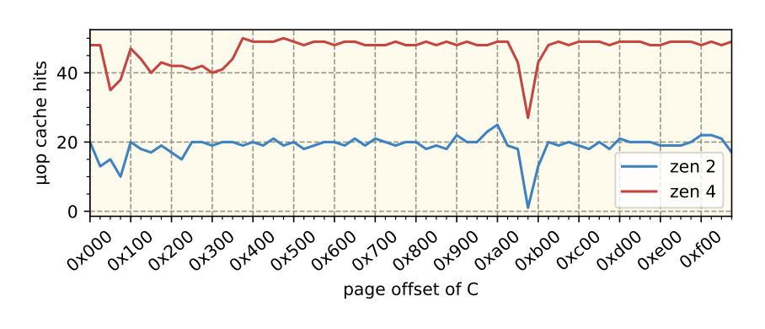
Observing Mispredictions
Instruction Fetch (IF): Measure the I-cache state using a timing side-channel
Not effective for distinguishing IF from BPU-assisted I-cache prefetching
Instruction Decode (ID): Samples performance counters indicating µop-cache use
Less reliable on Intel architectures than on AMD
Execute (EX): Detects execution by using a single memory fetch in the mispredicted path
Due to shorter speculation, resteer is issued before memory operations can be performed
Table 2, Pg. 6

Slide 8
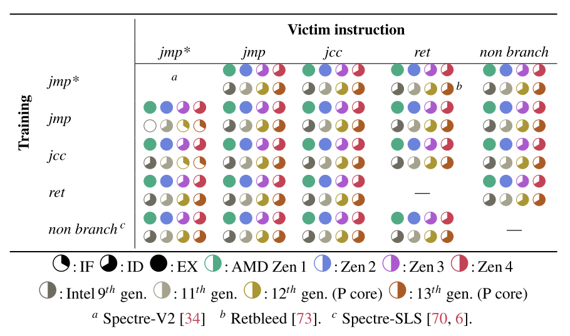
Branch Mispredictions
Phantom uses a training and victim branch to cause mispredictions
Study of instruction combinations causing mispredictions
How far in the pipeline mispredictions get before a resteer
Intel architectures do not re-use user-inject predictions in kernal mode (eIBRS 9th gen+)
Exploitations are only performed on AMD architectures
Table 1, Pg. 6

Slide 9
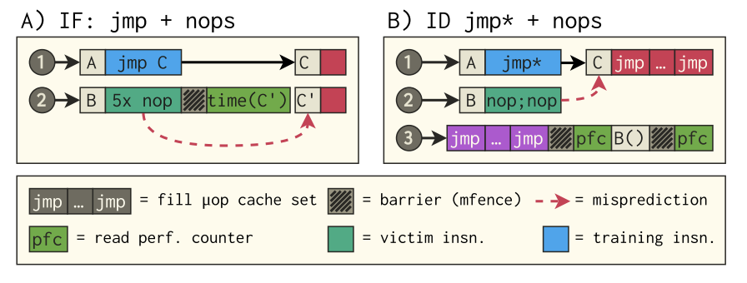
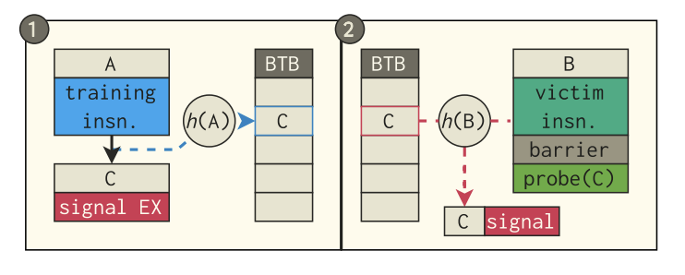
Phantom
Phantom speculation attacks are broken down into three steps:
Train the BTB to a target
Execute the victim
Infer whether the target was loaded from memory (can use Prime+Probe)
Figure 4, Pg. 5
Figure 5, Pg. 5

Slide 10
Phantom Attack Primitives
Detecting mapped executable memory
Fetch only populated I-cache if executable and backed by physical memory
Non-mapped executable memory
Failed fetch leaves I-cache unaffected
Adversary can trigger a data load
Requires a disclosure gadget
Leaking register values
Filters a single byte from the register and aligns with the cache-line
Creates an offset into victim’s address space and loads resulting address
(AMD Zen 1 & 2 only)

Slide 11
Kernel Address Collision
Cross-privilege BTB indexing functions can be manipulated to cause collisions with kernel addresses from user space
Brute forcing a pattern that collides with a user-space address ( < 6 bits )
Random patterns are generated and then collisions are observed using an SMT solver

Slide 12
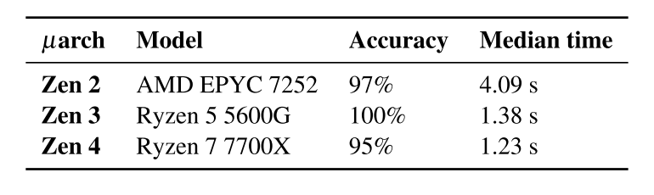
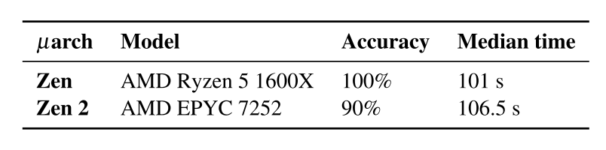
Breaking Physmap KASLR
Injecting a prediction and observing if the branch target was mapped in memory can indicate the correct location of the kernel image
Can be in 1 of 488 possible locations
Observe cache signal with Prime+Probe
After finding the kernel image location, the direct mapping of the kernel in physical memory can be de-randomized
physmap is non-executable, requiring the P2 attack primitive
Table 3, Pg. 9
Table 4, Pg. 9

Slide 13
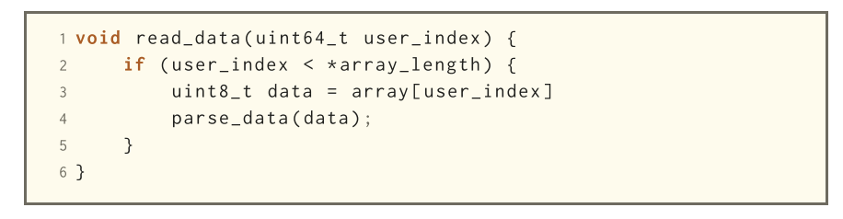
Leaking Kernel Memory
Extending the method for breaking KASLR, it is possible to also leak kernel memory
Find the location of a Flush+Reload buffer in physmap
Create a guess of the physical address of a virtual address
Pass the pair to a system call and verify if the guess was correct
Use a gadget to read and leak data under the guise of kernel privilege
Listing 4, Pg. 10

Slide 14
Mitigation
SuppressBPOnNonBranch: (Zen 2)
Bit that, when set, prevents branch prediction from advancing in the pipeline
Incurrs an overhead of 0.69% for multi-core and 0.42% for single core
Does not prevent IF or ID caused by Phantom
Not supported in AMD Zen 3+
AutoIBRS: (Zen 4)
Does not prevent IF or ID
Still vulnerable to direct branch speculation

Slide 15
Conclusions
Phantom provides methods for evaluating misprediction likelihood and vulnerability to exploitation
Defined how to measure instruction fetch, decode and execution
and
Proved effectiveness of Phantom attacks by breaking KASLR randomization and leaking kernel memory through the use of MDS gadgets

Slide 16
Strengths
Digestible
Relevant (affects billions of users)
Real threat model including all state-of-the-art Spectre security protocols
Methodology is effective in achieving attack goals

Slide 17
Weaknesses
Very little proposed solution
Could provide more well-rounded information on how some structures work or their impact
Often repeats filler sentences in paragraphs that otherwise could use more explanation
Exploitation techniques are only effective on AMD Zen architectures

Slide 18
Sources
[1] Johannes Wikner, Daniël Trujillo and Kaveh Razavi, Phantom: Exploiting Decoder-detectable Mispredictions, In: 56th Annual IEEE/ACM International Symposium on Microarchitecture (MICRO ‘23), October 28-November 1, 2023.

