Slide 1
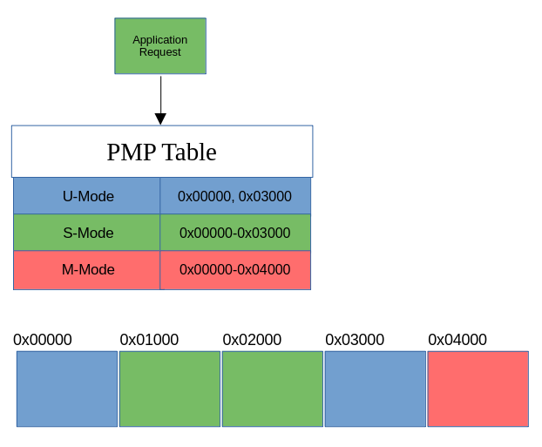
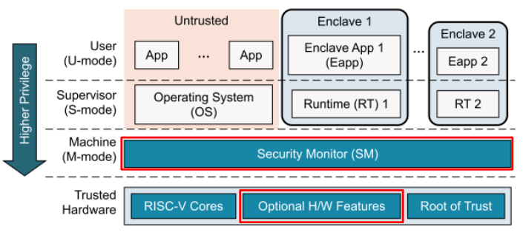
Extending Keystone within the gem5 Architectural Simulator
Keystone & gem5
gem5 is an open-source architectural simulator that provides full-system emulation, including the RISC-V ISA, enabling developers the ability to model performance on real workloads prior to fabrication.
The Keystone enclave has been implemented in gem5, including all necessary components. This allows developers to experiment with Keystone, but there is no pre-defined method for extending these components within the gem5 simulation environment.
Keystone defines a set of rules in the Bootloader by partitioning memory regions for different privileged modes. The rules are stored in the Physical Memory Protection (PMP) Tables that are checked on each memory access
How to implement
By: Will Buziak
Advisor: Dr. Iris Bahar
Department of Computer Science
Abstract
Trusted Execution Environments (TEEs) provide hardware guarantees that seek to protect the security and isolation of application data.
Many proprietary TEEs exist, each with its own implementation and respective way of providing security.
Keystone is an open-source TEE focusing on customization towards the specific needs of the user.
TEEs like Keystone leverage the transparency of the RISC-V ISA granting users the ability to contribute to Keystone’s standard for security
In order to extend TEEs, developers need to either implement their designs on FPGAs, which lack real-world benchmarking, or turn to architectural simulators.
Lack of effective tools for development and thorough testing on real-world benchmarks. This work defines a methodology for implementing and evaluating contributions to open-source TEEs within state-of-the-art architectural simulators.
References
D. Lee, Building Trusted Execution Environments, 2022.
J. Lowe-Power, A. Mutaal Ahmad, A. Alian, R. Amslinger, and et. al., The gem5 Simulator: 20.0+, 2020.
A. Akram, V. Akella, S. Peisert, and J. Lowe-Power, Enabling Design Space Exploration for RISC-V Secure Compute, In: Fifth Workshop on Computer Architecture Research with RISC-V (CARRV 2021), 2021.
Z. Moolman, T.S. Lehman, Extending RISC-V Keystone to Include Efficient Secure Memory, in: Eighth Workshop on Computer Architecture Research with RISC-V (CARRV 2024), 2024.

