Slide 1
Architecting Space Microdatacenters:
A System Level Approach
By: Nathan Bleier, Rick Eason, Michael Lembeck and Rakesh Kumar
Presentation By:
Will Buziak
Department of Computer Science
Colorado School of Mines
November, 2025

Slide 2
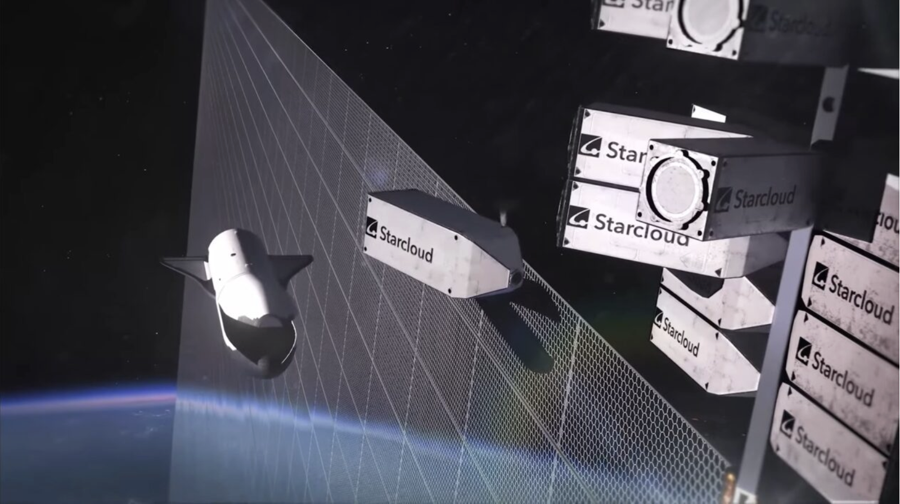
Background
Datacenters are a source of increasing controversy
  Resource hogs (space, water, energy)
  Unattractive additions to their environments
As a result, people have proposed the idea of placing datacenters in space
[2]

Slide 3
Motivating Space Microdatacenters
Substantial bottlenecks for server-based processing in space
Immense application-specific benefits:
  Lower-latency satellite imaging
  Forest-fire detection
  Military / Defense applications
Contribution: No prior work on architecture design for space data-centers

Slide 4
Total Cost of Ownership
Instead of simply evaluate the cost of a space data-center, this paper sums the major design challenges into a TCO:
  Largely considers energy along with communication costs
  Extends an existing satellite cost model to consider compute hardware and thermal management
Major Takeaway: TCO depends strongly on power of compute while compute mass, monetary cost & communication are relatively insignificant

Slide 5
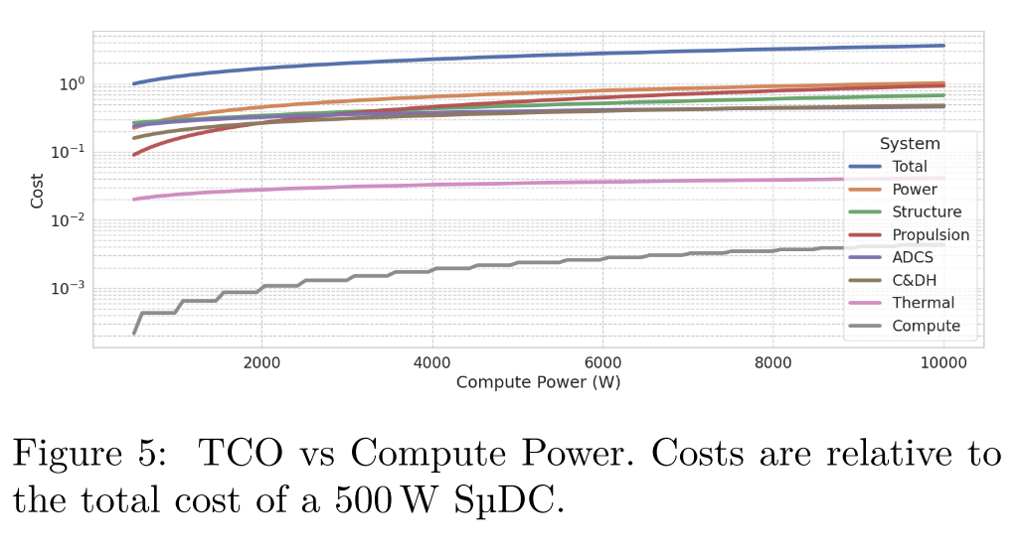
Non-compute > Compute
Commercial compute hardware is relatively cheap compared to custom satellite components
  Costs increase sub-linearly as the size of the compute payload increases
  Computer hardware is light

Slide 6
Power is the primary design constraint
Costs can increase > 3x when power changes from .5 kW to 10kW:
  Must account for fuel costs, proportional to the mass
  Thermal management is limited to radiation in a vacuum
Servers comprise up to 72% of costs* in terrestrial datacenters, while power is less than 10%
Key Takeaway: Must buy NVIDIA H100s

Slide 7
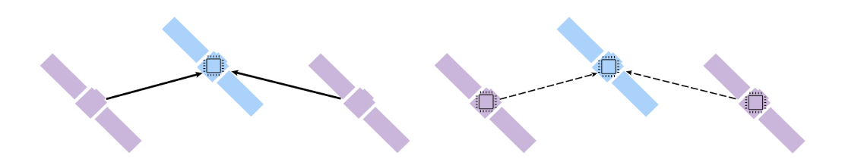
Power-informed Architecture Design
Since satellite size and on-board thermal management become limiting factors, applications are often processed in batches
  Arrange micro-datacenters into compute “constellations”
  Hope that launch and micro-datacenter reproducibility become cheaper
“Computer hardware which is 100x more energy efficient costs 3x more”

Slide 8
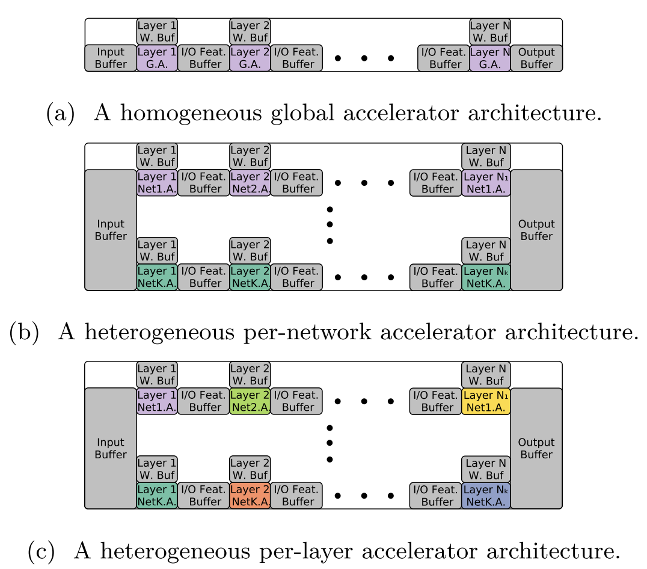
Heterogeneous Accelerator Architecture
a) Single accelerator runs all workloads
b) Each network has its own accelerator
c) Each layer of each network is assigned an accelerator
For each pipeline, every layer’s output is double-buffered for asynchronous execution

Slide 9
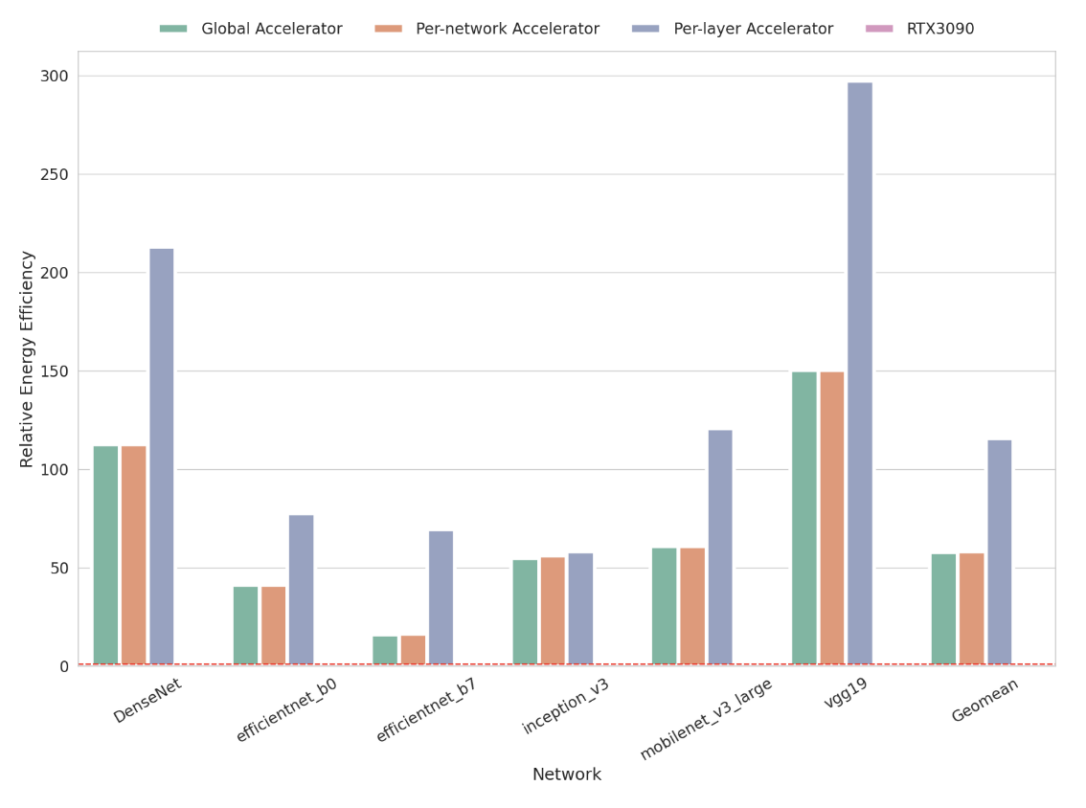
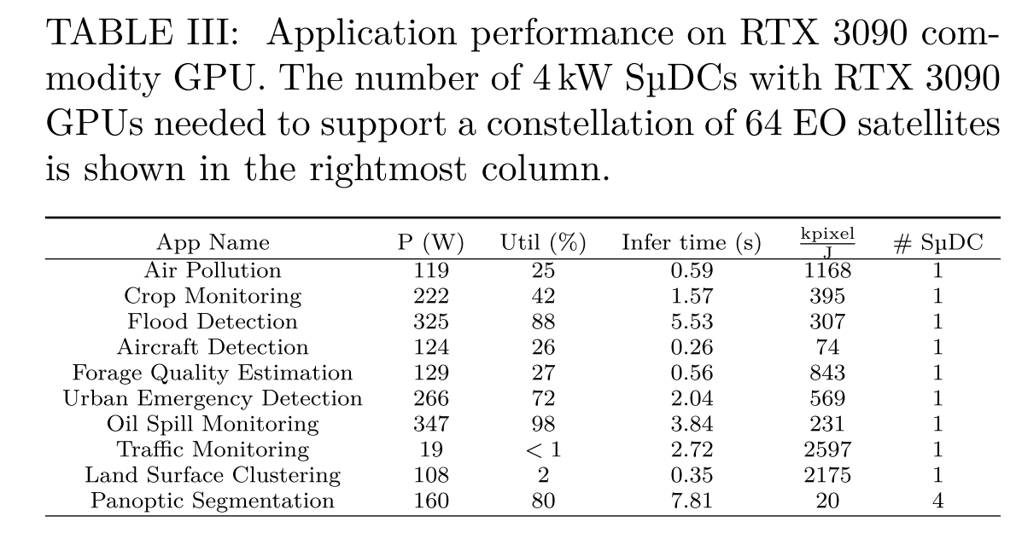
Heterogeneous Accelerator Architecture

Slide 10
Conclusion
Energy Efficiency is the most important design factor when considering space data-centers
Hardware costs are insignificant compared to thermal management and mass implications on satellite design
Utilizing a distributed, heterogeneous accelerator architecture is the most cost-effective way to structure micro-datacenters

Slide 11
Strengths
Constructs an architectural design perspective based on a cost analysis of satellites and space data-centers
Considers learning rates (Wright’s Law) and allows this to influence the best decision for the time

Slide 12
Weaknesses
Does not propose much for managing end-of-life
Does not discuss the usefulness for LLM or other common cloud application, despite being a major motivation for the idea
Constructs arguments based on their own model of a terrestrial datacenter, instead of modeling the idea of placing an existing terrestrial datacenter in space
Architecture discussion is limited to cost tradeoffs rather than how your architecture can be optimized to improve what you have

Slide 13
Sources
[1] Nathan Bleier, Rick Eason, Michael Lembeck and Rakesh Kumar, Architecting Space Microdatacenters: A System Level Approach, In: 2025 IEEE International Symposium on High-Performance Computer Architecture.
[2] https://www.geekwire.com/2025/lumen-orbit-starcloud-10m-space-data-centers/

