Slide 1
SecuriTEE: Secure Memory for RISC-V Trusted Execution Environments
Presentation By:
Will Buziak Department of Computer Science Colorado School of Mines
November 5, 2024

Slide 2
Background
Motivated attackers can employ many tactics to corrupt or steal data, this work focuses on preventing:
A malicious OS, application or thread
Replay or side-channel attacks targeting off-chip peripherals
Trusted Execution Environments (TEEs) provide hardware guarantees that separate address spaces, securing the integrity of the processor
Secure Memory methods protect against off-chip tampering by encrypting and storing metadata securely on-chip

Slide 3
Motivation
TEEs provide confidence against malicious applications attempting to tamper with data
Still vulnerable to side-channel attacks, replay attacks and off-chip tampering
Secure Memory can mitigate these concerns by adding another layer of protection for off-chip devices
RISC-V TEEs (e. g. Keystone^{[1]}) provides an open-source, configurable platform for developing TEEs to specific applications
Goal: Harden TEEs with Secure Memory protocols to further protect data integrity

Slide 4
Trusted Execution Environments
A TEE implements different privelege modes with separate address spaces, enforcing a set of rules dictating which components can access what regions of memory:
User mode, Supervisor mode, Machine mode
Almost all major CPU vendors have their own flavor of TEE:
Intel SGX
ARM Confidential Computer Architecture
AMD SEV
These implementations leverage proprietary hardware, opening the door for a configurable & open-source TEE, keystone^{[1]}
Still vulnerable to side-channel & replay attacks

Slide 5
Secure Memory
Secure Memory defines any off-chip device as untrusted & defines a process for verifying the integrity of off-chip data
Off-chip data is signed with a counter, cryptographically hashed and stored in a tree of hashes (merkle tree^{[2]} & bonsai merkle tree^{[3]})
Optimizations have been investigated that reduce memory overhead and efficient incrementing of counters
Builds a hash tree over the memory, the root of which is always stored on-chip
Memory blocks are fetched, hashed and compared against the entire tree for verification

Slide 6
gem5
gem5 is one of, if not the only, architecture simulator that supports RISC-V & multi-core simulation
Keystone including PMP tables & checker implementations
Memory encryption engine
Secure Memory implementation (Sam Thomas)

Slide 7
gem5 Simple Sanity Check
Base gem5 vs. Secure Memory implementation (version 24.0.0.1)
Benchmark:
10,000,000 accesses on 1GB array of memory
Secure memory implementation requires an increase in both runtime and memory overhead
 | Simulated Time (Seconds) | Host Memory (MB) | Number of Instructions (million)
Base gem5 | 36.55 | 1.18 | 525
Secure gem5 | 132.5 | 3.44 | 525

Slide 8
gem5 Cache Sanity Check
Binary
Simulated Time (seconds)
Host Memory (MB)
Number of Instructions
Base gem5
hello world
.000022
1.119
5882
array-flip
1.064
1.19
525,000,444
Secure gem5
hello world
.001425
3.44
5892
array-flip
132.15
3.44
525,000,444

Slide 9
Direction / Future Work
Keystone has been implemented in gem5
Not implemented for current version
Currently contacting previous authors

Slide 10
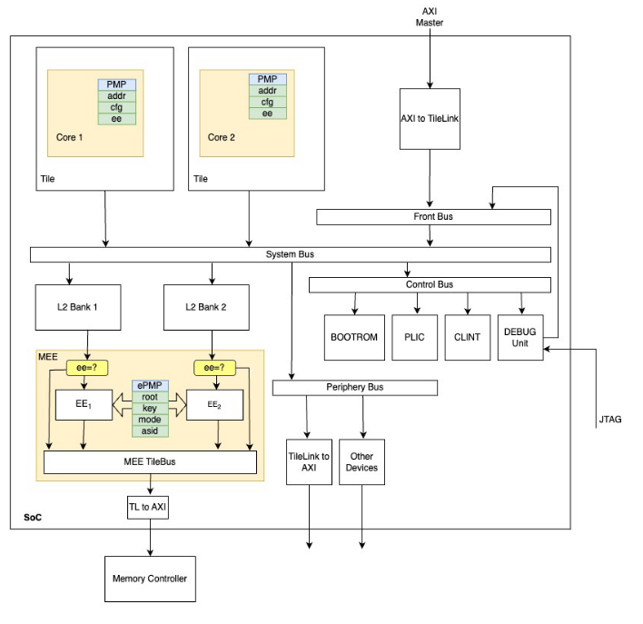
Direction / Future Work
Implementing a RISC-V TEE in gem5:
Currently adding cache hierarchy
Incorporating caches into secure memory through “board” hierarchy
Entirely different way of connecting things
PMP is included in any RISCV-cpu in gem5
What is my contribution?
Until now, I have been just trying to implement Zach’s work in gem5
Deeper understanding of attack methods (winter break project?)
Moolman, Z. & Lehman T.

Slide 11
Gap & Contribution
A Midsummer Nights Tree (AMNT) by Sam Thomas
Crash consistent secure memory protocol by defining write-back protocols that sync the on-chip BMT root & stored leaf counters in off-chip memory

Slide 12
Limitations
Computational and memory overhead

Slide 13
Sources
[1] Dayeol Lee (2022) Building Trusted Execution Environments. In: A dissertation submitted in partial satisfaction of the requirements for the degree of Doctor of Philosophy in Computer Science in the Graduate Division of the University of California, Berkeley.
[2] Chenyu Yan, Brian Rogers, Daniel Englender, et. al. (2006) Improving Cost, Performance, and Security of Memory Encryption and Authentication. In: Proceedings of the 33rd International Symposium on Computer Architecture (ISCA’06)
[3] Brian Rogers & Milos Prvulovic (2007) Using address independent seed encryption and bonsai merkle trees to make secure processors OS-and performance-friendly. In: 40th IEEE/ACM International Symposium on Microarchitecture (MICRO’07)
[3] Zach Moolman & Tamara Silbergleit Lehman (2024) Extending RISC-V Keystone to Include Efficient Secure Memory

