Slide 1
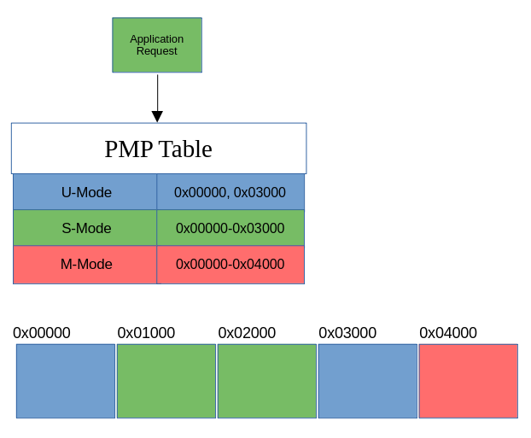
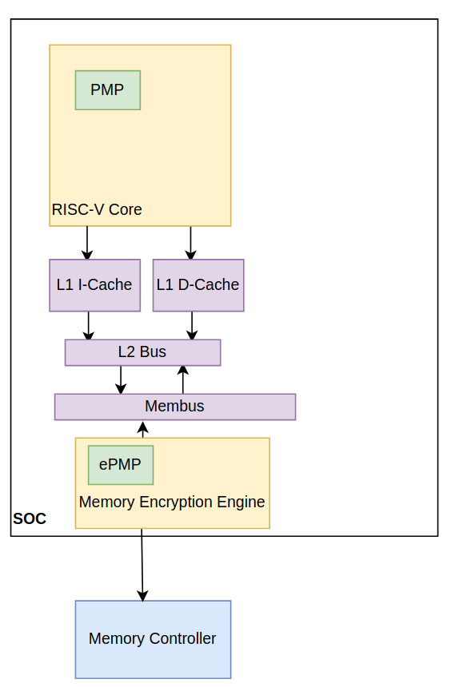
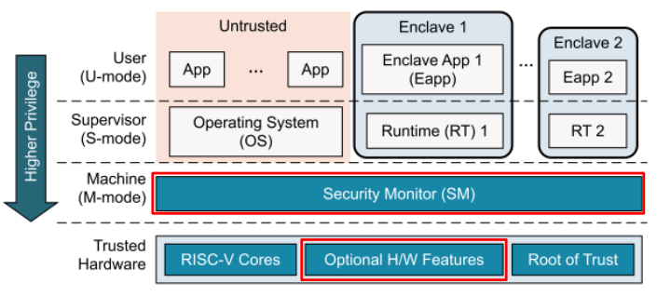

Extending Trusted Execution Environments in Architectural Simulators
Will Buziak
Abstract
Keystone
gem5
Evaluation
Trusted Execution Environments (TEEs) provide hardware guarantees that seek to protect the security and isolation of application data.
Many proprietary TEEs exist, each with its own implementation and respective way of providing security.
Open-source TEEs like Keystone grant users the ability to contribute to their standard for security
In order to extend TEEs, developers need to either implement their designs on FPGAs, or turn to architectural simulators.
Lack of effective tools for development and thorough testing on real-world benchmarks make pre-fabrication development difficult.
This work outlines the methods for implementing and evaluating contributions to Keystone within the gem5 architecture simulator.
Enclaves like Keystone provide hardware guarantees that data is safe from a malicious:
Application thread
Operating System
Remote User
Security is offered by isolating memory regions, rules are initiated by the bootloader (Security Monitor) and enforced during execution by a component in each core known as the Physical Memory Protection (PMP) Tables
Keystone grants different processes privileges by distinguishing its mode:
Machine (M) mode has the highest privileges and largely consists of the Security Monitor and the PMP table itself
Supervisor (S) & User (U) modes consist of OS-related and user threads
gem5 presents architectural design as typical class structures with attributes based on the behavior of the real world component
Developers wishing to extend Keystone components can create their own version of the desired component’s class structure, often requiring close attention to:
Port connections
Packet handling
For example, in order to properly connect the PMP to the proposed ePMP, it is either necessary to write a new:
Packet type, bypassing the cache hierarchy
Or
Port type directly connecting the core(s) to the Memory Encryption Engine
gem5 supports syscall-emulation mode that uses the OS and system calls from the host machine, assisting quick development
Thorough benchmarking can be achieved with full-system emulation in which an entire OS and emulated file system can be loaded into the simulation.
Designs can be tested on real workloads and state-of-the-art or custom benchmarks designed to stress test the specific design components of interest.
The ability to rapidly test and redesign is a major benefit of using a simulation environment over FPGA development
Development in Syscall-Emulation
Full-system Testing
Methodology
Keystone is an open-source, RISC-V TEE designed for custom configuration and modulation
gem5 is an open-source architectural simulator that provides full-system emulation, including Keystone components
References
D. Lee, Building Trusted Execution Environments, 2022.
J. Lowe-Power, A. Mutaal Ahmad, A. Alian, R. Amslinger, and et. al., The gem5 Simulator: 20.0+, 2020.
A. Akram, V. Akella, S. Peisert, and J. Lowe-Power, Enabling Design Space Exploration for RISC-V Secure Compute, In: Fifth Workshop on Computer Architecture Research with RISC-V (CARRV 2021), 2021.
Z. Moolman, T.S. Lehman, Extending RISC-V Keystone to Include Efficient Secure Memory, in: Eighth Workshop on Computer Architecture Research with RISC-V (CARRV 2024), 2024.
Study Keystone class structures
Benchmark
Implement design

