Slide 1
Phantom: Exploiting Decoder-detectable Mispredictions By: Johannes Wikner, Daniël Trujillo and Kaveh Razavi
Presentation By:
Will Buziak Department of Computer Science Colorado School of Mines
January 31, 2025

Slide 2
Background
The Branch Prediction Unit (BPU) provides a prediction of the upcoming control flow when the pipeline is dependent on the result of currently executing instructions
Branch History Buffers (BHBs) contain recent control-flows
Branch Target Buffers (BTBs) hold predictions and are indexed by BHBs
BPU
IF
ID
EX
Retire
Time

Slide 3
Branch Prediction
Mispredicted instructions are processed in the pipeline until a resteer signal is provided – known as the speculation window
This is the mechanism exploited by Spectre
BPU
IF
ID
EX
Retire
Mispredicted Target
Resteer
Speculation Window

Slide 4
Spectre
Takes advantage of speculative execution to perform mispredicted operations and leak victim’s information via side-channels
Circumvents numerous security countermeasures
Phantom proposes a new Spectre class that considers shorter speculation windows
Resteer is issued before instruction reaches execute stage

Slide 5
Phantom
Cases where training and victim branch sources are different are commonly considered non-exploitable
Instruction mismatches can be discovered at decode and resteered before execution
Previously believed to result in a short speculation window
Recently proven that these asymmetric cases can also lead to long speculation windows
Phantom analyzes mispredictions and provides a methodology for user-to-kernel exploitation on shorter speculation windows

Slide 6
Phantom Contributions
Provides tools for measuring transient fetch and decode of mispredicted targets
Analysis of mispredictions and how far instructions get in the pipeline
Presents the Phantom class of attacks
Proves ability to break KASLR and leak arbitrary kernel memory

Slide 7
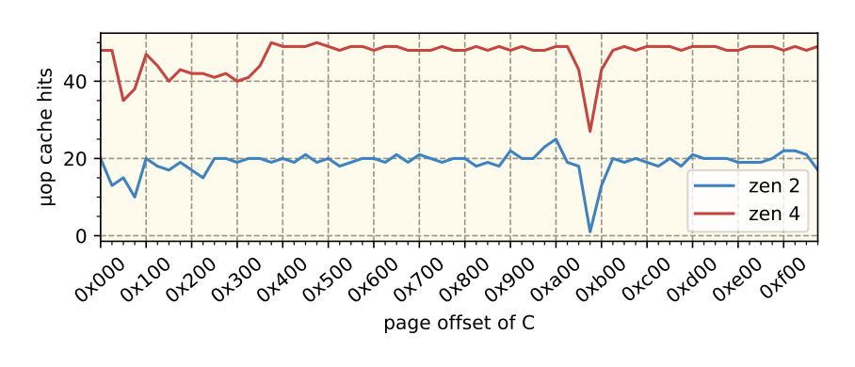
Observing Mispredictions
Instruction Fetch (IF): Measure the I-cache state using a timing side-channel
Not effective for distinguishing IF from BPU-assisted I-cache prefetching
Instruction Decode (ID): Samples performance counters indicating µop-cache use
Less reliable on Intel architectures than on AMD
Execute (EX): Detects execution by using a single memory fetch in the mispredicted path
Due to shorter speculation, resteer is issued before memory operations can be performed
Table 2, Pg. 6

Slide 8
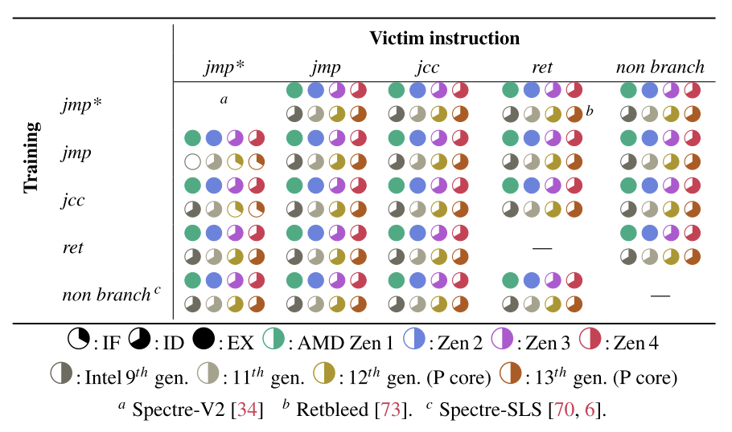
Branch Mispredictions
Phantom uses a training and victim branch to cause mispredictions
Study of instruction combinations causing mispredictions
How far in the pipeline mispredictions get before a resteer
Table 1, Pg. 6

Slide 9
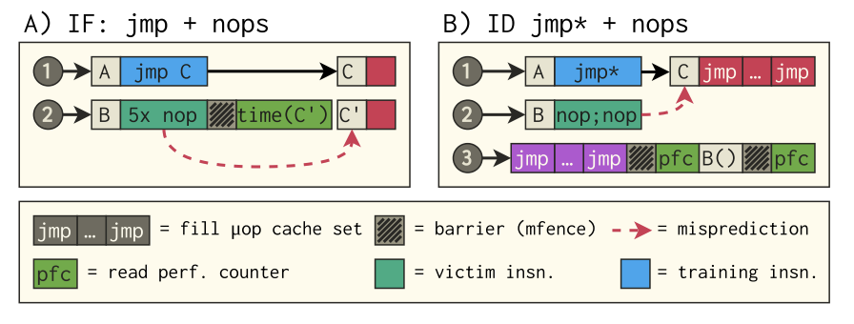
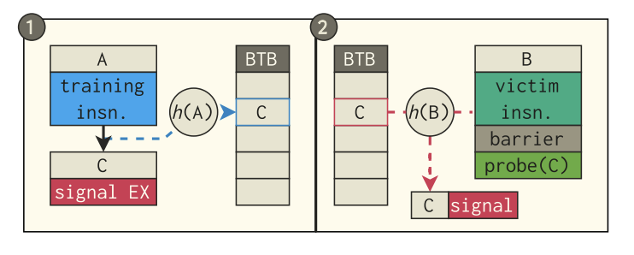
Phantom
Phantom speculation attacks are broken down into three steps:
Train the BTB to a target
Execute the victim
Infer whether the target was loaded from memory (can use Prime+Probe)
Figure 4, Pg. 5
Figure 5, Pg. 5

Slide 10
Phantom Attack Primitives
text

Slide 11
Breaking KASLR
text

Slide 12
Mitigation
text

Slide 13
Conclusions
text

Slide 14
Strengths
Digestible
Relevant (affects billions of users)
Methodology is affective

Slide 15
Weaknesses
Very little proposed solution
Could provide more well-rounded information on how some structures work or their impact
Presentation of results is somewhat confusing

Slide 16
Thoughts
text?

Slide 17
Sources
[1] Akshaye Senoi, Prasanna Karthik Vairam, Kanav Sabharwal, Jialin Li and Dinil Mon Divakaran (2023) iPET: Privacy Enhancing Traffic Perturbations for Secure IoT Communications. In: Proceedings on Privacy Enhancing Technologies.

