Slide 1
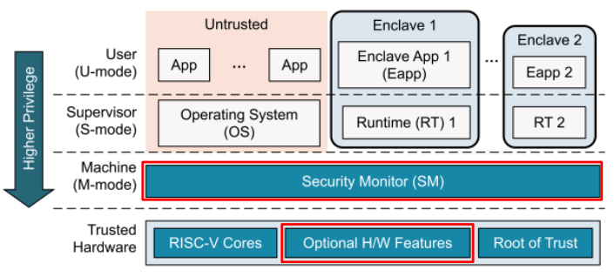
Extending Keystone within the gem5 Architectural Simulator
Keystone & gem5
What is gem5
Why gem5 & why gem5 for this purpose
What are we implementing in Keystone
How to implement
By: Will Buziak
Advisor: Dr. Iris Bahar
Department of Computer Science
Abstract
Trusted Execution Environments (TEEs) provide hardware guarantees that seek to protect the security and isolation of application data.
Many proprietary TEEs exist, such as Intel's SGX and ARM's Trustzone for example, each with its own implementation and respective way of providing security.
Keystone is an open-source TEE focusing on customization towards the specific needs of the user.
TEEs like Keystone leverage the transparency of the RISC-V ISA granting users the ability to contribute to Keystone’s standard for security
In order to extend TEEs, developers need to either implement their designs on FPGAs, which lack real-world benchmarking, or turn to architectural simulators.
Lack effective tools for development and thorough testing on real-world benchmarks. This work defines a methodology for implementing and evaluating contributions to open-source TEEs within state-of-the-art architectural simulators.

