Slide 1

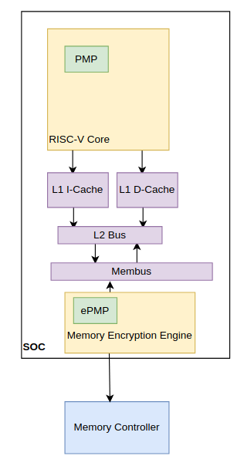
Extending Trusted Execution Environments in Architectural Simulators
Will Buziak Iris Bahar
Department of Computer Science Department of Computer Science
Background
Keystone
gem5
Insights
Trusted Execution Environments (TEEs) provide hardware guarantees that seek to protect the security and isolation of application data.
This work outlines methods for implementing and evaluating contributions to open-source TEEs within architectural simulation.
Many TEE implementations exist, but Keystone is a popular, open-source version with many pre-existing simulator implementations.
Keystone achieves isolation by segmenting memory & defining rules for different threads with a structure called a PMP table.
This work proposes ready-made simulations, reducing set-up time for future developers to build their contributions.
gem5 presents architectural design as typical class structures with attributes based on the behavior of the real world component
For example, to properly connect the PMP to the proposed ePMP, it is either necessary to write a new:
- Packet type, bypassing the cache hierarchy
Or
- Port type directly connecting the core(s) to the Memory Encryption Engine
Developers wishing to extend Keystone components can create their own version of the desired component’s class structure, often requiring close attention to:
- Port connections
- Packet handling
In order to further protect state-of-the-art TEEs, Keystone is extended to include secure memory protocols in the gem5 simulation environment
Potentially Malicious
TEEs
Application Thread
Operating System
Remote or Cloud User
Proprietary
Open-Source
SGX
Keystone
TEE
TrustZone
Phantom
Main Memory
...
...
Motivation
Application Request
Future Work
Experimentation within simulation allows a shorter pipeline from design idea to implementation testing.
Achieving a baseline model is non-trivial, requiring extensive knowledge of the simulator itself.
Designs in simulation can be tested on real workloads and state-of-the-art, or custom benchmarks.
PMP Table
Fabrication
Development Time
FPGA
Simulation
Ready-Made Simulation
Goals
User
(U-Mode)
Untrusted
Enclave 1
Enclave 2
App
App
Enclave App 1 (Eapp)
Eapp 2
Supervisor
(S-Mode)
Operating System
(OS)
Runtime (RT) 1
RT 2
Real-world Benchmarking
Implement Designs
Machine
(M-Mode)
Security Monitor
Trusted Hardware
RISC-V Cores
Optional H/W Features
Root of Trust
Tools for Extension

