Slide 1
SecuriTEE: Secure Memory for RISC-V Trusted Execution Environments
Presentation By:
Will Buziak Department of Computer Science Colorado School of Mines
November 5, 2024

Slide 2
Background
Motivated attackers can employ many tactics to corrupt or steal data, this work focuses on preventing:
A malicious OS, application or thread
Replay or side-channel attacks targeting off-chip peripherals
Trusted Execution Environments (TEEs) provide hardware guarantees that separate address spaces, securing the integrity of the processor
Secure Memory methods protect against off-chip tampering by encrypting and storing metadata securely on-chip

Slide 3
Motivation
TEEs provide confidence against malicious applications attempting to tamper with data
Still vulnerable to side-channel attacks, replay attacks and off-chip tampering
Secure Memory can mitigate these concerns by adding another layer of protection for off-chip devices
RISC-V TEEs (e. g. Keystone^{[1]}) provides an open-source, configurable platform for developing TEEs to specific applications
Goal: Harden TEEs with Secure Memory protocols to further protect data integrity

Slide 4
Trusted Execution Environments
A TEE implements different privelege modes with separate address spaces, enforcing a set of rules dictating which components can access what regions of memory:
User mode, Supervisor mode, Machine mode
Almost all major CPU vendors have their own flavor of TEE:
Intel SGX
ARM Confidential Computer Architecture
AMD SEV
These implementations leverage proprietary hardware, opening the door for a configurable & open-source TEE, keystone^{[1]}
Still vulnerable to side-channel & replay attacks

Slide 5
Secure Memory
Secure Memory defines any off-chip device as untrusted & defines a process for verifying the integrity of off-chip data
Off-chip data is signed with a counter, cryptographically hashed and stored in a tree of hashes (merkle tree^{[2]} & bonsai merkle tree^{[3]})
Optimizations have been investigated that reduce memory overhead and efficient incrementing of counters
Builds a hash tree over the memory, the root of which is always stored on-chip
Memory blocks are fetched, hashed and compared against the entire tree for verification

Slide 6
gem5
gem5 is one of, if not the only, architecture simulator that supports RISC-V & multi-core simulation
Keystone including PMP tables & checker implementations
Memory encryption engine
Secure Memory implementation (Sam Thomas)

Slide 7
gem5 Simple Sanity Check
Base gem5 vs. Secure Memory implementation (version 24.0.0.1)
Benchmark:
1,000 accesses on 1GB array of memory
No caches
Secure memory implementation requires an increase in both runtime and memory overhead
 | Simulated Time (Seconds) | Host Memory (MB) | Number of Instructions (thousands)
Base gem5 | .00388 | 1.18 | 55,966
Secure gem5 | .014 | 3.43 | 55,966

Slide 8
gem5 Cache Sanity Check
Cache
Simulated Time (seconds)
Host Memory (MB)
Number of Instructions
Base gem5
False
.003880
1.18
55,966
True
.000069
1.18
55,966
Secure gem5
False
.014
3.43
55,966
True
.000531
3.44
55,966

Slide 9
PMP Sensitivity Analysis
How does a variable PMP size affect performance
Efficient PMP packing:
Currently, gem5 implements Naturally Aligned Power of Two (NAPOT) packing, which requires the base address to be aligned by a power of two.

Slide 10
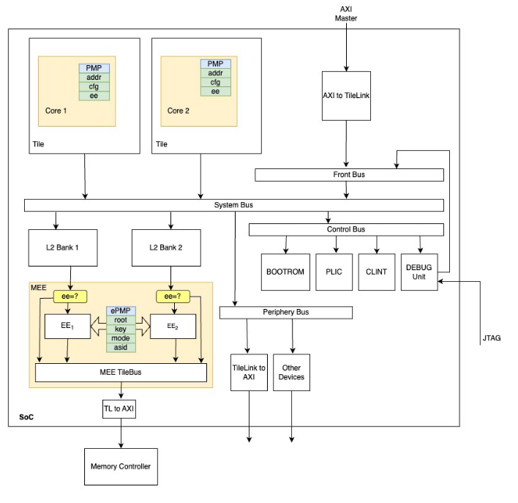
Direction / Future Work
Implementing a RISC-V TEE in gem5:
Currently adding cache hierarchy
Incorporating caches into secure memory through “board” hierarchy
Entirely different way of connecting things
PMP is included in any RISCV cpu in gem5
What is my contribution?
Until now, I have been just trying to implement Zach’s work in gem5
Deeper understanding of attack methods (winter break project?)
Moolman, Z. & Lehman T.

Slide 11
Gap & Contribution
A Midsummer Nights Tree (AMNT) by Sam Thomas
Crash consistent secure memory protocol by defining write-back protocols that sync the on-chip BMT root & stored leaf counters in off-chip memory

Slide 12
Limitations
Computational and memory overhead

Slide 13
Sources
[1] Dayeol Lee (2022) Building Trusted Execution Environments. In: A dissertation submitted in partial satisfaction of the requirements for the degree of Doctor of Philosophy in Computer Science in the Graduate Division of the University of California, Berkeley.
[2] Chenyu Yan, Brian Rogers, Daniel Englender, et. al. (2006) Improving Cost, Performance, and Security of Memory Encryption and Authentication. In: Proceedings of the 33rd International Symposium on Computer Architecture (ISCA’06)
[3] Brian Rogers & Milos Prvulovic (2007) Using address independent seed encryption and bonsai merkle trees to make secure processors OS-and performance-friendly. In: 40th IEEE/ACM International Symposium on Microarchitecture (MICRO’07)
[3] Zach Moolman & Tamara Silbergleit Lehman (2024) Extending RISC-V Keystone to Include Efficient Secure Memory

