Slide 1
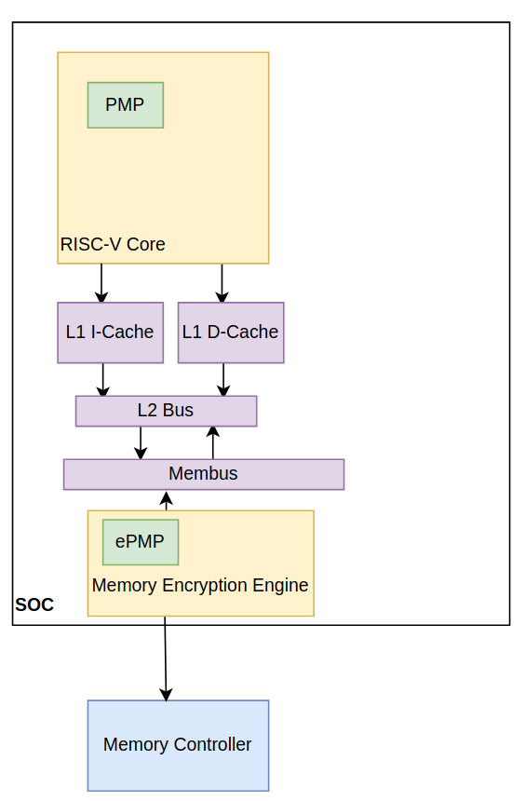
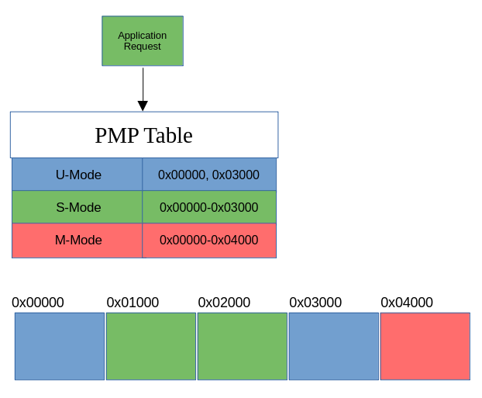

Extending Trusted Execution Environments in Architectural Simulators
Will Buziak
Abstract
Keystone
gem5
Evaluation
Trusted Execution Environments (TEEs) provide hardware guarantees that seek to protect the security and isolation of application data.
Many proprietary TEEs exist, each with its own implementation and respective way of providing security.
Open-source TEEs like Keystone grant users the ability to contribute to their standard for security
In order to extend TEEs, developers need to either implement their designs on FPGAs, or turn to architectural simulators.
Lack of effective tools for development and thorough testing on real-world benchmarks make pre-fabrication development difficult.
This work outlines the methods for implementing and evaluating contributions to Keystone within the gem5 architecture simulator.
Enclaves like Keystone provide hardware guarantees that data is safe from a malicious:
Application thread
Operating System
Remote User
Keystone segments memory & defines rules for different threads
Contributions have been proposed to extend the security of Keystone by providing secure memory protocols
gem5 presents architectural design as typical class structures with attributes based on the behavior of the real world component
For example, to properly connect the PMP to the proposed ePMP, it is either necessary to write a new:
- Packet type, bypassing the cache hierarchy
Or
- Port type directly connecting the core(s) to the Memory Encryption Engine
Developers wishing to extend Keystone components can create their own version of the desired component’s class structure, often requiring close attention to:
Port connections
Packet handling
Development in Syscall-Emulation
Full-system Testing
Potentially Malicious
Application Thread
Operating System
Remote or Cloud User
Designs in simulation can be tested on real workloads and state-of-the-art or custom benchmarks.
Keystone
Real Benchmarks
Tailored Benchmarks
Main Memory
Simulation
Fabrication
FPGA
Fabrication
Development Time
FPGA
Methodology
Simulation
Keystone is an open-source, RISC-V TEE designed for custom configuration and modulation
gem5 is an open-source architectural simulator that provides full-system emulation, including Keystone components
References
D. Lee, Building Trusted Execution Environments, 2022.
J. Lowe-Power, A. Mutaal Ahmad, A. Alian, R. Amslinger, and et. al., The gem5 Simulator: 20.0+, 2020.
A. Akram, V. Akella, S. Peisert, and J. Lowe-Power, Enabling Design Space Exploration for RISC-V Secure Compute, In: Fifth Workshop on Computer Architecture Research with RISC-V (CARRV 2021), 2021.
Z. Moolman, T.S. Lehman, Extending RISC-V Keystone to Include Efficient Secure Memory, in: Eighth Workshop on Computer Architecture Research with RISC-V (CARRV 2024), 2024.
Study Keystone class structures
Untrusted
Enclave 1
Enclave 2
User
(U-Mode)
App
App
Enclave App 1 (Eapp)
Eapp 2
Benchmark
Implement design
Higher Privilege
Supervisor
(S-Mode)
Operating System
(OS)
Runtime (RT) 1
RT 2
Machine
(M-Mode)
Security Monitor
Trusted Harware
RISC-V Cores
Optional H/W Features
Root of Trust

