Slide 1
Git/Github Will Buziak MABE/EECS University of Tennessee ME495 February, 2024

Slide 2


Behold, git
git was designed for version control
- i.e. tracks your files and defines a hierarchy for keeping a history of changes
git repositories can be hosted and shared through Github
1

Slide 3

Autosave vs Command Line
Google Drive is effective for file streaming
- Directly edit the same file(s)
git/Github creates tags called a commit
- Clone and edit file(s) in repositories with histories of each commit
- Collaborators can branch and fork their own versions
add
commit
push
2

Slide 4
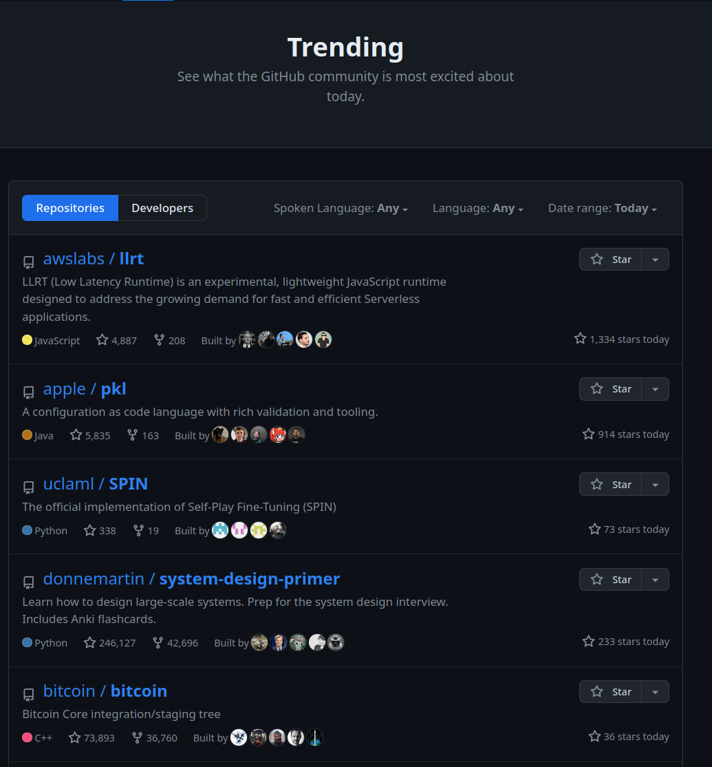
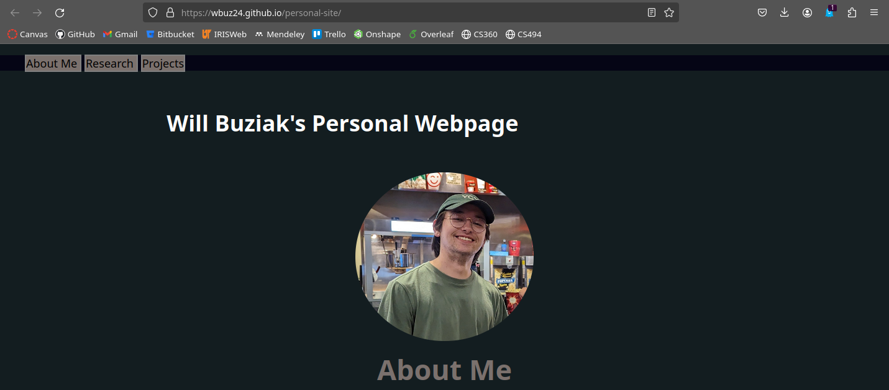
But ... I am a Mechanical Engineer!
Your grandfather doesn’t have to care about git – your mileage differs
- To your great delight, git will help you with
much more than recovering files
3

Slide 5


git Galore
git is open-source, for personal and large-scale software efforts
Github is owned by microsoft and is not open source
- Derivatives like Bitbucket, gitlab, etc. support larger groups and repos
- Pragmatically meaningless – just think free and paid server support
4

Slide 6

Common Workflow
Push
Push
Pull
Pull
Branches:
master
personal
collab
dev
Personal
Collaborator
5

Slide 7
Common Workflow
Now, lets zoom in
Push
Push
Pull
Pull
Branches:
master
personal
collab
dev
Personal
Collaborator
5

Slide 8
The ‘Art’ of Saving
push
commit
add
new edit
6

Slide 9
The ‘Art’ of Saving
push
commit
add
new edit
6

Slide 10
The ‘Art’ of Saving
push
commit
add
new edit
6

Slide 11
The ‘Art’ of Saving
push
commit
add
new edit
6

Slide 12
The ‘Art’ of Saving
push
commit
add
new edit
6

Slide 13
The ‘Art’ of Saving
Wait, I have new changes
push
commit
add
new edit
6

Slide 14
The ‘Art’ of Saving
Wait, I have new changes
push
commit
add
Which means I need to pull those changes
new edit
6

Slide 15
The ‘Art’ of Saving
fetch
pull
new edit
7

Slide 16
The ‘Art’ of Saving
fetch
pull
new edit
7

Slide 17
The ‘Art’ of Saving
fetch
pull
new edit
7

Slide 18
The ‘Art’ of Saving
fetch
pull
Updated
7

Slide 19
“This is starting to get convoluted.”
8

Slide 20
“This is starting to get convoluted.”
“Didn’t you say this was all through the ‘terminal’?”
8

Slide 21
“This is starting to get convoluted.”
“Didn’t you say this was all through the ‘terminal’?”
“Hate to break it to you man, I run Windows.”
-you
8

Slide 22
Haslam is Hiring
“This is starting to get convoluted.”
“Didn’t you say this was all through the ‘terminal’?”
“Hate to break it to you man, I run Windows.”
-you
8

Slide 23

The Promise Land
push
git status
commit
add
new edit
9

Slide 24

It’s Never Too Late For You
git fetch
push
git status
commit
add
new edit
10

Slide 25

git is Here to Help
git fetch
push
git status
commit
add
git pull
new edit
11

Slide 26
git is Here to Help
git is navigated through commands and can be split into stages
git status
- show info on file(s)
12

Slide 27
git is Here to Help
git is navigated through commands and can be split into stages
git status
- show info on file(s)
git fetch
- grab new changes from remote repos
fetch
12

Slide 28
git is Here to Help
git is navigated through commands and can be split into stages
git status
- show info on file(s)
git fetch
- grab new changes from remote repos
git pull
- Actually merge the changes into your local branches
fetch
pull
Updated
12

Slide 29
git is Here to Help
git is navigated through commands and can be split into stages
git add
- stage changes for a commit
add
new edit
13

Slide 30
git is Here to Help
git is navigated through commands and can be split into stages
git add
- stage changes for a commit
git commit
- save all staged files with a message
commit
add
new edit
13

Slide 31
git is Here to Help
git is navigated through commands and can be split into stages
git add
- stage changes for a commit
git commit
- save all staged files with a message
git push
- Upload your commit to Github
push
commit
add
new edit
13

Slide 32
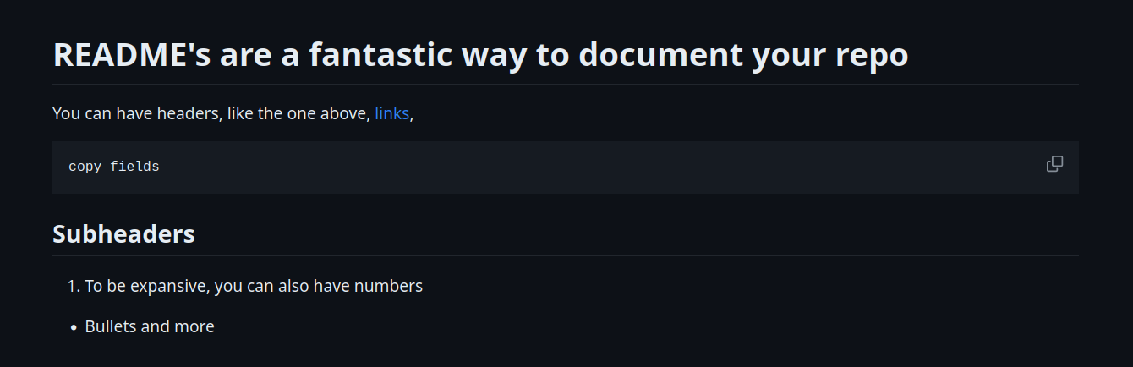
README
14

Slide 33
Don’t git it Twisted
git gives you command line control of the “auto-save” process
15

Slide 34
Don’t git it Twisted
git gives you command line control of the “auto-save” process
Github can host your repositories online:
- Industry standard for codebase collaboration
- git/Github are designed to help you be organized and thorough
15

Slide 35
Don’t git it Twisted
git gives you command line control of the “auto-save” process
Github can host your repositories online:
- Industry standard for codebase collaboration
- git/Github are designed to help you be organized and thorough
Be creative, git can be used in a wide array of applications beyond code
- Track coursework/projects and display in public repos
- Back-up important documents with a private repo
15

Slide 36
Don’t git it Twisted
git gives you command line control of the “auto-save” process
Github can host your repositories online:
- Industry standard for codebase collaboration
- git/Github are designed to help you be organized and thorough
Be creative, git can be used in a wide array of applications beyond code
- Track coursework/projects and display in public repos
- Back-up important documents with a private repo
- Documentation, Documentation, Documentation!
15

Slide 37
The Modern Day Resume
Personally, I would never hire an engineer who is unwilling to learn git
- and I am a mere undergrad
16

Slide 38
The Modern Day Resume
You must be able to present your ideas/projects, and therefore yourself, effectively
16

Slide 39
The Modern Day Resume
You must be able to present your ideas/projects, and therefore yourself, effectively
Even if you build a table, I think it should be featured somewhere linked to your personal Github page
16

Slide 40
Resources
Git reference ppt
https://github.com/wbuz24/undergrad-repo/blob/master/github-intro.pdf
Github docs
https://docs.github.com/en/get-started/start-your-journey/about-github-and-git

Slide 41
Git/Github Will Buziak MABE/EECS University of Tennessee ME495 February, 2024

