Slide 1
Hydrogen electrolysers
Will Buziak

Slide 2
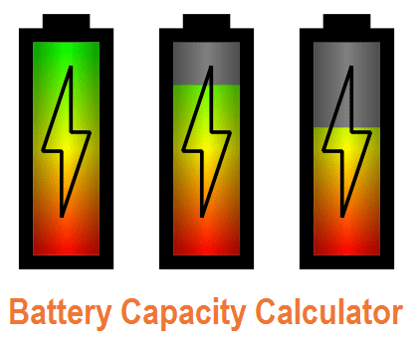
Batteries
Batteries can be charged/discharged to an inherent charge capacity
Limited Capacity
Charge time
Degradation over time
Limited lifespan
Harmful manufacturing process

Slide 3
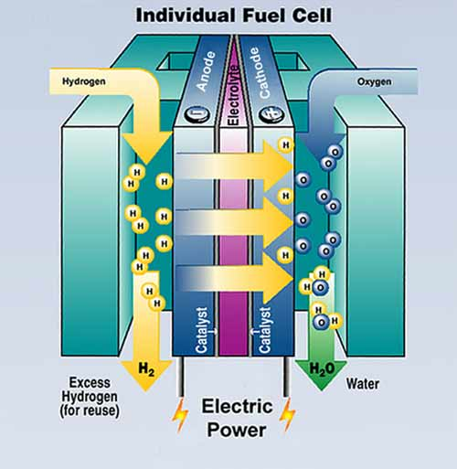
Hydrogen Fuel cells
Fuel Cells convert energy by combining hydrogen fuel with oxygen, producing energy and water as a by-product:
Clean energy conversion
Only limited by amount of fuel
Requires viable hydrogen atoms as fuel
Plenty of funding and research to improve electricity generation

Slide 4
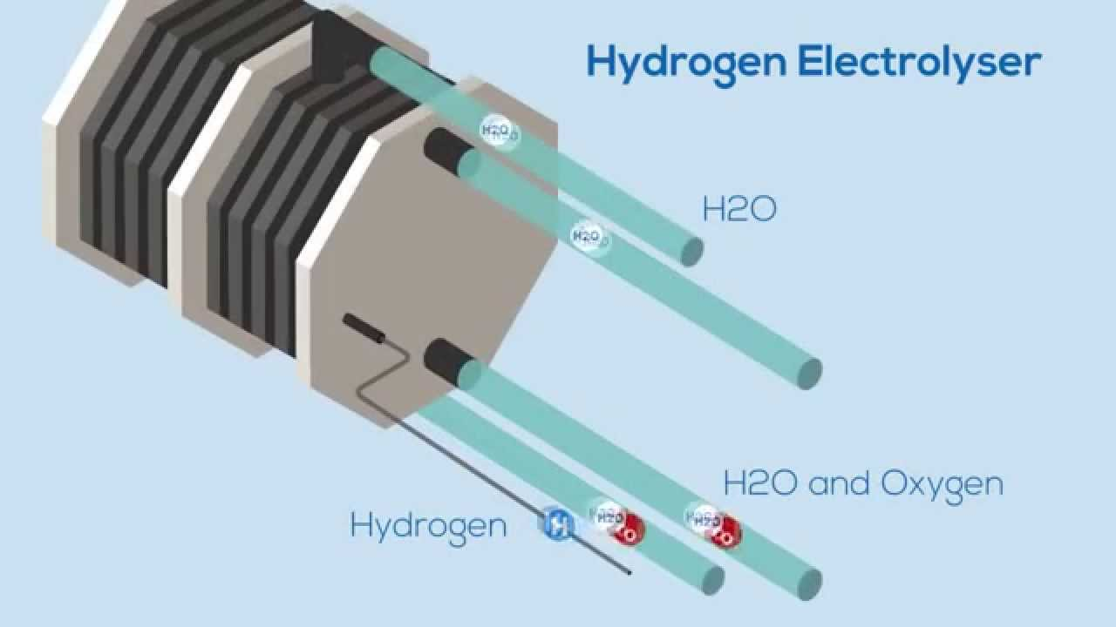
The Hydrogen Electrolyser
Is it energy storage or production?
Is it considered a “renewable” option?
How does it work?

Slide 5
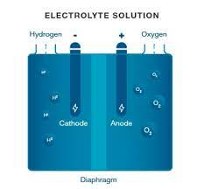
Clean Energy conversion
The electrolyser is the brother to the fuel cell:
Takes water and electricity
Separates hydrogen and oxygen
Creates viable hydrogen fuel as the energy carrier

Slide 6
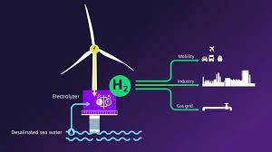
Is it sustainable?
Electrolysers are sustainable so long as their power source is also sustainable.
Ideally connect the electrolyser to a wind or solar farm
Create completely clean energy ready for storage and transportation
Used with a fuel cell produces a closed circuit of sustainable energy.

Slide 7
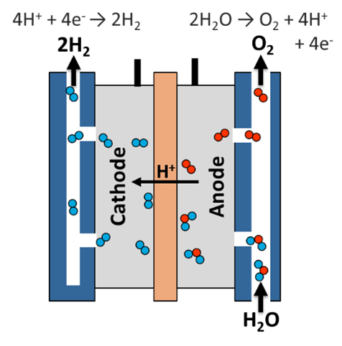
How does it work?
Electrolysers use electrolysis to separate hydrogen and oxygen:
An ionically conductive, but not electrically conductive membrane passes water ions, but not electrons
Anode and Cathode parts create an electric potential
Hydrogen and oxygen parts are diverted and processed separately

Slide 8
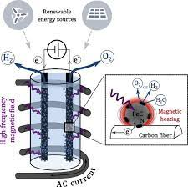
Future research interest
There is lots of funding in many different areas seeking to increase the efficiency of electrolysers:
Primarily through materials research
Increase the efficiency through improving the design of the system
Application of magnetic fields, pulsing electric fields, or ultrasonic fields

Slide 9
THANK YOU
“Increasing the efficiency of hydrogen production from solar powered water electrolysis” – Burton, Padilla, Rose, & Habibullah
https://www.sciencedirect.com/science/article/pii/S136403212030544X

