Slide 1
Program
Electrolyzer
Goal
Investigations into mass transport characteristics of cells
Milestone
Last week | This week | Next week
Began developing Li-ion visualizer tool Gathered data on ragone plots using webplotdigitizer (Datathief) | Improve functionality of 3D plot Look into HTML/CSS/JS for website development | Translate python plots to javascript Look in to Dash Learn HTML, JS, & CSS or Learn Dash
Achievements
and Learning
(current week)
Created 3D plot from data sheet and built out GUI window Plotly can plot in javascript which can be embedded into HTML/CSS for a website Plotly has a python software Dash that could be the simple answer Translate python plots to javascript Implement more functionality: data extrapolation models (predictive models) Need to decide on GUI or website as medium of delivery
Plan
Next Week
Issues and
New Ideas

Slide 2
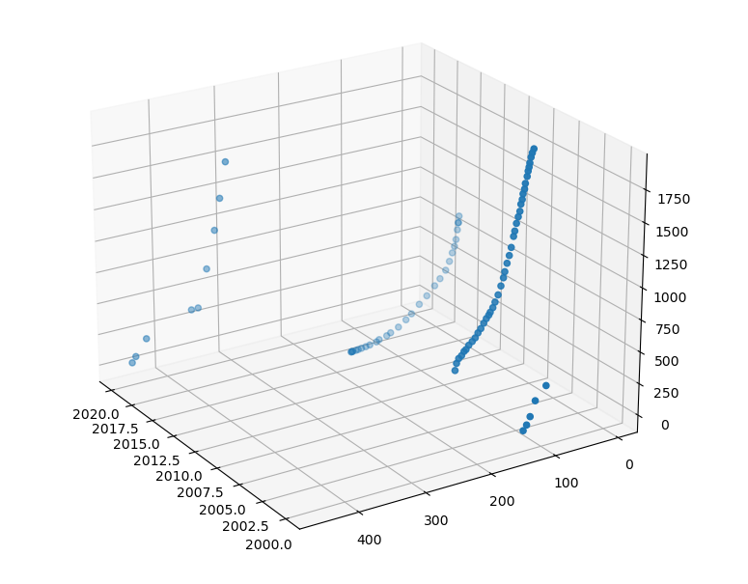
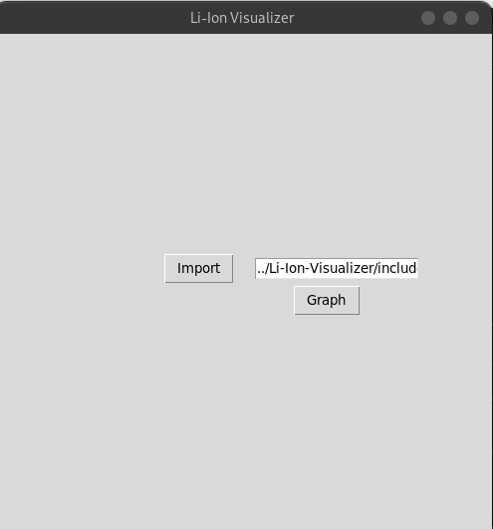
Li-ion Ragone plot visualizer – Previous State
We have extrapolated data from different papers to generate a 3D plot displaying the industry trend and trade-offs for specific energy or specific power
Primitive GUI window reading input file and displays 3D plot

Slide 3
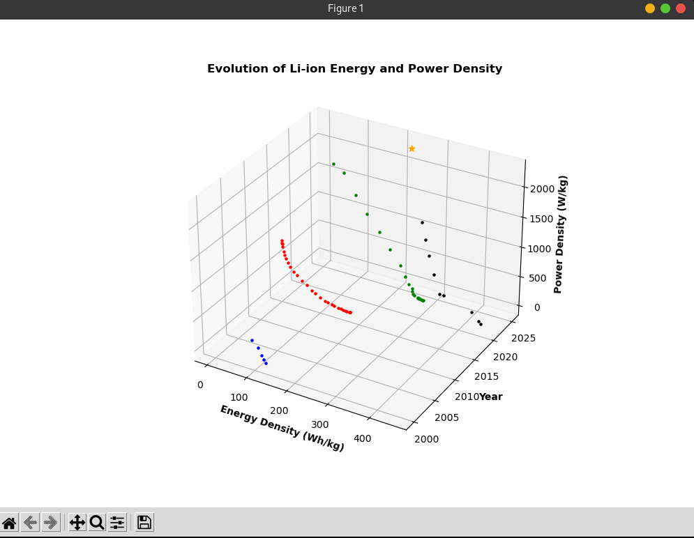
Li-ion Ragone plot visualizer – Current state
Will add more interactivity with the data:
Color coordinate
Fit and extrapolate to predict future trends
Ability to add data
Tie data points to sources
Plots are color coded and interactive (hovering shows data and source)

Slide 4
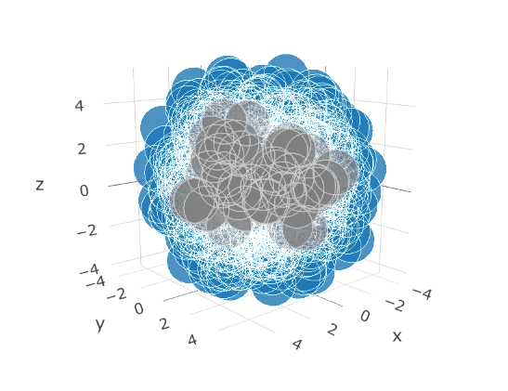
Li-ion Ragone plot visualizer – Website or GUI?
A website would arguably be more convenient and accessible
Take longer to get working (must learn HTML, JS & CSS)
More functionality/interactivity means more programming hurdles to jump
Plotly can plot 3D plots in JS and are arguably more appealing to the eye
JS functions can be embedding into html functionality
PyScript or Dash? (avoids re-plotting, but still js under the hood)
Python 3D plot
Plotly 3D plot

