Slide 1
Program
Electrolyzer
Goal
Investigations into mass transport characteristics of cells
Milestone
Last week | This week | Next week
Began developing Li-ion visualizer tool Gathered data on ragone plots using webplotdigitizer (Datathief) | Improve functionality of 3D plot Look into HTML/CSS/JS for website development | Finish visualizer Re-verify low resolution parameters
Achievements
and Learning
(current week)
Created 3D plot from data sheet and built out GUI window Need to decide on GUI or a website Implement more functionality, mainly data reduction and extrapolation models
Plan
Next Week
Issues and
New Ideas

Slide 2
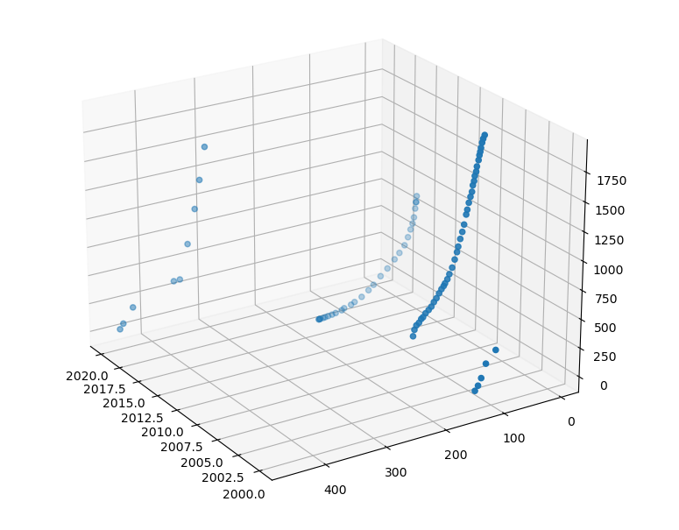
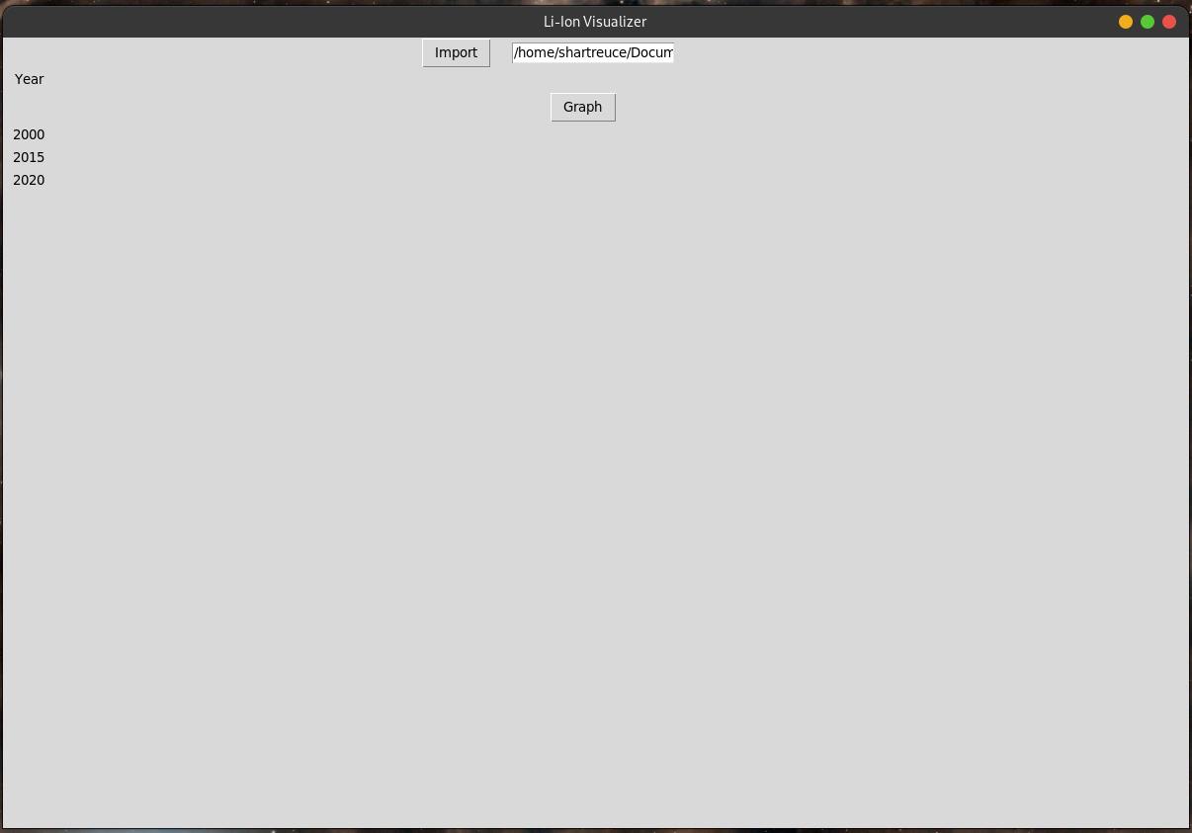
Li-ion Ragone plot visualizer – Current state
We have extrapolated data from different papers to generate a 3D plot displaying the industry trend and trade-offs for specific energy or specific power
Primitive GUI window reading input file and displays 3D plot
Primitive GUI window reading input file and displays a 3D plot

Slide 3
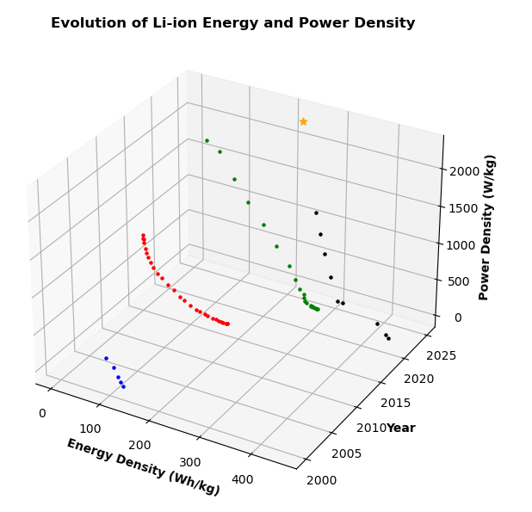
Li-ion Ragone plot visualizer – Future plans
Will add more interactivity with the data:
Color coordinate
Fit and extrapolate to predict future trends
Ability to add data
Tie data points to sources
Website or GUI?

