Slide 1
Program
Electrolyzer
Goal
Investigations into mass transport characteristics of cells
Milestone
Last week | This week | Next week
Ran high resolution colliding bubble simulations on ISAAC | Finished high resolution simulations Worked with Preetam on new Li-ion Ragone visualizer | Finish visualizer Re-verify low resolution parameters
Achievements
and Learning
(current week)
High resolution colliding bubble simulations
Plan
Next Week
Issues and
New Ideas

Slide 2
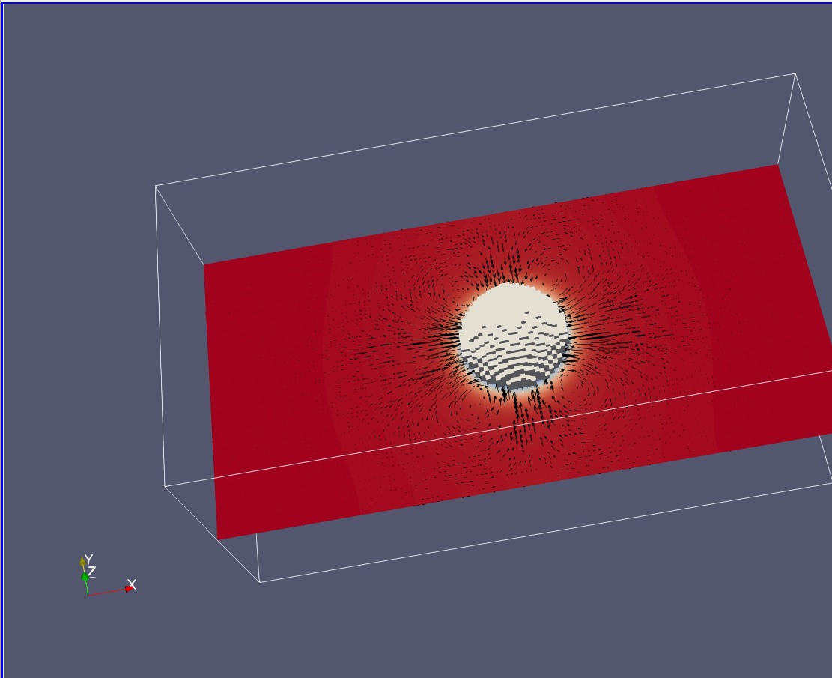
Low resolution simulations have constant volume throughout runtime
Results:
Res: | Radius: | 1e-5 | 1e-3
64 | 16 | .246-.246 | .246-.246
 | 8 | failed | .246-.246
256 | 64 | .24902 | .24902
 | 32 | .00067-.000665 | .24902

Slide 3
High resolution simulations did not change volume
High resolution simulations held constant volume, however, most high resolution simulations failed before finishing and therefore did not reach steady state.
For the simulation that did finish, volume was NOT constant. (high resolution, radius = res/8, Pe=1e-5)
Res: | Radius: | 1e-5 | 1e-3
64 | 16 | .246-.246 | .246-.246
 | 8 | failed | .246-.246
256 | 64 | .24902 | .24902
 | 32 | .00067-.000665 | .24902

Slide 4
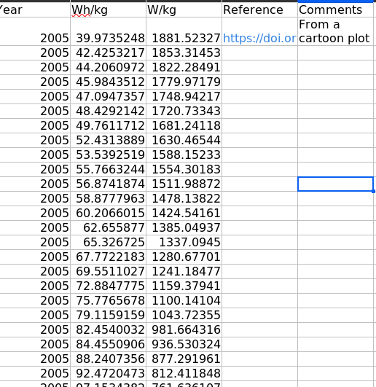
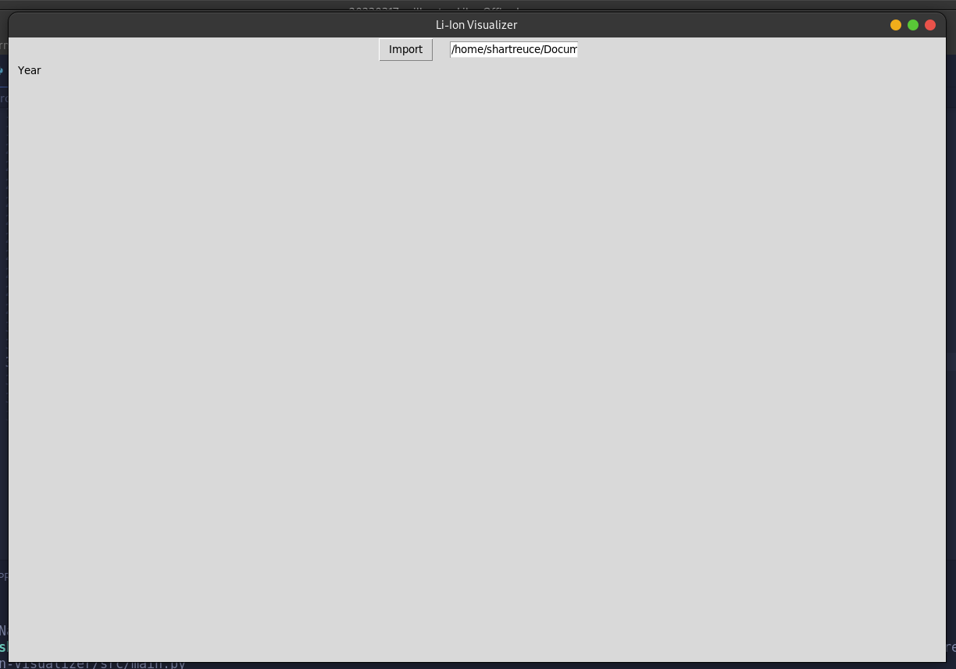
Li-ion Ragone plot visualizer
Using the data the Preetam has collected, we will build a GUI around a plot that graphs specific power vs specific energy over time.
Primitive GUI window reading input file and will display parameters. Eventually produces an interactive 3-D plot

