Slide 1
Git/Github Will Buziak MABE/EECS University of Tennessee ME495 February, 2024

Slide 2


Behold, git
git was designed for version control
- i.e. tracks your files and defines a hierarchy for keeping a history of changes
git repositories can be hosted and shared through Github
1

Slide 3

Autosave vs Command Line
Google Drive is effective for file streaming
- Directly edit the same file(s)
git/Github creates tags called a commit
- Clone and edit file(s) in repositories with histories of each commit
- Collaborators can branch and fork their own versions
add
commit
push
2

Slide 4
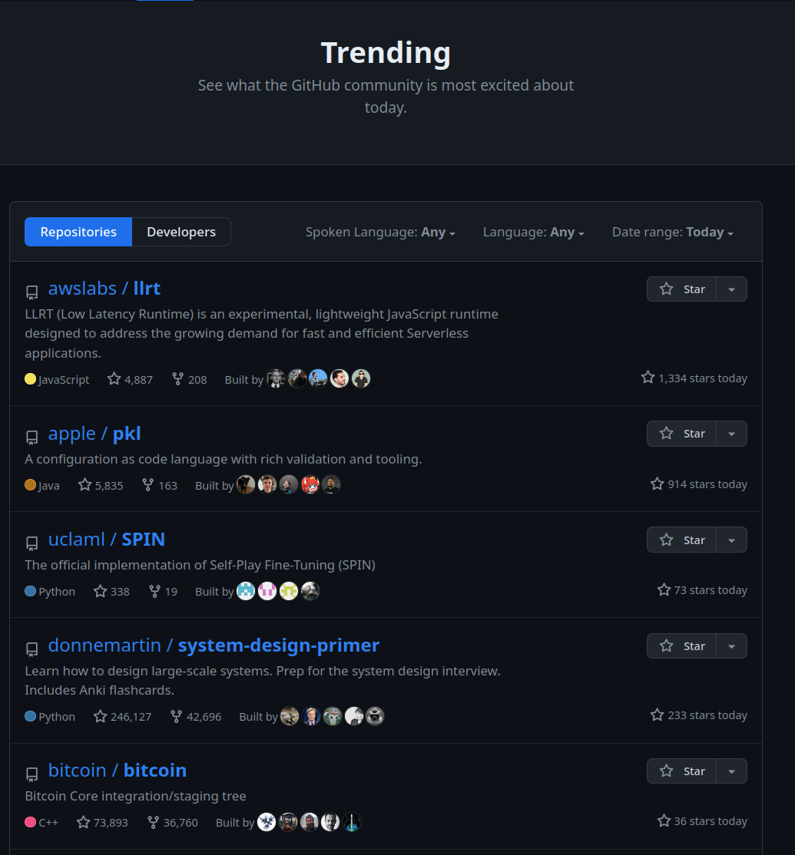
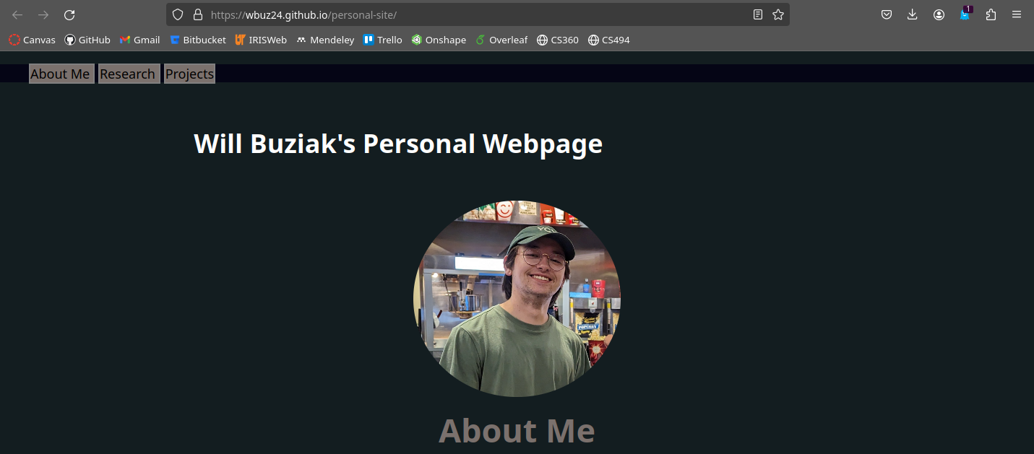
B-But ... I am a Mechanical Engineer!
Your grandfather doesn’t have to care about git – your mileage differs
- To your great delight, git will help you with
much more than recovering files
3

Slide 5


git Galore
git is open-source, for personal and large-scale software efforts
Github is owned by microsoft and is not open source
- Derivatives like Bitbucket, gitlab, etc. support larger groups and repos
- Pragmatically meaningless – just think free and paid server support
4

Slide 6

Common Workflow
Push
Push
Pull
Pull
Branches:
master
personal
collab
dev
Personal
Collaborator
5

Slide 7
Common Workflow
Now, lets zoom in
Push
Push
Pull
Pull
Branches:
master
personal
collab
dev
Personal
Collaborator
5

Slide 8
The ‘Art’ of Saving
push
commit
add
new edit
6

Slide 9
The ‘Art’ of Saving
Wait, I have new changes
push
commit
add
new edit
6

Slide 10
The ‘Art’ of Saving
Wait, I have new changes
push
commit
add
Which means I need to pull those changes
Updated
6

Slide 11
“This is starting to get convoluted.”
7

Slide 12
“This is starting to get convoluted.”
“Didn’t you say this was all through the ‘terminal’” ?
7

Slide 13
“This is starting to get convoluted.”
“Didn’t you say this was all through the ‘terminal’” ?
“Hate to break it to you man, I run Windows.”
-you
7

Slide 14
Haslam is Hiring
“This is starting to get convoluted.”
“Didn’t you say this was all through the ‘terminal’” ?
“Hate to break it to you man, I run Windows.”
-you
7

Slide 15

The Promise Land
push
git status
commit
add
new edit
8

Slide 16

It’s Never Too Late For You
git fetch
push
git status
commit
add
new edit
9

Slide 17

git Is Here To Help
git fetch
push
git status
commit
add
git pull
new edit
9

Slide 18
git Is Here To Help
git is navigated through commands and can be split into stages
git status
- show info on file(s)
10

Slide 19
git Is Here To Help
git is navigated through commands and can be split into stages
git status
- show info on file(s)
git fetch
- grab new changes from remote repos
fetch
10

Slide 20
git Is Here To Help
git is navigated through commands and can be split into stages
git status
- show info on file(s)
git fetch
- grab new changes from remote repos
git pull
- Actually merge the changes into your local branches
fetch
pull
Updated
10

Slide 21
Summary
7

Slide 22
Resources
Git reference ppt
https://github.com/wbuz24/undergrad-repo/blob/master/github-intro.pdf
Github docs
https://docs.github.com/en/get-started/start-your-journey/about-github-and-git

Slide 23
Git/Github Will Buziak MABE/EECS University of Tennessee ME495 February, 2024

