Slide 1
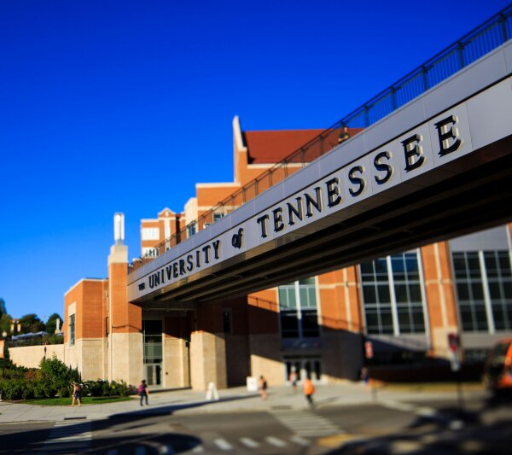
ME 494/495 Update Presentation Will Buziak 11/15/23

Slide 2
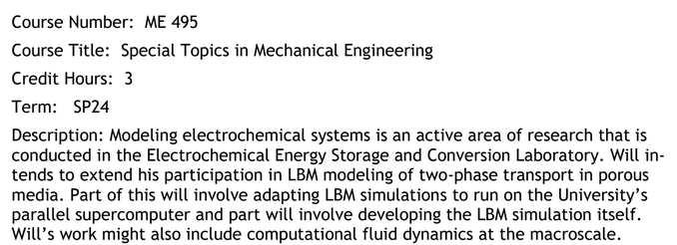
Course Goals
The description of this course covers a review of modeling two-phase transport through porous media utilizing the Lattice-Boltzmann Method.
This will involve tasks such as:
Learning critical paper review
Reading and improving code
Running simulations via the Universities’ supercomputer
In part, developing the simulations myself
Fulfilling other computational demands for the EESCL

Slide 3
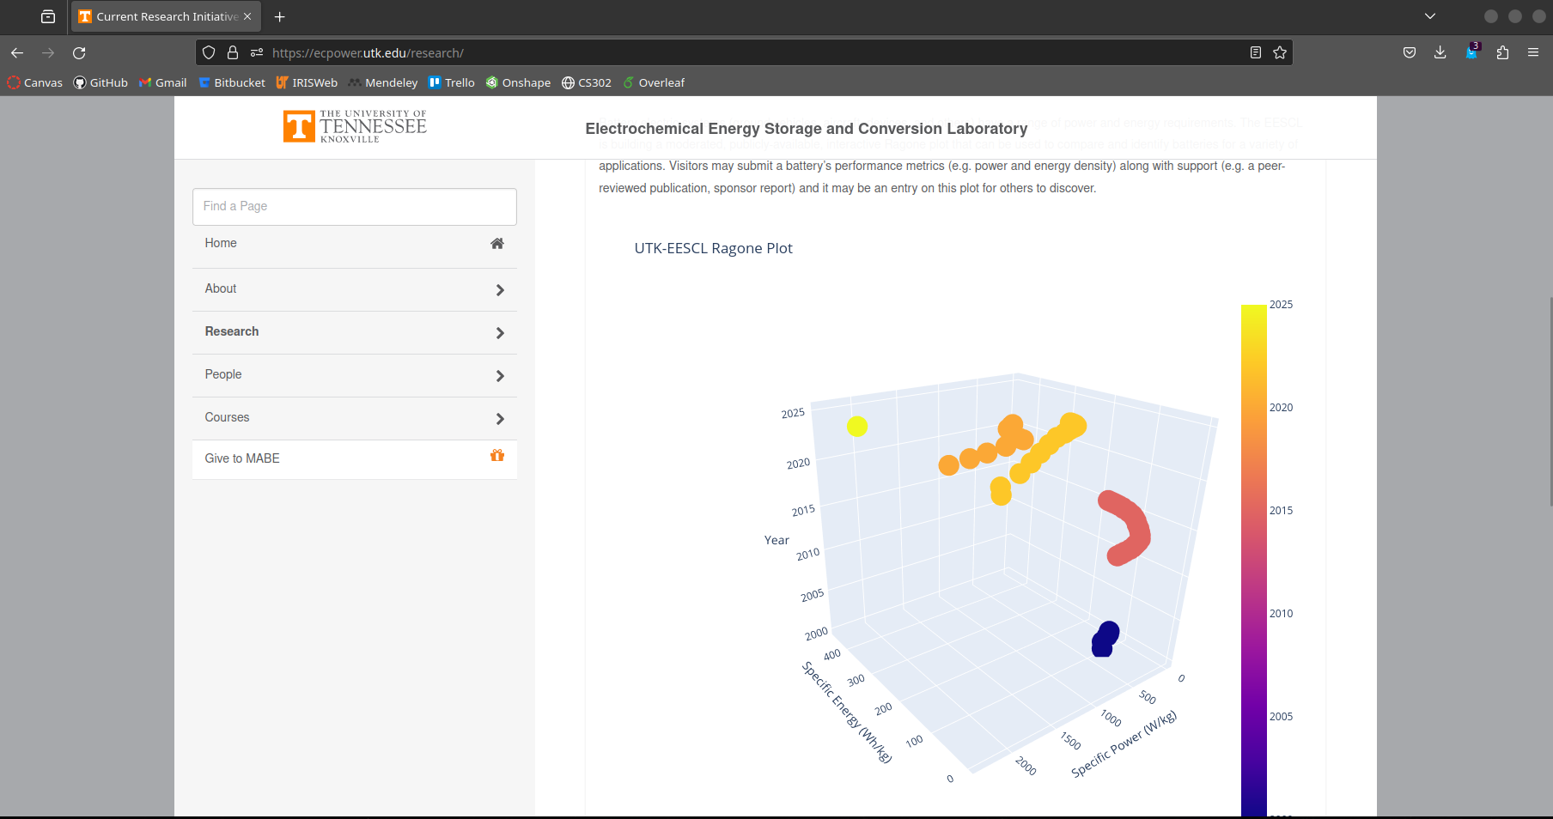
Midterm Progress Report
In the first part of the semester, I began by reviewing papers on LBM techniques for modeling the electrochemical kinetics of a PEM hydrogen electrolyzer reaction.
Next, I compiled my own PEM Electrolyzer modeling review paper
Additionally I was successful in initializing the web-based EESCL Ragone Plot tool
The focus of the review paper is the motivation for a Lattice-Boltzmann approach to modeling the system and the state of Lattice-Boltzmann CFD modeling
The state-of-the-art kinetic model is the Butler-Volmer equation, the advantage of using B-V is the assumptions, most notably mass-transport affects being considered negligible

Slide 4
Moving Forward
Next, I will insert more data points into the Ragone Plot tool. The vision for the tool is to transfer ownership to the lab and therefore control over the online representation will be completely dictated by the EESCL.
The primary focus of ME 494/495 is LBM simulation and will continue with the state-of-the-art review. Additionally, as the demand necessitates, I will continue working with the EESCL on the simulation code as it pertains to computational efficiency and memory allocation, as well as running the simulations themselves.
Next semester, my exterior coursework will allow me to begin working on a systems level and further contribute to my understanding of the Palabos software framework.

