Slide 1
LZ77 Compression Will Buziak MABE/EECS University of Tennessee CS494 February 20, 2024

Slide 2
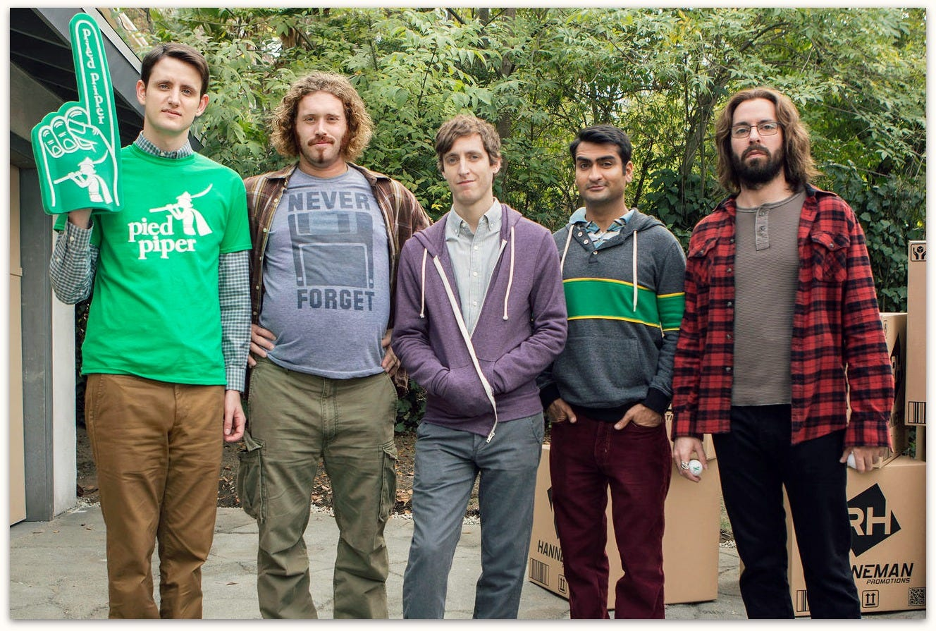
What is Lossless Data Compression
Uses a shorthand to redundant data
Completely reconstruct the compressed data with no quality lost

Slide 3
Applications of LZ77
LZ77/LZ78 are the basis of many derivations:
- Deflate → PNG & ZIP
- LZW → GIF
Img showing txt file → encoded file → txt file

Slide 4
The “Sliding Window” Shorthand
Two buffers slide along, encoding the file by creating pointers to earlier instances of characters with a read distance
Search Buffer
Look Ahead Window
A
A
B
C
A
A
B
C
D
Z
Current Place

Slide 5
How Do The Buffers Work?
Each buffer can be thought of as look up memory, distinguished by its relative position to the current character
In other words, you want an idea of the characters/words around you
- Otherwise, you would simply be expanding characters while encoding!
Search Buffer
A
A
B
C
Look Ahead Window
A
A
B
C
D
Z

Slide 6
Algorithm
text

Slide 7
Behold, A Simple Example
text

Slide 8
Experiment
Text
Runtime

Slide 9
Performance Evaluation
Text
Runtime

Slide 10
Resources
https://cs.stanford.edu/people/eroberts/courses/soco/projects/data-compression/lossless/lz77/algorithm.html
https://en.wikipedia.org/wiki/LZ77_and_LZ78
https://medium.com/@vincentcorbee/lz77-compression-in-javascript-cd2583d2a8bd

Slide 11
LZ77 Compression Will Buziak MABE/EECS University of Tennessee CS494 February 20, 2024

