Slide 1
Git/Github Will Buziak MABE/EECS University of Tennessee ME495 February, 2024

Slide 2
Behold, git
git was designed for version control
- i.e. tracks your files and defines a hierarchy for keeping a history of changes
git repositories can be hosted and shared through Github
1

Slide 3

Autosave vs Command Line
Google Drive is effective for file streaming
- Directly edit the same file(s)
git/Github track commit histories
- Clone and edit file(s) in repositories
- Collaborators can branch and fork their own versions
add
commit
push
2

Slide 4
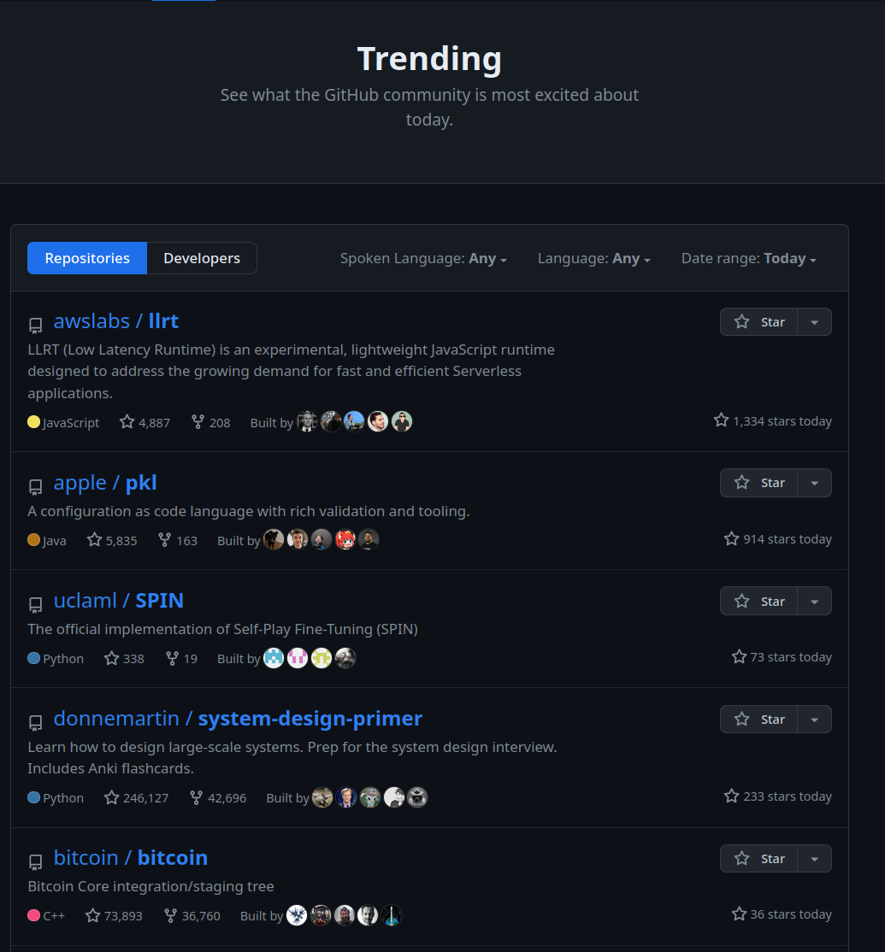
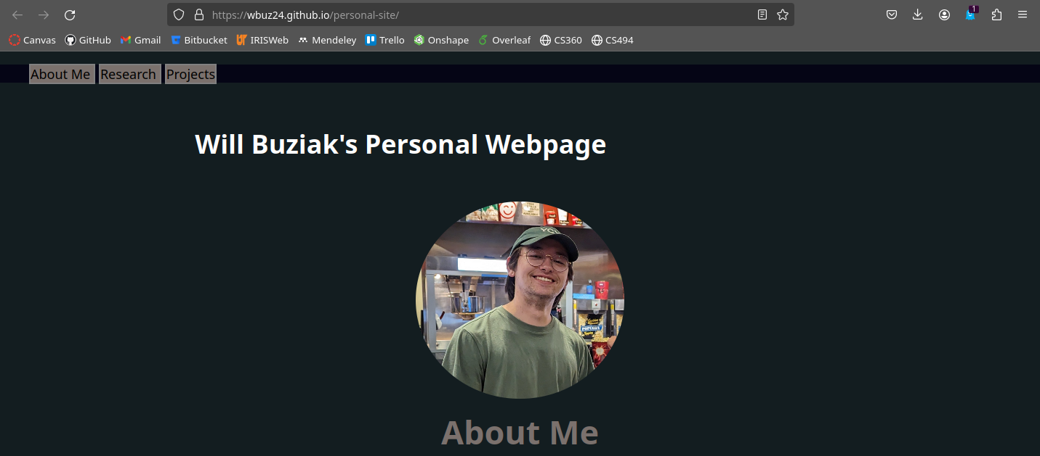
B-But ... I am a Mechanical Engineer!
Your grandfather doesn’t have to care about git – your mileage differs
- To your great delight, git will help you with
much more than recovering files
3

Slide 5



git Galore
git is open-source, for personal and large-scale software efforts
Github is owned by microsoft and is not open source
- Derivatives like Bitbucket, gitlab, etc. support larger groups and repos
- Pragmatically meaningless – just think free and paid server support
4

Slide 6

Common Workflow
Push
Push
Pull
Pull
Branches:
master
personal
collab
dev
Personal
Collaborator
5

Slide 7
Common Workflow
Now, lets zoom in
Push
Push
Pull
Pull
Branches:
master
personal
collab
dev
Personal
Collaborator
5

Slide 8
The ‘Art’ of Saving
push
commit
add
new edit
6

Slide 9
The ‘Art’ of Saving
Wait, I have new changes
push
commit
add
new edit
6

Slide 10
The ‘Art’ of Saving
Wait, I have new changes
push
commit
add
new edit
6

Slide 11

The ‘Art’ of Merging
push
git status
commit
add
new edit
6

Slide 12

The ‘Art’ of Merging
git fetch
push
git status
commit
add
new edit
6

Slide 13

The ‘Art’ of Merging
git fetch
push
git status
commit
add
git pull
new edit
6

Slide 14
Summary
7

Slide 15
Resources
Git reference ppt
https://github.com/wbuz24/undergrad-repo/blob/master/github-intro.pdf
Github docs
https://docs.github.com/en/get-started/start-your-journey/about-github-and-git

Slide 16
Git/Github Will Buziak MABE/EECS University of Tennessee ME495 February, 2024

