Slide 1
Program
Electrolyzer
Goal
Investigations into mass transport characteristics of cells
Milestone
Last week | This week | Next week
Low resolution simulation verification | Speak with Anirban and Tom about the website | Work with Tom and Anirban on website
Achievements
and Learning
(current week)
Low resolution simulations verified. Batch job submission 4 failed low resolution, Pe: 1e-3, bubble radius 8
Plan
Next Week
Issues and
New Ideas

Slide 2
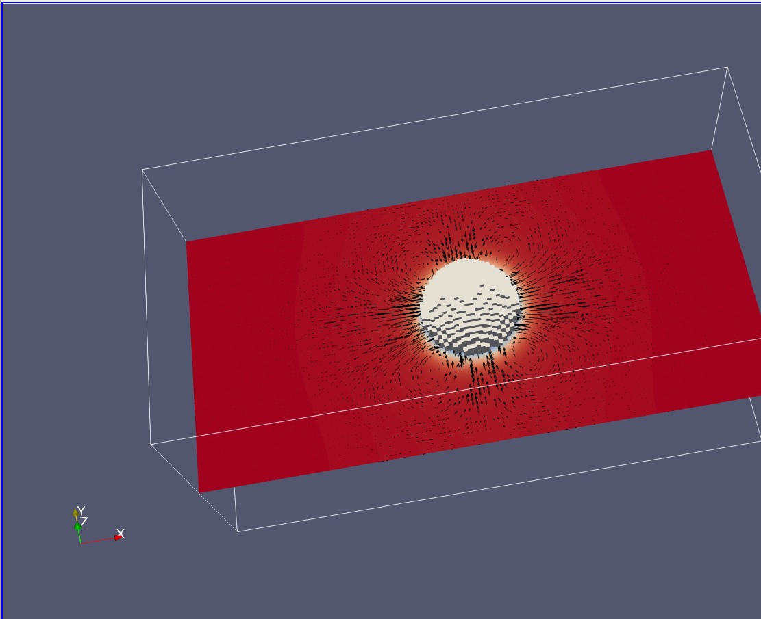
Low resolution simulations have constant volume throughout runtime
Results:
Res: | Radius: | 1e-5 | 1e-3
64 | 16 | .246-.246 1 | .246-.246 2
 | 8 | .246-.246 3 | Failed 4
256 | 64 | .24902 5 | .24902 6
 | 32 | .00067-.000665 7 | .24902 8

