Slide 1
Program
Electrolyzer
Goal
Investigations into mass transport characteristics of cells
Milestone
Last week | This week | Next week
Worked with Anirban and Preetam on Li-Ion visualizer | Re-verified parameters for low resolution simulations Looking into web dev | Continue verification of low resolution simulations Convert ragone graphs to javascript
Achievements
and Learning
(current week)
Low resolution simulations were run using a lower time step than what was necessary for high resolution simulations. This week, I ran those simulations at higher time steps which resulted in an inability to finish low resolution simulations even at 5 nodes with 24 tasks per node. Re-run the low resolution simulations at a lower time step, or perhaps ask the program to produce more vtk files for the smaller resolutions. Why do some simulations with the same sbatch specifications have different runtimes? Does ISAAC allocate more nodes if they are available? More time steps and more nodes produces less .gif output files
Plan
Next Week
Issues and
New Ideas

Slide 2
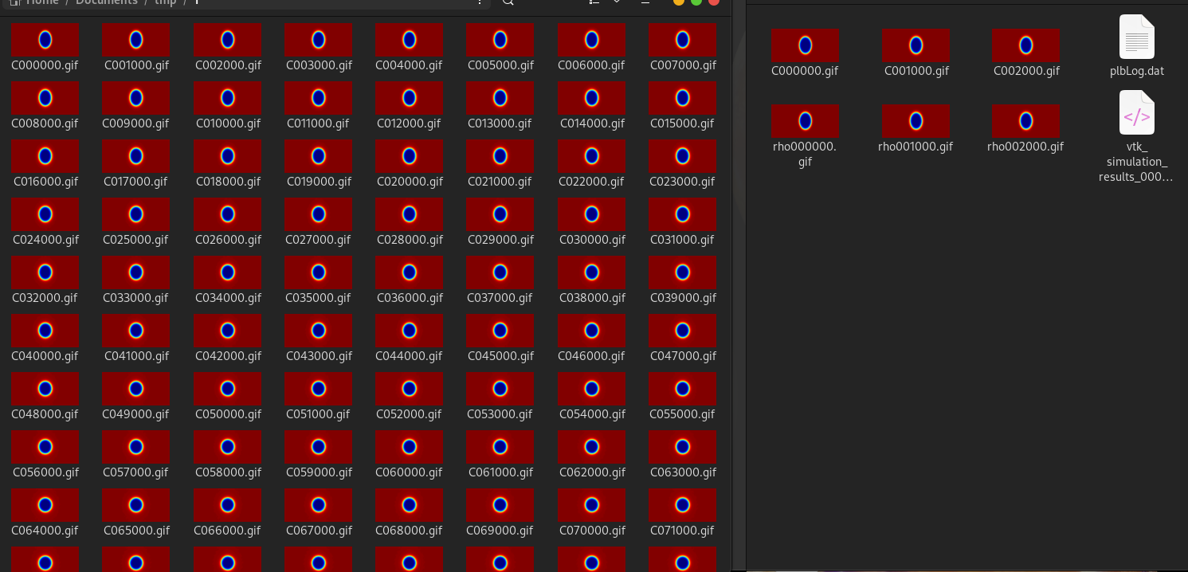
Re-verifying simulation results
Results:
Res: | Radius: | 1e-5 | 1e-3
64 | 16 | .246-.246 1 | .246-.246 2
 | 8 | Failed 3 | .246-.246 4
256 | 64 | .24902 5 | .24902 6
 | 32 | .00067-.000665 7 | .24902 8
The left folder is simulation 1, the first time it was run with less nodes and less time steps.
The right is the most recent simulation with more time steps and more nodes.

