Slide 1
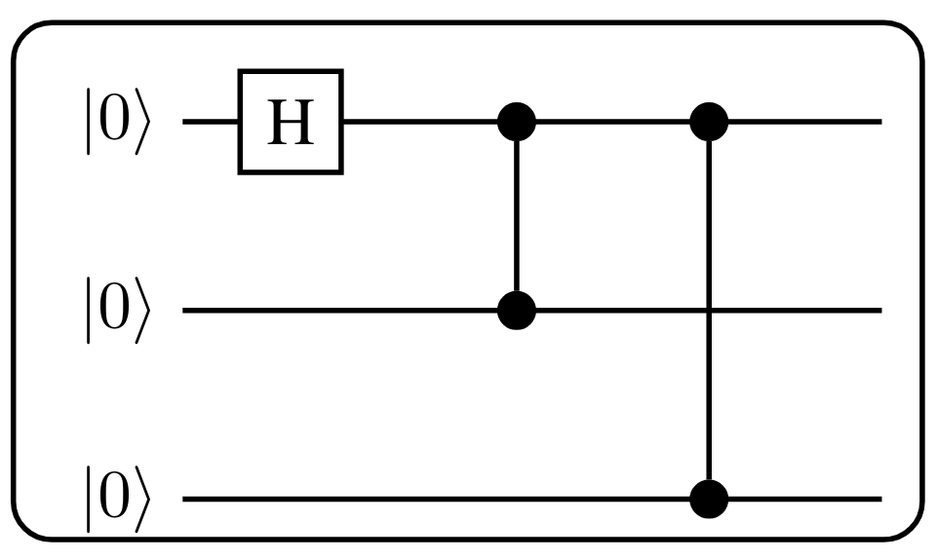
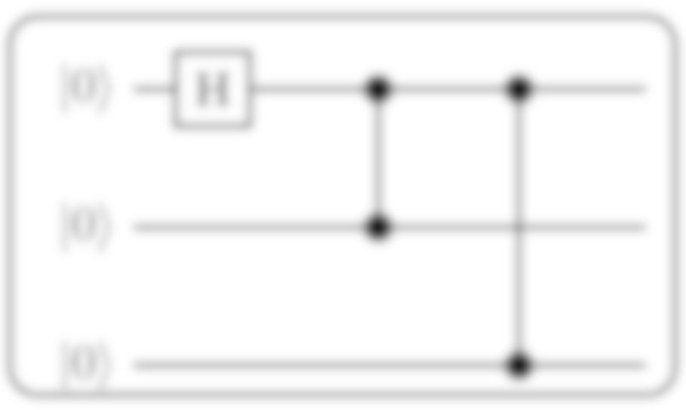
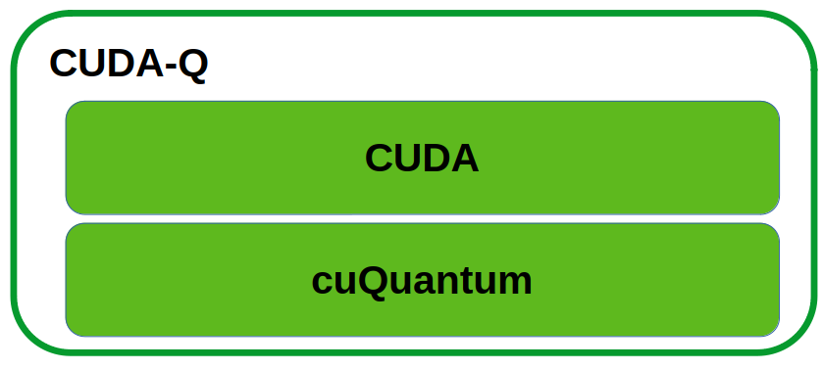
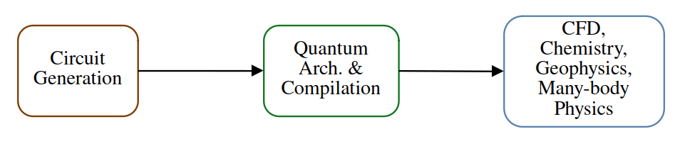

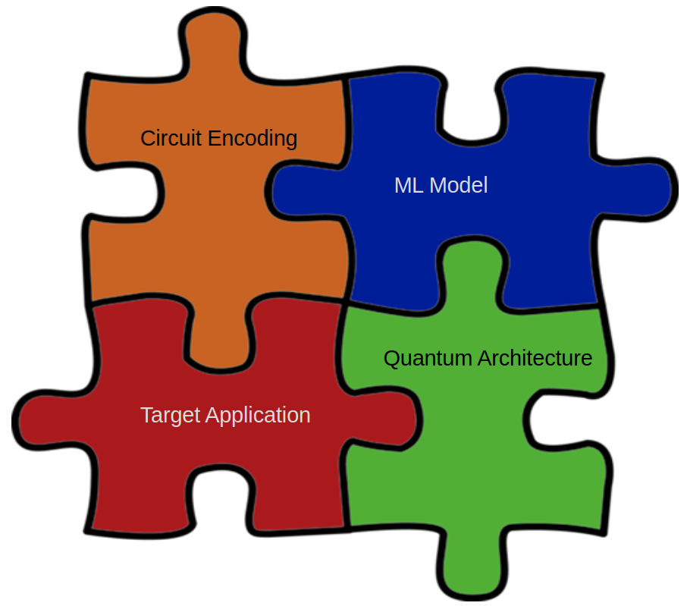
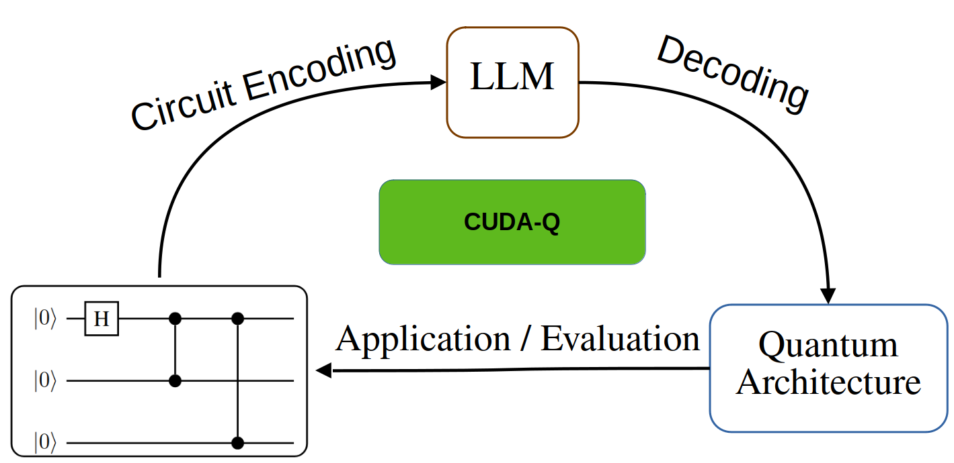
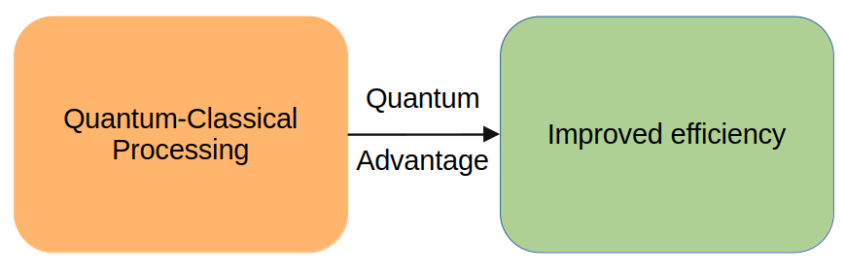
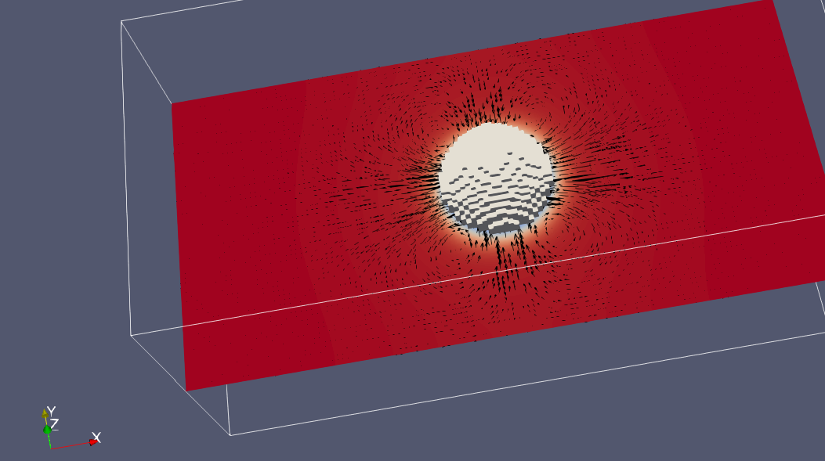
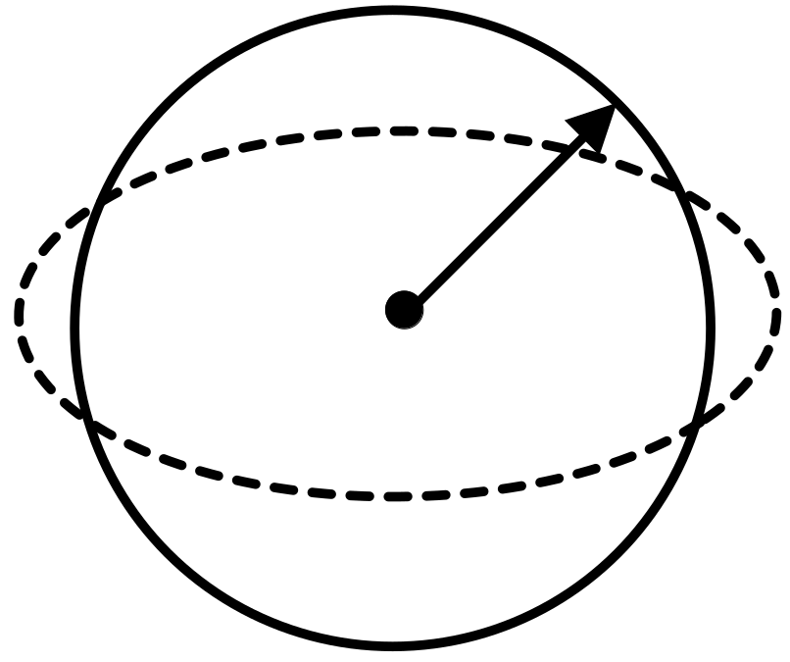


Quantum Circuit Generation for Modeling Complex Interactions
Will Buziak
Iris Bahar
Pooja Rao
Department of Computer Science Department of Computer Science NVIDIA
Abstract
Quantum Architecture
CUDA-Q
Large-Language Models
If we intend to make use of complex quantum algorithms, we need either:
Scalable, reliable quantum hardware.
or
Sophisticated algorithm, architecture & compilation frameworks that enable execution on heterogeneous, distributed systems.
This work proposes a framework for quantum circuit generation in hopes to better utilize complex quantum modeling techniques on real quantum hardware.
Classical modeling methods are expensive due to an inability to scale for:
Large / dense domain sizes
Long-term model stability
We are interested in making quantum algorithms for modeling complex systems viable for execution on real quantum hardware.
Quantum architecture, encoding and qubit mapping can all fall under the umbrella of quantum circuit compilation.
NVIDIAs quantum SDK, CUDA-Q enables:
Parallelization
Hamiltonian Simulation
Multi-GPU acceleration
CUDA-Q wraps NVIDIAs backend development kits, targeting high performance applications:
cuQuantum: Library that accelerates quantum simulations on a circuit & device-level.
CUDA: GPU development SDK
Ideal for hybrid quantum-classical processing and HPC applications.
Placing CUDA-Q at the center of this framework indicates the full utilization of hardware acceleration at every step.
Quantum circuit generation with diffusion models resembles image generation.
We imagine quantum circuits as a flexible representation - enabling us to consider them as images, or a language.
Compilation Techniques
Motivation
Applications
Quantum Architecture methods such as gate cutting can further improve the fidelity of a quantum circuit and reduce depth.
Quantum circuit generation mitigates the need for high-level algorithm expertise.
A hybrid quantum-classical ML workflow with CUDA-Q at the center
Each major component of this paradigm is intended to be interchangeable, opening the door for a larger swath of applications.
Quantum computing provides speedups over classical solutions when algorithms can map to an algorithm that takes advantage of entanglement similarities.
Quantum Architecture & Compilation frameworks can target heterogeneous distributed systems.
Quantum advantage is dependent on the ability to encode domain properties and conditions into the quantum state
Challenges
Quantum Hardware is noisy & unreliable.
Qubit technologies are non-homogeneous.
Classical models experience exponential blowup when scaling to real-world systems.
Algorithm design is non-trivial & often requires additional techniques to improve circuit fidelity on NISQ hardware.

