Slide 1
GQE-inspired QLBM
Will Buziak, Iris Bahar & Pooja Rao

Slide 2
What do Engineers want from Quantum Computers?

Slide 3
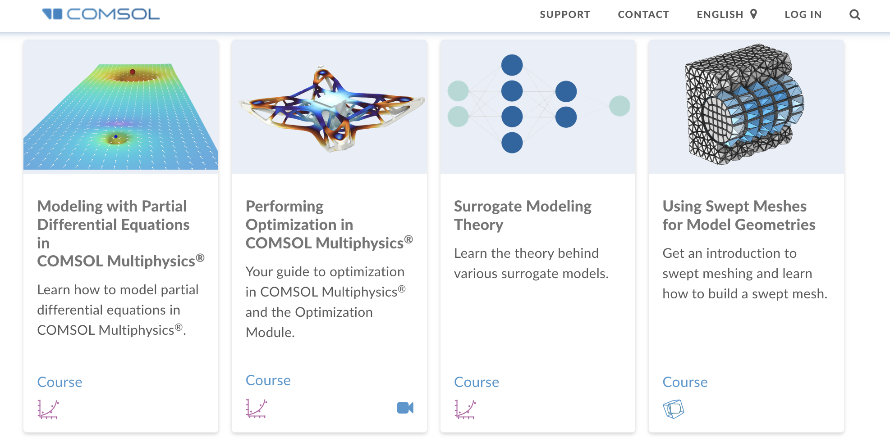
What do Engineers want from Quantum Computers?
Physicists have a compute problem
Highly complex multi-physics simulations
Moore’s law is dead
[3]

Slide 4
What kind of problems map to Quantum Computers?
Natural candidates for optimization offered by Quantum Algorithms
Partial Differential Equation solvers
Molecule interactions
- Material Properties
- Fluid dynamics
High-Energy physics

Slide 5
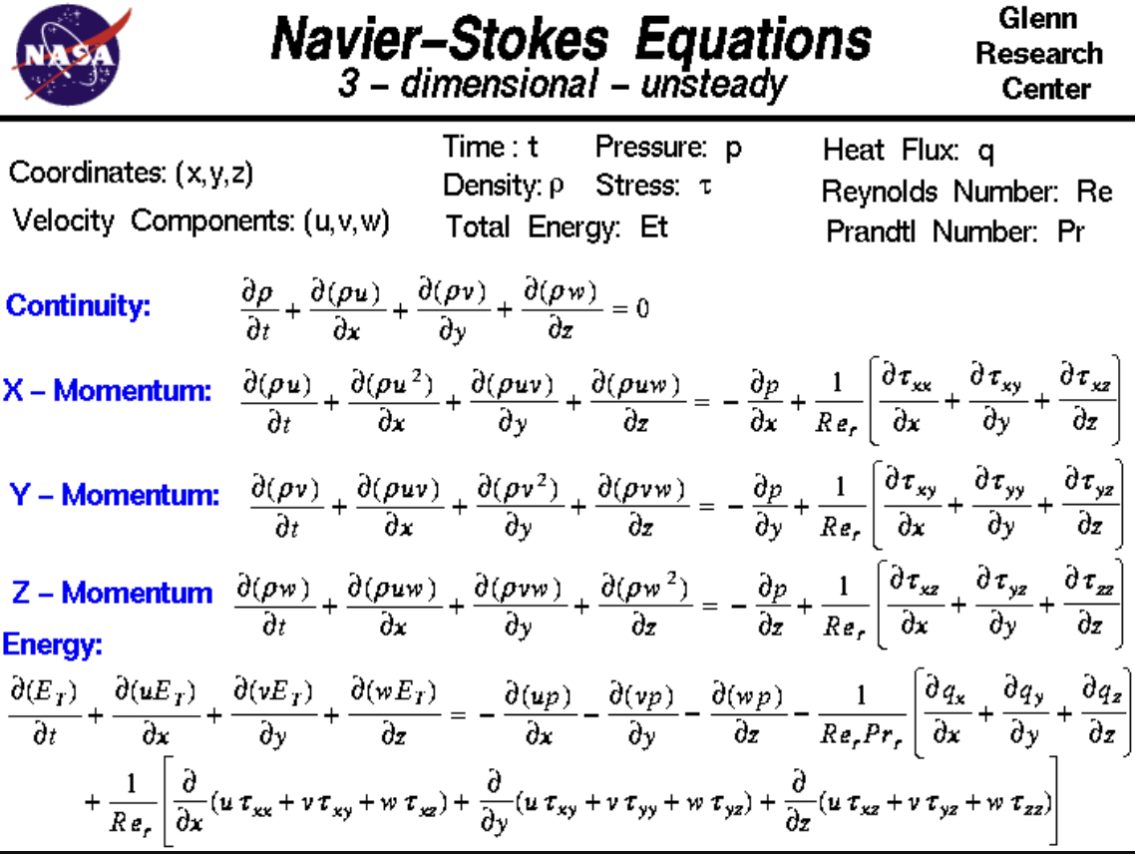
Classical Fluid Simulation is Complex
The Navier-Stokes Equations are PDEs that describe the molecular physics of fluid simulations
Adapted to a huge variety of application problems
Can be coupled with other expressions to model more complex multi-physics behavior
[4]

Slide 6
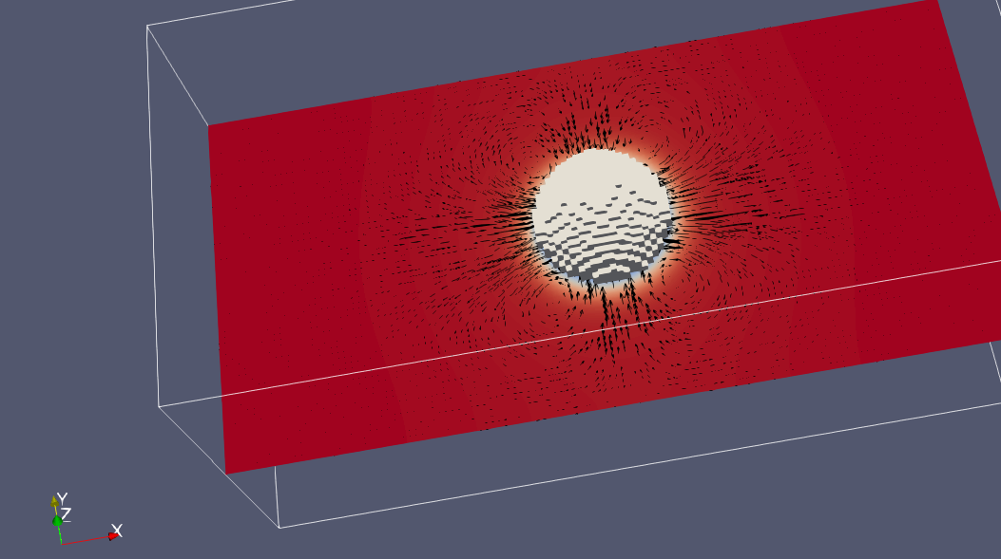
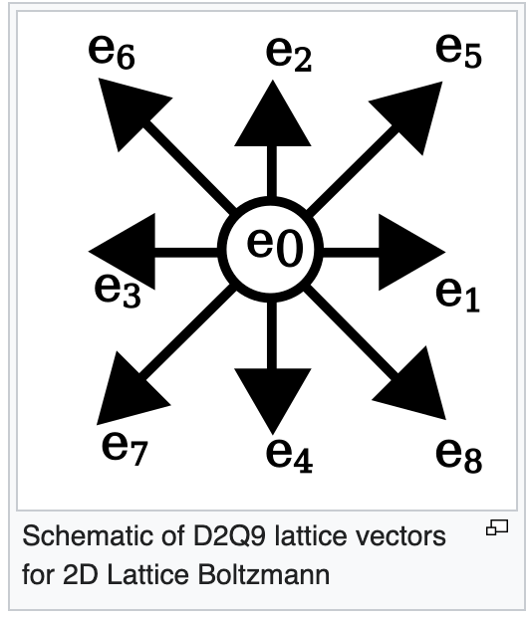
Lattice-Boltzmann Method
Instead of modeling the position for each molecule at each moment in time, we can:
Discretize our domain into “mesoscopic” nodes that model the approximate microscopic molecular interactions
The nodes then “collide” and “stream” information to each other
[5]

Slide 7
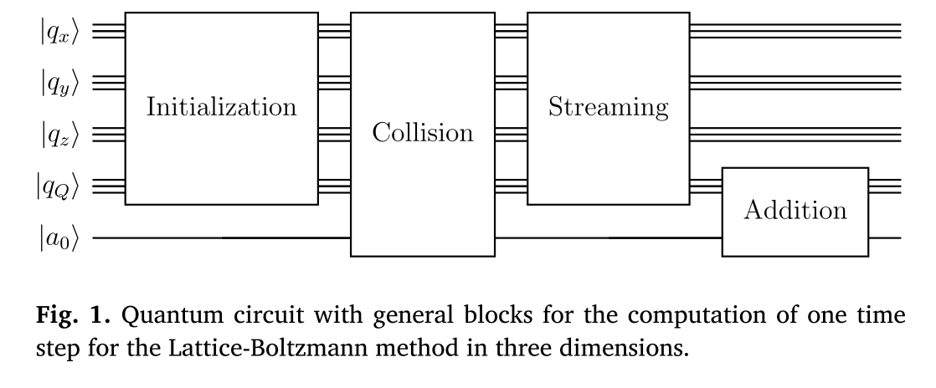
Quantum Lattice-Boltzmann Method
Fluid properties can be encoded in the amplitudes of the quantum states and initial conditions transform into a quantum state vector
The QLBM algorithm can then be broken down into four steps that evolve the system:
Encoding
Collide
Stream
Calculate macroscopic variables

Slide 8
QLBM Issues
Issues with the hardware:
To effectively simulate these systems, we need 100s or 1000s of lattice sites (qubits)
Must be reasonably error-free / fault-tolerant
Requires lots of shots
Therefore, QLBM becomes difficult to deploy on real quantum hardware

Slide 9
VQA & GQE
Variational Quantum Algorithms (VQAs) utilize classical processing to optimize an encoded problem
Several issues with scaling to large problem sizes
Quantum Informed Machine Learning (QIML) techniques take a similar approach, but utilize classical ML with cost functions that tailor the optimization:
Generative Quantum Eigensolvers^{[6]} (GQEs) utilize Generative Pre-trained Transformers (GPTs) to determine the entire circuit structure

Slide 10
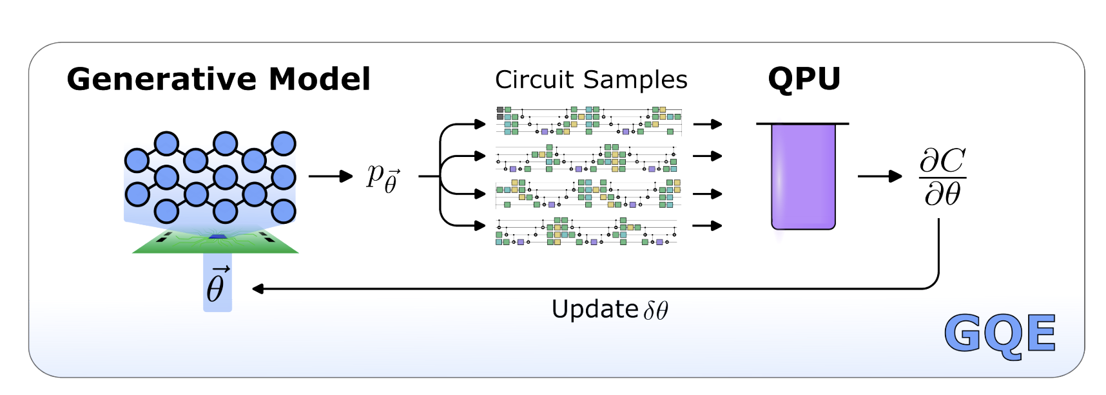
GQE circuit generation
GQE utilizes a transformer similarly to LLMs by employing a “dictionary” of “words” (A set of quantum gates)
This circuit is then processed on the QPU and evaluated with a cost function that is then fed back into the transformer model
[6]

Slide 11

Distributed Quantum Computing
Distributed Quantum architecture combines different qubit technologies into a heterogeneous QPU structure
Quantum compilation^{[7]} becomes more complex as you begin to leverage inter-QPU communication costs with error rates on hardware with different qubit counts and tradeoffs

Slide 12
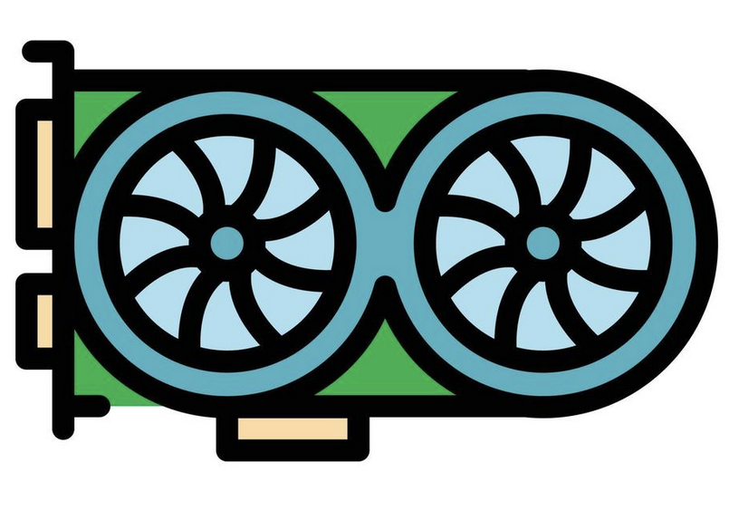
An optimized Distributed Quantum System
There is lots of interest in placing the GPU at the center of the DQC to accelerate any classical processing
This structure is an excellent candidate for quantum algorithms that would otherwise be infeasible to scale to real hardware
[8]

Slide 13
GQE-inspired QLBM deployed on DQC
In hopes to outpace a classical LBM solution, we could pair GQE with a QLBM implementation and seek to deploy onto a heterogeneous DQC
We can leverage CUDA-Q parallelization to obtain drastic speedup compared to a CPU
GPT-inspired circuit optimization
[5]

Slide 14
Sources
[1] David Wawrzyniak, Josef Winter, Steffen Schmidt, Thomas Indinger, Christian F. JanSen Uwe Schramm and Nikolaus A. Adams. A quantum algorithm for the lattic-Boltzmann method advection-diffusion equation, In: Computer Physics Communications 306 (2025) 109373.
[2] Solving Multiphysics with quantum computers. https://medium.com/qiskit/solving-multiphysics-with-quantum-computers-6307017b2cc5
[3] https://www.comsol.com/support/learning-center
[4] https://www1.grc.nasa.gov/beginners-guide-to-aeronautics/navier-strokes-equation/
[5] https://en.wikipedia.org/wiki/Lattice_Boltzmann_methods
[6] Kouhei Nakaji, Lasse Bjorn Kristensen, Ryota Kemmoku, et. al. The generative quantum eigensolver (GQE) and its application for ground state search, ArXiv 2025.
[7] Ruilin Zhou, Jinglei Cheng, Yuhang Gan, Junyu Liu and Chen Qian. Optimizing Compilation for Distributed Quantum Computing via Clustering and Annealing
[8] https://www.vecteezy.com/vector-art/15663056-gpu-graphic-card-icon-color-outline-vector

