Slide 1
Cutting circuits with multiple two-qubit unitaries By: L. Schmitt, C. Piveteau & D. Sutter
Presentation by:
Will Buziak Department of Computer Science Colorado School of Mines

Slide 2
Background
To make real-world use of quantum algorithms, we need to address two main issues with quantum hardware:
Scaling
Fault-tolerance
Both issues are related to circuit depth, entangling gates & specific device constraints
Goal: Use classical processing with a small quantum computer to efficiently simulate a larger quantum circuit

Slide 3
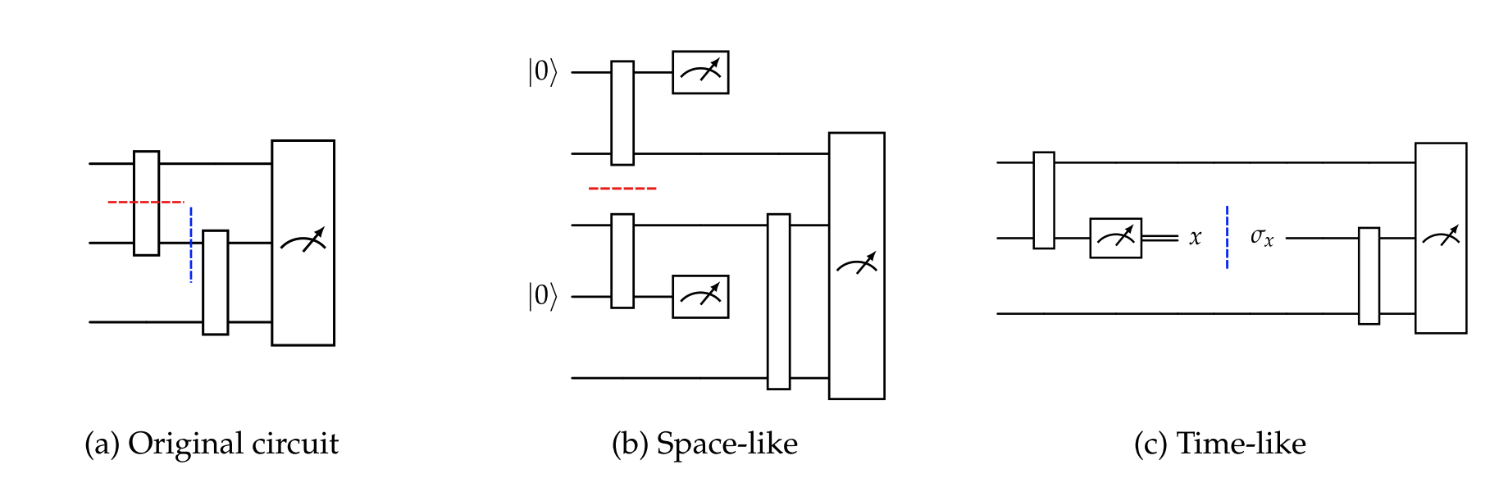
Circuit cutting
We can break our circuit into sub-circuits with a circuit cut (knitting)
Two main types:
Space-like (gate): Substitute an entangling unitary with single-qubit gates
Time-like (wire): A qubit register is measured and local operations are inserted
[2]

Slide 4
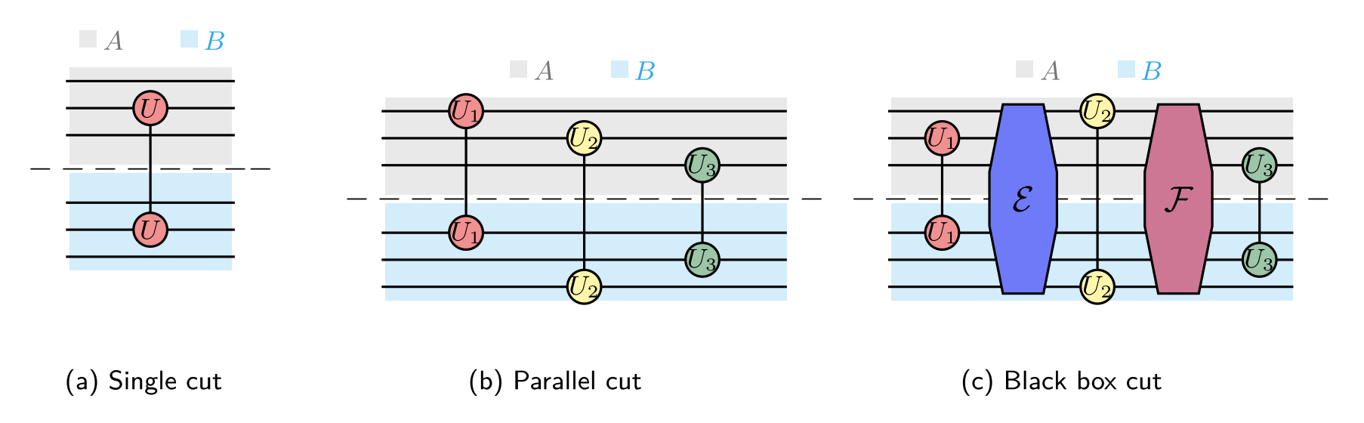
Circuit classification
After a cut, we reconstruct the expectation value with classical post-processing
The extent of the post-processing step is dependent on the desired accuracy relative to the original circuit
Gate cutting is a form of unitary decomposition
[1]

Slide 5
Optimal cuts
Finding the optimal cut is still an open research topic
Complicated interleaving gates can be non-trivial to schedule and replace
Guarantees & proofs explored in this paper are all case-dependent
Necessitates a robust compilation technique that factors device topology with circuit characteristics
[1]

Slide 6
Unitary decomposition
We replace an entangling unitary with a string of single qubit gates
Often the pauli rotation gates (this paper argues pauli basis is not ideal)
Many decomposition methods:
LCU
Quasi-Probability
KAK

Slide 7
Unitary decomposition
We replace an entangling unitary with a string of single qubit gates
Often the pauli rotation gates (this paper argues pauli basis is not ideal)
Many decomposition methods:
LCU
Quasi-Probability
KAK
Pauli gates
Unitary
M = .12XY + .34YZ
coefficients

Slide 8
Quasi-Probability Decomposition
A QPD* is a Monte Carlo simulation that probabilistically replaces non-local gates with local operations:
Each shot samples a probability distribution and indexes a set of allowable gates
After repeating this calculation and accumulating the results, we can reconstruct the original circuit expectation value from each sub-circuit
This demands an additional sampling overhead that scales exponentially with number of cuts
* Reference [1] equation 9

Slide 9
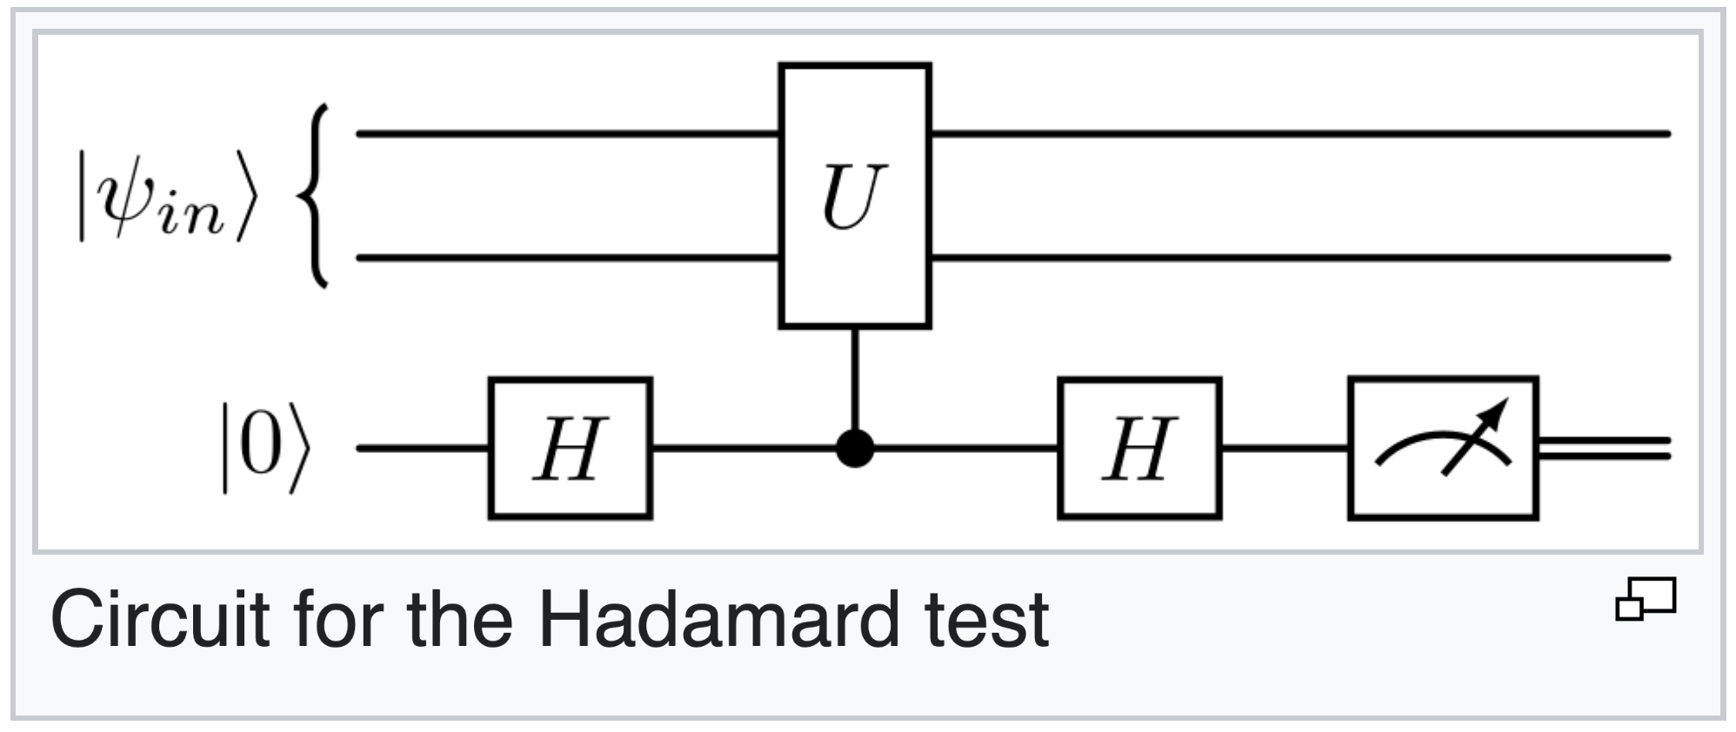
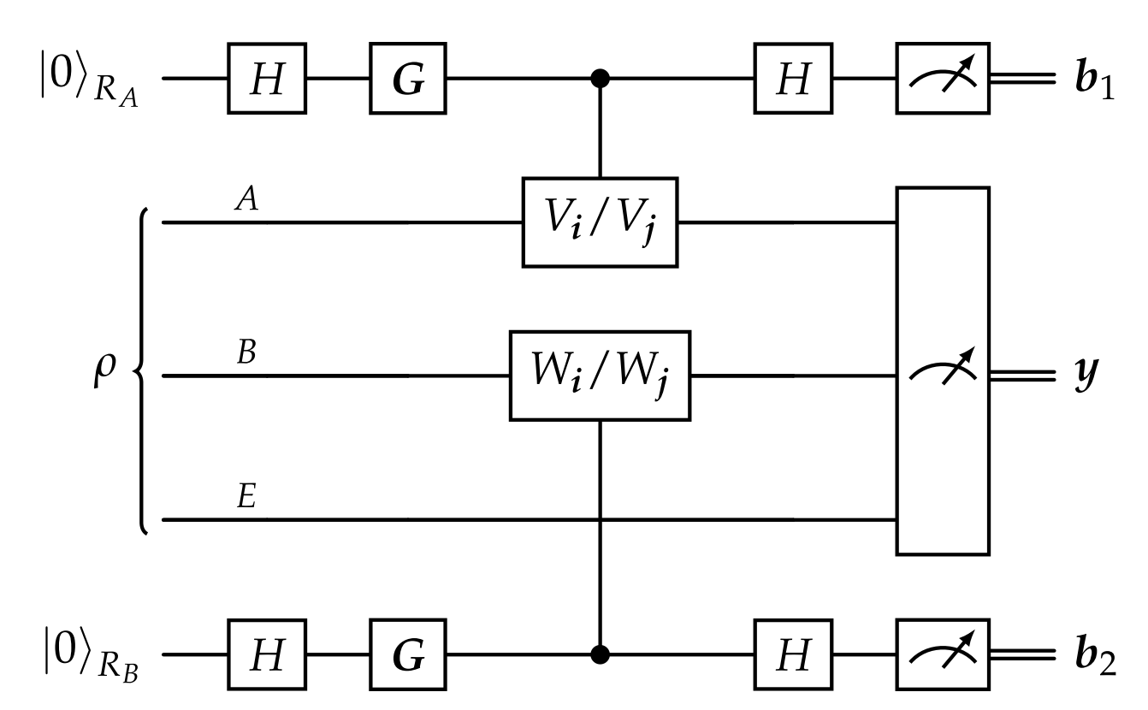
Hadamard Test
Hadamard Test:
A random controlled unitary is entangled with an ancilla qubit in superposition
We are able to construct an expectation value
Double Hadamard Test^{[2]}:
An additional ancilla is used in to test a circuit cut
Reconstruct the expectation value of a circuit cut on an arbitrary two-qubit unitary
[3]
[2]

Slide 10
Takeaways
We can simulate a large quantum circuit by executing small sub-circuits on real quantum devices
The cost of circuit cutting is a sampling overhead that grows exponentially with the number of cuts
Cutting an arbitrary number of two-qubit unitaries in parallel is cheaper than doing so individually

Slide 11
Discussion
How are quantum channels included mathematically?
Channels introduce a phase shift
Why is QPD so widely used / cited?
Intuition behind Lie algebra – is this important to internalize?
Simple?
Semi-simple?!

Slide 12
Sources
[1] Cutting circuits with multiple two-qubit unitaries. L. Schmitt, C. Piveteau, and D. Sutter in Quantum February 08, 2025.
[2] Optimal quantum circuit cuts with application to clustered hamiltonian simulation. A. Harrow and A. Lowe in ArXiv December 17, 2024.
[3] https://en.wikipedia.org/wiki/Hadamard_test

