Slide 1
An Efficient, Configurable Secure Memory Implementation
Presentation By:
Will Buziak Department of Computer Science Colorado School of Mines
February, 2026

Slide 2
Content
Background & Motivation .............................................................3-4
Trusted Execution Environments ...................................................5-7
Secure Memory .............................................................................8-12
gem5 ............................................................................................13-25

Slide 3
Background
Motivated attackers can employ many tactics to corrupt or steal data, this work focuses on preventing:
A malicious OS, application or thread
Replay or side-channel attacks targeting off-chip peripherals
Trusted Execution Environments (TEEs) provide hardware guarantees that attempt to secure the integrity of the processor
Secure Memory methods protect against off-chip tampering by encrypting and storing metadata securely on-chip

Slide 4
Motivation
TEEs provide confidence against malicious applications attempting to tamper with data
Still vulnerable to replay attacks and off-chip tampering
Secure Memory can mitigate these concerns by adding another layer of protection for off-chip devices
RISC-V TEEs (e. g. Keystone^{[1]}) provides an open-source, configurable platform for developing TEEs to specific applications
Goal: Leverage TEE architecture to implement efficient secure memory

Slide 5
Trusted Execution Environments
A TEE implements different privelege modes with separate address spaces, enforcing a set of rules dictating which components can access what regions of memory:
User mode, Supervisor mode, Machine mode
Almost all major CPU vendors have their own flavor of TEE:
Intel SGX/TDX
ARM Confidential Computer Architecture
AMD SEV
These implementations leverage proprietary hardware, opening the door for a configurable & open-source TEE, keystone^{[1]}

Slide 6
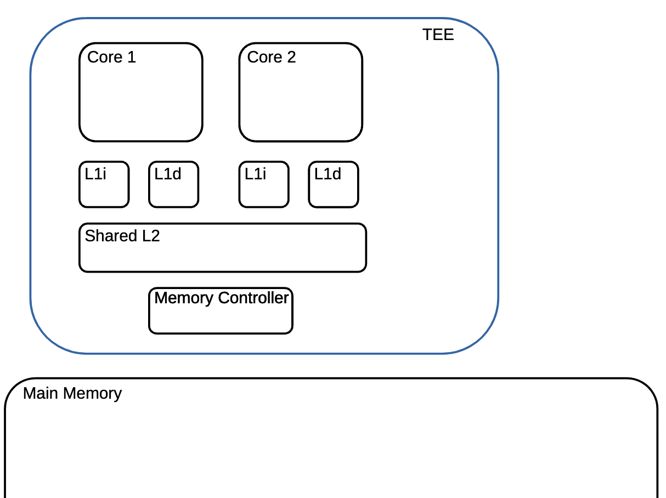
Trusted Execution Environments
TEEs protect the processor:
Attempts to avoid malicious activity from the application
Still vulnerable to side-channel & replay attacks
Application mode is checked on memory request:
Memory regions are assigned to modes with permissions
A region in which the mode does not have access is denied
PMP

Slide 7
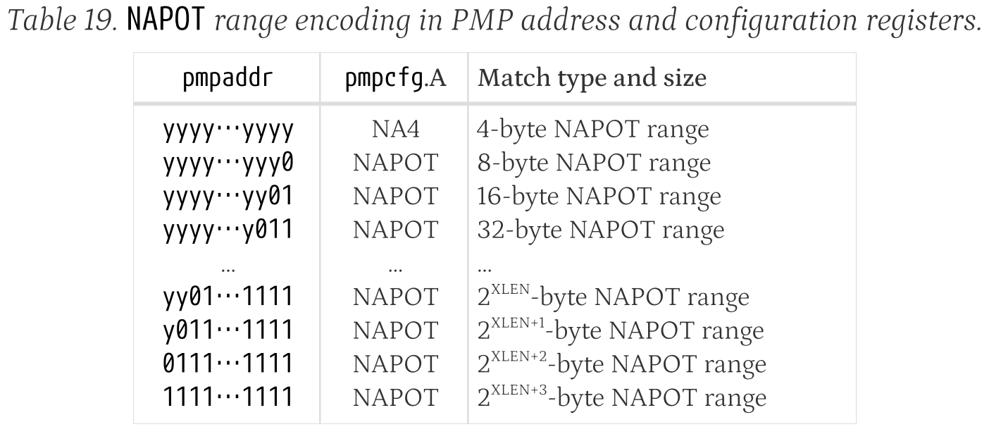
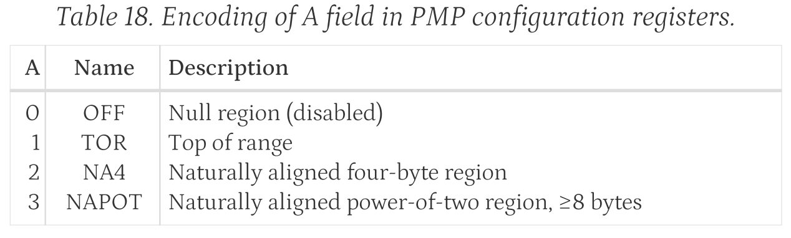
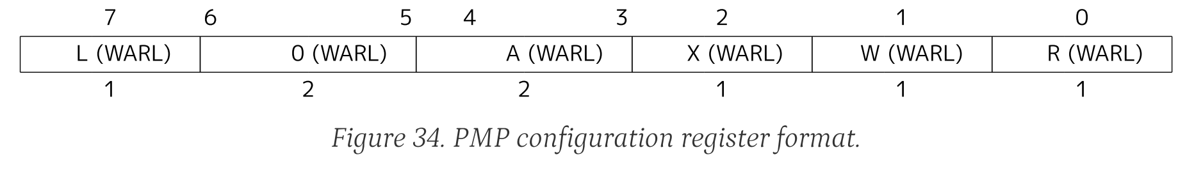
Physical Memory Protection
Each core has a PMP table:
Stores the address range along with the pmpCfg
pmpCfg determines:
Permissions, address matching, & locking with space for extra bits
PMP checks walk the table & match the request address with each stored entries A field & respective address

Slide 8
Secure Memory
Base Assumption: off-chip data is untrusted & requires verification
Secure memory protects data / memory devices
Builds a hash ( merkle^{[2]}) tree, the root of which is always stored on-chip
Built over data & metadata
Nodes can be stored in a metadata cache to reduce fetch latency
root
hmac
hmac
hmac
hmac
hmac
data
data
data
data
data

Slide 9
Counter-Mode based Encryption
HMACs are produced through the xor of a one-time pad & the plaintext:
One-time pad is generated with a hardware key and a write-incremented counter
Tree must be re-hashed when counters overflow
Counter incrementing methods reduce the frequency of rehashing the tree
seed
AES
HW key
One-time pad
XOR
plaintext
cipher text

Slide 10
Secure Memory
Process: Off-chip data is signed with a counter, cryptographically hashed and stored in a merkle tree
Memory blocks are fetched, hashed and compared against each successive parent node from the data leaves up to the secure root
SOC
Metadata-Cache
hmac
hmac
hmac
hmac
hmac
data
data
data
data
data

Slide 11
Secure Memory
Process: Off-chip data is signed with a counter, cryptographically hashed and stored in a merkle tree
Memory blocks are fetched, hashed and compared against each successive parent node from the data leaves up to the secure root
This incurs peripheral node fetch latencies
SOC
Metadata-Cache
hmac
hmac
hmac
hmac
hmac
data
data
data
data
data

Slide 12
Counter-Mode based Encryption
Hashing:
Generating the one-time pad
Refers to the mac
mac_queue
Encryption:
Masking the plaintext with the one-time pad
Refers to the encryption or cipher
cipher_queue, xor_queue
HMAC is the final cipher text
Counter goes here
seed
AES
HW key
One-time pad
HMAC
XOR
plaintext
cipher text
Data (can be counter)

Slide 13
Secure Memory
Bonsai merkle trees^{[3]} are built solely over the counters:
Reduces metadata storage requirements
Each node can protect a larger block of memory
SOC
Metadata-Cache
hmac
hmac
hmac
hmac
hmac
cntr
cntr
cntr
cntr
cntr

Slide 14
gem5
gem5 supports RISC-V & multi-core simulation
Keystone including PMP tables & checker implementations
Memory encryption engine
Secure memory implementation
Developer space is divided into different scopes
User Space
Config Files
Program Binary
Hardware Description
Python Wrapper
cpp Implementation

Slide 15
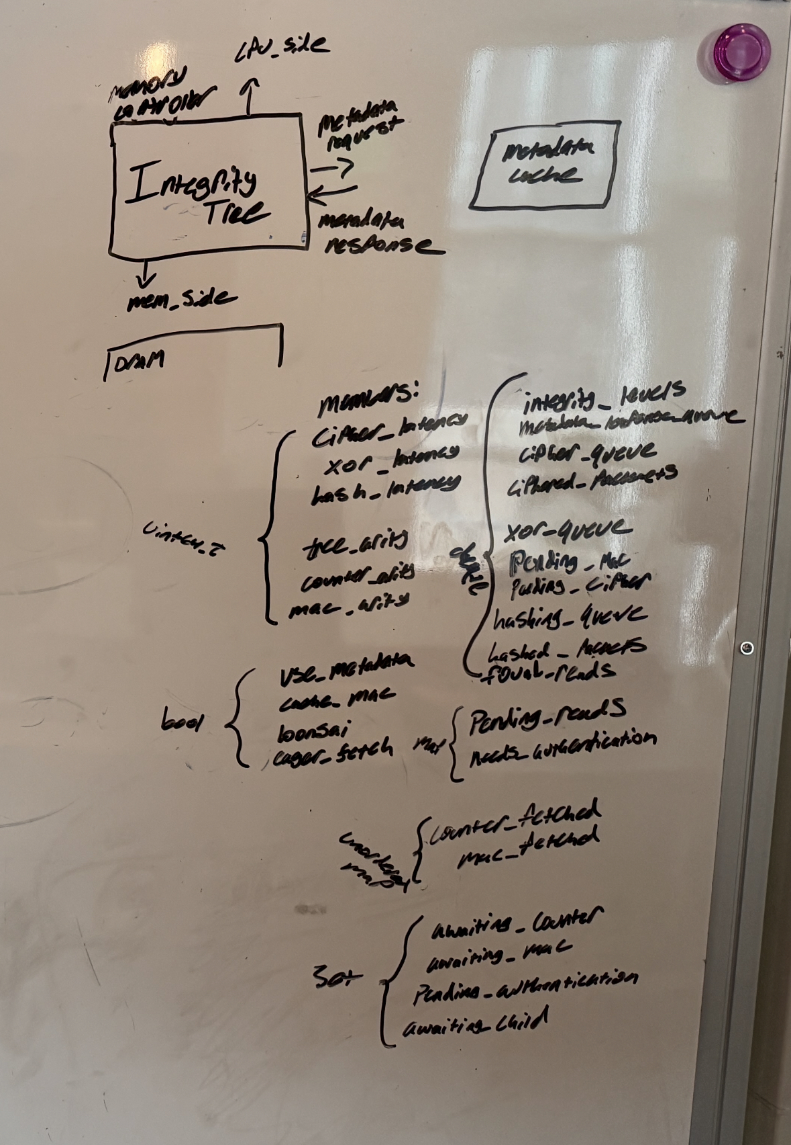
gem5 eventQueue
The eventQueue is how gem5 schedules processes to enable multi-core simulation
Most member functions operate shared queues instead of directly calling one another
eventWrappers are scheduled instead
Events are scheduled with latencies:
i.e. things like computing the cipher arent actually done, but scheduled & the latency is modeled

Slide 16
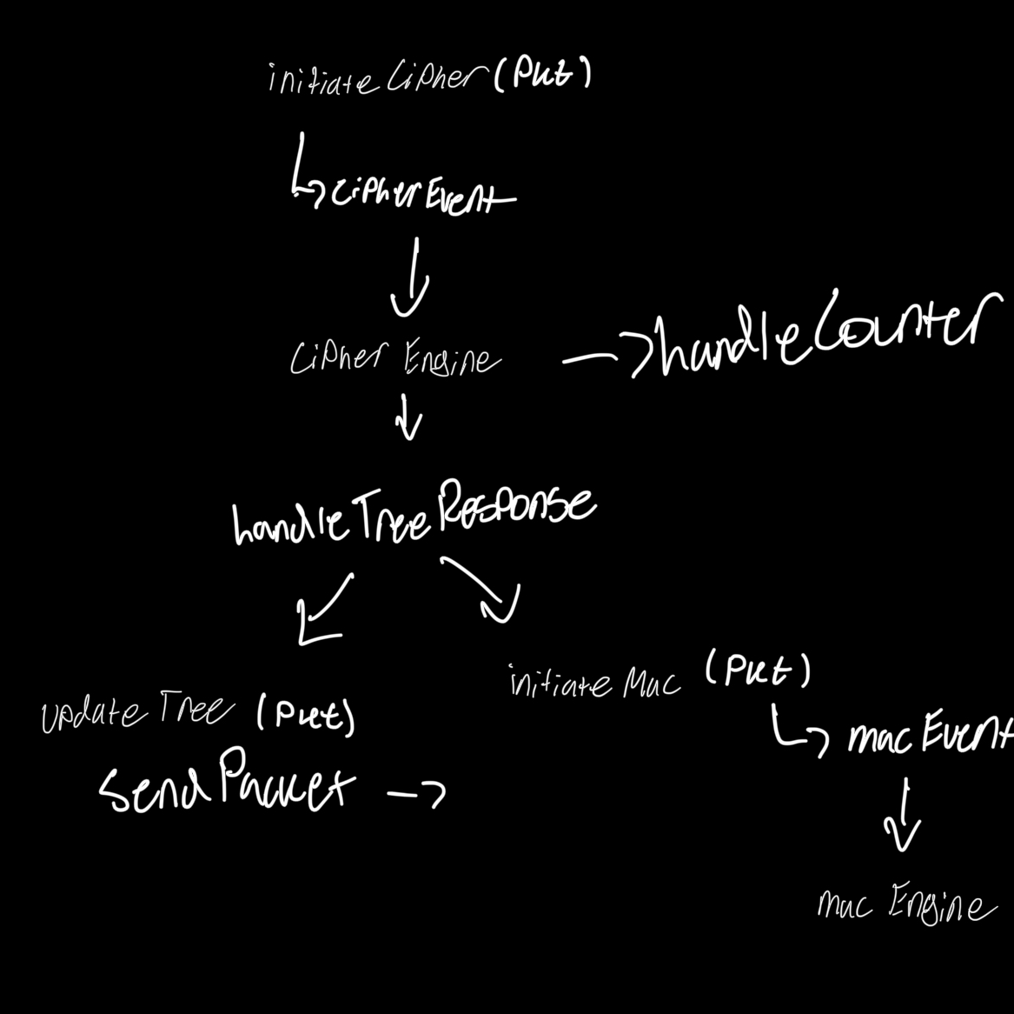
initiateMac & initiateCipher
Prepare the pkt for hashing:
Assigns pkt with a time signature & inserting into the hashing_queue / cipher_queue
Schedules a mac/cipher event for the eventQueue to trigger the mac/cipher engine
initiateCipher must also account for counter vs data mac pkts:
Control flow to insert into separate queues and handled by cipherEngine

Slide 17
macEngine & cipherEngine
Process one pkt from respective queue & schedule the next:
Calls handleTreeResponse / handleCounterResponse
- These in turn can call initiateCipher/Mac on the child
Calls updateTree and responds to the processor

Slide 18
updateTree
Creates packets for counters, mac & parent:
Sends nodes to memory & metadata cache
Data has been encrypted & hashes computed, all stored in the pkt
calculateAddress functions operate on the packet to return the desired address
cntr
cntr
cntr
cntr
cntr

Slide 19
handleRequest
Prepare counter & mac for the pkt
Place into queues for authentication
Send to memory / metadata cache
This starts the recursive hashing / authentication
Writes are just placed in a queue

Slide 20
handleResponse
Decryption & authentication of responses from memory requests
Handle functions prepare pkts by checking, popping and placing into queues
Uses other functions to actually schedule
The important / complex thing to consider in all scenarios is the coontext of control flow
Debugging, development & code reading

Slide 21
Port functions
Functions like sendPacket & recvRespRetry manage blocked packets in a similar manner:
Pop / push pkts onto a blocked_packets & pending_* queues
Calls handle functions
Important to consider the scope of the call (mem_side vs cpu_side)

Slide 22
handleCounterResponse
Check for data waiting on the counter:
Send for encryption / decryption
If pkt is a write, compute the MAC

Slide 23
handleMacResponse
Check for returned data waiting on a counter
Push onto pending_mac queue

Slide 24
handleTreeResponse
Handles the recursive authentication of the integrity tree
Parent and all children nodes are authenticated
Authenticates metadata & sends to metadata cache
Mostly removes eligible pkts from needs_authentication queue

Slide 25
handleMetadataCacheMiss
Adds pkt to authentication queue
Checks for eager fetch and sends parent pkt to metadata cache
Must be metadata

Slide 26
Conclusion
Everything is stored and processed through the pkt
The eventQueue schedules processes
Functions operate on shared queues in order to service pending pkts
The state of the system is the important thing to debug as problems arise and implementations progress

Slide 27
Sources
[1] Dayeol Lee (2022) Building Trusted Execution Environments. In: A dissertation submitted in partial satisfaction of the requirements for the degree of Doctor of Philosophy in Computer Science in the Graduate Division of the University of California, Berkeley.
[2] Chenyu Yan, Brian Rogers, Daniel Englender, et. al. (2006) Improving Cost, Performance, and Security of Memory Encryption and Authentication. In: Proceedings of the 33rd International Symposium on Computer Architecture (ISCA’06)
[3] Brian Rogers & Milos Prvulovic (2007) Using address independent seed encryption and bonsai merkle trees to make secure processors OS-and performance-friendly. In: 40th IEEE/ACM International Symposium on Microarchitecture (MICRO’07)
[4] Zach Moolman & Tamara Silbergleit Lehman (2024) Extending RISC-V Keystone to Include Efficient Secure Memory
[5] The RISC-V Instruction Set Manual: Volume II Privileged Architecture. Version 20240411
[6] Samuel Thomas (2025) Towards A Practical Secure Memory for Practical Development

Slide 28
Where does Secure Memory fit in?
Secure memory methods protect SoCs against off-chip memory corruption by additionally:
Encrypting / Decrypting protected memory
Storing and checking an integrity tree to verify data
These checks result in latencies both in encryption and memory
Potentially Malicious
Application Thread
Operating System
Remote or Cloud User
RISC-V Keystone
Secure Memory
Storage
Chenyu Yan, Brian Rogers, Daniel Englender, et al. (2006) Improving Cost, Performance, and Security of Memory Encryption and Authentication. (ISCA’06)

Slide 29
Secure Memory Incurs Latency
An integrity tree, or Merkle tree, is simply a hash tree
Each parent is the hash of its children
Root is kept on-chip
On a memory fetch, the core must additionally:
Check that the data hash matches a leaf and the parent has not been tampered with
Recursively check each node up to the root
RISC-V Keystone
Secure Memory
hash
hash
hash
hash
hash
data
data
data
data
data
Chenyu Yan, Brian Rogers, Daniel Englender, et al. (2006) Improving Cost, Performance, and Security of Memory Encryption and Authentication. (ISCA’06)

Slide 30
Secure Memory Incurs Latency
An integrity tree, or Merkle tree, is simply a hash tree
Each parent is the hash of its children
Root is kept on-chip
On a memory fetch, the core must additionally:
Check that the data hash matches a leaf and the parent has not been tampered with
Recursively check each node up to the root
RISC-V Keystone
Secure Memory
hash
hash
hash
hash
hash
data
data
data
data
data
Chenyu Yan, Brian Rogers, Daniel Englender, et al. (2006) Improving Cost, Performance, and Security of Memory Encryption and Authentication. (ISCA’06)

Slide 31
Secure Memory Incurs Latency
An integrity tree, or Merkle tree, is simply a hash tree
Each parent is the hash of its children
Root is kept on-chip
On a memory fetch, the core must additionally:
Check that the data hash matches a leaf and the parent has not been tampered with
Recursively check each node up to the root
RISC-V Keystone
Secure Memory
hash
hash
hash
hash
hash
data
data
data
data
data
Chenyu Yan, Brian Rogers, Daniel Englender, et al. (2006) Improving Cost, Performance, and Security of Memory Encryption and Authentication. (ISCA’06)

Slide 32
Keystone Memory Isolation
On boot, the Security Monitor (SM) sets up a component called the Physical Memory Protections (PMP) Table:
Divides memory and assigns to modes
Resides in each core
If a memory request from an application does not have access, it is denied
Potentially Malicious
Application Thread
Operating System
Remote or Cloud User
RISC-V Keystone
PMP
DRAM
Dayeol Lee, David Kohlbrenner, Shweta Shinde, Krste Asanovic, and Dawn Song, Keystone: An Open Framework for Architecting Trusted Execution Environments, EuroSys 2020.

Slide 33
Extending Keystone to include Efficient Secure Memory
To mitigate latency concerns, our work proposes to store metadata on-chip, greatly reducing memory access overhead
This structure is called the Aggregated Extended PMP (ePMP) table:
Tracks requests through the Memory Encryption Engine (MEE)
Updates metadata entries corresponding to their PMP status
RISC-V Keystone
Memory Encryption Engine
ePMP
DRAM
Zach Moolman & Tamara Silbergleit Lehman, Extending RISC-V Keystone to Include Efficient Secure Memory CARRV 2024

Slide 34
Extending Keystone to include Efficient Secure Memory
To mitigate latency concerns, our work proposes to store metadata on-chip, greatly reducing memory access overhead
This structure is called the Aggregated Extended PMP (ePMP) table:
Tracks requests through the Memory Encryption Engine (MEE)
Updates metadata entries corresponding to their PMP status
SoC
CPU
RISC-V Keystone
Memory Encryption Engine
ePMP
DRAM
Zach Moolman & Tamara Silbergleit Lehman, Extending RISC-V Keystone to Include Efficient Secure Memory CARRV 2024

Slide 35
The gem5 Simulation Suite
gem5 is an open-source, cycle-accurate architecture emulation platform
Allows end-to-end development including full-system simulation & benchmarks
Breaks hardware description into different layers, enabling researchers to edit any aspect of an implementation
This is helpful, but also results in a colossal codebase
User Space
Config Files
Program Binary
Hardware Description
Python Wrapper
cpp Implementation
Jason Lowe-Power, Abdul Mutaal Ahmad, Ayaz Akram, Mohammad Alian, et al. (2007), The gem5 Simulator: Version 20.0+ (arXiv)

Slide 36
Challenges with gem5
This work requires the use of gem5 full-system emulation, while many aspects of gem5 enable research, some also hinder progress
Scattered source files
Lots of detail, making high-level understanding non-trivial
FS requires gem5 resources and pre-compiled binaries
gem5 Pre-compiled Resources
Boot-loader
Linux Kernel
Disk Image

Slide 37
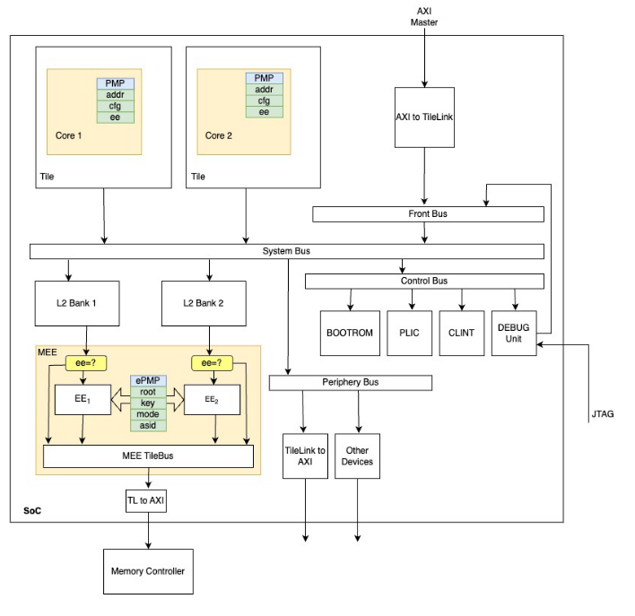
Direction / Future Work
Implementing a RISC-V TEE in gem5:
Currently adding cache hierarchy
Incorporating caches into secure memory through “board” hierarchy
Entirely different way of connecting things
PMP is included in any RISCV cpu in gem5
What is my contribution?
Until now, I have been just trying to implement Zach’s work in gem5
Deeper understanding of attack methods (winter break project?)
Moolman, Z. & Lehman T.

Slide 38
Gap & Contribution
A Midsummer Nights Tree (AMNT) by Sam Thomas
Crash consistent secure memory protocol by defining write-back protocols that sync the on-chip BMT root & stored leaf counters in off-chip memory

Slide 39
Limitations
Computational and memory overhead

Slide 40
PMP Sensitivity Analysis
How does a variable PMP size affect performance
Efficient PMP packing:
Currently, gem5 implements Naturally Aligned Power of Two (NAPOT) packing, which requires the base address to be aligned by a power of two.

Slide 41
gem5 Simple Sanity Check
Base gem5 vs. Secure Memory implementation (version 24.0.0.1)
Benchmark:
1,000 accesses on 1GB array of memory
No caches
Secure memory implementation requires an increase in both runtime and memory overhead
 | Simulated Time (Seconds) | Host Memory (MB) | Number of Instructions (thousands)
Base gem5 | .00388 | 1.18 | 55,966
Secure gem5 | .014 | 3.43 | 55,966

Slide 42
gem5 Cache Sanity Check
Cache
Simulated Time (seconds)
Host Memory (MB)
Number of Instructions
Base gem5
False
.003880
1.18
55,966
True
.000069
1.18
55,966
Secure gem5
False
.014
3.43
55,966
True
.000531
3.44
55,966

