Slide 1
ASP.NET Core MVC

Slide 2
Agenda
Introduction
What’s new
Dive into MVC
Minor other improvements
dotnet CLI

Slide 3
.NET Framework
4.7 (Windows 10 Creators Update)
>10 years
For all of your current Windows and Web projects
Notes:
The .NET framework exists for over 10 years now, all the way up from version 1.0 until 4.7, which has just been release together with Windows 10 Creators Update. This is the framework we all know, with which we can create a variety of applications: Windows Forms, WCF services, Console apps, MVC, Web API, ...

Slide 4
.NET Core
Small and modular
Cross-platform
App-level isolation
Open source
Notes:
.NET Core has been written from scratch and has been made leaner to reduce its footprint. And because its modularity (no humongous mscorlib.dll), your application will only have the part of .NET Core it actually uses instead of the full framework.
This also means that you can deploy an application with its own copy of .NET Core, making it a truly isolated application. You’ll no longer need to rely on system administrators to make sure they’ve deployed the correct version of the .NET Framework on the server.

Slide 5
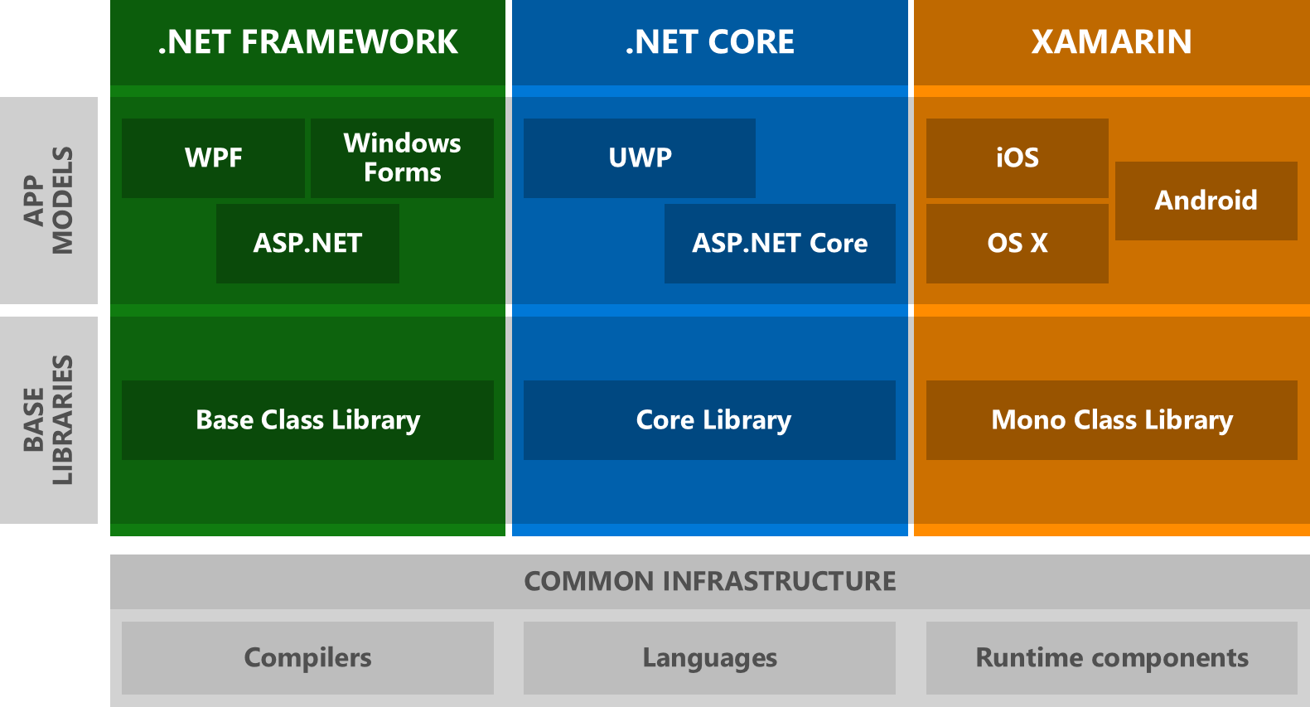
Notes:
Why the need for .NET Standard?
Different implementations of .NET and libraries: Compact Framework, Full framework, Core, UWP, Xamarin, Mono, Unity, ... This is good for diversity, but bad for maintenance, security updates, ...

Slide 6
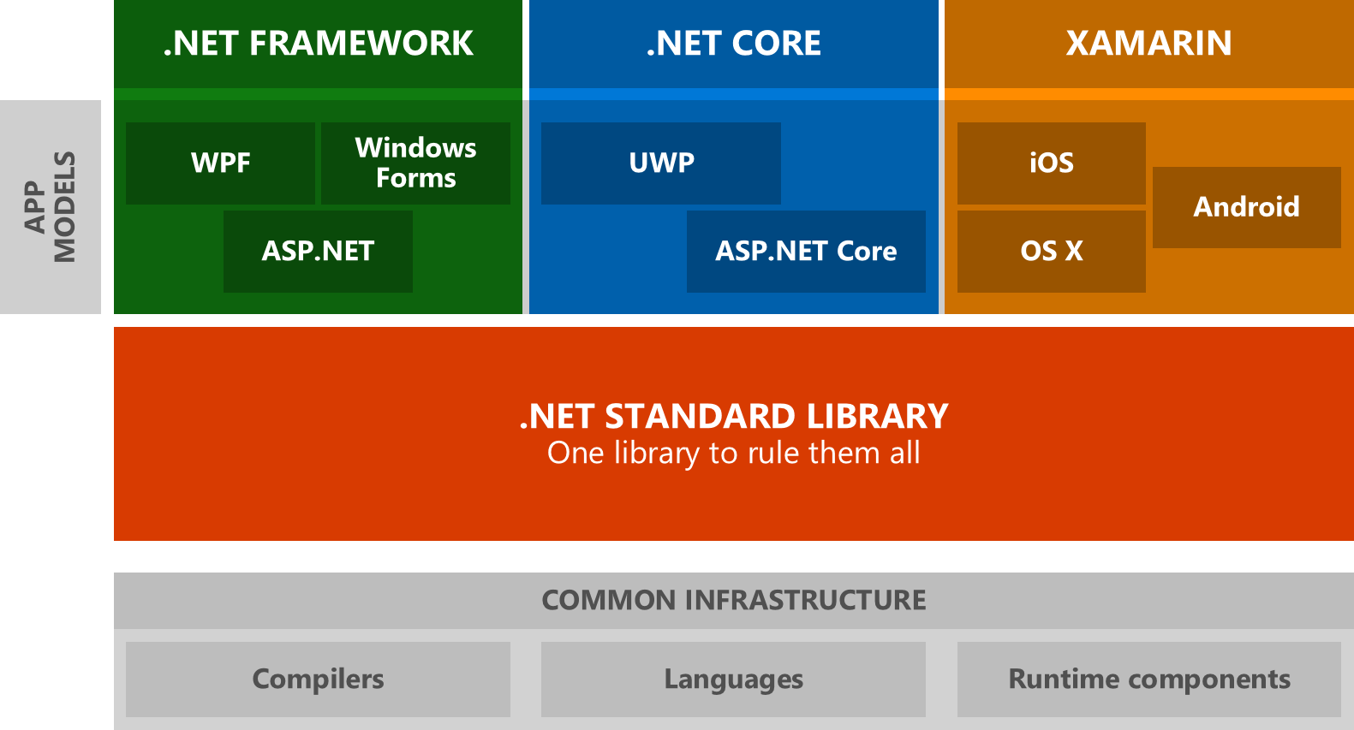
Notes:
Enter .NET Standard, a combined set of APIs which you as a developer can target in all situations. Instead of having to learn the BCL, Core library and Mono library, you can now focus on the .NET Standard instead.

Slide 7
.NET Standard
Set of APIs that all .NET platforms must implement.
https://github.com/dotnet/standard/blob/master/docs/versions.md
Notes:
So: .NET Standard is born: a set of APIs that all .NET platforms must implement. Because there are a lot of possible target framework monikers (netcoreapp1.1, net462, portable-net45+win8, ..., typically seen in nuget packages), it was preferred to have a better way to define common concepts, especially when creating shared components and libraries. Now, you can target netstandard1.5 for example, which makes it a lot easier to target a variety of platforms and toolsets in one go.

Slide 8
ASP.NET Core 1.0
Used to be ASP.NET 5
But ASP.NET 4.6 is more complete
ASP.NET Core 1.0 is (still) missing SignalR, Web Pages and VB / F# support
VB support announced in v2.0, SignalR for v2.1
Similarly: Entity Framework 7 => EF Core 1.0
Notes:
.NET Core was initially labeled .NET Core 5, together with ASP.NET 5 etc. But this felt wrong, because it wasn’t “larger” than .NET 4.6 or ASP.NET 4.6, but a completely fresh start. It makes more sense to reflect this in restarting the versioning as well, although a lot of concepts will return and be familiar.

Slide 9
ASP.NET Core – What’s new?
Open-source and cross platform framework for building web applications and APIs
No longer dependent on System.Web.dll
NuGet packages
Get what you need. Nothing more, nothing less.
Notes:
So, what’s new in ASP.NET Core for us developer? One of the key points is that ASP.NET is now truly open source: everyone can join in and contribute. Want to find out how something works? Jump in the code and learn, there are no secret parts hidden away in native DLLs any more!
ASP.NET (and .NET Core) is also cross platform, with support for RedHat, Ubuntu, Mint, Debian, Fedora, CentOS, openSUSE and Mac.

Slide 10
ASP.NET Core – What’s new?
Middleware, middleware, middleware!
New configuration system
Dependency injection out of the box
Better support for targeting environments
Notes:
When ASP.NET 4.5.1 was released in 2013, Microsoft also introduced OWIN, which added a more middleware-based approach for writing web applications. ASP.NET Core builds further on this principle, so it’s all middleware now when starting and configuring your web app.
We can also (finally) say goodbye to the XML web.config file, and embrace a whole new configuration system. Fans of XML do not need to worry: you can still use XML files, but you can also use json, environment variables and so on. It’s also a lot easier to create custom option classes to inject into controllers, services, ...
Speaking of, ASP.NET Core also has dependency injection out of the box: you can define singleton, scoped (per HTTP request) and transient (per use) dependencies. You do not need to “register” your controller classes, as ASP.NET Core will automagically use constructor injection for them.
In ASP.NET, we could add extra transform files for web.config for release builds or even other environments, like production/staging. ASP.NET Core leverages the new configuration system to improve this experience. In MVC, we will also see an extra feature concerning the environment where the web app will run.

Slide 11

ASP.NET Core – What’s new for MVC?
Tag helpers
View components
Dependency injection in views
@await in views
Notes:
So, what’s new specifically in ASP.NET Core MVC? Let’s dive into each of these features.
One thing though: in VS2017, please install the Razor Language Services extension in the Tools and Extensions menu item: it will make you developer experience a lot better.

Slide 12
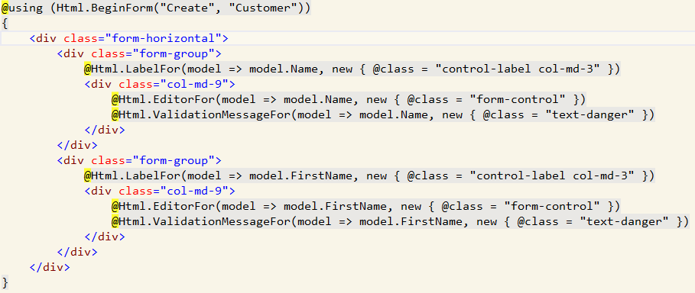
Tag helpers
Notes:
The old way, which still works, using the HtmlHelper methods. While this works, and MVC developers have grown used to doing this, it often resulted in using the wrong overload. New developers on the other hand often forget to add the @ before class (because class is a reserved keyword).
Also, if you compare writing this to an Angular app, you appear to be writing code in an HTML view.

Slide 13
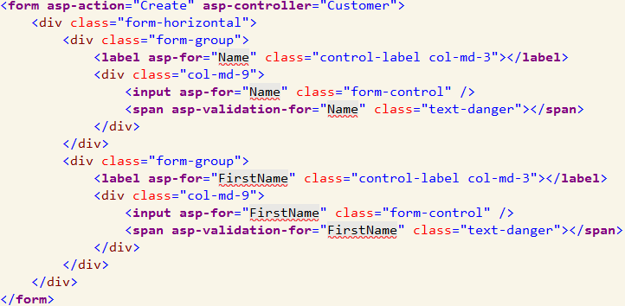
Tag helpers
Notes:
So we get tag helpers, not to be confused with WebForms controls! These are (mostly) normal HTML elements which are enriched with behavior. Consider it to be the ASP.NET Core equivalent of data-* attributes.

Slide 14
Tag helpers
Focus more on markup and less on code in views
@addTagHelper and @removeTagHelper
@tagHelperPrefix
https://docs.microsoft.com/en-us/aspnet/core/mvc/views/working-with-forms
https://docs.microsoft.com/en-us/aspnet/core/mvc/views/tag-helpers/authoring
Notes:
Check the _ViewImports.cshtml file for the default @addTagHelper line. You can create custom tag helpers as well, but remember that you’ll need to register them using @addTagHelper, otherwise they will not work!

Slide 15
View components
Similar to partial views, but more powerful
Can have business logic, like in an Action method
Examples
Dynamic navigation menus
Login panel
Shopping cart

Slide 16
View components
Class
Derive from ViewComponent
Decorated with [ViewComponent] or derivatives
End class name with “ViewComponent”
Supports constructor DI, like the Controller classes
Can’t use filters though
Implement InvokeAsync

Slide 17
View components
Place a Razor view in
Views/Shared/Components/ {View component name} /Default.cshtml
Views/ {Controller name} /Components/ {View component name} /Default.cshtml
You can use another view name as well
Call View(“OtherName”) like in action methods

Slide 18
View components
Calling a view component
@await Component.InvokeAsync(“MyComponent”, new { id = 1 })
<vc:my-component id=“1”></vc:my-component>
return ViewComponent(“PriorityList”, new { id = 1 });

Slide 19
Dependency injection in views
@inject <Type> <Name>
Will also inject other dependencies
@await <Name>.Method()

Slide 20
Dependency injection in views
Please, don’t use this for business logic!
Use it for localization
Use it to retrieve data for populating lists
…

Slide 21
Minor other improvements
CSRF/XSRF
AutoValidateAntiForgeryToken
New CORS middleware (Microsoft.AspNet.Cors)
App.UseCors(b => b.WithOrigins(“http://mysite.com”));
Named policies
https://docs.microsoft.com/en-us/aspnet/core/security/cors

Slide 22
Minor other improvements
New caching capabilities
IMemoryCache
IDistributedCache, optionally backed by Redis
OutputCache => ResponseCache

Slide 23
dotnet CLI
Create, build, run, … .NET Core projects from the command line
dotnet new (-all for a list of templates)
dotnet build
dotnet run

Slide 24
Questions?

