Slide 1

Chaos Engineering for
everyone:
How to add some chaos to .NET
Wesley Cabus
Notes:
Hi there! I’ve been developing software for over 15 years, starting with the .NET Compact Framework on industrial PDAs with barcode scanners, up until .NET Core, in which I’m currently mostly creating APIs for all sorts of applications. After being a consultant for several years, I joined UCB Pharma two years ago as an internal developer. And my name is Wesley Cabus.
But you didn’t come here to learn more about me, you wanted to know more about chaos testing and how to do it inside your applications and services. Let’s see what the plan is for the next 50 minutes:

Slide 2
Agenda
Introduction on Chaos Engineering
Scaling it down
Introducing Ruh Roh
Demo
Notes:
First, I’ll start with an introduction on chaos testing or chaos engineering, just to make sure that everyone at least has a quick reminder on the topic.
Then, after introducing some examples of companies that are actively using Chaos Engineering, I’ll bring it back to the scale of small to medium-sized companies.
Of course, I’ll not only be talking about this topic, but I’ll also introduce an open-source library and show you how you can add chaos engineering in .NET codebases.

Slide 3

Notes:
We all know Netflix. Most of us in here probably even have a subscription. But apart from their marketing strategy and catalog of movies and TV shows, what makes Netflix so popular?
I’m not going to lie here, I have no clue. But I do know that their apps, whether I use them on a Windows PC, on my phone or using their website, almost always work. When they don’t, I can usually get them working again by logging off and on again, the equivalent of “Have you tried turning it off and on again” for a service. The reasons why their apps and services work so well is that they use the cloud to scale everything out and that they regularly apply chaos engineering to their services, even in production!

Slide 4

Notes:
In the case of Netflix, they schedule, for example, an hour where one or more instances of the Login microservice will be impacted by their Chaos Monkey. This is, among many other things, an extra piece of software running on the host of the Login (and other) services, that can cause the CPU to spike to, i.e., 80% load, or that introduces a higher load on the network interface, causing the actual microservice to lag.
By introducing these chaotic events, they can see how much impact a certain load or lag spike has on their infrastructure and their users, long before these events manifest themselves by actual service usage. This helps Netflix to check if their microservices work properly (using the Circuit Breaker pattern for example) and if their infrastructure contains enough nodes to deal with load spikes.
Over time, Netflix added more “monkeys” in their chaos toolset, one specific for adding lag, another to disable systems that have vulnerabilities, to one that brings down an entire availability zone.

Slide 5


Notes:
Another large example is Audible by Amazon. They are also actively using Chaos Engineering to stress test their services and use Gremlin to disrupt services in the same way as Netflix does, by adding CPU load or lag spikes. But Gremlin also offers the capability to inject code in Java, allowing Audible to go even further and create services that misbehave on a completely different level: a service might suddenly start throwing Exceptions for example. This is interesting because using these exceptions, you could simulate running out of memory or disk space.

Slide 6
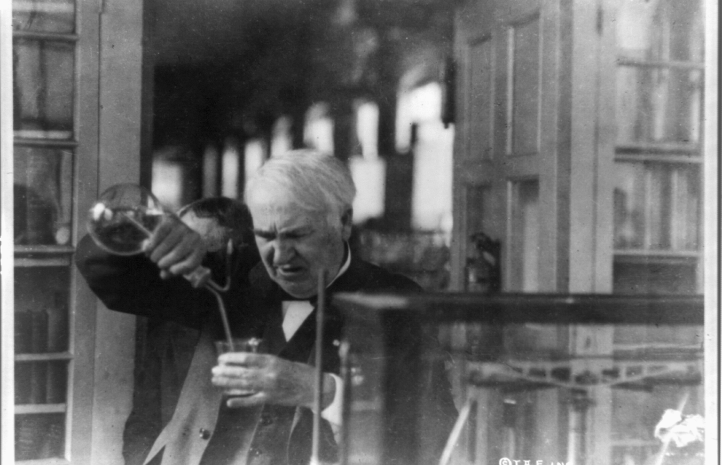
Notes:
Chaos Engineering, in effect, is more about performing experiments on a system, rather than running tests. When you create a test, you define an assumption and the test will verify whether the assumption is true or false. Or, simply put: you know how the system should behave when giving the system some specific data and letting the system go through a defined path in the codebase. And these tests help us tremendously to validate business logic. But when you start experimenting on the same system, you start to think outside the box: what would the system do when it can’t reach the database? What would happen if one of the regions we’ve deployed our system in goes down? If we would bring a region down ourselves to apply updates, can we bring it back up again without any issues?

Slide 7
Scaling it down
Notes:
I know that scaling down is not done in the Cloud computing era, but hear me out. While reading about Chaos Engineering, seeing videos about Netflix’s story and attending a talk about the topic from someone at Audible, I kept thinking the same thing:

Slide 8
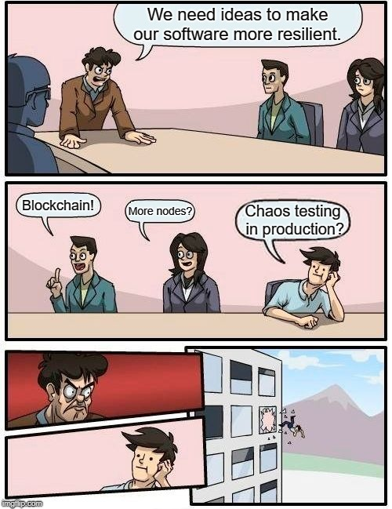
Scaling it down
Notes:
This is great. This is awesome! But no way that my company is going to let me do this on that scale. And if I would try to propose adding chaos to production? Well, let’s just say I’m glad my manager is not in this room.

Slide 9
Scaling it down
Controlled chaos
Chaos environment
Next steps
Notes:
So I wanted to bring this down a bit. Also because we are sometimes still running multiple services on the same box. Could you imagine the other team freaking out because I’m spiking the CPU to chaos test my service? No, if I’m going to add chaos, I want to do this in my codebase. Code I can control. And then, I can choose what chaos I can add, when it would have an impact and where, by deploying a chaos build or introducing a chaos environment next to the typical DEV, Acceptance and Production environments. And maybe, this first level of chaos engineering can help in convincing peers, stakeholders or management to take the next step towards chaos engineering.
But you might wonder, do you really need to add chaos engineering at all? Your services are running in the cloud and you’re using monitoring (I hope) with, i.e. Application Insights, your code is tested (I hope) using Unit Tests, Integration Tests, Regression Tests etc. Let me tell you about two situations:

Slide 10
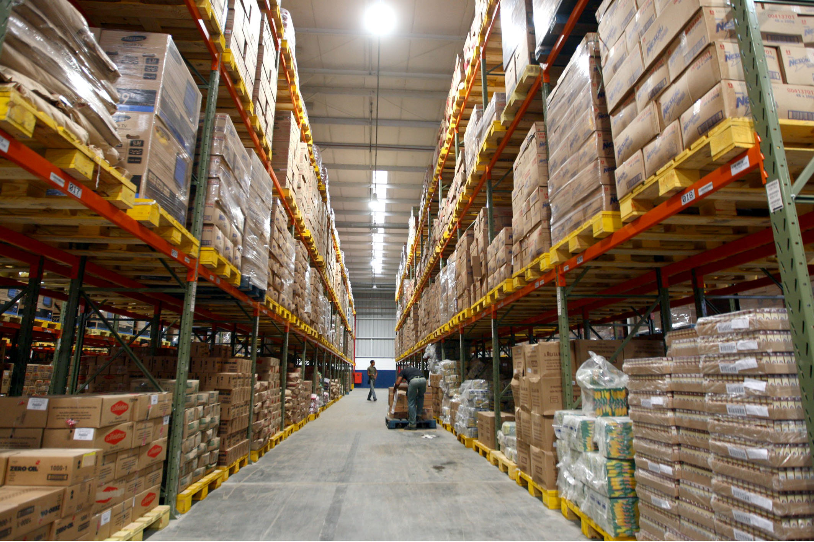
Notes:
The first situation I encountered during my first job. We created software for PDAs with barcode scanners integrated, mostly to create track and trace solutions in large warehouses. When we were discussing one of our solutions with a new customer, we also asked them if they needed an Always On (online) solution, or if we needed to implement an offline mode as well, because warehouses – especially in the year 2005 – didn’t typically have a decent WiFi connection everywhere because of all the concrete and metal. They almost always choose for the Always On method, because it was cheaper, to which we then replied: “Do you want us to do a wireless survey, measuring if you need to add more WiFi Access Points?”
They said: “No, our IT already did that and assured us that we should be good.”
I think you can already guess that we found out rather quickly that their warehouse didn’t have the wireless coverage that we were told before starting to work on the project. Their feedback on the software, however, didn’t tell us that, our logging in the application did.

Slide 11

Notes:
The second situation is more recent and isn’t a personal experience, my colleague shared this one with me. He had to go to Rwanda in Africa for a project and quickly experienced that the datacenter over there was offline. In fact, it had been offline for quite some days already, and that was fine. The people there were used to this, it was the norm, while for us that would be unthinkable. But it also meant that we had to rethink about how to deal with being offline. Being offline for a split second or an hour (the horror), that was calculated in the design of the solution. But days or whole weeks, not so much. While the solution might work fine, we had to be sure not to miss any event in the application while it is in an offline state. Data in the pharmaceutical business is critical!

Slide 12

Notes:
Both cases illustrate the same problem: dealing with a device being offline or having a poor connection. Developers typically simulate this by setting an emulator or actual device into “airplane mode”, but that’s cheating: airplane mode disables all signals: mobile, WiFi and Bluetooth. Airplane mode also triggers a system event informing apps that the network is down, so they can gracefully deal with that situation. This only simulates the issue of being offline, not the issue of having a poor connection, which is a lot harder to test in the average office.
And this is just one example of a situation that might occur on a device or in a service that’s beyond your control. There are many other situations out there, ranging from environments running out of memory or disk space to entire data centers becoming unavailable because of power outages or natural disasters. Luckily, these last two events are rare, but they can happen and it pays to be prepared for them, especially in certain sectors like the financial or pharmaceutical ones.

Slide 13

ruh roh
Notes:
More than a year ago, long before I joined my current employer, an idea started brewing in my head. I had seen talks online about chaos testing/engineering and wanted to introduce the idea at the customers who I was currently working for as a consultant, but of course, on a smaller scale. Not that all of the customers were small companies, but because they would most likely be hesitant to let a consultant randomly install extra software to then cause chaos on their servers. Can’t really blame them for their train of thought there.
So I would need a different approach, something to make chaos engineering even more manageable. To be able to configure what happens, when it happens and in which binaries it happens. That’s when I started working on my open source project called Ruh Roh.
Ruh Roh is, in its essence, nothing more than a tool to wrap services, just like you’d mock services when writing a unit test. The difference here is that the affected service will sometimes misbehave, but still be able to call the actual service to produce the correct and expected result. The result might just be delayed with 30 seconds, or be changed into something different.
But why don’t I switch over to Visual Studio and show you how easy it can be to add a little chaos to a UWP application?

Slide 14
Demo
Notes:
Microsoft has created an awesome sample UWP application, called VanArsdel Inventory, over at https://github.com/Microsoft/InventorySample. It showcases a line of business desktop application, using an MVVM architecture, support for both SQLite and SQL Server, and contains some of the nice new fluent design features. They also use the new Microsoft Dependency Injection library introduced in ASP.NET Core, which makes my life as a chaos engineer to be a lot easier.
Let’s start by adding a NuGet package to the UWP project. Ruh Roh is still in alpha at the moment, so I have to look for preview releases. You’ll see two packages for now: the core package containing all of the wrapping code, affectors, and triggers (more about these later), and a second package specifically tailored to use together with the Microsoft.Extensions.DependencyInjection package. Let’s add that second one to the project.
In this sample application, dependency injection is being configured in the ServiceLocator class. You’ll immediately see all of the services being added as singletons (some scoped), followed by the view models which are transient services. Right before the last line in this method, it’s time for me to start adding some chaos to the application.
This application allows you to use Windows Hello to sign in once you’ve enabled it. My laptop doesn’t have a fingerprint reader or iris scanner installed, but I can still use a PIN to sign in, so I went ahead and configured this already. But what would happen if Windows Hello starts misbehaving? Let’s go ahead and find out, shall we?
Rather than adding a new service in the application, now I’m going to affect a service that has already been configured before, using one of the AffectXYZ extension methods. In this case, I call AffectSingleton<ILoginService, LoginService>(). Next, just like a typical mocking framework, I want to say which method or property getter/setter I want to start affecting, using the WhenCalling method. Since I want to change the behavior when signing in using Windows Hello, the method I select will be SignInWithWindowsHelloAsync.
After selecting the method to affect, I want to add an affector. An affector will add chaos and at this moment, I have created two affectors: one to slow down a call, and another one that throws exceptions. In this case, let’s let the call to SignInWithWindowsHelloAsync throw an exception. At this moment, every call to SignInWithWindowsHelloAsync would throw an exception. Even for me, as a Lord of Chaos in training, that’s a bit too much. Time to add a trigger to control the chaos a little bit.
(Explain the different options briefly)
Let’s choose AfterNCalls and choose 2, meaning that the first two calls will not be affected. From the third call onwards, however, the method will start throwing exceptions.
Let’s build and run this version of the application.
The first time I log on using Windows Hello, the application should behave normally. I enter my PIN and I’m able to access the application. Let’s log off and try again. If I enter an incorrect PIN, it’s Windows Hello that’s showing the display again, so the application is still behaving fine so far. Let’s cancel this attempt and try again. Remember, this is the third time that I will call the SignInWithWindowsHelloAsync method.
Ruh roh. (see what I did there?)
Let’s start the application again and see what happened when reviewing its activity log. You’ll see that we had a crash due to an exception. Luckily, the application has a routine that catches unhandled exceptions so we have a log entry of the event, but the application still crashed. Let’s fix that.
The activity log shows that the ILoginService is being used in the LoginViewModel, in the method LoginWithWindowHello. And we were a bit optimistic because obviously, we aren’t expecting Windows Hello to throw exceptions. Time to fix this by adding a simple try/catch block, so the user is able to log on using their email address and password instead.
If I now quickly cancel out of the Windows Hello dialog twice, the third time will behave a bit better, allowing the user to log on into the application rather than having the application crash.
And now, for my second trick, I will check if the application behaves nicely when things start to slow down. Let’s imagine that the customers are being loaded using a Web API that has a connection to a CRM system. Both our network and the CRM system are experiencing high loads, so retrieving the customers is taking a bit more time than usual sometimes.
So, again, let me go back to the ServiceLocator class to add some chaos, this time, to the ICustomerService. When I select the method GetCustomerAsync, you’ll notice that this method has been overloaded. I know that, in the CustomerListViewModel, the first overload is being used. So I’m going to configure that method. And this method has a parameter, but I don’t really care about its contents, so let’s just allow any instance of a DataRequest to be used, using With.Any().
And, as said, we want to slow this method down, so instead of throwing an exception, we will now use the SlowItDownBy method and give it a TimeSpan of, say, 30 seconds. We don’t want this to happen every time the method is being called, so I’m going to add the EveryNCalls trigger method, to slow the method down on every second call.
Time to see the effect on the application. If this was a good old, pre-async/await Windows Forms application that did everything in the UI thread, the screen would go blank and the title bar would start to show a Not Responding title. But, since we’re in the UWP era and using asynchronous Tasks, we shouldn’t see a similar effect here.
Now, we’ve seen that this application has an activity log. Imagine that the log service is writing every event to disk, but suddenly, we ran out of disk space! I don’t want my application to crash in this case, of course, so let’s see what happens if this chaotic event would occur.
Back to the ServiceLocator, let’s go ahead and affect the ILogService this time. The WriteAsync method again has two overloads, but I know that the one with the Exception parameter actually calls the second overload, so I only need to add chaos to that method to cover all the paths to WriteAsync. And again, by using With.Any(), I can allow any parameter to be used when calling WriteAsync.
Mimicking a disk running out of space means throwing an IOException, and let’s say that I want this to happen after the 3rd call onwards. While I’m here, I’m going to reduce the time that GetCustomersAsync is being slowed down, because 30 seconds is a bit much to test the logging chaos.
Let’s go and edit an order a few times because saving an order triggers a log event. You’ll notice that after the third edit, the application crashed.
If we want to go and fix this issue however, we’ll see that this is a bit harder to repair because of the way the logging feature has been implemented. In this case, by adding chaos, we pinpointed an error in our design because we cannot safely call into a dependent system.
And now, let’s really start messing about with this application. One of the latest features I added to Ruh Roh allows us to change the data that’s being returned by a service, replacing it with a null value or a customized response. Of course, it is impossible to change a Customer response into an Order one, unless you control the JSON values being returned, but we can garble the data inside or try and erase some data that the application is relying on to be properly set.
Back inside the ServiceLocator class, let us again change the ICustomerService’s behavior by introducing this new affector. We’re going to affect the method GetCustomerAsync this time, and let’s return a fixed CustomerModel (use ReturnsAsync, set FirstName and LastName and leave the other properties to their default values). If we go through the list with the arrows, you’ll start to see some weird behaviour after a while because we’re overwriting the list items. Of course, since we’ve only set the FirstName and LastName properties, all the other data is blank.
Let’s go back to the code and make this a bit nicer, by replacing specific values. For this to work, however, we need access to the original data that’s about to be returned. We’ll get rid of the customerModel instance and use another overload of the ReturnsAsync method. Because we’re in an asynchronous method however, this is going to be a bit trickier to pull off. The reason why it’s so tricky, is that you can’t have method bodies inside of a LINQ expression, so we’re going to have to build a delegate method or Func<T> expression first, and use that in our actual expression. (Func<Task<CustomerModel>, Task<CustomerModel>>, async task => await ..., set PictureSource to null if you want to hide the picture)
So you see that it’s very easy to add chaos inside an application, but you could do the same for a Web API. If you navigate to Ruh Roh over at GitHub, I’ve added sample code showcasing an ASP.NET Core Web API using Ruh Roh. And because Ruh Roh is affecting your code rather than an actual server, you could also use this library to add chaos to an Azure Function if you wanted to do so.

Slide 15
https://github.com/ruh-roh
Notes:
Using Ruh Roh to add controlled chaos in your application is only a first step in the chaos engineering process because you simply cannot mimic all of the chaos experiments using code alone. But it can help you to expose issues in your codebase who do not appear when running unit, integration or other tests. And it can also help in showcasing that this extra step of chaos engineering, might be worth considering after all.
If you want to dive into Ruh Roh, I suggest to take a look at the code on GitHub, feel free to suggest new features or to help in building this NuGet package. There’s still a lot of work to be done before I mark the official v1 release, I wouldn’t want to accidentally add chaos in your code because of a bug in Ruh Roh. Or do I?

Slide 16
Questions?
wesley@gotsharp.be @WesleyCabus

