Slide 1
SaltStack Overview
Initial Commit

Slide 2
About me
SaltStack Certified Engineer # 23
Presenter at SaltConf15
Various projects using SaltStack as a key component:
hadoop - real clusters
white hat botnet - mobile game company
fast parallel lamp stack application deployment
configuration management
custom web application testing
Phoenix - open source HA implementation on AWS

Slide 3
My take on SaltStack
Fast solutions platform
parallel remote execution
configuration management
simple api to program custom solutions
very flexible
ideal for projects that require orchestration between servers
active helpful open source community
The swiss army knife for DevOps!

Slide 4
Major components of SaltStack
Master: the “controller” of servers
Minion: a controlled server
Grains: static info about a server
Pillars: key/value lookup dictionary (on master)
Modules: python execution modules (run on minions)
States: configuration management (built on top of modules)

Slide 5
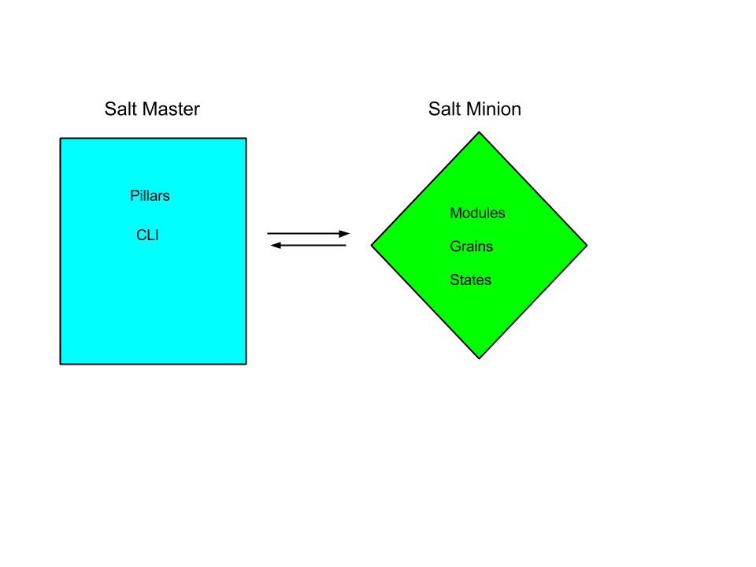
SaltStack Components
Notes:
c

Slide 6
Masters and Minions
Salt Master:
handles key management
agent based minions attach to master (zeromq) to receive / publish messages (tcp 4505/4506)
ssh based minions must be accessible via ssh (tcp 22)
code is transported from master to minions (e.g. modules/states/grains)
pillar information resides on master
Salt Minion:
listens to messages on master for execution, config management
data is compiled on minion
actions take place (generally) on minion, results are returned to the master
config file on minion “points” to master (ip/dns)

Slide 7

SaltStack CLI

Slide 8
salt command line
general syntax
(remote) salt [options] '<target>' <function> [arguments]
(remote) salt-ssh [options] '<target>' <function> [arguments]
(local) salt-call [options] '<target>' <function> [arguments]

Slide 9

SaltStack Pillar

Slide 10
Salt Pillar
Key / Value pairs, can be nested
Python dictionary
Handy for secure distribution of information
Nice way to override values in config mgmt

Slide 11
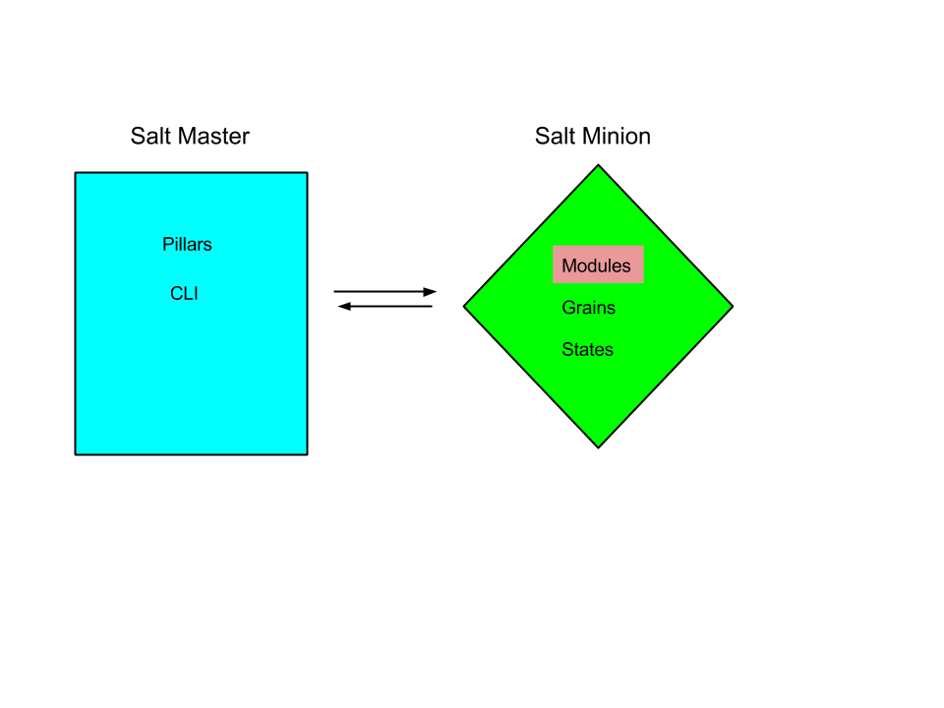
SaltStack Modules

Slide 12
salt modules
The heart of salt is remote execution
done by standard python modules
modules have access to salt dictionaries (e.g. grains/pillars)
a module can execute other modules
a module can execute code on other servers

Slide 13
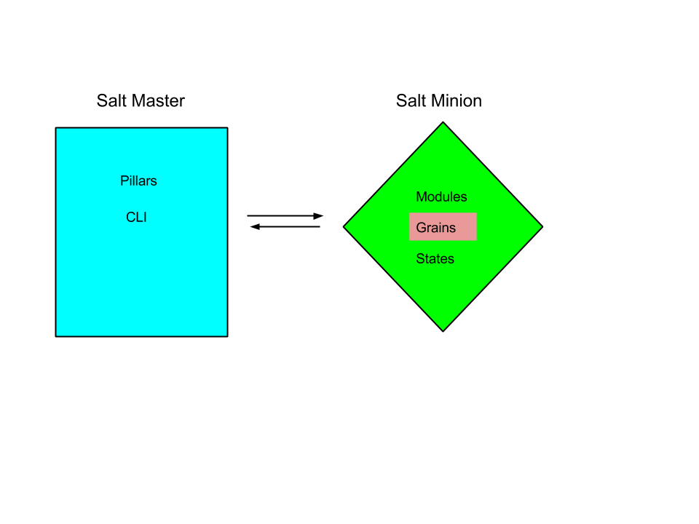
SaltStack Grains

Slide 14
salt grains
key / value pairs
data is gathered when minion starts up
standard grains include information about a server
custom grains are very useful, especially on cloud servers e.g. targeting

Slide 15

SaltStack States

Slide 16
salt states
used for config management
conceptually a state is how / what you want something to be
a state is transformed into a run list on the minion
states = data, usually created by combining jinja + yaml on the minion
a state is transformed into a run list on the minion
salt states use execution modules to determine what needs to be done, and to perform the actions
states return an expected (python) dictionary back to the master showing what changed, what failed and etc.

Slide 17
Other Components and Additions
reactors
salt-cloud
engines
beacons
scheduler
proxy minion
multi-master

Slide 18
Next Meeting Topic?
salt agentless / salt-ssh in depth
salt cloud
orchestration of servers - how to do it with examples
writing custom grains
writing custom execution modules
writing custom states
salt-mine
the salt reactor -- when + why + how
salt formulas - what, how, why
best practices for pillars, states, what to back up, key mgmt and etc
running saltstack in a highly available / fault tolerant way

Slide 19
Reference Links:
General Information: http://docs.saltstack.com/en/latest/
Full list of execution modules: http://docs.saltstack.com/en/latest/ref/modules/all/index.html
Full list of state modules: http://docs.saltstack.com/en/latest/ref/states/all/
Phoenix - SaltStack HA in AWS: https://github.com/wcannon/saltconf2015.git
List of returners: http://docs.saltstack.com/en/latest/ref/returners/
Salt over SSH: http://docs.saltstack.com/en/latest/topics/ssh/

Slide 20
Thanks for attending the “initial commit”

