Slide 1
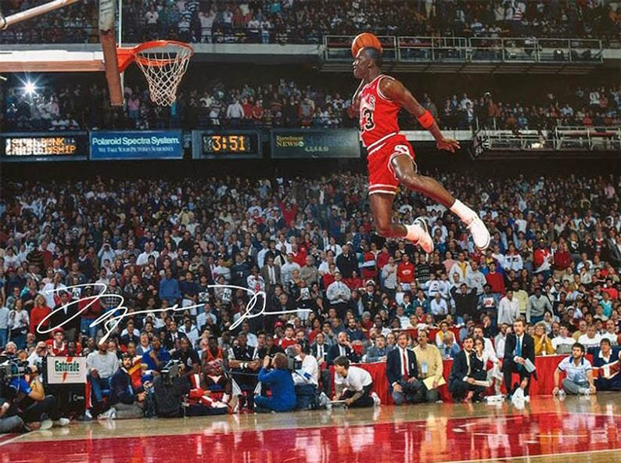
DATA DETECTIVES Introduction to computer programming with python
JNB1 MICHAEL JORDAN’S HIGHEST SCORING GAME

Slide 2
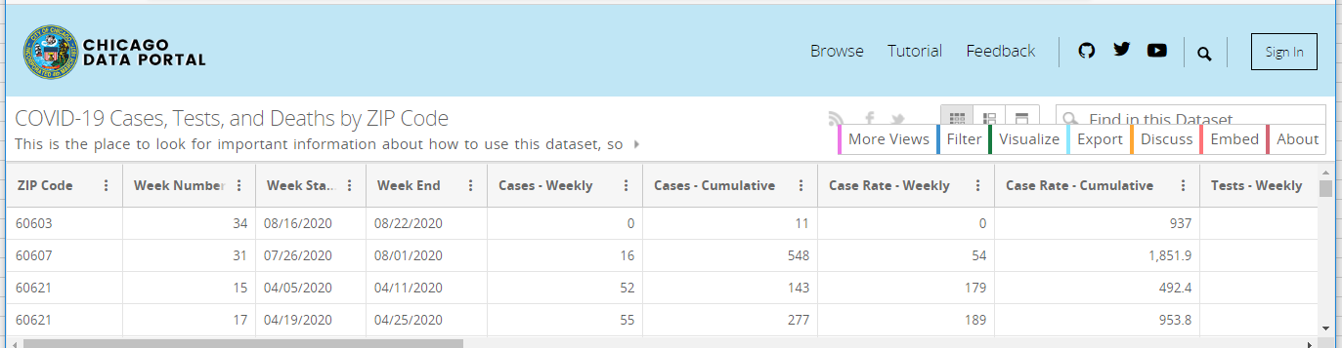
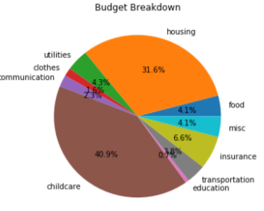

What will YOU get out of The DATA-DETECTIVES ACADEMY LEVEL 1 PROGRAM?
Guidance and Encouragement from a Mentor
Learn several different uses of computer such as data analysis
COVID-19 Data
Budgets
Rap Lyrics

Slide 3
What we will cover in TODAY’S LESSON
What a computer is
What a computer program is
What Python is
What variables are (in breakout rooms)
An introduction to functions (in breakout rooms)

Slide 4
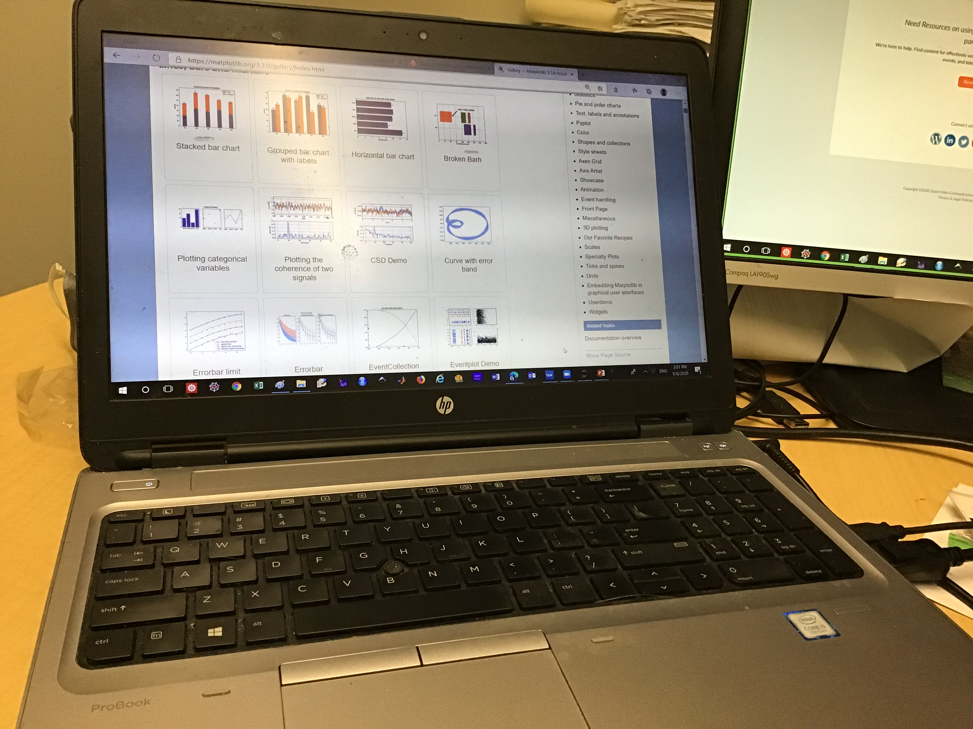
What is a computer?
A computer is a special m _ _ _ _ _ _ for working with information.

Slide 5
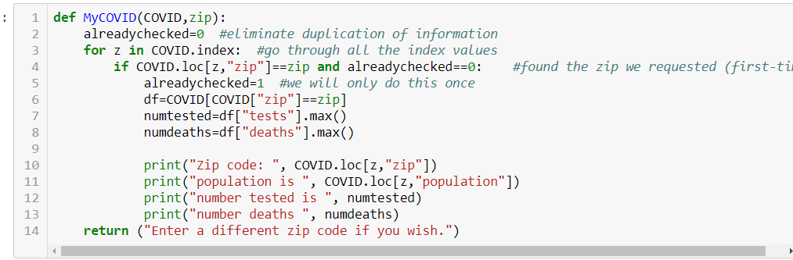
What is a computer program?
A computer program is a set of instructions for the computer
The term code means a small p _ _ _ _ _ _.

Slide 6

What is a programMing language?
A programming language is a way of giving the computer instructions in a way that the computer can u _ _ _ _ _ _ _ _ _.

Slide 7

What is python?
Python is a programming language.
The Python language is one of the most popular worldwide.
Python is one of the tools used by many data scientists, a profession that is currently in high demand. It take a lot of work to become a professional data s _ _ _ _ _ _ _ _.

Slide 8

Variables
A variable is a place to store information.
Imagine I told you to get a box and label the box with a big X. Then write the number 3 on a small slip of paper and put it into the box marked with an X. Then, if I say tell me what is in box X, you would answer the number 3.
A variable is like a box. So in Python, we must provide the name of the variable, and what I _ _ _ _ _ _ _ _ _ _ to store in that variable.

Slide 9
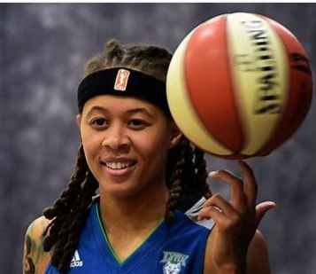
Question
If Seimone Augustus is exactly 6 feet tall,
how many inches tall is she?

Slide 10
functions
A function is a set of instructions that tells the computer to:
Take a piece of information we give Seimone’s height in ft and in: feet=6, inches=0
Do something with the information convert her height to inches:
(remember there are 12 inches in 1 foot)
Then give us a new piece of information Seimone’s height in inches is 72
The usefulness of a function is that a function should work for a _ _ height in feet and inches, not just for Seimone’s height of 6 feet 0 inches.

Slide 11
FINAL QUESTION
In today’s lesson, our main goal is to learn how to create a f _ _ _ _ _ _ _ in Python.

