Slide 1
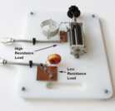
VE3KL
Antenna Tuners Revealed
(2010-2014 Study)
A General Approach for all Tuners…the goal
How to Look at Tuners……Smith Chart?? No.
Use the Impedance Z plane
Use SimSmith for system analysis…4nec2x, VNA for data
Use the L match as a basic building block
Several Examples: VE3XK 43 foot Vertical
Easy to tune into a bed spring but at what cost?
Losses, Bandwidth, Voltages, Currents, Return Loss
1

Slide 2
Antenna Tuners VE3KL
Introduction
Block Diagram for Analysis
(Note Right to Left Flow)
Antenna
Measured or Calculated Z
Linear System
Tx Line
Compete Model Required
(TLDetails)
Tuner
Circuit Model
(including losses)
(SimSmith)
Tx Line
Complete Model Required
(TLDetails)
Transmitter
Output Impedance
Not 50 Ohms

Slide 3
The Problem & Basic Questions
Transform from any Z to 50 Ohms..usually a filter
How to Design a Tuner
Only Two Tuning Elements needed (max)
What is the best circuit? There isn't one!
Components? Roller Inductors have Low Q if not maintained very carefully
How to analyze the complete system?
How to use real data.. Spice does not do well with transmission lines

Slide 4
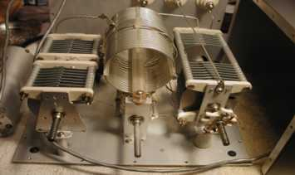
Many Tuner Types since 1955
Need a Common View
L Match….. Six Types
T Match….. Two Types (many variations)
PI Match…..Two Types (many variations)
Z Match…….A few variations
EF Johnson Match Box Tuner…Several Types (Some Capacitors not needed)
Transformer type for resistive loads..end fed half wave antenna
Match Box Tuner

Slide 5
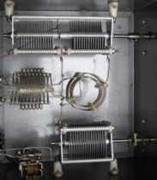
Design Method

Slide 6
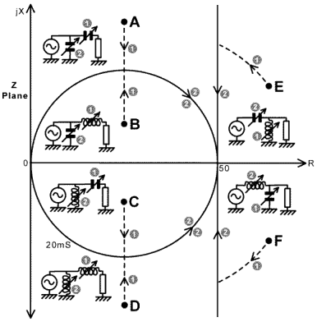

Slide 7
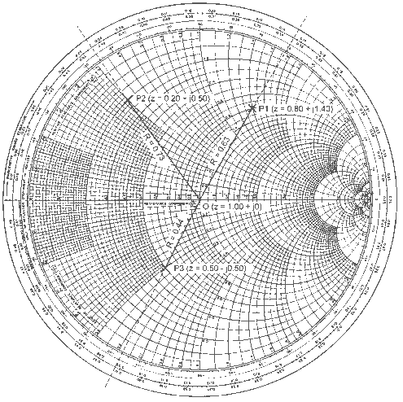
Z Plane
Smith Chart

Slide 8
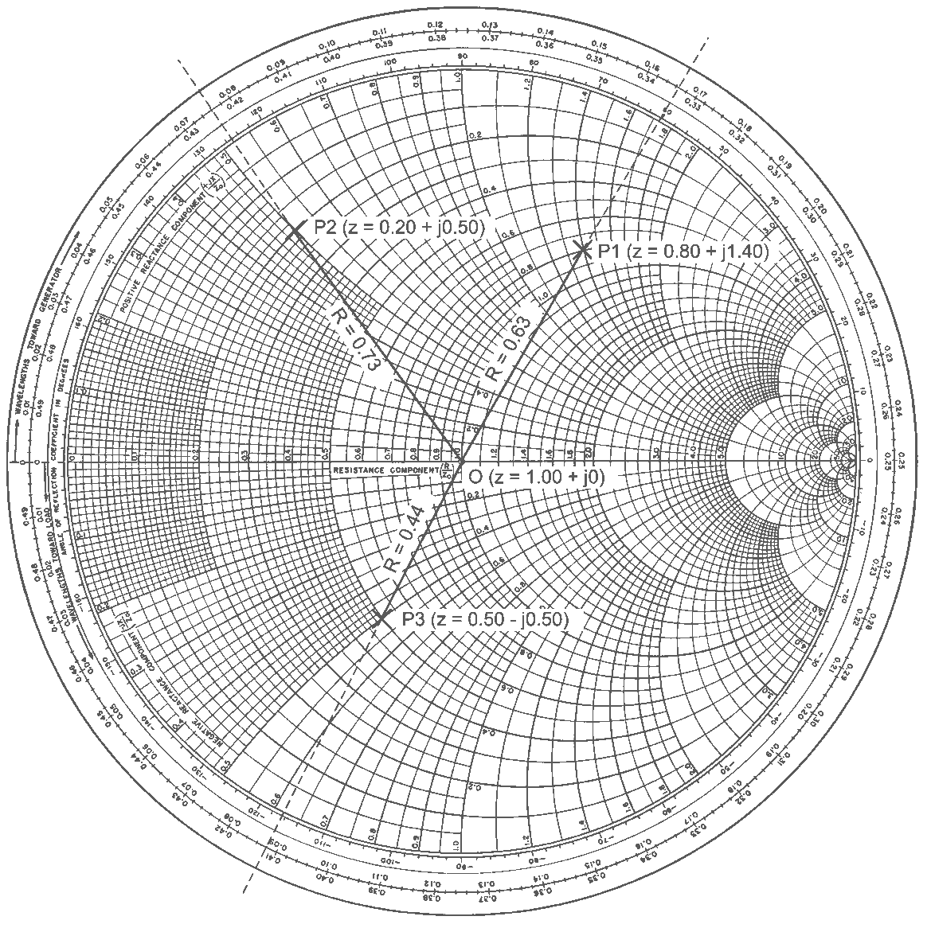
Smith Chart: Reflection Coefficient
Hard to Visualize Using LC Tuners
Many Overlays: Z,Y,SWR,RL,NF,
Max Power, Negative Resistance Parametric Amplifiers
Impedance
Overlay
R < zero Region
R>zero Region

Slide 9
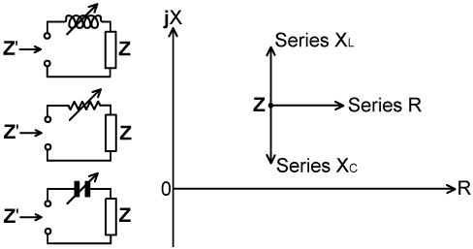
Z Plane Ideal for LC and Simple Matches
Impedance based
Series Loads
Zplane Drawings Compliments of
Dave Knight, G3YNH

Slide 10
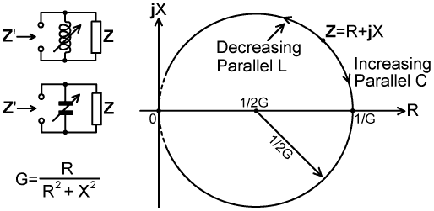
Z Plane Parallel Loads
Z=1/Y Y = G +jB
Circle of Constant G

Slide 11
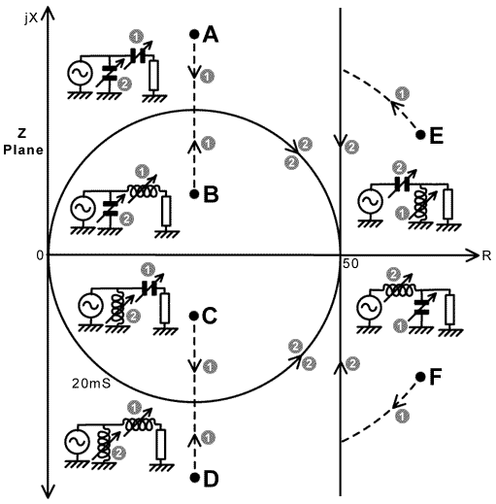
Z Plane Region
L Match Types Six Regions

Slide 12
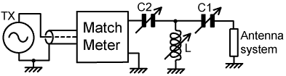
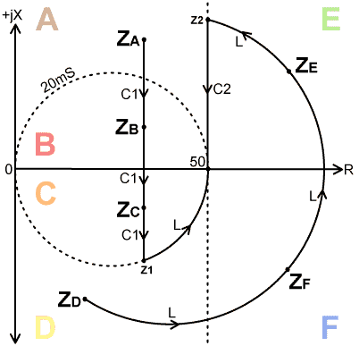
Z Plane Region TMatch
Regions A,B,C,D,E,F
Special Cases
Region A,B,C: C2 = infinity
Region D,E,F: C1 = infinity
Many Other Tuning Strategies
Palstar Differential C Tuner
C1 = kC2…….K variable.

Slide 13
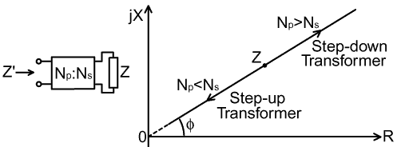
Transformer
Preserves Phase Angle of Impedance
Used in VE3KL End Fed Halfwave 20 Metre Antenna

Slide 14
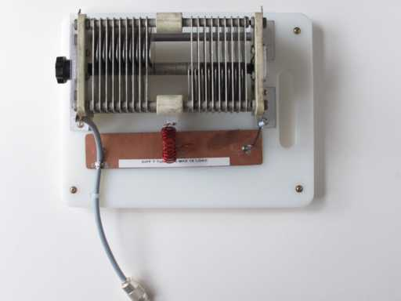

VE3KL
Time for some Measurements
Differential T Type
Rload = 1000 Ω
L = 3.55 uH Powdered Iron
Two L Match Tuners
High R & Low R
Load
2014 Palstar uses a Roller L

Slide 15
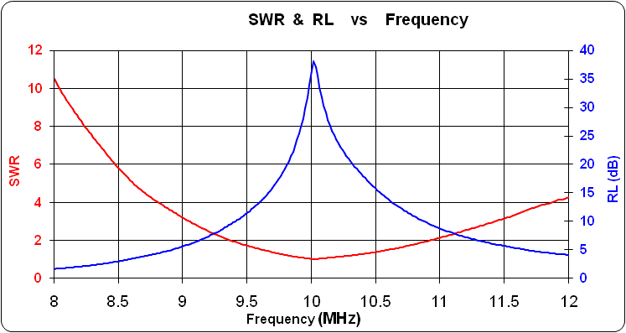
VE3KL
Antenna Tuner Examples
(2010-2014 Study)
Differential T Type....Measured
Rload = 1000 Ω
L = 3.55 uH Powdered Iron
Note the High Return Loss @ 10 MHz

Slide 16
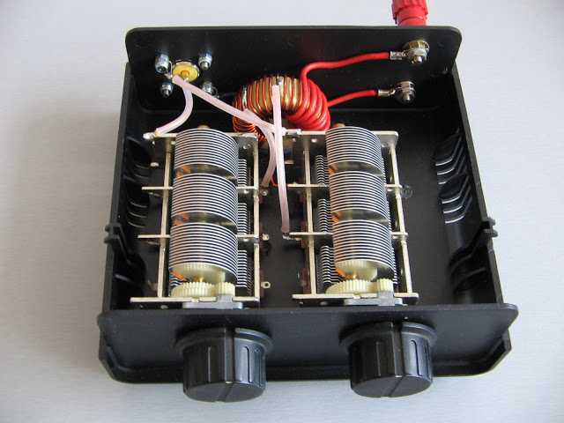
Z Match
Two Tuning Capacitors
PD7MAA 100 Watt T200 Toroid

Slide 17
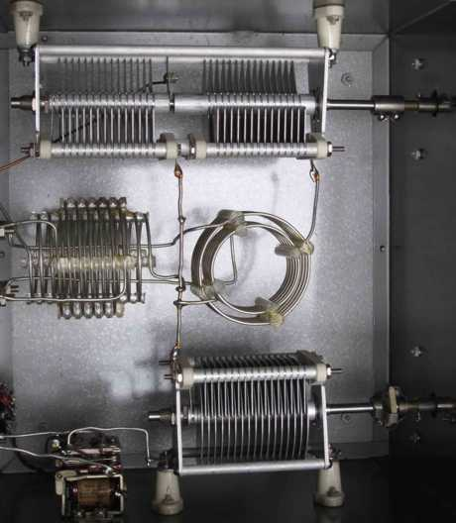
VE3KL
Antenna Tuner Examples
(Zmatch Two Coil Type Jim Dean VE3IQ Built 1957)
Design 1955
Two Tuning Knobs

Slide 18
The Basic Circuit… Lmatch
Summary
Antenna
Antenna
(a) Low Pass L-C
High Resistance Antenna
> 50 Ohms, All Reactive Loads
(b) Low Pass L-C
Low Resistance Antenna
< 50 Ohms, Drop-Out for some Inductive Loads
Antenna
Antenna
(c) High Pass L-C
Low Resistance Antenna
< 50 Ohms, Drop-Out for Some Capacitive Loads
(d) High Pass L-C
High Resistance Antenna
> 50 Ohms, All Reactive Loads

Slide 19
Simulation Tools and Data Collection
  Measured or simulated antenna impedance
  VNA such as an AIM 4170
  EZNEC or 4nec2 for Antenna Simulation
  TL Details for Transmission Line Data
  SimSmith for System Simulation
  Imports data from VNA, Antenna Simulators, TLDetails

Slide 20
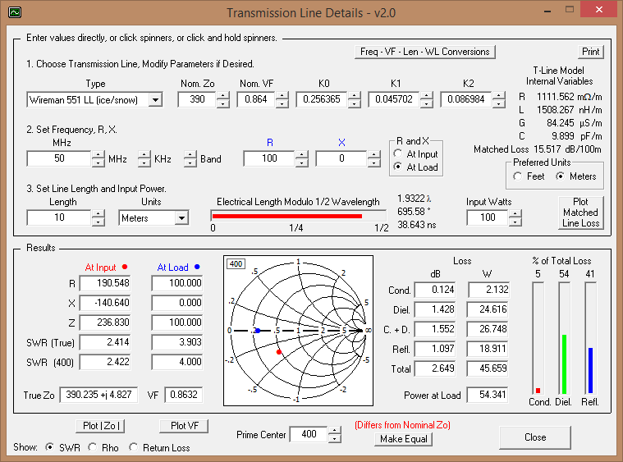
TLDetails
Example Wireman 551 Window Line
Loss 2.6 dB 50 MHz Ice Covered 10m
Tx Modeled as a zero Z impedance

Slide 21
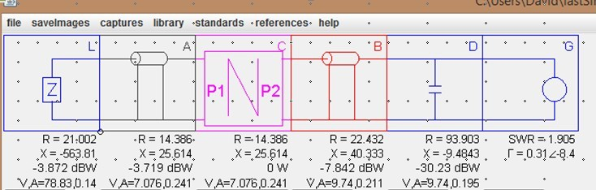
SmithSmith
The Cascaded System tool
Uses TL Details
Imports Antenna Data from VNA,EZNEC ,4nec2

Slide 22
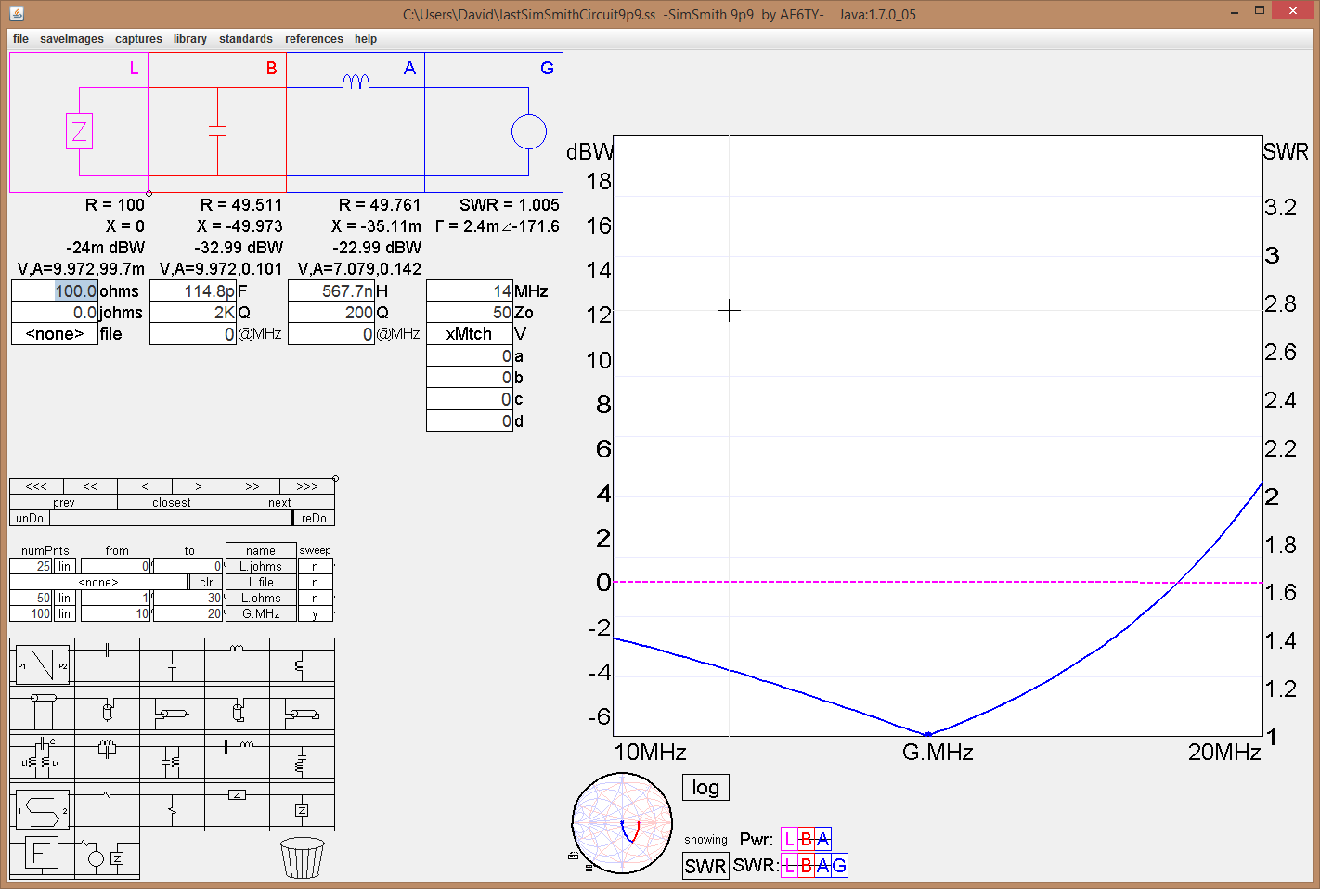
SmithSmith
LC Example 100 Ohm Load
Type (a) L Match

Slide 23
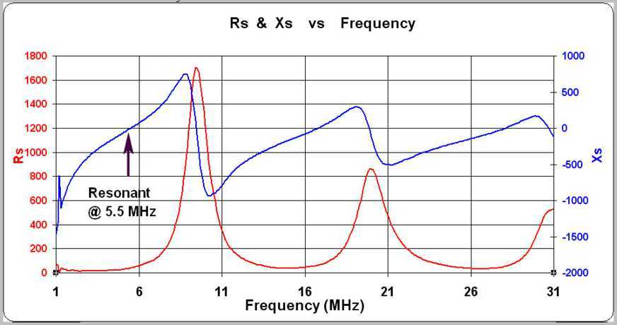
VE3XK Vertical ..An example
1.9 MHz Low R 18.1 MHz High R
Measured Impedance 1-31 MHz

Slide 24
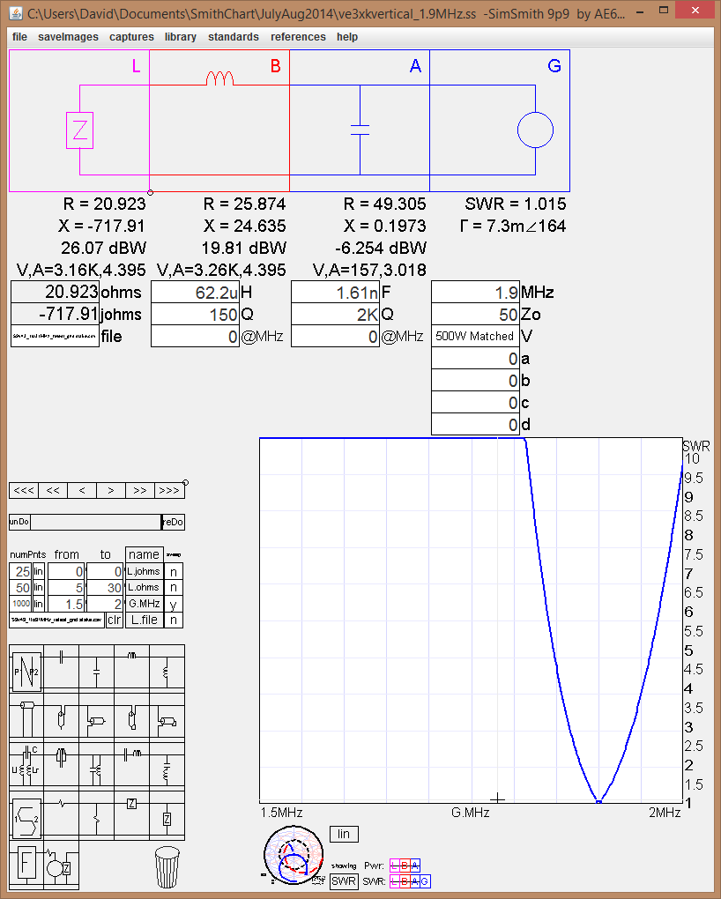
SmithSmith
VE3XK Vertical Antenna Using Measured Impedance Values
1.9 MHz R Load < 50 Ohms B type LC
Good Match
L = 62 uH
Very Narrow Bandwidth
High Voltages (>3KV RMS)
0.96 dB Loss
96 W loss in Inductor
500 WattsTx

Slide 25
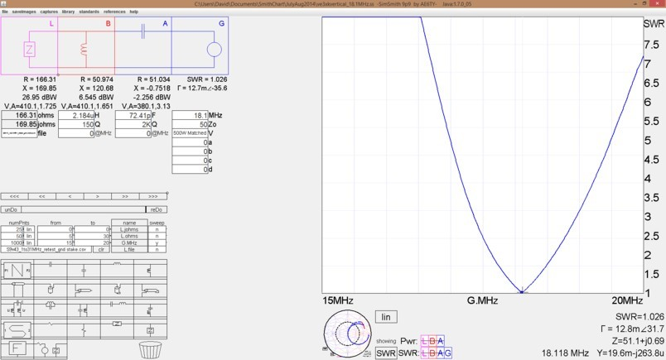
SmithSmith
VE3XK Vertical Antenna Using Measured Impedance Values
18.1 MHz
Good Match
Wide Bandwidth
Low Voltages (<410RMS)
0.05 dB Loss
6 dBW loss in Inductor
New Topology Based on Z Plane
R Load > 50 Ohms D Type LC

Slide 26
SmithSmith
VE3XK Vertical Antenna Using Measured Impedance Values
Summary
Transmitter Power 500 W Continuous, VE3XK Vertical
Frequency [MHz] | Tuner Type (See L Match Summary) | Load Power [W] | Power Lost in L [W] | Voltage across L [V]
1.9 | (b) | 405 | 96 | 3260
3.7 | (d) | 425 | 73 | 1330
5.3 | (b) | 495 | 5 | 191
7.1 | (a) | 488 | 12 | 552
10.1 | (d) | 476 | 22 | 940
14.2 | (b) | 484 | 16 | 908
18.1 | (d) | 495 | 4 | 410
21.2 | (d) | 480 | 19 | 709
24.9 | (d) | 472 | 27 | 672
28.5 | (a) | 496 | 3 | 150

Slide 27
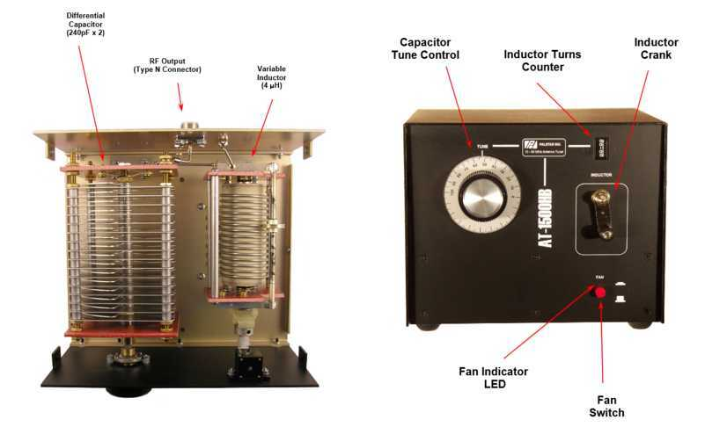
T Match.. A Closer Look
Three Tuning Elements only Two Needed..but
Three gives a broad range if a tuning method can be developed
Three needed if L is a switched inductor
C1 and C2 can be part of a Differential Capacitor (Two knobs to tune)
C1=K1*C2 + K2 0<k1<1
Palstar Diff. Cap
T Tuner

Slide 28
Palstar AT 1500 Manual Tuner
Two Tuning Elements: Easy to Tune
Note the Use of a Fan
To Cool Roller Inductor

Slide 29
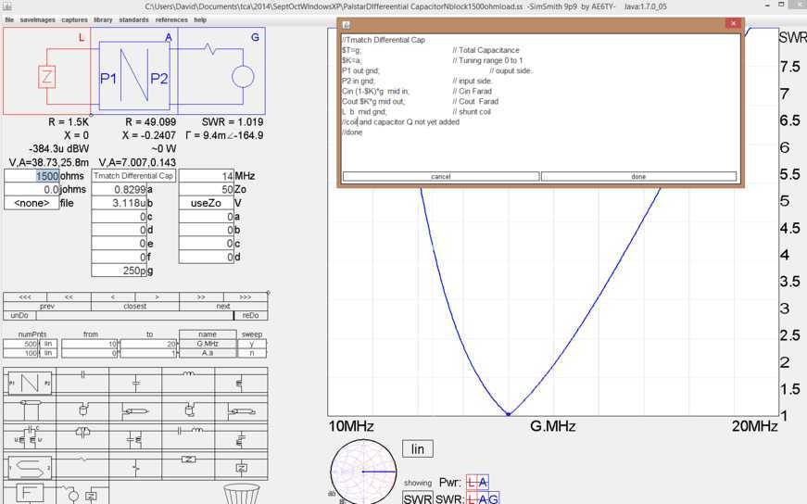
Palstar AT 1500 Manual Tuner
Performance SimSmith

Slide 30
T Match.. A Closer Look
Three Tuning Elements…Some Examples
T Type Tuner Simulation Transmitter Power 500 W 10 MHz Inductor Q = 200 Capacitor Q = 2000
Tuner # | RL [Ω] | C_{S} [pF] | L [uH] | C_{L} [pF] | Power in L [W] | Circuit Q
1 | 300 | 15 | 12 | 6 | 72 | 15
2 | 300 | 45 | 4.1 | 19 | 31 | 5
3 | 300 | 113 | 2.0 | 75 | 9 | 2
4 | 25 | 22 | 5.1 | 28 | 82 | 15
5 | 25 | 66 | 1.7 | 88 | 29 | 5
6 | 25 | 452 | 0.56 | 450 | 5 | 1
7 | 0.1 | 18.6 | 1.48 | 152 | 391 | Not calculated
8 | 50 | 225 | 0.84 | 225 | 7 | Not Calculated
9 | 50 | 24 | 5.4 | 23 | 63 | Not Calculated
Short Circuit

Slide 31
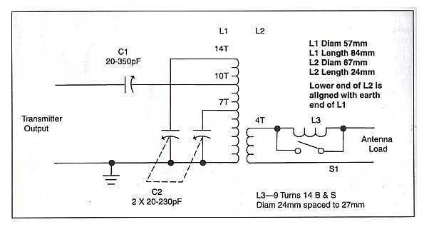
Z Match
Single Coil Type VK5BR
Two Tuning Knobs
Essentially a Series C Shunt L Match
Rp Reflected from Antenna > 50 Ohms
Possible Drop Out Regions
Type (D) Circuit

Slide 32
Summary
  Z Plane Clarifies the Design Process
  SimSmith Does the Number Crunching
  TLDetails Supplies Transmission Line Data
  VNA Collects Measurements
  EZNEC, 4nec2 does the antenna simulation
  See references TCA, VE3KL, July/Aug..Sept/Oct 2014
Tools Now Available to Evaluate Most Tuner Types
73 Dave VE3KL

Slide 33
References
  Dave Knight, G3YNH..Impedance Matching
  SimSmith Simulator, AE6TL
  TLDetails AC6LA
  EZNEC, W7EL
  See references TCA, VE3KL, July/Aug..Sept/Oct 2014
Tools Now Available to Evaluate Most Tuner Types

