Slide 1
2014 VHF Contest Planning
Doug Leach – VE3XK
WCARC Vice President

Slide 2
My Objectives for a New Venue
Increase club participation, especially by experienced VHF contesters, by finding a location close to Ottawa. No need for a weekend commitment, camping or motel room.
Space for three towers plus microwave.
Secure indoor operation room. No tents.
Adequate AC power. No generators.
Inside washroom. No rented outhouse.
Close to fast food for those not wanting to brown-bag.
Affordable for the limited financial resources of WCARC.

Slide 3
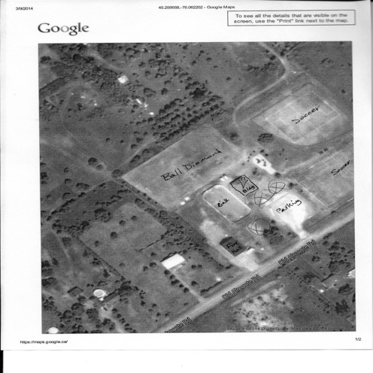
The New Contest Venue - 1

Slide 4
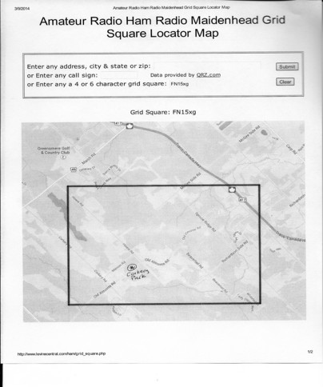
The New Contest Venue - 2

Slide 5
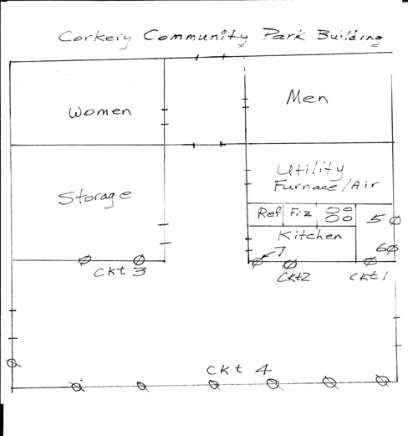
The New VHF Contest Venue - 3

Slide 6
How Does Corkery Rate?
All my objectives have been met. Soil depth for the stakes now confirmed, and tower locations marked.
Not only indoor operation, but heated and air conditioned.
25 yr old building has steel locking doors and window bars.
60 amps of 115V in the room and more in the kitchen.
Two washrooms.
10 km from FN25 and about 25 km from grid intersection.
Less travel time and fuel costs for members.
Only $110 for the weekend, which is less than the rented motel room, rented outhouse and generator fuel at FN04xa.

Slide 7
Thank You
George Roach – VE3BNO for the donation to WCARC of 300 ft of 3/8” heliax and 50 ft of ½” heliax
Ray Perrin – VE3FN for the donation to WCARC of 275 ft of 3/8” heliax, 25 ft of ½” Superflex heliax, 30 ft of 7/8” heliax and six RG-400 coax jumpers.
The anonymous donor of $1000 to help cover the cost to replace the VO1NO equipment used in past years at FN04xa.
Greg Milley VA3ITB for repairs and loan of a CDE-44 rotator.
The WCARC members who are lending cables and equipment to help make 2014 another WCARC June VHF Contest success.

Slide 8
Available Coaxial Cables
RG-58 and RG-8 Station Jumpers – UHF connectors
RG-400 Station Jumpers – Type N connectors
LMR-400UF Antenna Jumpers – both UHF and Type N
3/8” Heliax – most with PL-259 UHF connectors
½” Heliax and Superflex – with Type N connectors
7/8” Heliax – with Type N connectors
Donated cables were cut to size and connectors installed (thanks also to Paul VE3PLE). Cables all swept 1-1500 MHz, with the losses noted by band, for use in selecting which to use.

Slide 9
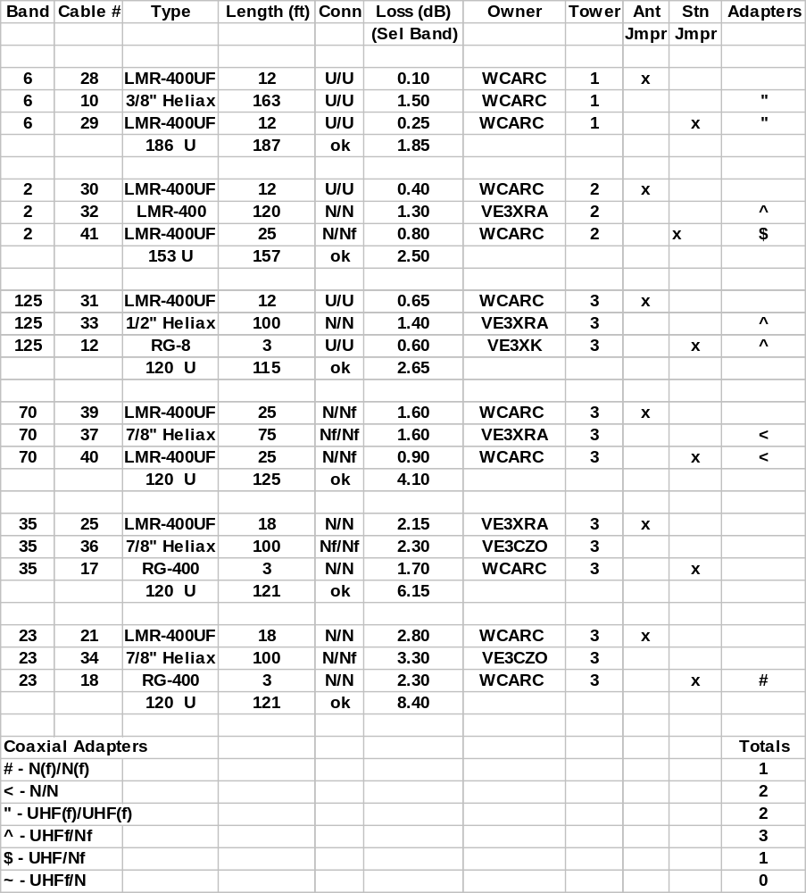
Cable allocations based on minimal
end-to-end loss.
The notations under Type are the target feedline length from station and connector type.
Notation under Length is the actual total feedline length using these cables.

Slide 10
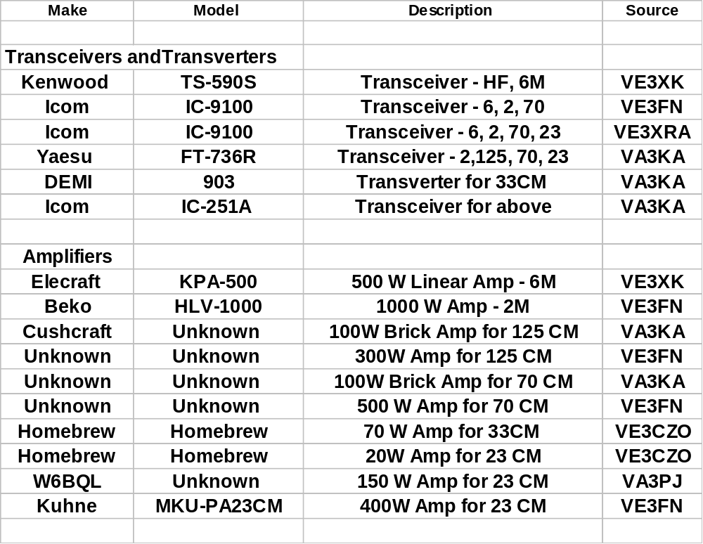
Equipment Offered - 1
Amplifiers
Elecraft
KPA-500
500 W Linear Amp - 6M
VE3XK
Beko
HLV-1000
1000 W Amp - 2M
VE3FN
Cushcraft
Unknown
100W Brick Amp for 125 CM
VA3KA
Unknown
Unknown
300W Amp for 125 CM
VE3FN
Unknown
Unknown
100W Brick Amp for 70 CM
VA3KA
Unknown
Unknown
500 W Amp for 70 CM
VE3FN
Homebrew
Homebrew
70 W Amp for 35CM
VE3CZO
Homebrew
Homebrew
20W Amp for 23 CM
VE3CZO
W6BQL
Unknown
150 W Amp for 23 CM
VA3PJ
Kuhne
MKU-PA23CM
400W Amp for 23 CM
VE3FN

Slide 11
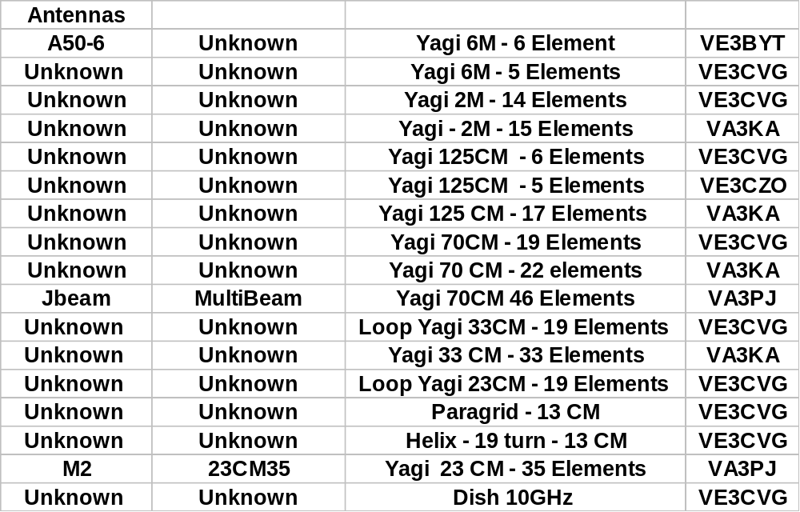
Equipment Offered - 2

Slide 12
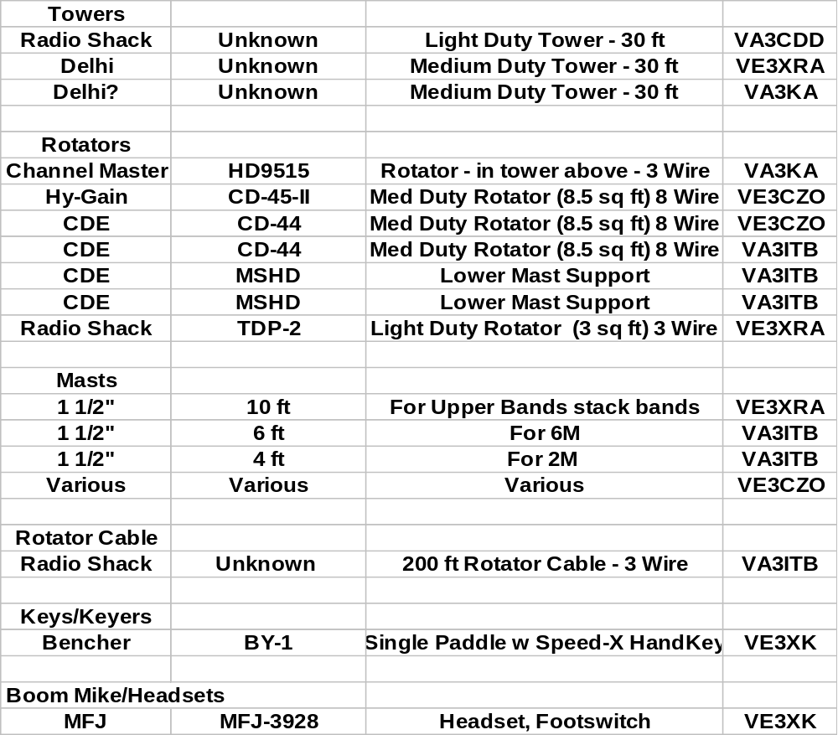
Equipment Offered - 3

Slide 13
Transportation Requirements
VA3CDD – Radio Shack tower*
VA3KA - Delhi tower, rotator*
VE3XRA – Delhi tower, rotator and masting*
VE3XK – Coax/heliax cables and masting*
* Truck or trailer required for above
Other equipment on loan for the contest to be transported to and from site in member’s vehicle.
Does any member need any help transporting other equipment on loan for the contest?

Slide 14
Storage Requirement
As a result of the kind donations noted previously, WCARC now owns a substantial amount of coaxial cable, stakes and guy rope piled to about 4 ft diameter X 2 ft high, when coiled tightly, plus some masting.
Can anyone provide a safe indoor storage place where the cable can be delivered after the contest?

Slide 15
Operating
This is a club effort, so we want to have as many members participating as possible. That is why we chose a local site and provided for the following training:
The June 3 Meeting features a presentation on VHF Contesting and the N1MM contest logging program by contester-extraordinaire Dave Goodwin - VO1AU/VE3AAQ. This is a MUST for those planning to operate in the contest.
Now that we have a local venue that does not require you to commit to a whole weekend, how many members will be participating with WCARC in the June 2014 VHF Contest?

Slide 16
Shift Scheduling
With this many operators we will have adequate participation to operate in shifts and give the active operators time off to go home or out to eat.
The midnight to dawn period has been very quiet in the past and we may choose to shut down then.
Who volunteers to schedule the shifts?

Slide 17
Nourishment
Tim Horton’s and several other restaurants are 10 minutes southwest in Almonte.
In the kitchen - coffee maker, refrigerator, freezer, microwave and stove. If we have to draw power from the kitchen circuits, the coffee maker and microwave may be problematic as both draw close to the 15A circuit limit.
Alcohol is not allowed on site.
This is a not a weekend social event with some visitors more interested in eating burgers than operating.
On-site food preparation and/or consumption should not tie up an operator or be a distraction to other operators.

Slide 18
The Important Food Decision
Shall we just go with brown-bag sandwiches from home or go out for Timmy’s soup & sandwich or chili or for pizza, the simplest solution?
- OR -
If the majority vote for on-site food, will a non-operator volunteer to look after food preparation and service?

Slide 19
Agenda for Friday – June 13
Drive to VA3CDD, VA3KA, VE3XRA, VE3BYT and VE3XK and bring to Corkery the three towers, rotators, antennas and coax.
Assemble towers, rotators and antennas. Connect, dress and tape feedline runs. Attach guy ropes. Install stakes.
Erect towers ensuring antennas face south so rotators remain calibrated. Tape off each tower with Caution tape.
Set up tables with equipment and connect to the six feedlines and three rotator cables.
Test all equipment and logging software network (to be completed by contest start time - 2 PM EDT Saturday)

Slide 20
Thank You
Please don’t miss the
June 3
VHF Contesting
and N1MM Contest Logging
Training
presentation

