Slide 1
WSPR (pronounced whisper)
Weak Signal Propagation Reporter
on the FlexRadio 1500
By Paul Boltwood VE3PLE
paul@boltwood.ca
March 3, 2015

Slide 2
What Is WSPR?
A HF digital communications protocol good for DX
Provides propagation data for other radio amateurs
Does not support conventional QSO’s. No QSLs
World wide contacts with <100 mW
5 W max usually
Not enough stations (<1000) or locations
Very narrow bandwidth of 6 Hz gives good SNR
Requires high frequency stability and accuracy (to ~1 Hz), & accurate time (to ~1 sec. via the Internet)
Uses an Internet database to log all contacts

Slide 3
Operation
Worldwide it runs on a 2 minute cycle
Every station starts either to transmit or to receive on each even clock minute
At random, you transmit on about 20% of all of the cycles
Transmissions are at a user chosen frequency in a 200 Hz wide subband within each amateur band
All transmitting and receiving is automatically computer controlled and computer data processed by WSPR.EXE

Slide 4
Messages
WSPR messages are digital and well protected
Each message contains in 50 bits: call sign, Maidenhead locator, output power in dBm
plus forward error correction to total 162 bits per message
Data rate of 1.4648 baud, continuous phase 4-FSK modulation
Your computer decodes all received transmissions in the 200 Hz sub band at once

Slide 5
Software – WSPR.EXE
Wspr.exe from Joe Taylor decodes the audio received by a transceiver to:
  Isolate the 200 Hz sub band
  Separate the individual signals
  Decode all of the messages and display them
Wspr.exe generates the audio to be transmitted too
Wspr.exe is somewhat buggy – total crashes happen after days of running. Cycle power completely to recover

Slide 6
Software - VSPMgr
VSPMgr is needed to provide virtual COM ports so two software packages that normally would talk to COM I/O, can talk directly to each other in the same computer
It is needed for CAT port transceiver control on the Flex 1500 from WSPR.EXE
See http://k5fr.com/ddutilwiki/index.php?title=VSPM. You must be licensed but it is free

Slide 7
Transceiver Audio Connections
WSPR.EXE expects the use of archaic SSB transceivers rather than full digital!
Audio must flow both ways between your PC and your SSB transceiver
The old way is to use phono cables and 2 audio cards
Modern way is all digital using Virtual Audio Cable software (which costs $35. Version 4.13 has a nasty bug)
My rig has no wired audio connections

Slide 8
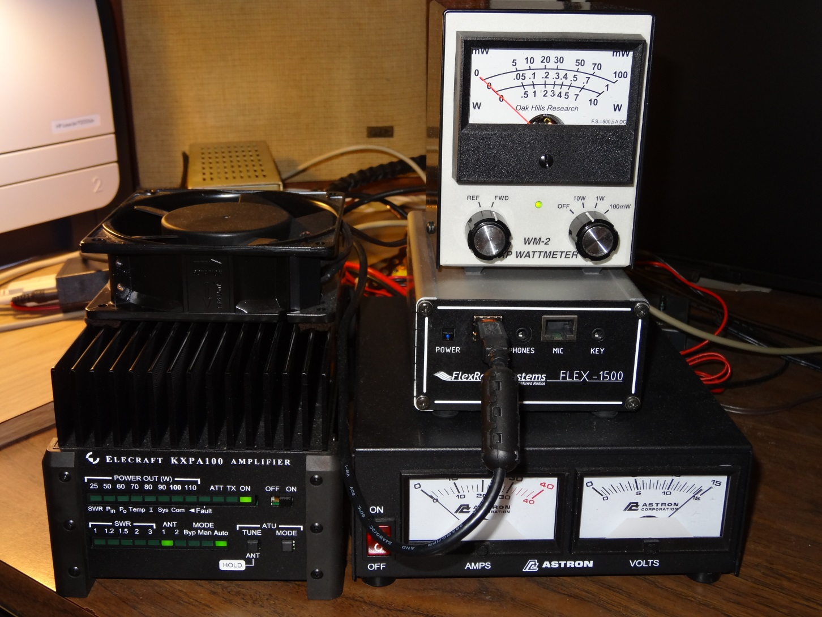
My Rig (only Flex 1500, computer and a PS is needed for WSPR)
Only used
as an
expensive
antenna
tuner with
WSPR
transceiver
Power supply
(much bigger
than needed)
for WSPR
Antenna is a Cushcraft R8 (modified so it doesn’t fall down), bands 40m to 6m vertical

Slide 9
FlexRadio 1500 Transceiver
This little (10.2 cm x 5.1 cm x 15.2 cm) $650 box provides the RF to audio interface for HF/6m
With a good computer, it equals much more expensive conventional hardware
It has some bugs – cycle all power to fix
Thanks to Doug Leach for pushing me into it

Slide 10
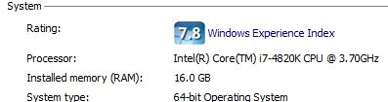
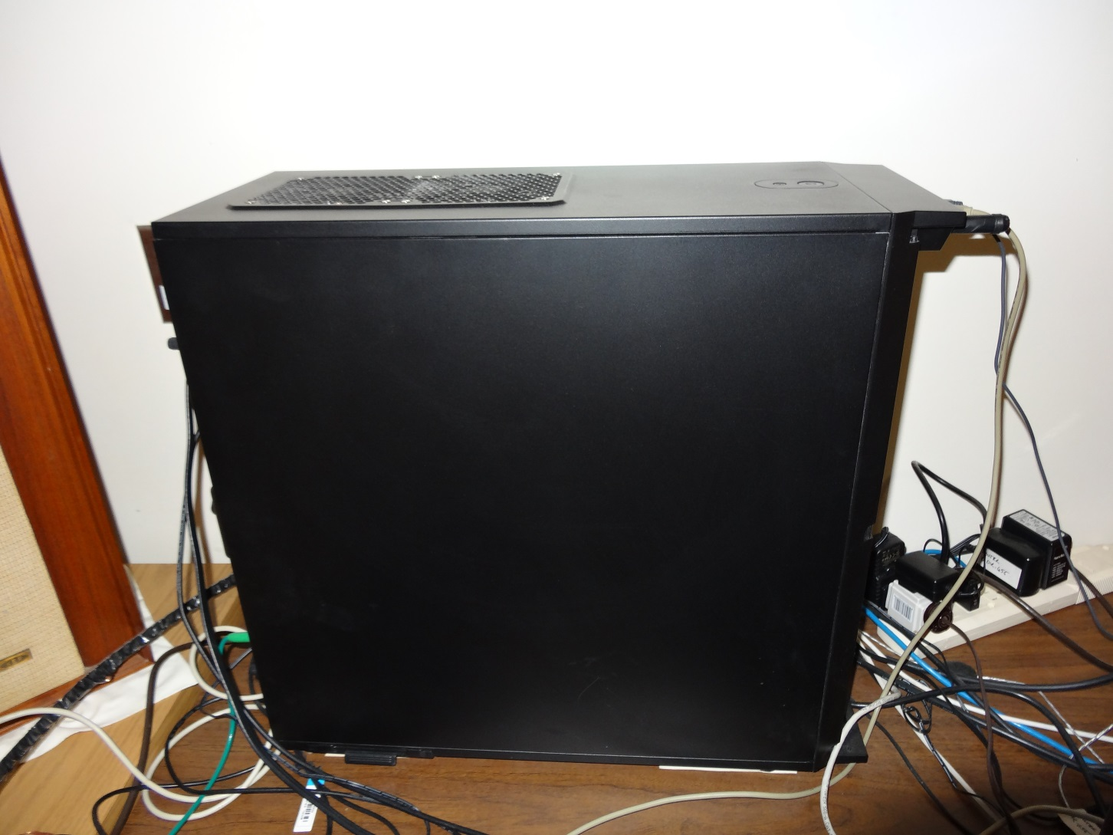
Most Of The Real Transceiver

Slide 11

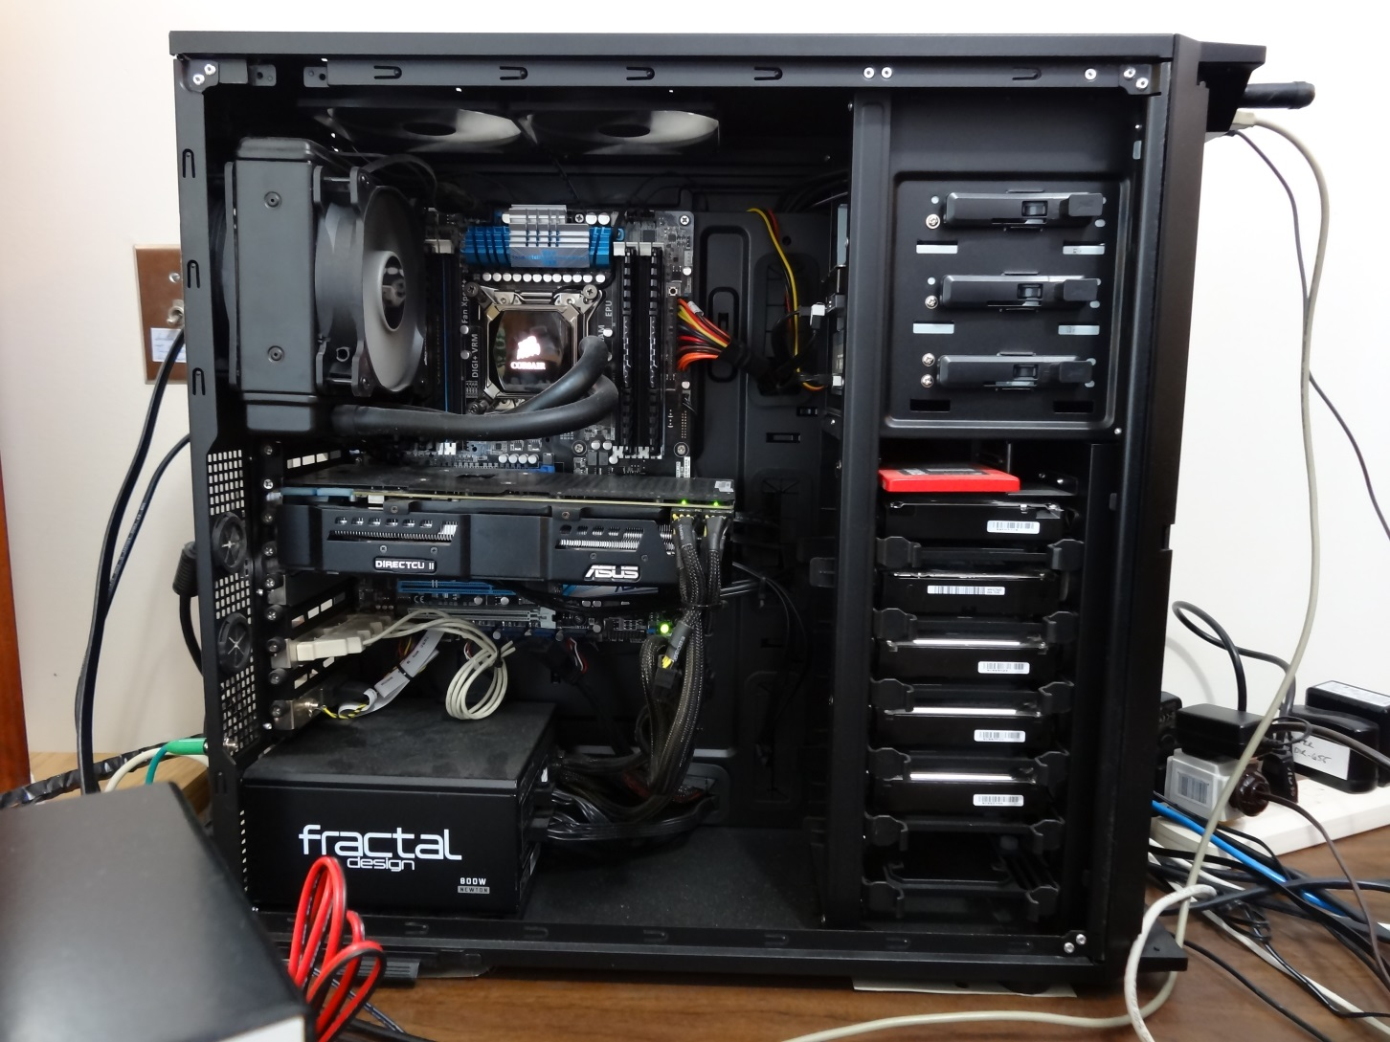
The Real Transceiver Revealed
Several times more powerful than needed. Older dual core 3 GHz was too slow.

Slide 12
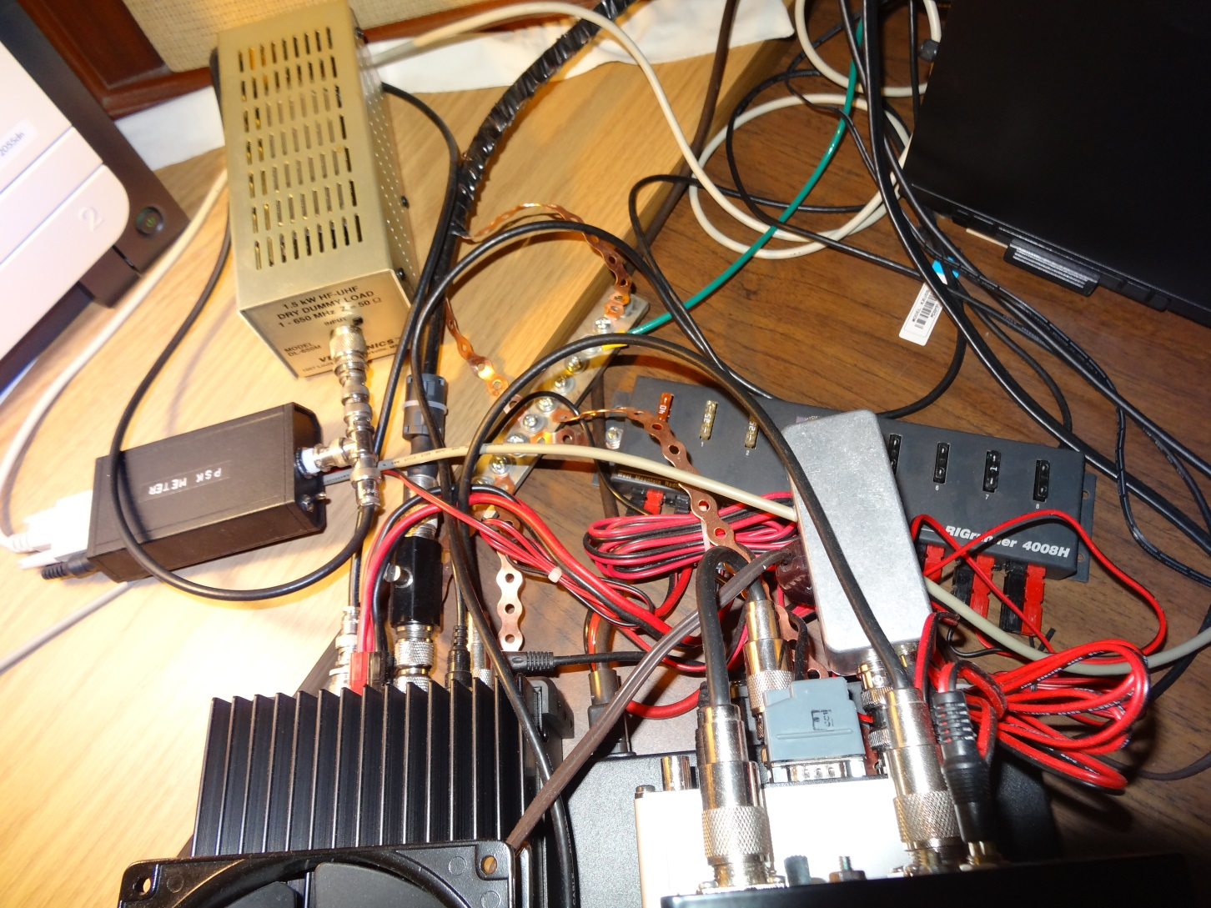
Rats Nest
Precision 10 MHz ovenized stable source for Flex 1500

Slide 13
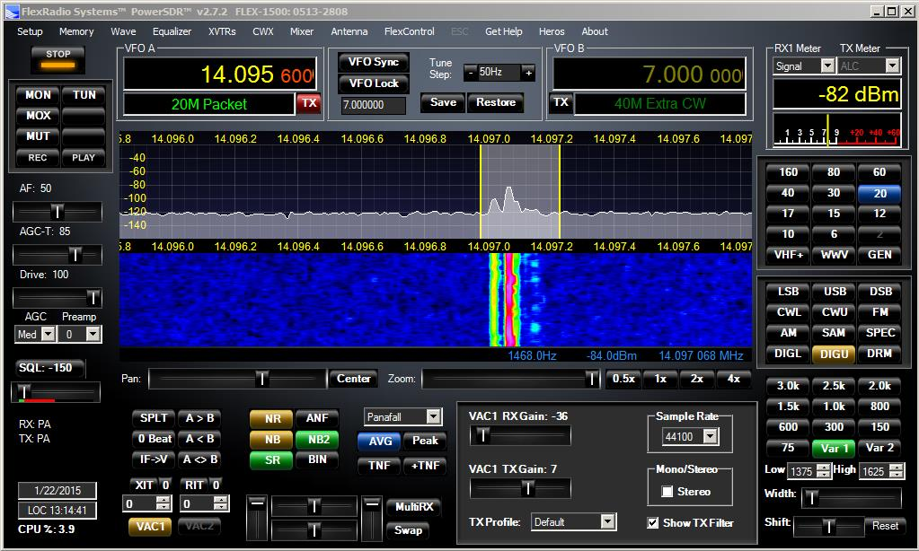
FLEX-1500 Window Doing WSPR
Transmit passband between yellow lines
Receive passband (dark grey)
WSPR makes very effective use of the spectrum space it uses. Some say WSPR wastes spectrum
space that should be used for SSB. Here we have 5 signals in 200 Hz.

Slide 14
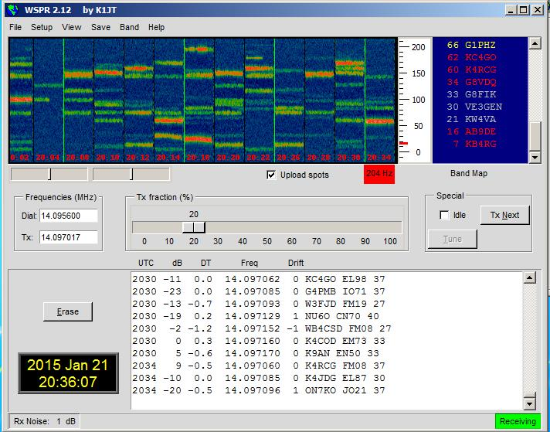
WSPR.EXE Window
WSPR subband
In Hz
UTC
Transmit
Freq.
To WSPR.NET

Slide 15
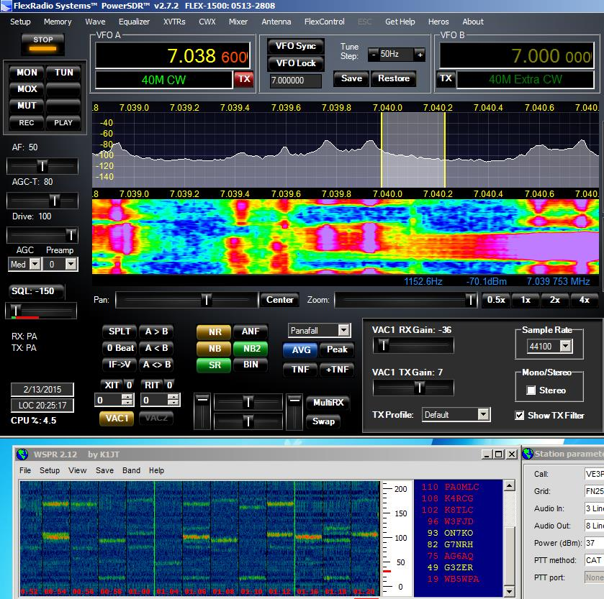
Some People Do Not Like WSPR

Slide 16
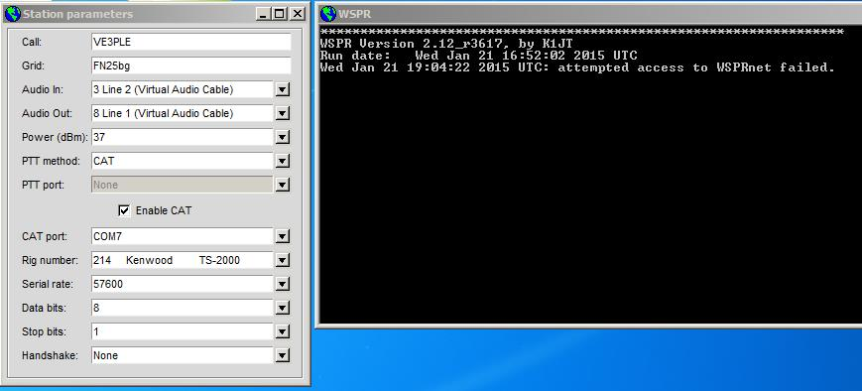
WSPR Extra Windows
My rig is not on the list
VAC (virtual audio cable) replaces all audio connections with digital over USB.
Bug - you must refresh the Audio In and Out each time you start WSPR.EXE – ugh!

Slide 17
WSPR.NET
A web site that records all WSPR messages sent and received world-wide in a data base
Propagation statistics are computed from this data to predict what amateur band communications are possible at the time
You can tailor displays to see how you are doing, both what stations you have received and what stations have heard you

Slide 18
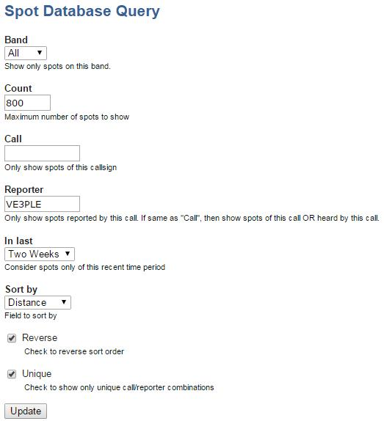
WSPR.NET Display Control

Slide 19
WSPR.NET Spot Database Samples
Timestamp | Call | MHz | SNR | Grid | Pwr | Reporter | RGrid | km | az
2014-12-04 12:40 | VE3PLE | 7.040027 | -21 | FN25bg | 5 | VK6ZT | OF78sq | 18175 | 324
2014-11-30 10:38 | VE3PLE | 10.140131 | -22 | FN25bg | 5 | VK5KJP | PF95fc | 16903 | 280
2014-12-09 13:42 | VE3PLE | 7.040019 | -28 | FN25bg | 5 | VK5EI | PF95gc | 16897 | 280
2014-12-03 21:04 | VE3PLE | 14.097022 | -21 | FN25bg | 5 | VK5MR | PF96lh | 16792 | 281
2014-12-02 11:38 | VE3PLE | 7.040020 | -19 | FN25bg | 5 | VK3CRG | QF21ex | 16612 | 269
2014-11-30 09:38 | VE3PLE | 10.140117 | -18 | FN25bg | 5 | VK7TW | QE37pc | 16598 | 259
2014-12-03 00:18 | VE3PLE | 14.097025 | -25 | FN25bg | 5 | VK7ZGK | QE37pd | 16597 | 259
2014-12-03 20:46 | VE3PLE | 14.097011 | -21 | FN25bg | 5 | VK7ZL | QE37pd | 16597 | 259
These are the top lines out of hundreds of lines, all in reverse distance order

Slide 20
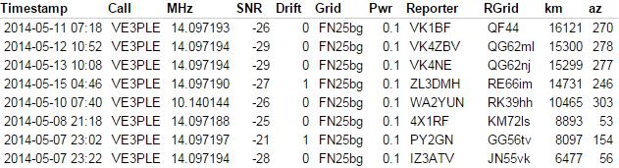
100 mW Gets To Large Distances

Slide 21
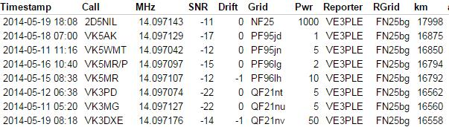
Me Receiving

Slide 22
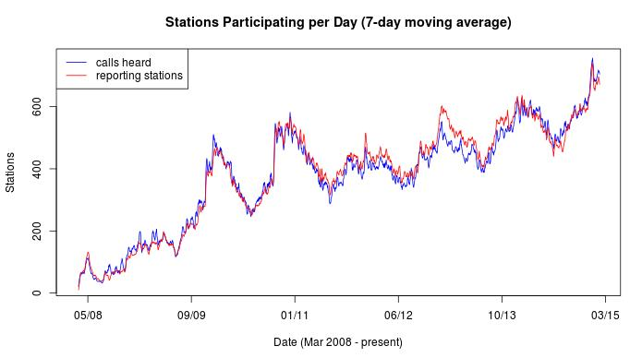
WSPR.NET Statistics

Slide 23
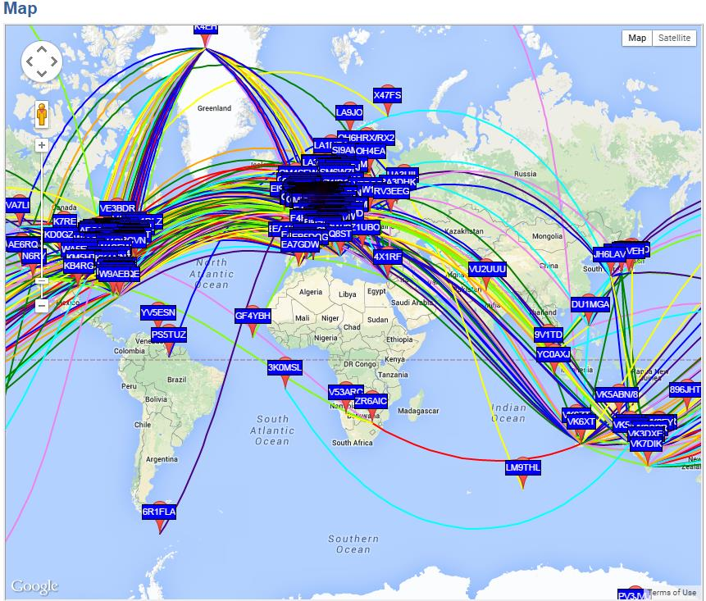
40 m, 24 hours, all stations

