Slide 1
WCARC VHF/UHF Beacon Relocation
To 1655 Stittsville Main St

Slide 2
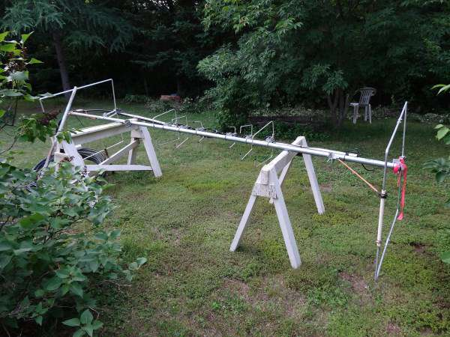
Beacon Relocation
The nested stack antenna array required a lot of adjustment after the rough ride from Almonte and Richmond.
A number of rusted nuts and washers were replaced.
Several connectors were tightened. No retuning was done.

Slide 3
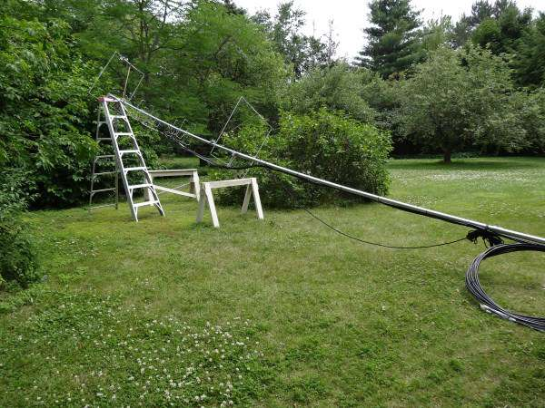
Beacon Relocation
The new 20 ft mast, comprising two 1.5” ID 10 ft metal conduits with one 1.25” ID metal conduit stiffener inside was laid out between the step ladder and the base.
Heliax is dressed and ready for the erection crew.

Slide 4
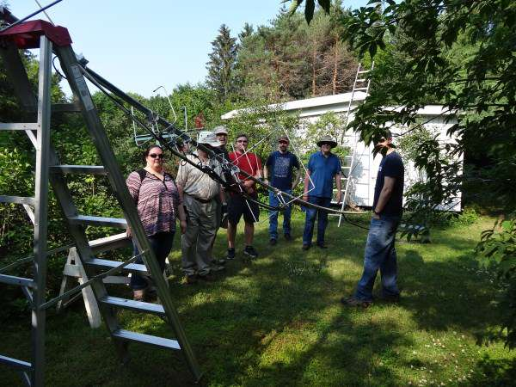
Beacon Relocation
The Crew:
Margaret VA3VXN
Glenn VE3XRA
Wayne VE3CZO
Randy VE3AX
Tyler VA3DGN
Doug VE3XK
Clayton VE3IRR
Photographer
Paul VE3PLE

Slide 5
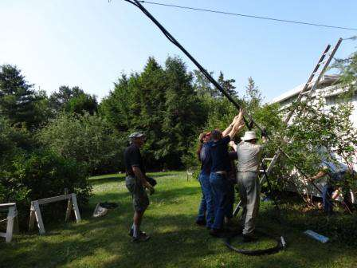

Beacon Relocation
Up she goes.

Slide 6
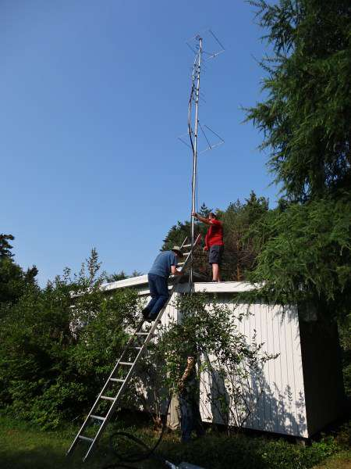
Beacon Relocation
Doug VE3XK, screws in the lag screws to hold the pipe brackets while Randy VE3AX steadies the mast.
Subsequently, Randy ties the “upwind rope guy” to an eye bolt on the opposite eve, to supplement the pipe clamps in a heavy wind.

Slide 7
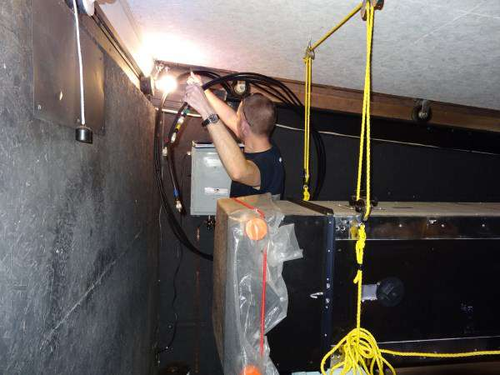
Beacon Relocation
Tyler VA3DGN pulls the 3/8” Heliax into the building.
The close 150 watt bulb made that task very uncomfortable
The telescope in foreground is now gone.

Slide 8
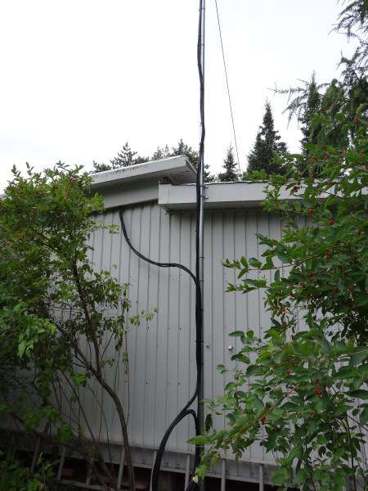
Beacon Relocation
This is the final layout of mast and feedine cables after redressing them the following day.
It was necessary to pull out all the cable from the building to re-coil it neatly.

Slide 9
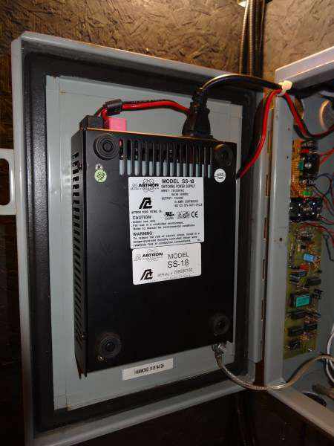
Beacon Relocation
Since moving the beacons from the Almonte location, one major improvement was mounting the power supply on the lid.
This allows easier access to the electronic modules.

Slide 10
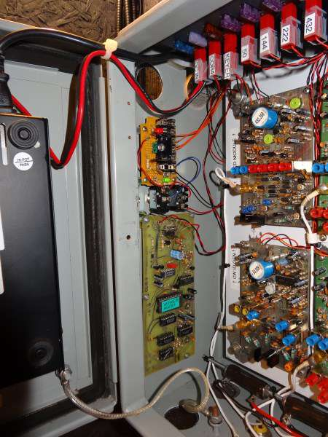
Beacon Relocation
The Identification Generator is the module on the left. The ID EPROM has a light green label.
The small perf board has the circuitry to simultaneously key all four beacon final amplifier 12V power lines.
Thanks to Paul VE3PLE for the green and red LED’s to confirm keying from the ID Gen and keying output.

Slide 11
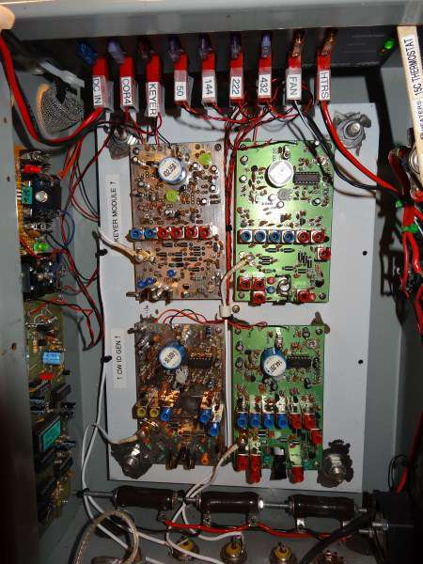
Beacon Relocation
The overall view of the beacon cabinet shows the four beacon modules with the Rig-Runner power distribution/fuse panel at top.
Along the bottom, above the RF connectors, are the wire-wound resisistor heaters with 70 kHr fan at right. A15°C thermostat is on the wood strip.
The Keying/Carrier and RF On/Off switches are on the left and the Fan and Heater On/Off switches are on the right.

Slide 12
Beacon Relocation
Ron Klimas WZ1V has been advised so he can update his VHF/UHF/Microwave Beacons List
Rick VE3CVG reports from Cumberland that he is now hearing all four beacons better than ever before!
Other local reports are variable but reasonable.
Randy VE3AX reports that the 6M beacon has been heard in Florida from the new location.
So much for foliage attenuation fears!

Slide 13
That’s All Folks
Thank you
VE3XK

