Slide 1
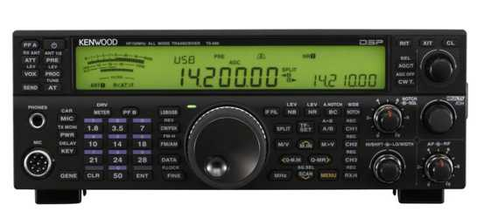
Adding CW Skimmer to the 11.347 MHz
IF Test Point of the
Kenwood TS-590S
Transceiver
Photo © Kenwood
Doug Leach – VE3XK

Slide 2
TS-590S / CW Skimmer
Several recent postings have been made about using various Software-Defined Radios to display signals from the CN101 RF Test Point just behind the TS-590S Transmit/Receive relay.
This method at least avoids the need for an additional T/R relay but requires that the SDR operate as a parallel radio to the TS-590S.
The frequency calibration of that parallel radio does not track the dial of the TS-590S, which can be disconcerting.

Slide 3
TS-590S / CW Skimmer
My sincere thanks to Cornell Drentea KW7CD for his informative post to a QRZ Forum suggesting connection to TS-590S IF Test Point CN301 for a panoramic display. CW Skimmer provides a panoramic display (Bandscope) but it also decodes call signs and presents them on a waterfall display, with point and click capability.
Since it is before the IF bandpass filter, Test Point CN301 provides an 11.347 MHz IF signal with approximately 200 kHz bandwidth at a signal level of –104 dBm.

Slide 4
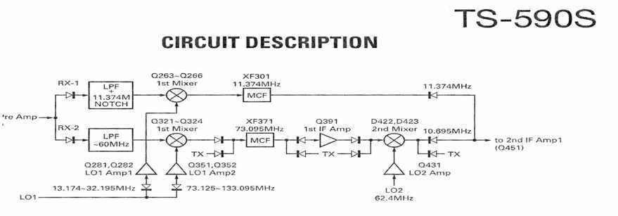
TS-590S / CW Skimmer
The block diagram shows the RX1 path through the 1st Mixer to the 11.347 MHz Bandpass Filter. CN301 is just after the Mixer and presents a 200 kHz bandwidth.
The 11.347 MHz IF is limited to 160, 80, 40, 20 and 15 M.
Because the Local Oscillator is above the IF, the IF signal is inverted. This is an important factor for signal processing.
Diagram © Kenwood

Slide 5
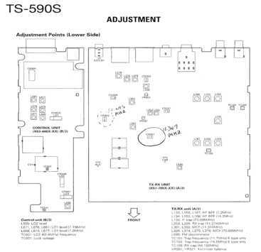
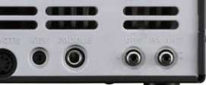
TS-590S / CW Skimmer
CN301 comprises two pins.It is located in the middle of the circuit board just inside the bottom cover of the TS-590S. A coaxial cable such as RG-174 can be soldered to those pins and led outside the TS-590S through a file-enlarged fold at the rear bottom right corner of the case.
The other test point CN302 provides the 10.695 MHz IF signal but is behind a 6 KHz bandpass filter, so is of very limited use for Bandscope or CW Skimmer.
Diagram and photo © Kenwood

Slide 6
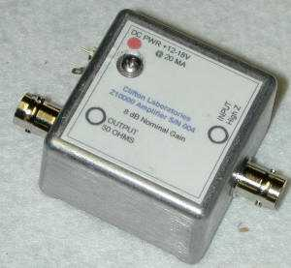
TS-590S / CW Skimmer
I used a Clifton Labs Z10000B Buffer Amplifier to minimize TS-590S IF circuit loading at CN301. It also features 90 dB Reverse Isolation that prevents leakage from the SDR getting back into the radio. Order or build it with a gain of 0 dB.
This unit requires a source of 12Vdc@20ma. It has BNC connectors from the CN301 cable and output to the Ensemble II Software Defined Radio.
Photo © Clifton Laboratories

Slide 7
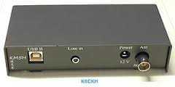
TS-590S / CW Skimmer
Since the Software Defined Radio is going to be used only for operation at IF, I chose the inexpensive SoftRock Ensemble II Receiver. This is available in kit form or assembled. The optional case is shown (R).
Connections shown:
  USB cable to your PC
  Stereo audio cable from Line In to your PC Line In jack
  12 V DC @50 ma
  BNC cable from Clifton Labs Z10000B Buffer Amp
Photo © K0CKH
See product documentation for SDR Theory of Operation and schematic diagrams.

Slide 8
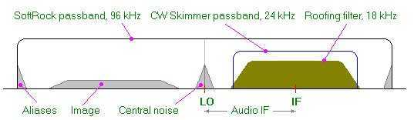
TS-590S / CW Skimmer
Diagram © Afreet
CW Skimmer CWS) may be used with a stand-alone SDR, on a 3 KHz audio signal, or, as here, on the IF of a transceiver.
The diagram shows CW Skimmer’s 24 passband positioned to cover the 11.347 MHz IF output of the TS-590S.
The 24 kHz passband avoids aliases, image and central noise.
In this application there is no 18 KHz Roofing Filter.

Slide 9
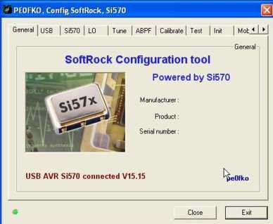
TS-590S / CW Skimmer
The computer you are using (XP, Vista, W7, W8,32 or 64 bit) dictates what driver and Root Certificate you download and install before you connect USB, download and install CFGSR. Read instructions carefully before downloading.
Photo © PE0FKO
The Ensemble II Receiver includes a tunable Local Oscillator. This can be set to the user’s choice of Si570 Output Frequency using the CFGSR SoftRock Configuration Tool, as shown, downloaded from the PE0FKO web site (See References).

Slide 10
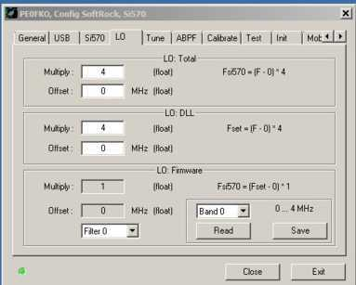
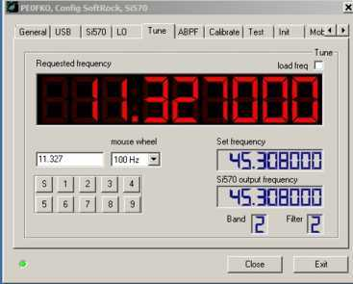
TS-590S / CW Skimmer
Photos ©
PE0FKO
Ensure the LO screen settings are as shown (L).
Ignore the “Si570 output frequency” legend and set the “Requested frequency” (red digits) to 11.327000 MHz, 20 kHz below the signal from the TS-590S, using your mouse wheel and the mouse wheel window.
As this is below the inverted IF passband from the TS-590S, the passband remains inverted as passed to CW Skimmer.

Slide 11
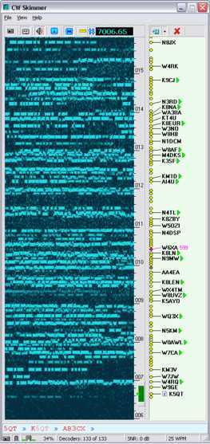
TS-590S / CW Skimmer
CW Skimmer provides a panoramic display of all CW activity but it also decodes and displays call signs.The small window shows TS-590S frequency
With Start button selected (Under File), the waterfall starts. It flows horizontally to display the lettering.
The photo (R) shows a 10 kHz wide pileup calling a DXpedition. W6XA just gave a 599 report so that is where the DX is listening.
Just point and click and send your callsign.That is much much more than just a panoramic display!
Photo © Afreet

Slide 12
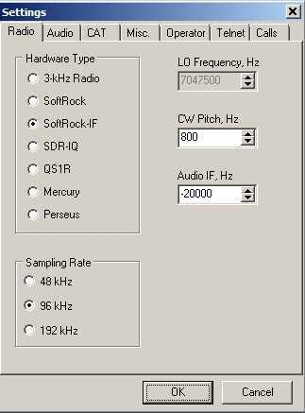
TS-590S / CW Skimmer
Photo (R) shows the CWS Radio screen with Soft-Rock-IF selected, 96 kHz sampling rate, and 800 Hz CW Pitch.
The Si-570 LO is below the inverted IF from the TS-590S. So it remains inverted. Set the “Audio IF, Hz” to -20000 Hz.
This initial setting will change in the calibration process.
Photo © Afreet

Slide 13
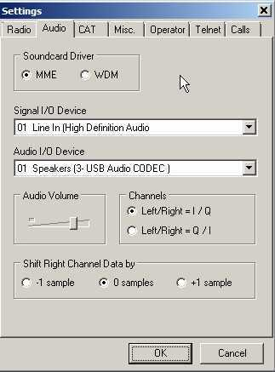
TS-590S / CW Skimmer
Photo (R) shows the CWS Settings Audio screen with MME Soundcard Driver selected (works best with my Windows 7), SigmaTel Audio and USB Codec (in my Signalink USB)
The SigmaTel bandwidth is 96 kHz and the SignaLink 48 kHz, best settings for my audio setup.
With a -20000 Hz Audio IF, set Left/Right = Q/I as shown.
Photo © Afreet

Slide 14
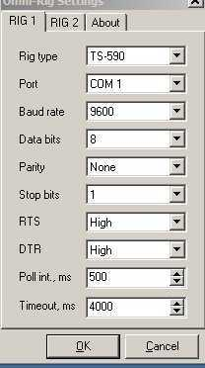
TS-590S / CW Skimmer
The CAT Configure settings allow the TS-590S frequency to be displayed on the CW Skimmer display and for Point and Click control from CWS of the transceiver frequency.
The OmniRig application, downloaded with CW Skimmer, and enabled by these CAT settings, also integrates with AALog, Logic 9, Log4Win as well as FAROS and Bandmaster
Photo © Afreet

Slide 15
TS-590S / CW Skimmer
To allow Point and Click operation, you must calibrate the CWS frequency display up the right side of the screen to agree with the TS-590S frequency in the small window.
Tune to the CW portion of an active band and copy a CW signal – ideally W1AW Code Practise. As you listen to that signal watch the CWS display for that same signal. It will probably be off the bottom of the scale.
Iterate the “Audio IF, Hz” setting in the Radio screen to move the signal on the CWS display so it is exactly at the cursor position (TS-590S frequency). (You can drag the scale. I placed the pointer at the top of the scale.)
Start with 10 KHz steps until you see the signal on screen.
Then you can slow the correction amount until the two dial scales agree. This process takes many corrections.
My initial -20000 Hz is now -46985 Hz. Yours will differ.

Slide 16
TS-590S / CW Skimmer
The span of frequencies shown on screen depends on the height setting of the window on your screen.
You can “drag” the display up or down to cover more of the band than one window width of frequencies.
You can also drag the cursor, but keep it on-screen.
The CWS Help files are very informative. You will find them useful in choosing other Settings and modes.
The Bandscope feature, selected under View, shows a conventional panoramic display, as in a spectrum analyzer. The Bandscope is only functional on CW signals and unmodulated carriers. AM or FM signals will not show on the display.

Slide 17
TS-590S / CW Skimmer
There is much more that can be said about using CW Skimmer for DXing and contesting.
You should not use any decoding software without knowing Morse code. Decoders make errors. They are just helpful crutches.
To use CWS in a contest, register in “Assisted Mode” or equivalent.
Callsign validation may be selected and checked against a Master data list of valid contest station callsigns downloaded from the internet.
CWS can even generate automatic DX Spots to the Reverse Beacon Network. You can be your own DX Cluster Node.

Slide 18
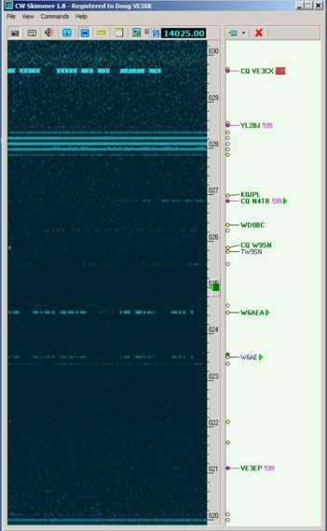
TS-590S / CW Skimmer
Canada Winter Contest
20M screen grab
12-27-14 at 4:55 PM EST
Transceiver tuning centred on scale.
Shows +/- 5 kHz range on screen
CW Skimmer Troubleshooting states that horizontal stripes are due to insufficient CPU time to repaint the waterfall but they seem not to affect ability to display stations heard.

Slide 19
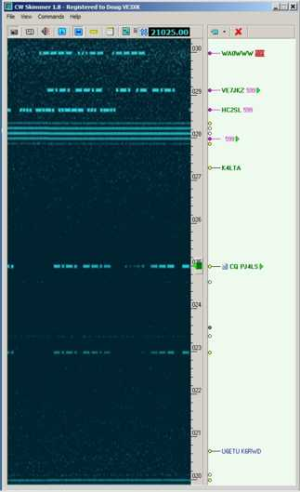
TS-590S / CW Skimmer
Canada Winter Contest
15 M screen grab
12-27-14 at 4:55 PM EST
Transceiver tuning centred on scale.
Shows +/- 5 kHz range on screen
To reduce CPU consumption CW Skimmer developer suggests lower sampling rate, smaller window size or enabling adaptive number of decoders. No success for me with any of these suggestions.

Slide 20
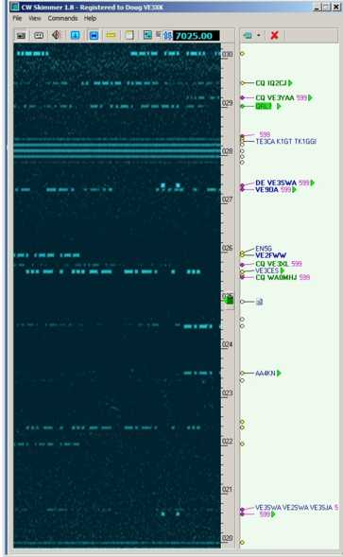
TS-590S / CW Skimmer
Canada Winter Contest
40M screen grab
12-27-14 at 4:52 PM EST
Transceiver tuning centred on scale.
Shows +/- 5 kHz range on screen

Slide 21
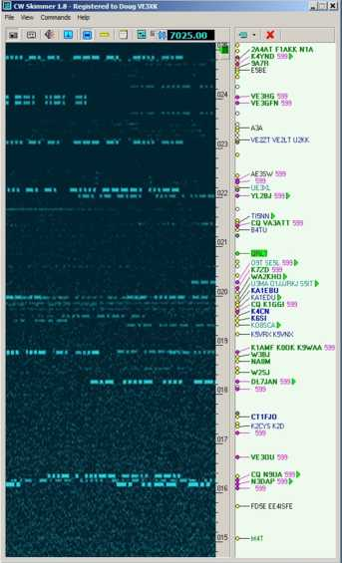
TS-590S / CW Skimmer
Canada Winter Contest
40M screen grab
12-27-14 at 5:23 PM EST
Transceiver tuning at top of scale.
Shows -10 kHz range on screen

Slide 22
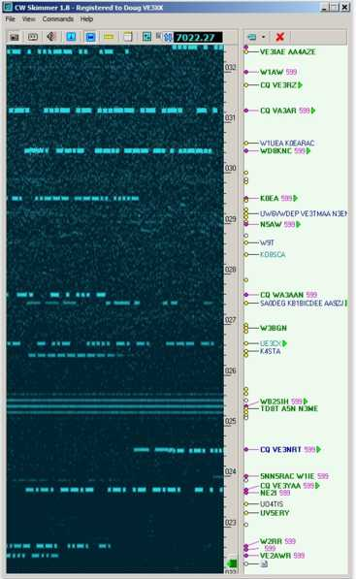
TS-590S / CW Skimmer
Canada Winter Contest
40M screen grab
12-27-14 at 5:50 PM EST
Transceiver tuning at bottom of scale.
Shows +10 kHz range on screen
Note signals shown and decoded within the band of horizontal stripes.

Slide 23
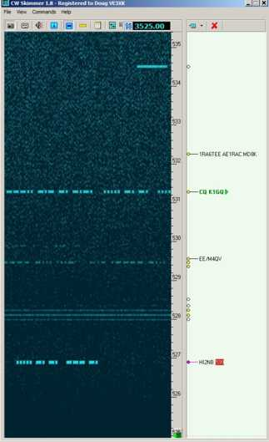
TS-590S / CW Skimmer
Canada Winter Contest
80M screen grab
12-27-14 at 5:34 PM EST
Transceiver tuning at bottom of scale.
Shows +10 kHz range on screen
Noisy 80M band creates decoding errors.

Slide 24
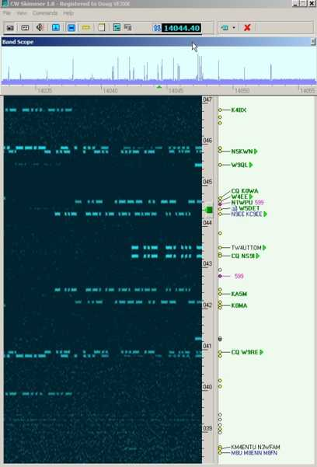
TS-590S / CW Skimmer
CW Skimmer Band Scope
This display shows about 25 kHz of the 20M band centred on 14.044 MHz
Note how much more information is presented on the decoder screen.
Band Scope may be positioned on screen independent of decoder.
Please note that the Band Scope is only for display of CW signals!

Slide 25
TS-590S / CW Skimmer
What did all this cost (US Funds)?
SoftRock Ensemble II Receiver (assembled) & case ~$120
Clifton Labs Z10000B Buffer Amp & Case ~$50
SMA jumper cable ~$20
BNC jumper cable ~$20
USB Cable ~$15
CW Skimmer Registration after free download $75
Total under $300 - cheaper than a stand-alone panoramic display or some SDRs and does so much more for a CW operator.

Slide 26
References
Clifton Laboratories – Z10000B Buffer Amplifier
http://www.cliftonlaboratories.com
SoftRock Ensemble II Software Defined Radio Receiver
http://www.wb5rvz.org/ensemble_rx_ii/
CFGSR Configuration Tool for Ensemble II
http://www.wb5rvz.org/common/softwareinstallation
CW Skimmer Program
http://www.dxatlas.com/cwskimmer/
Please read product descriptions supplied with each product

