Slide 1
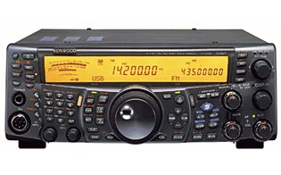
Adding Panoramic Display to my Kenwood TS-2000 Transceiver
Photo © Kenwood
and getting CW Skimmer as a bonus
v4
Doug Leach – VE3XK

Slide 2
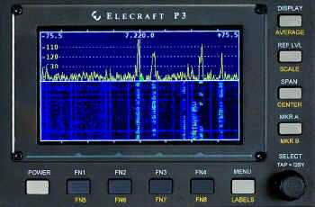
TS-2000 with CW Skimmer
When Rich VE3KI showed me his LP-PAN - similar to the newer Elecraft P3 Panoramic Display (L), I knew that is what I needed in my station to see empty spots on a busy band.
Such IF displays need an external IF connector on the companion transceiver. My Kenwood TS-2000 has none.
Photo © Elecraft

Slide 3
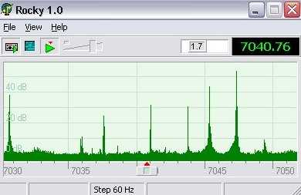
TS-2000 with CW Skimmer
Then Clayton Smith VE3IRR gave his presentation on Software Defined Radio. Aha!!
I didn’t want a stand-alone SDR transceiver but the SoftRock SDR with Rocky software (L) might be a low-cost alternative for my DXing, when connected to my IF, if I had a connector.
Photo © Afreet

Slide 4
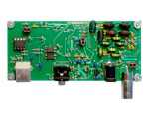
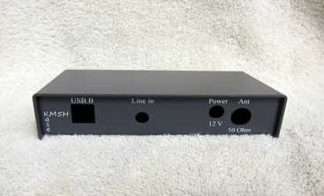
TS-2000 with CW Skimmer
Rocky requires use of one of the SoftRock family of Software Defined Radios.
Shown here (L) are the SoftRock Ensemble II Receiver Module and the companion case.
Photos © FiveDash

Slide 5
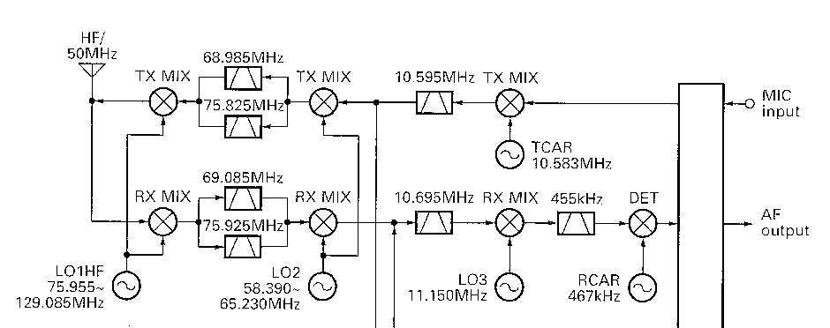
TS-2000 with CW Skimmer
Block Diagram © Kenwood
Above is the Kenwood TS-2000 block diagram.
The First LO is above the RF so the First IF is inverted.
There is no IF Output connector on the rear panel.
A Google search uncovered the excellent paper by Doug Hall K4DSP “SoftRock Interface to Kenwood TS-2000 10.695 MHz IF” . Voila!

Slide 6
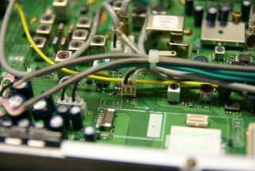
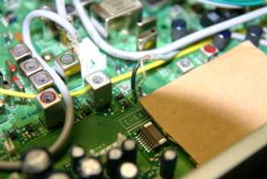
TS-2000 with CW Skimmer
Photos on this and next slide courtesy of Doug Hall K4DSP
Once the TS-2000 bottom cover is removed, you can see the white connector where K4DSP suggests you can tap into the wiring at the Second IF output to add a buffer amplifier feeding an IF Output connector to the SoftRock receiver.
That white connector must be VERY carefully cut away as shown (R) to reveal the black (ground) and white (Second IF) wire pins. There you solder the RG-174 coax to the buffer amplifier input. The cardboard is where the buffer amp will go.

Slide 7
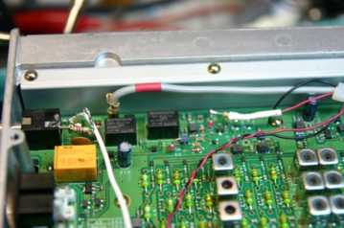
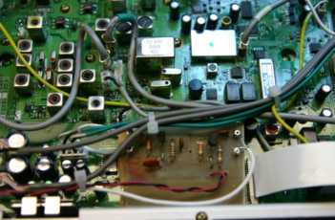
TS-2000 with CW Skimmer
The photo (L) shows the 12V connection point on top of Diode D9. Doug Hall used a 200 ohm resistor (in white heat-shrink tubing) as a fuse. I used a real pig-tail fuse. The ground lug on the black (12V ground) wire is on a ground screw.
The photo (R) shows Hall’s homebrewed buffer amplifier mounted in place of the optional Kenwood DRU-3 module.

Slide 8
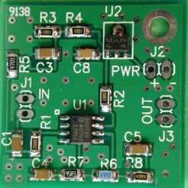
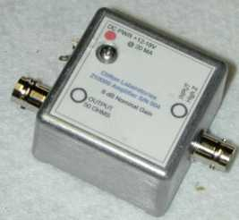
TS-2000 with CW Skimmer
I didn’t want to design and build a buffer amplifier on a pc board so I searched the web and found the inexpensive Clifton Laboratories Z10000B Buffer Amplifier shown below.
It can be bought as a kit, assembled, or with housing (R) – the latter for those who already have an IF Output connector and want to externally mount the IF Buffer Amplifier.
Photos © Clifton Laboratories

Slide 9
TS-2000 with CW Skimmer
The Z10000B has excellent specifications:
  Reverse Isolation: > 90 dB (prevents the SoftRock leakage from getting back into the transceiver IF).
  Input impedance: > 1.5 K at 10 MHz (doesn’t load the IF).
  Output Impedance: 50 ohms (matches the SoftRock input)
  Size: 1.4” X 1.25” (half the size of the homebrewed amp).
  Gain: settable by resistor selection (+15 dB to – 4.2 dB) – factory set at 4 dB gain (which works well here)
  Intermodulation Distortion: -70 dB; IP3 (typical) +30 dBm.
  Bandwidth: >100 MHz (far more than needed here).

Slide 10
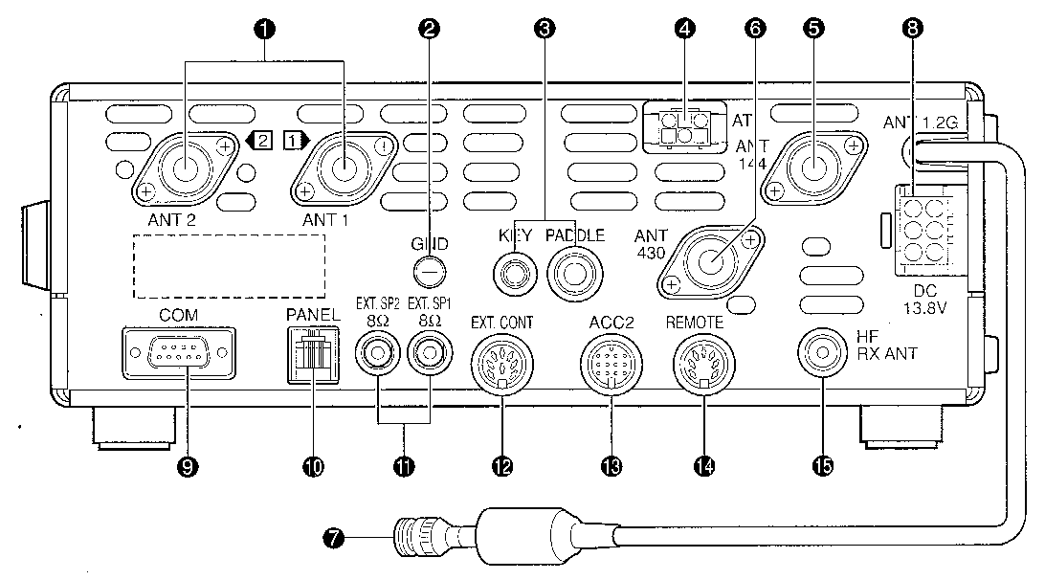
TS-2000 with CW Skimmer
Diagram © Kenwood
With the Z-10000B mounted in place of the cardboard, I was able to run a short RG-174 coax from the output eyelets to an SMA connector through an 1/8” hole filed in the space at the bottom of the PANEL connector (10 above). An SMA to BNC jumper cable then connects to the SoftRock SDR input.

Slide 11
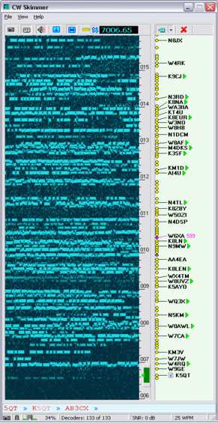
TS-2000 with CW Skimmer
When I spoke with Alex VE3NEA, author of Rocky, he pointed out that my roofing filter(s) may not work well with Rocky’s 48 kHz bandwidth, but that CW Skimmer (CWS) would work well for my application.
Not only could CWS give a panoramic display of all the activity on a band, but it could decode and display call signs!
The CWS waterfall flows horizontally to be able to display the lettering.
The photo (R) shows the pileup calling a DXpedition station.W6XA just gave a 599 report so that is where the DX is listening.
Just Point & Click and send your callsign.
Photo © Afreet

Slide 12
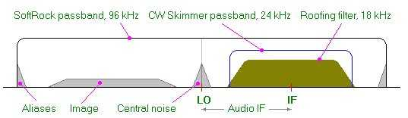
TS-2000 with CW Skimmer
Photo © Afreet
CW Skimmer (CWS) may be used with a stand-alone Software Defined Radio, on a 3 kHz audio signal (overkill), or on the IF of a transceiver (my application).
The above diagram shows the optimal choice of frequency in the SoftRock Receiver local oscillator (20-30 kHz above or below the IF) to avoid aliases and noise getting past the CW Skimmer’s 24 kHz passband.

Slide 13
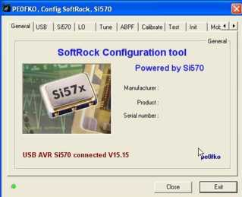
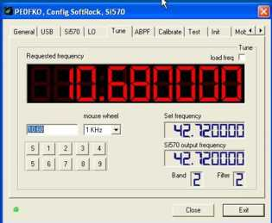
TS-2000 with CW Skimmer
Photos © PE0FKO
The Soft-Rock Ensemble II Receiver includes a tunable Si-570 Local Oscillator. This can be set to the user’s choice of frequency using the CFGSR SoftRock Configuration Tool downloaded from the PE0FKO web site (see References).
The LO frequency here is 10.680 MHz (15 kHz below the TS-2000 2nd IF), as used in the Doug Hall K4DSP article.

Slide 14
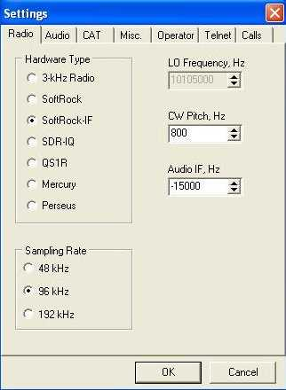
TS-2000 with CW Skimmer
Photo (R) shows the CWS Settings screen with SoftRock-IF, 96 kHz Sampling Rate and and 800 Hz CW Pitch selected.
Though the LO is below the IF, minus15000 Hz is selected as the initial Audio IF as the First IF is inverted. The 15000 will be changed in the final calibration process.
Photo © Afreet

Slide 15
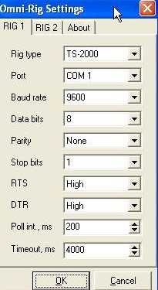
TS-2000 with CW Skimmer
The communications settings shown (R) allow the TS-2000 frequency setting to be displayed on the CW Skimmer display and for Point and Click control from CWS of the transceiver frequency.
The Omni-Rig application also integrates with AALog3, Logic9, Log4Win and some other logging programs, as well as Faros and BandMaster, etc.
Photo © Afreet

Slide 16
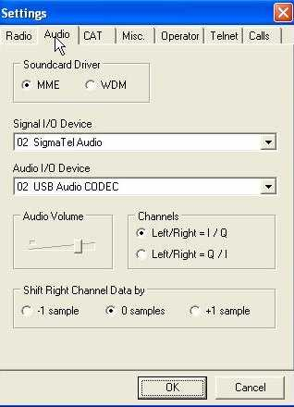
TS-2000 with CW Skimmer
Photo (R) shows the CWS Audio Settings window with MME driver,(it works best in my computer), SigmaTel Audio (my Dell 390 internal soundcard) and USB Audio Codec (my SignaLink USB).
The SigmaTel bandwidth is 96 kHz (input) and the SignaLink 48 kHz (output), which are ideal for CWS.
Photo © Afreet

Slide 17
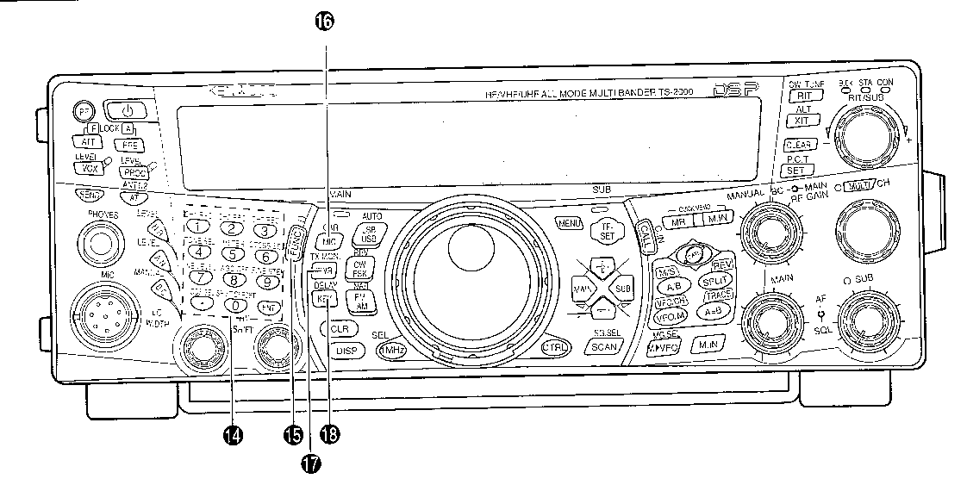
TS-2000 with CW Skimmer
Diagram © Kenwood
Setting up CWS requires knowing the exact frequencies generated by the TS-2000 so that the CWS displays agree with the TS-2000 frequencies.
The convention is for FSK to be generated on lower sideband. The TS-2000 also generates CW on lower sideband, unless the Function key (15 above) is used to select CWR. This is required for CWS compatibility.

Slide 18
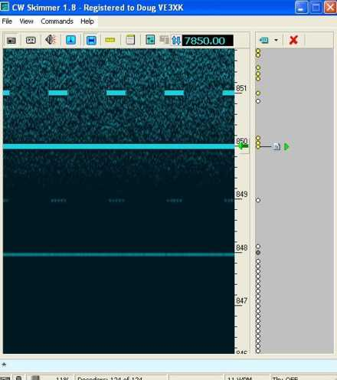
TS-2000 with CW Skimmer
To allow Point and Click, you must first calibrate the CWS display so its frequencies agree with the TS-2000.
Tune the TS-2000 to CHU and zero-beat the carrier using CWR mode. (shown).
Iterate the number in the Audio IF setting window to move the CHU carrier onto the the 7850 line at the green arrow. My initial -15000 setting is now -16165 Hz.
Photo © Afreet

Slide 19
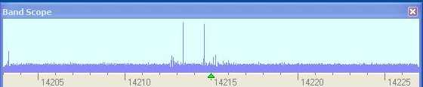
TS-2000 with CW Skimmer
There is so much more that could be said about using the CW Skimmer for DXing and contesting.
CWS can even automatically generate spots to the Reverse Beacon Network and you can be your own personal DX Cluster node. Details are included in the CWS Help files.
I wanted to find a panoramic display for my TS-2000. I have it. My CWS Bandscope shows a quiet 20M band after a solar flare
Photo © Afreet

Slide 20
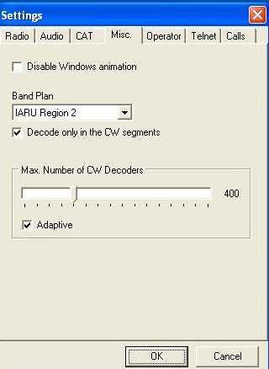
TS-2000 with CW Skimmer
Let’s look at a few of the additional Settings panels that customized CW Skimmer to my station – first the MISC panel.
I can disable Windows animation if I wish
I have selected IARU Region 2 and opted to decode CW signals only in the CW segments of the various HF amateur radio bands.
Photo © Afreet

Slide 21
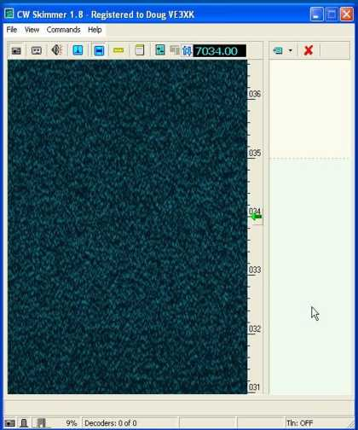
TS-2000 with CW Skimmer
This photo shows a quiet 40M band.
Notice that my CWS-IF setup shown here gives me 5.5 MHz on screen.This can be stretched to almost 11 MHz on screen simultaneously.
Also notice the colour change, indicating the top of IARU Region 2 40M CW band, as selected on the previous MISC panel.
Photo © Afreet

Slide 22
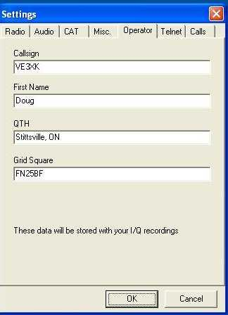
TS-2000 with CW Skimmer
The Operator panel is another step in customizing the setup for any station.
I did not previously mention that I/Q recordings can be made, stored and played back using CWS. The data from this panel are stored with any I/Q recordings.
Photo © Afreet

Slide 23
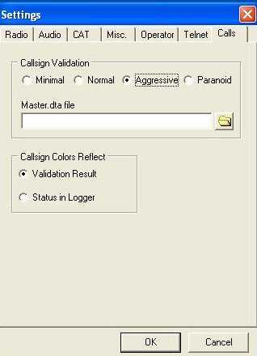
TS-2000 with CW Skimmer
On the Calls panel, you can choose how selective the callsign decoding will be.
Paranoid is for contesters. It is the highest validation and requires CWS to also confirm that a decoded callsign is on the contest callsigns master.dta file, which is down-loaded from the following website: http://www.supercheckpartial.com
The callsign display screen reflects the result of the CWS callsign validation process.
Photo © Afreet

Slide 24
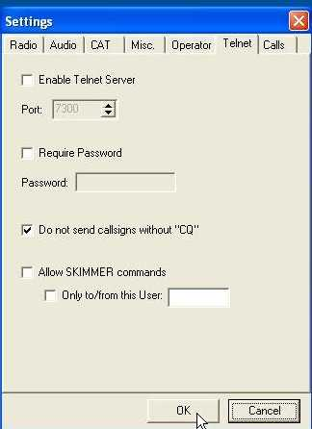
TS-2000 with CW Skimmer
The Telnet panel sets up CWS to originate DX Spots.
CWS can be password-protected.
Spots can be limited to stations calling CQ.
The user can select whether or not the CWS will allow SKIMMER commands sent from an outside source
Commands can also be limited to the local user.
I want to have more experience before I venture into using Telnet.
Photo © Afreet

Slide 25
TS-2000 with CW Skimmer
Some final comments:
  You can’t use CW Skimmer, or any other Morse decoding software, without being competent in Morse code. The decoders make too many errors in the presence of noise. They are just helpful crutches.
  If you plan to use CW Skimmer in a contest you must enter the contest in “Assisted Mode” or equivalent.
  SoftRock is the least expensive SDR, but CW Skimmer is also compatible with SDR-IQ, QS1R, Mercury and Perseus, which all have better performance. On the IF?
  One subtle benefit of using the IF Output connection for the SDR input is that the transceiver does the Transmit/Receive switching, and any linear amplifier setup remains undisturbed. That saves providing a T/R relay and possibly a sequencer.

Slide 26
TS-2000 with CW Skimmer
What did all this cost?
SoftRock Ensemble II Receiver Kit US $67
SoftRock Ensemble II Receiver Cabinet US$20
Clifton Labs Z10000B Buffer Amplifier Kit US$25
Total including shipping and tax about C$135.
CW Skimmer Registration is C$75.
I also bought locally: an SMA to BNC cable, a USB cable and a sound-card audio cable (1/8” Stereo plugs on both ends).
Even bought “assembled” the total cost was well under C$300.

Slide 27
References
“SoftRock Interface to Kenwood TS-2000 10.695 MHz IF” - Doug Hall K4DSP
http://www.telepostinc.com/Mods/K4DSP-TS-2000-mod.pdf
Clifton Laboratories – Z10000B Buffer Amplifier http://www.cliftonlaboratories.com
SoftRock Software Defined Radios – Ensemble II Receiver
http://www.fivedash.com
Configuration Tool for SoftRock Radios CFGSR http://www.pe0fko.nl/CFGSR/
CW Skimmer http://www.dxatlas.com/cwskimmer/
Introduction to CW Skimmer – Pete Smith N4ZR
CW Skimmer One Year Later - Pete Smith N4ZR
What’s Next – Pete Smith N4ZR
Reverse Beacon Network http://www.reversebeacon.net/

Slide 28

TS-2000 with CW Skimmer
Questions?
Thank you
Doug - VE3XK

