Slide 1
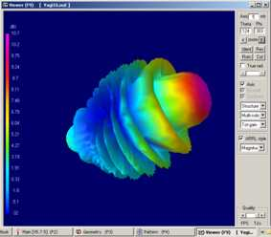
VE3KL Presentation
4NEC2
Antenna Simulator by Arie Voors
Based on the NEC2/4 Fortran Kernel
Uses the classic Method of Moments
Models radiating wires, loads, ground, sources…….more
Four Editors with extensive Math capabilities
Smith Charts
Optimizer
Extremely powerful graphics capabilities
Free, users forum, updated frequently
Notes:
A method that you can use easily to evaluate your own noise environment
A method that you can use to evaluate the quality of the ionosphere at any give time.
Some methods to control received noise
The Shannon Hartley limits

Slide 2
Spherical Coordinate System
Z
θ
Rx Antenna
Elevation angle = 90 - θ
Tx Antenna
Y
XY Horizontal Plane
Z Vertical axis
φ
X
φ is the horizontal azimuth angle
Θ is the angle measured from vertical
Notes:
A method that you can use easily to evaluate your own noise environment
A method that you can use to evaluate the quality of the ionosphere at any give time.
Some methods to control received noise
The Shannon Hartley limits

Slide 3
Method of Moments
A discrete numerical method
Divide wires into many segments…25 per wavelength
Apply Coulomb’s Law and match boundary conditions
Solve large matricies
EE Students usually solve the 3D Capacitor Problem

Slide 4
3D Capacitor Example
Divide plates into 14 segments
Assume each plate has a point charge, ρi…not equal
Apply a voltage V across the plates
Write Coulombs Law for each charge > 14 by 14 Matrix
Solve for charge by matrix inversion
ρ1
ρ2
ρi
V
ρ14
Vj
ρ1>ρ2 .. Charge piles up at edges

Slide 5
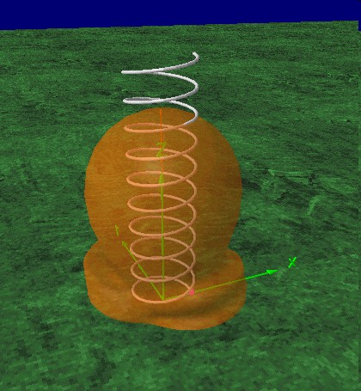
4NEC2
Super Graphics
Helix Antenna
Vertically Oriented
Notes:
A method that you can use easily to evaluate your own noise environment
A method that you can use to evaluate the quality of the ionosphere at any give time.
Some methods to control received noise
The Shannon Hartley limits

Slide 6
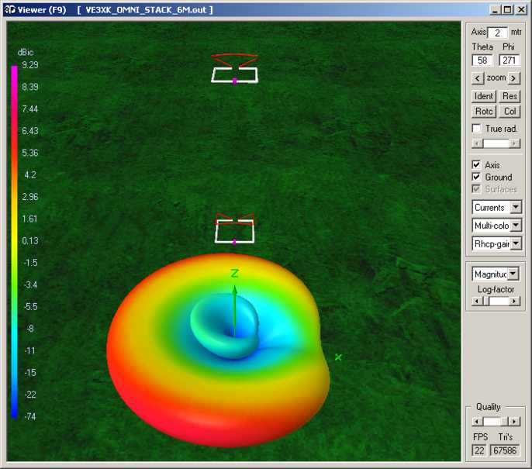
3D VE3XK 50 MHz Stack
50 MHz OMNI
Source Side
Along X Axis
Right Hand Circular
Polarization
Shown
Notes:
A method that you can use easily to evaluate your own noise environment
A method that you can use to evaluate the quality of the ionosphere at any give time.
Some methods to control received noise
The Shannon Hartley limits

Slide 7
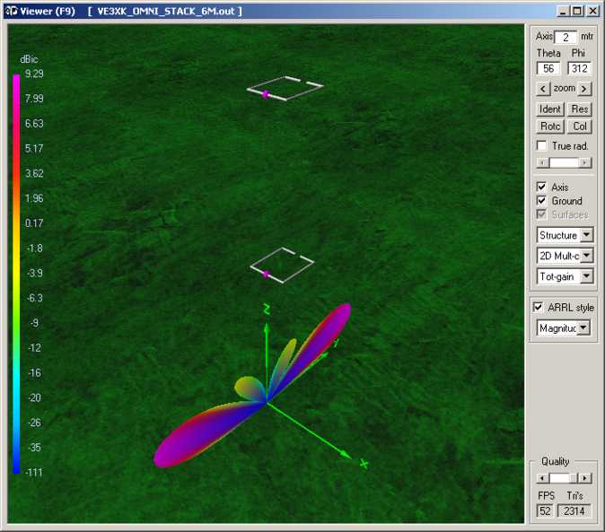
2D VE3XK 50 MHz Stack
50 MHz OMNI
Source Side
Along X Axis
Total Gain
Shown
Notes:
A method that you can use easily to evaluate your own noise environment
A method that you can use to evaluate the quality of the ionosphere at any give time.
Some methods to control received noise
The Shannon Hartley limits

Slide 8
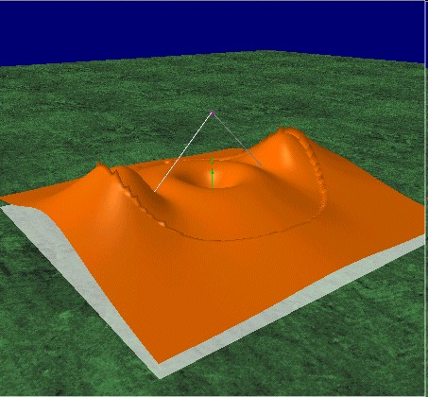
4NEC2
3D Near Field
Notes:
A method that you can use easily to evaluate your own noise environment
A method that you can use to evaluate the quality of the ionosphere at any give time.
Some methods to control received noise
The Shannon Hartley limits

Slide 9
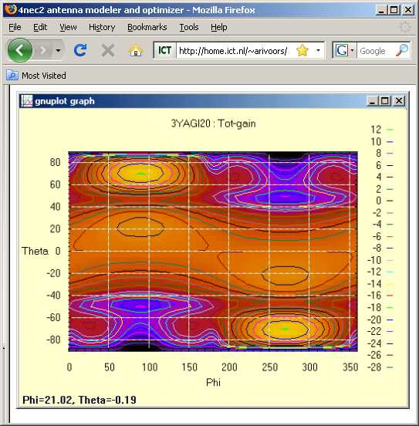
4NEC2
Advanced Far Field Map
θ
High Gain
φ
Notes:
A method that you can use easily to evaluate your own noise environment
A method that you can use to evaluate the quality of the ionosphere at any give time.
Some methods to control received noise
The Shannon Hartley limits

Slide 10
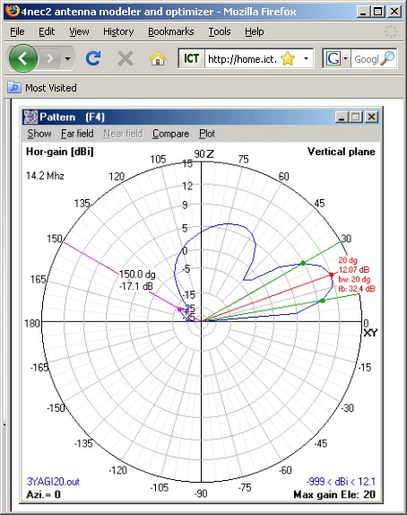
4NEC2
Far Field Traditional Plot
Several Views
Vertical, Horizontal, Total
Circular Polarization
RHC, LHC, Total
Notes:
A method that you can use easily to evaluate your own noise environment
A method that you can use to evaluate the quality of the ionosphere at any give time.
Some methods to control received noise
The Shannon Hartley limits

Slide 11
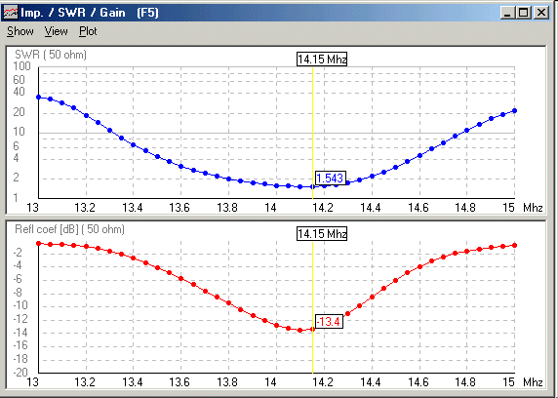
4NEC2
Several Views of Frequency Response
Notes:
A method that you can use easily to evaluate your own noise environment
A method that you can use to evaluate the quality of the ionosphere at any give time.
Some methods to control received noise
The Shannon Hartley limits

Slide 12
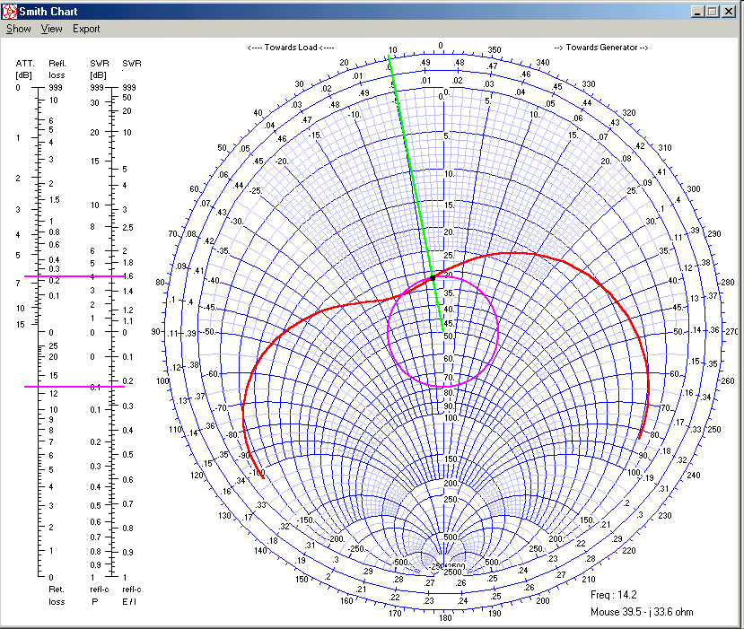
4NEC2
Smith Chart
Notes:
A method that you can use easily to evaluate your own noise environment
A method that you can use to evaluate the quality of the ionosphere at any give time.
Some methods to control received noise
The Shannon Hartley limits

Slide 13
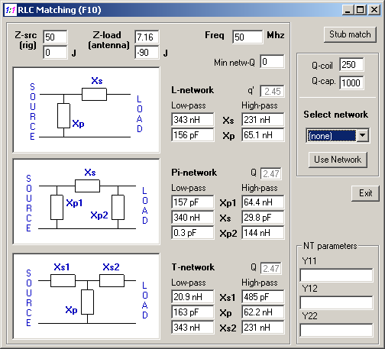
Matching
Notes:
A method that you can use easily to evaluate your own noise environment
A method that you can use to evaluate the quality of the ionosphere at any give time.
Some methods to control received noise
The Shannon Hartley limits

Slide 14
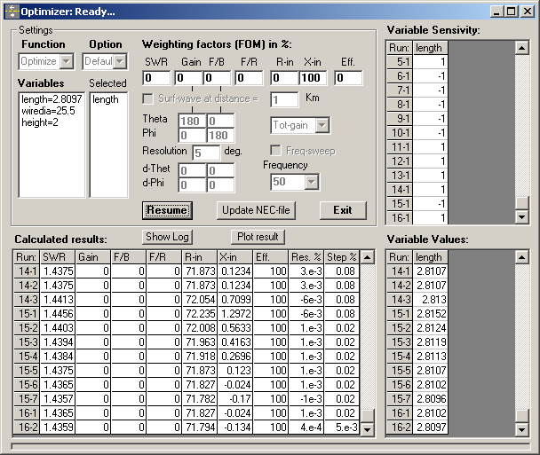
4NEC2..The Big Gun (Optimization)
Optimize (Tune) a 2 metre dipole to 6 metres
Adjust reactance to zero
Vary Length
Results
L= 2.8 metres
Xin = -0.13 Ohms
Notes:
A method that you can use easily to evaluate your own noise environment
A method that you can use to evaluate the quality of the ionosphere at any give time.
Some methods to control received noise
The Shannon Hartley limits

Slide 15
Optimization Issues
An extremely complex and active field of study
Local minimum vs. global minimum .. Optimizer gets trapped
Poorly defined problem by the user .. Optimizer loops forever
Type of Objective function
minimum .. for science and math people
good enough .. for engineers
constrained values .. for engineers
Can be difficult for beginners
Example: An optimizer might set the antenna length to infinity!
Notes:
A method that you can use easily to evaluate your own noise environment
A method that you can use to evaluate the quality of the ionosphere at any give time.
Some methods to control received noise
The Shannon Hartley limits

Slide 16
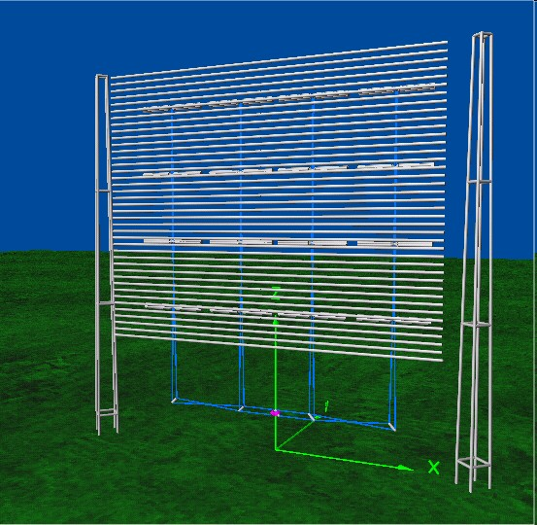
Using the Editors
Define the wires
and axis
Define the
Voltage Sources
Define the Ground
Type if any
Define R,L,C,
Transmission Line
components

Slide 17
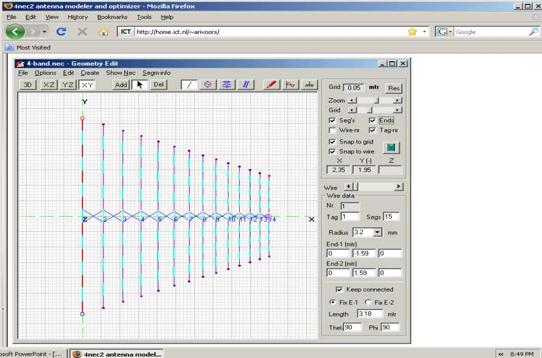
4NEC2
Graphical Editor for Beginners
Notes:
A method that you can use easily to evaluate your own noise environment
A method that you can use to evaluate the quality of the ionosphere at any give time.
Some methods to control received noise
The Shannon Hartley limits

Slide 18
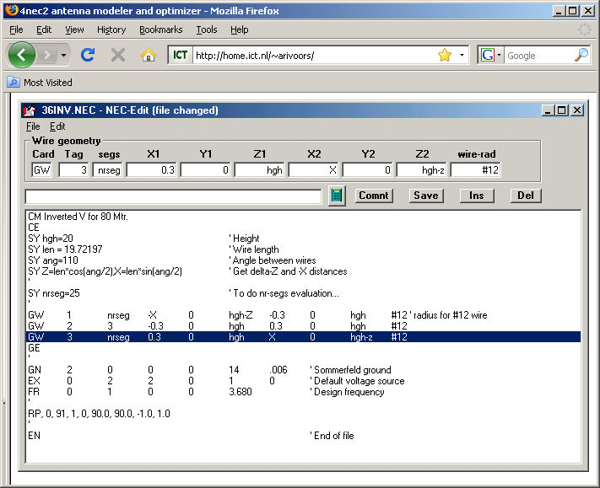
4NEC2 NEC Editor to Describe the Antenna
Note the use of Math
Functions
Notes:
A method that you can use easily to evaluate your own noise environment
A method that you can use to evaluate the quality of the ionosphere at any give time.
Some methods to control received noise
The Shannon Hartley limits

Slide 19
Simple Text Editor
'VE3XK OMNI 6 metres..stack
SY height=3 'height in metres
SY Freq=50.0 'freq in MHz
SY B=0.3556 'metres
SY C=0.8128 'metres
SY D=0.29845 'metres
SY rad=3.17e-3 'metres
SY spacingWave=0.5 'spacing in wavelengths
SY spacing=spacingWave*300/freq 'spacing in metres
GW 1 21 -B 0 height B 0.00 heigh height+spacing rad
GW 8 21 B C height+spacing B-D C
Best for Computer Defined
Antennas
Notes:
A method that you can use easily to evaluate your own noise environment
A method that you can use to evaluate the quality of the ionosphere at any give time.
Some methods to control received noise
The Shannon Hartley limits

Slide 20
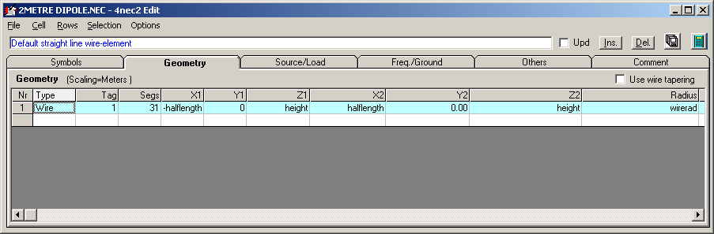
A New Windows Menu Type Editor
Menu Bar on top allows user to define files rapidly
Geometry Menu Open in this example

Slide 21
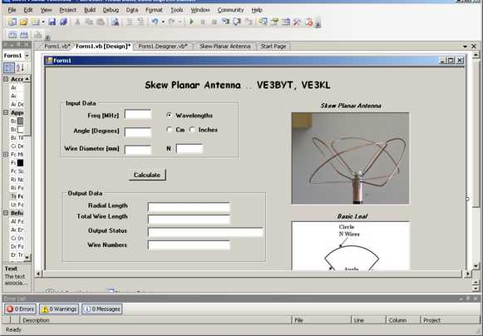
Editing Big Antennas..500 Segments
Complex Geometry
Use VB.Net or C#.net to drive the editors.
4NEC2 Text Editor
VB.net Program
Skew Planar Antenna

Slide 22
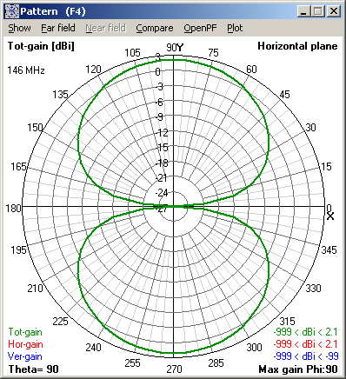
Examples “Simple” 2m Dipole Free Space
-L/2
L/2
X Axis
Horizontal Plane
Theta = 90 degrees
Horizontally Polarized
No Vertical Component
(No surprises Here!)

Slide 23
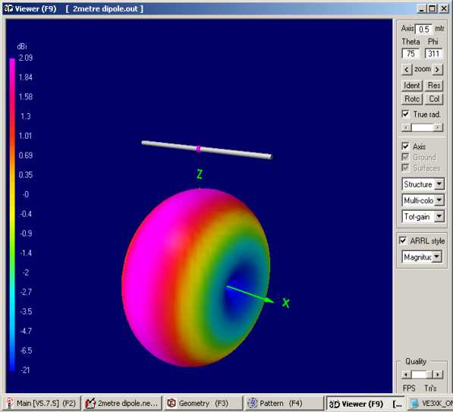
Examples “Simple” 2m Dipole Free Space
-L/2
L/2
X Axis
Horizontal Plane
Theta = 90 degrees
Horizontally Polarized
No Vertical Component
(No surprises Here!)

Slide 24
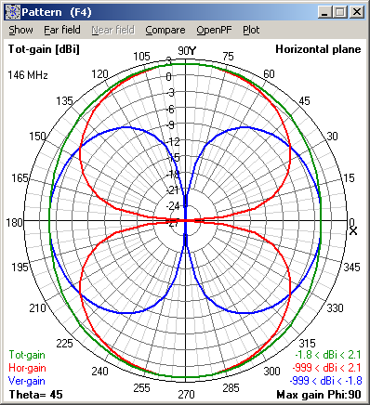
Examples..Simple 2m Dipole
-L/2
L/2
X Axis
Horizontal Plane
BLUE :Vertical E Field
RED: Horizontal E Field
Green: Total Field
Theta = 45 degrees
(Is it OK to say that a dipole
is Horizontally Polarized?)

Slide 25
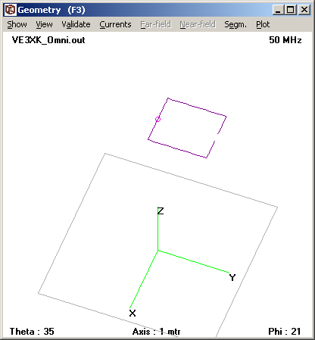
50 MHz Horizontal OMNI
Geometry
Source side on X axis
Horizontally Mounted
Geometry Window

Slide 26
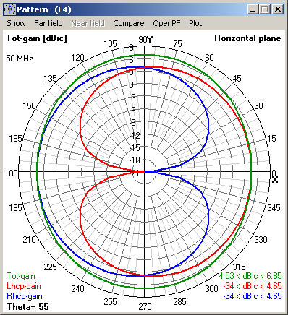
50 MHz Horizontal OMNI Pattern
Horizontal Plane
Showing Circular Polarization
Blue RHCP
RED LHCP
Green Total
Nearly Omni Directional
Circular Polarization on X axis
Linear Polarization on Y axis
Note the Red/Blue Cardioids
θ = 55 Degrees

Slide 27
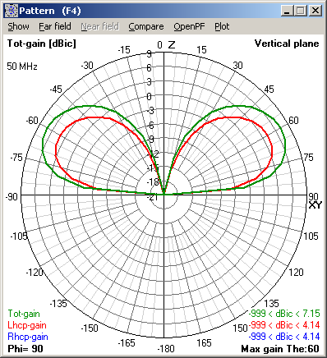
50 MHz Vertical OMNI Pattern
Height = 3 metres
Vertical Plane
Linearly Polarized
Takeoff angle 30 deg
Max Gain = 7.15 dBi
θ = 90 Degrees

Slide 28
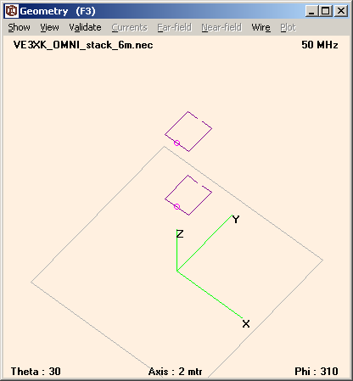
50 MHz OMNI Stack
Same Orientation as Single
Element
Height = 3 metres
Spacing = 0.5 wavelengths

Slide 29
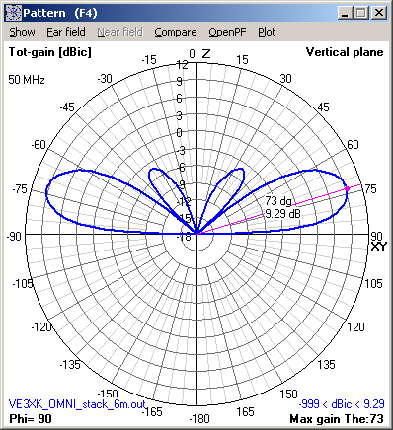
50 MHz OMNI Stack Vertical Plane
Same Orientation as Single
Element
Height = 3 metres
Spacing = 0.5 wavelengths
Gain Increased to 9.29 dBi
Take off angle now 15 degrees
Some high angle side lobes.

Slide 30
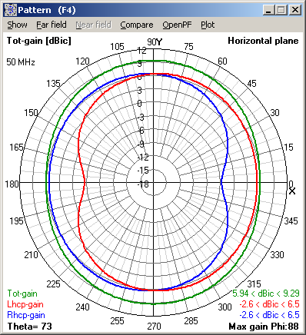
50 MHz OMNI Stack Horizontal Plane
Same Orientation as Single
Element
Height = 3 metres
Spacing = 0.5 wavelengths
Circularly Polarized along the X axis
Θ = 73 degrees

Slide 31
Summary
  Uses NEC2 or NEC4 Engine
  Contains an Optimizer
  Outstanding Graphics capability
  Uses four different editors
  Many features not covered in this talk
Fundamental Wave Reflection Talk Available
73 Dave VE3KL
Notes:
A method that you can use easily to evaluate your own noise environment
A method that you can use to evaluate the quality of the ionosphere at any give time.
Some methods to control received noise
The Shannon Hartley limits

