Slide 1
WCARC Beacon Project
Update May, 2008
Doug Leach – VE3XK

Slide 2
WCARC Beacon Project
Status Report
Enclosure with power supply, fusing, ID keyer and keying distribution amplifier is complete and now able to accommodate up to six beacon modules
The 70CM beacon module has been installed and running flawlessly in my garage for over six weeks
The 70CM KU4AB omni is mounted on a PVC conduit mast at about 10 ft up until tower mounting
Heard in Cumberland, Kemptville and Perth
The 125CM module is now installed and working with a temporary 125CM ground plane antenna on a separate PVC conduit mast about 10 ft up.

Slide 3
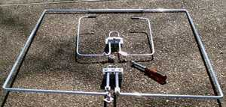
WCARC Beacon Project
The two antennas on order - SQ-50 6M Omni with SQ-222 125CM Omni and nut driver for size comparison.
Note that KU4AB omnis are bent dipoles and not loops. The SQ-50 has a sleeve across the opening for added strength. Both loosely approximate a circular pattern (They are cheaper but inferior in performance to the PAR omnis now unavailable to the ham market).

Slide 4
WCARC Beacon Project
Status Report (cont)
Kieran VA3KS would like to continue operating the VA3SJS 2M beacon for the foreseeable future, and has ordered a second KU4AB omni to be stacked
Our plan to order a KU4AB 2M omni has been switched to a KU4AB 6M omni for use by Bill W4TAA
Soon we will mount the enclosure and mast with 70CM and 125CM omnis hung 58” (1/4 wave on 6M) off the side of the tower at VE3XK
Initially we will continue to use the MFJ 4115 15A 13.5 VDC power supply inside the enclosure with 115VAC run up the tower
Planned antenna configuration is as shown next

Slide 5
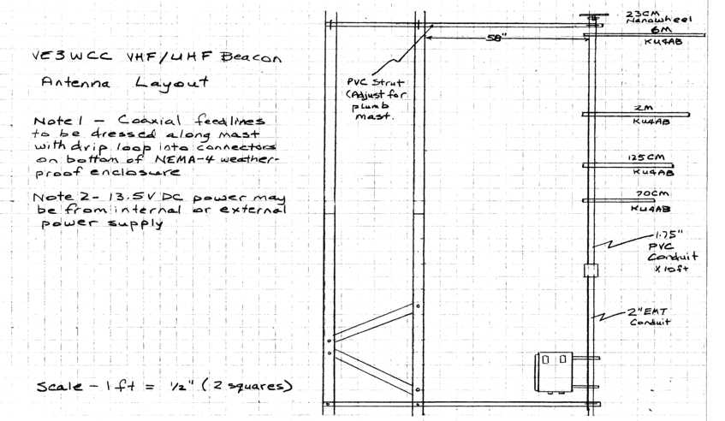
WCARC Beacon Project

Slide 6
WCARC Beacon Project
Use of U-bolts on the tower allows the struts to slide in and out to the 58” spacing needed for 6M.
To compress the vertical space required on the mast, the 6M omni can be on top, half wave at 6M above the enclosure, with the lower band omnis each spaced a half wave below their neighbour.
The smaller antennas have minimal effect on the larger 6M antenna, and the 6M antenna is outside the capture areas of the smaller antennas
The future 23 CM “Nano-Wheel” antenna must be mounted on top of the PVC mast with a pipe clamp around the coaxial connector.
What is planned for a WCARC 23CM beacon?

Slide 7
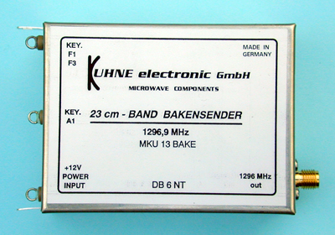
WCARC Beacon Project
Kuhne Electronic GMBH (DB6NT)
23 CM Beacon Module 800 MW; TCXO, -20C to +40C C$370

Slide 8
WCARC Beacon Project
Other DB6NT Beacon modules cover 2.4, 3.4, 5.7, 10.3 and 24.2 GHz ham bands, if and when we ever want to expand into the microwave bands.
They are the perfect complement to Hamtronics which covers only the VHF/UHF bands - 6M through 35CM (except 23CM) – and the same size.
The DB6NT module is a safer choice than adapting the 35CM Hamtronics TB-901 to 23CM.
MKU 13 available only wired and tested - a bit more expensive, but quality of the DB6NT products is superb – well designed using proper microwave packaging and excellent craftsmanship.
Only concern is temperature range and 40C TCXO

Slide 9
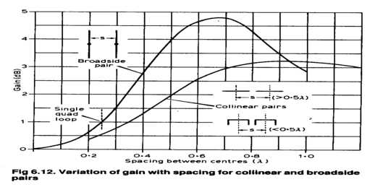
WCARC Beacon Project
The Beacon Program Future
Stacking two omnis ½ wave apart provides good gain improvement without undue side-lobes while reducing the vertical lobe. Could lead to nesting of 6M, 2M, 125CM and 70CM stacks – all on 16 ft of PVC mast.
Better location – well away from receivers of any kind

