Slide 1
WCARC Beacon Project
Update 2
June, 2008
Doug Leach – VE3XK

Slide 2
WCARC Beacon Project
Status Report
Enclosure complete - houses up to six beacon modules
70CM module has been running flawlessly for 8 wks
into 70CM KU4AB omni antenna mounted on a PVC conduit mast at about 10 ft up pending tower mount
Heard in Cumberland, Kemptville and Perth
135CM module has been working for almost a month
into 135CM omni antenna on second PVC conduit mast, about 10 ft up pending tower mount.
Also heard around area with slight chirp. That’s the way that commercial product works.

Slide 3
WCARC Beacon Project
Status Report (cont)
Kieran - VA3KS has decided to restore operation of his 2M store & forward SSTV repeater, so 2M is now available for WCARC weak signal beacon use.
Sean - VE3HXP is donating a GE Mitrek handheld for an interim 2M beacon pending WCARC buying a TA-51/144
Our KU4AB 2M omni order had been switched to a 6M omni for use initially with W4TAA’s 6M beacon.
We need to now re-order that KU4AB SQ-144.
Soon we will hang the enclosure and mast 58” (1/4 wave on 6M) off the side of my tower with 3 bands.
While beacon is here we will continue to use my 15A internal power supply with 115VAC run up my tower.

Slide 4
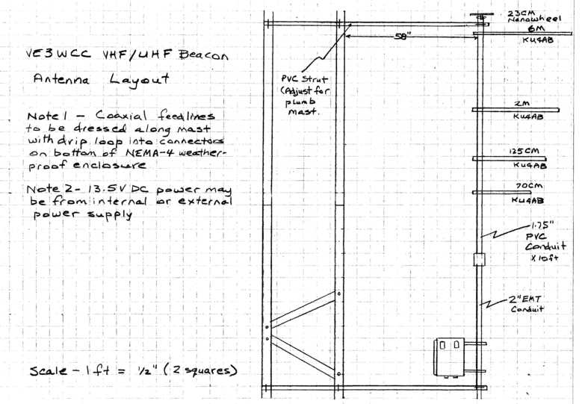
WCARC Beacon Project

Slide 5
WCARC Beacon Project
U-bolts on tower allow L-bracket and strut to slide in (for access) and out to the 58” spacing.
With the proposed Tree configuration, the 6M omni is on top, a half wave at 6M above the enclosure, with the lower band omnis each spaced their half wave below their neighbour.
In theory, the smaller antennas would have minimal effect on the larger 6M antenna, and the 6M antenna is outside the capture areas of the smaller antennas.
The future 23 CM “Nano-Wheel” antenna must be mounted on top of the PVC mast with a pipe clamp around the coaxial connector.
Before thinking 23CM let’s examine our other antennas

Slide 6
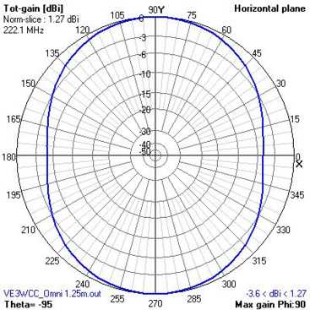
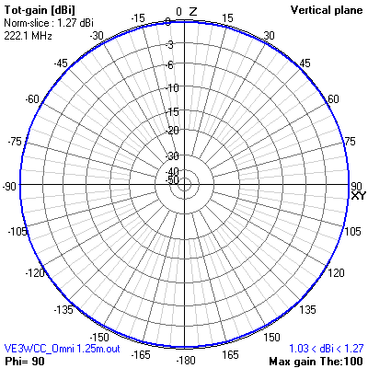
WCARC Beacon Project
Typical KU4AB Omni (Free Space). Note the surprising amount of Vertical Plane radiation (Both Left Hand & Right Hand circular polarization at high angles!)

Slide 7
WCARC Beacon Project
If the KU4AB omni antennas are pretty marginal as stand-alone antennas in Free Space, how is one of them going to perform in the proposed Christmas Tree configuration over a Perfect Ground?

Slide 8
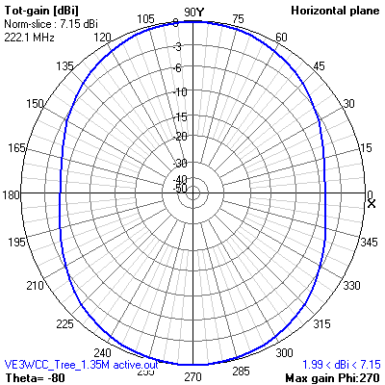
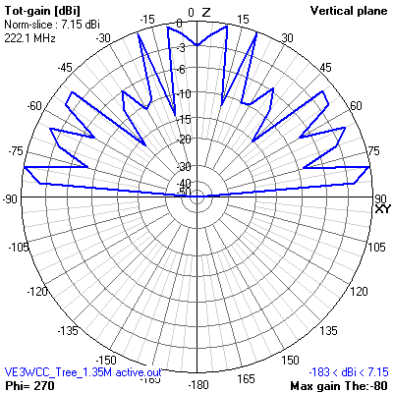
WCARC Beacon Project
SQ-222 antenna in the proposed upside-down Christmas Tree configuration over “Perfect Ground”. Shows 5.88 dB “gain” from ground enhancement.

Slide 9
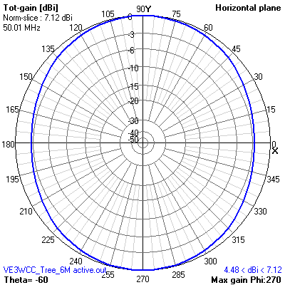
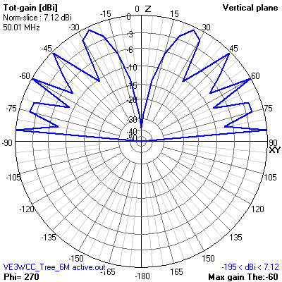
WCARC Beacon Project
SQ-50 antenna in the upside-down Christmas Tree configuration over “Perfect Ground”. Shows 5.83 dB “gain” from ground enhancement. SQ-144/432 similar

Slide 10
WCARC Beacon Project
KU4AB promotes the stacking of his omnis for better performance.
Is this just sales hype?
What effect will stacking have on the performance we saw for a single omni in Free Space?
What gain difference will we observe with 5/8 wave stacking (for maximum gain) over normal 1/2 wave stacking? What is the tradeoff?

Slide 11
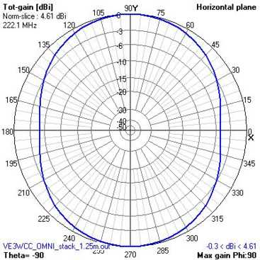
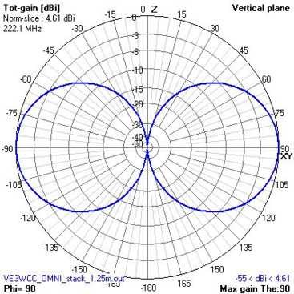
WCARC Beacon Project
SQ-222 Omni Half-Wave Stack (Free Space). Half-wave stacking (as shown) gives 3dB gain and excellent Vertical Plane. All SQs show similar Free Space results

Slide 12
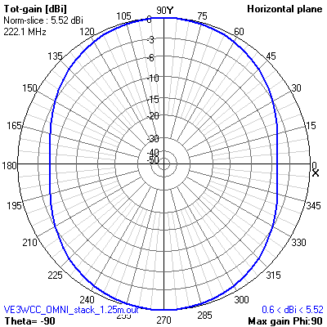
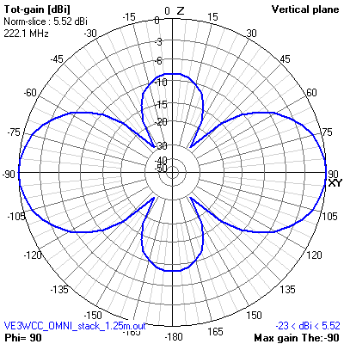
WCARC Beacon Project
SQ-222 Omni 5/8 Wave Stack (Free Space). The added 0.92 dB gain over half-wave stacking comes at the expense of high vertical lobes. Not a good trade-off.

Slide 13
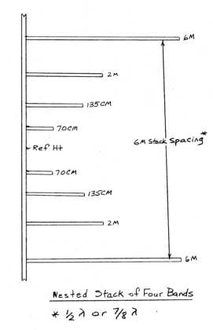
WCARC Beacon Project
If one stack produces good performance, what about nesting 2M, 135CM and 70 CM stacks in a 6M stack?

Slide 14
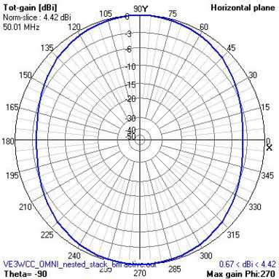
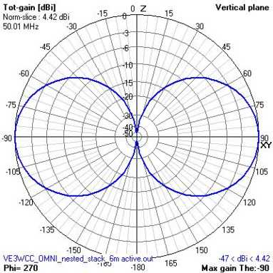
WCARC Beacon Project
SQ-50 Omni active in half-wave stack containing nested 2M, 135CM and 70CM stacks (Free Space)

Slide 15
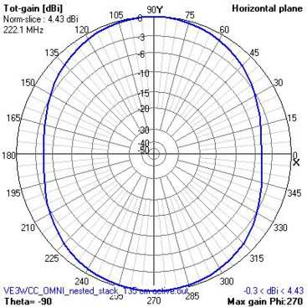
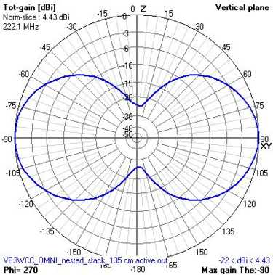
WCARC Beacon Project
SQ-222 active in half-wave stack nested within 2M and 6M stacks and containing 70CM half-wave stack (Free Space). Note slight ground effect in Vertical Plane due to proximity to 6M and 2M stacks.

Slide 16
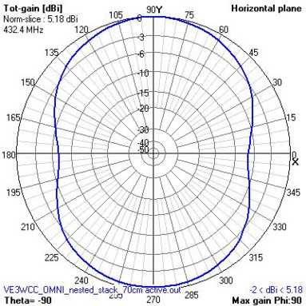
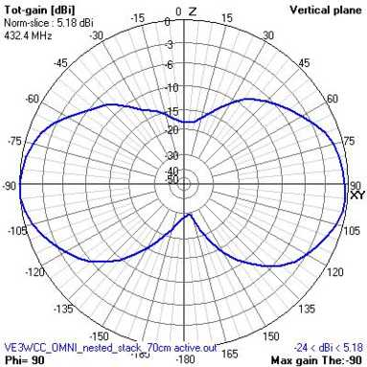
WCARC Beacon Project
SQ-432 active in half-wave stack nested within 135CM, 2M and 6M stacks (Free Space). Vertical Plane shows effect of proximity to other stacks, but good gain.

Slide 17
WCARC Beacon Project
There appears to be no advantage in positioning a smaller stack anywhere but midway between the antennas in a larger (lower band) stack. Any advantage above is lost below and v/v.
You can’t nest inside a Three-Stack or Four-Stack.
Previous projected theoretical performance is in Free Space, but what about working over Ground?
There are so many types of ground from salt-water marsh to desert sand, I have chosen to model with Perfect Ground as that provides the maximum effect of Ground on projected antenna performance.

Slide 18
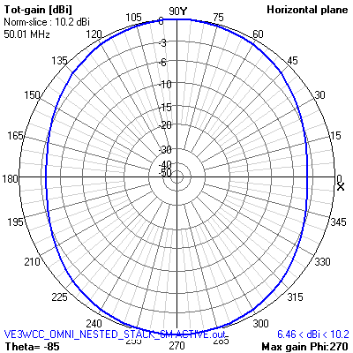
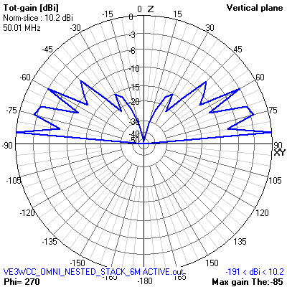
WCARC Beacon Project
SQ-50 active in half-wave stack containing nested 70CM, 135CM, and 2M stacks (Perfect Ground). Shows 8.9 dB gain over Free Space and ok Vertical Plane.

Slide 19
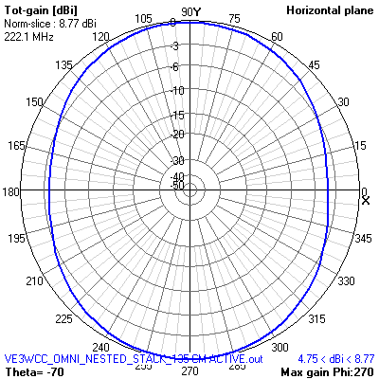
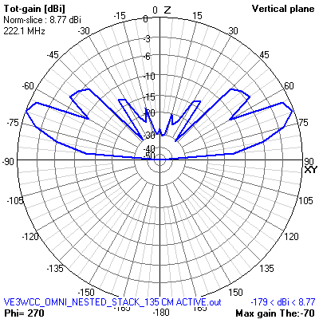
WCARC Beacon Project
SQ-222 active in half-wave stack containing nested 70CM, 135CM, 2M and 6M stacks (Perfect Ground). Shows 7.5 dBi ground enhancement, ok Vertical Plane. Similar performance with other SQ models.

Slide 20
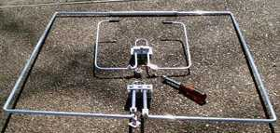
WCARC Beacon Project
Note that KU4AB omnis are not loops but bent dipoles
Photo shows SQ-50 6M and SQ-222 135CM Omnis. Note the connector, & matching stub with shorting bar (adjustable for resonance and best impedance match).
The SQ-50 has plastic tubing across the opening for added rigidity. The SQ-432 has no “fourth sides”.

Slide 21
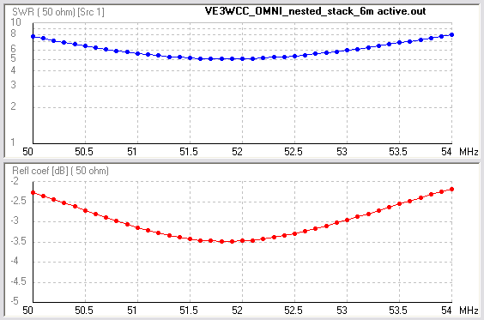
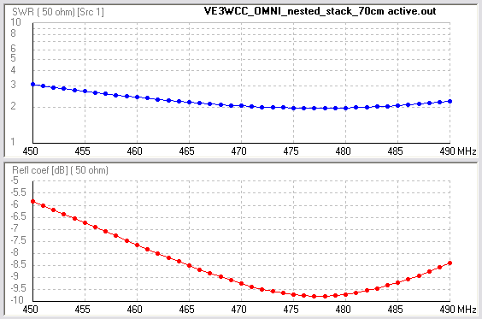
WCARC Beacon Project
For these 4NEC2 models we ignored the stub so their resonance is higher than the real “tuned” antenna.
The short is slid up and down to achieve 50 ohm match.
Stack spacing can also be adjusted “in situ” for best overall match. This adjustment is probably interactive.

Slide 22
WCARC Beacon Project
Conclusions
Stacking dramatically improves performance of KU4AB Omnis over their performance as single antennas.
Nesting of stacks does not greatly compromise performance of the stacks, and saves significant mast space. A 6-2-1.35-.7 nest fits onto 10 ft of mast space.
The purchase of additional antennas to allow stacking should be our next priority now that we have an interim 2M beacon coming, using a converted Mitrek.

Slide 23
WCARC Beacon Project
Additional Antenna Equipment Prices
KU4AB SQ-50 - US$71.95 (one more needed)
KU4AB SQ-144 - US$32.95 (two needed)
KU4AB SQ-222 - US$32.95 (one more needed)
KU4AB SQ-432 - US$34.95 (one more needed)
Plus 4 short runs of LMR-240 (feedlines), 4 coaxial ‘T’s, eight 75 ohm RG-6 phasing/matching lines, 24 crimp PL-259s, 20 Wurth 74270035 Ferrites (for use as choke baluns) and 100 ft 115VAC outdoor extension.
Total for all antennas & hardware needed now - C$250
Hamtronics TA-51/50, cabling, etc - C$350
TA-51/144 C$350 next year?

Slide 24
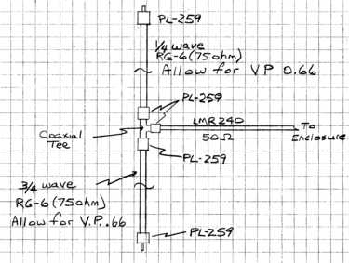
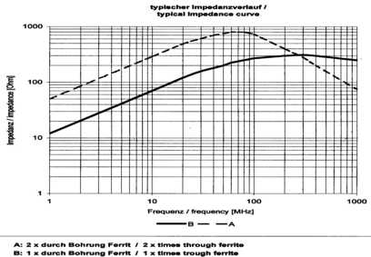
WCARC Beacon Project
Q-Section stacking harness for each pair of omnis
For a choke balun to reduce RF current on the outer coax shield by 20 dB, you need 500 ohms of impedance (20 log [500/50]). Three (50MHz) or two (over 100 MHz) of Wurth 7470035 ferrite cylinders provide 500 ohms with ID of 6.9 mm for LMR-240 or RG-6. 23CM?

Slide 25
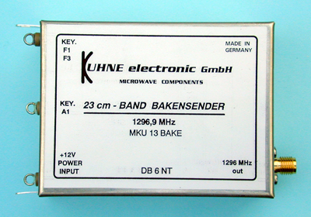
WCARC Beacon Project
Kuhne Electronic GMBH (DB6NT) 23 CM Beacon Module
800 mw output power, CW Keying, -20C to +40C

Slide 26
WCARC Beacon Project
MKU 13 is only available Wired and Tested ~C$370
Kuhne/DB6NT more expensive than Hamtronics
Product quality is superb - proper microwave packaging and excellent craftsmanship.
With other modules inside our enclosure, -20 to +40C temperature range should not be a problem.
Other Kuhne Beacon modules cover all 2.4 to 24 GHz ham bands, if and when we want to expand there.
Kuhne is the perfect complement to Hamtronics -same size for convenient mounting in our enclosure.
Maybe next year?

Slide 27
WCARC Beacon Project
Thank You
- To the WCARC members for your attention and patience. I hope this project update was as interesting and informative to you as its preparation was to me.
- To Dave Conn - VE3KL for advice and assistance with 4NEC2 antenna modeling and choke baluns designs.

