Slide 1
WCARC Beacon Project
Update 3
January, 2009
Doug Leach – VE3XK

Slide 2
WCARC Beacon Project Update 3
Antenna array back up again after windstorm loosened strut again. Thank you Barney. Safety bolt installed.
Enclosure mounted on the tower at eye level.
Weatherproof “Finals On/Off” switch added to enclosure.
Short conduit stubs added to bottom air inlets to prevent ingress of blown snow with with flip caps for air control.
Interior at 25C with OAT of -18C. 43C differential will allow circuitry operation at 0C with OAT of -43C.

Slide 3
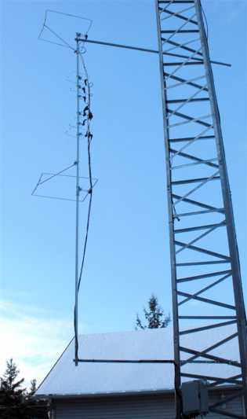
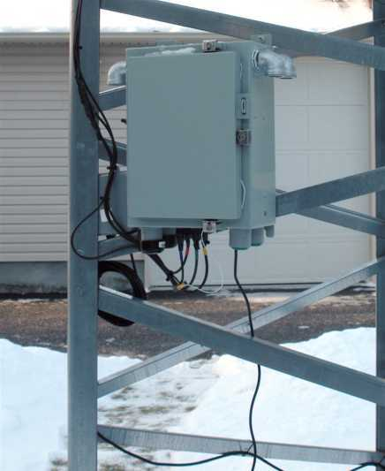
WCARC Beacon Project Update 3

Slide 4
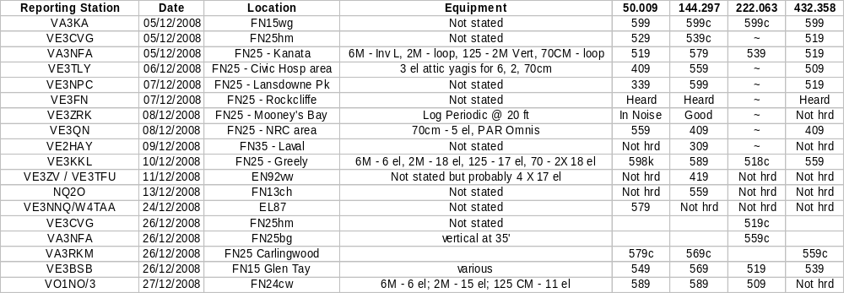
WCARC Beacon Project Update 3

Slide 5
WCARC Beacon Project Update 3
Thanks for your support

