Slide 1
Moving to FN15vf
Project to re-locate the WCARC
VHF/UHF Weak Signal Beacons
from
FN15wg on the VE3XK Tower
to
FN15vf north of Almonte
on a Christie-Walther tower site

Slide 2
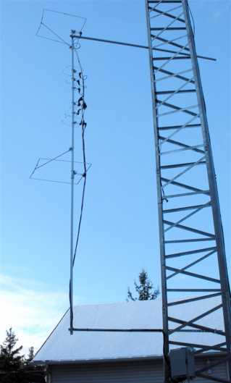
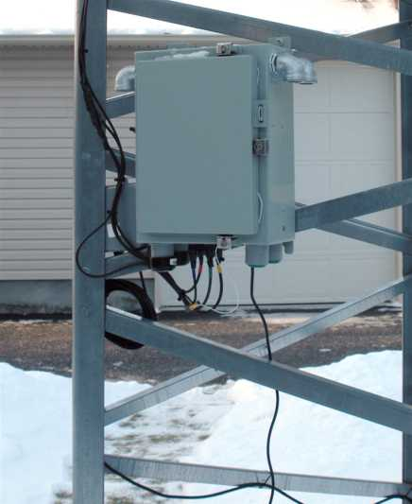
The FN15wg Setup

Slide 3
Moving to FN15vf
Step 1
Prepare new 50 ft Heliax Feedlines using the 3/8” Andrews LDF2-50 Heliax donated by WCARC Treasurer Ken Asmus - VA3KA

Slide 4

PL-259 to Heliax LDF2-50
3/8” nominal size
50 MHz - 0.73 dB loss /100 ft
150 MHz - 1.286 dB loss / 100 ft (RG-8X - 4.5 dB/100 ft)
200 MHz - 1.494 dB loss /100 ft
450 MHz - 2.29 dB loss / 100 ft (RG-8X - 8.1 dB/100 ft)
1250 MHz - 3.98 dB loss / 100 ft
LMR-400 losses/100 ft: 150 MHz - 1.5dB, 450 MHz - 2.7 dB

Slide 5
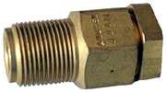

PL-259 to Heliax LDF2-50
N-Male
N- Female
Typical 1/2” Heliax connectors thread onto outer conductor. New - $40+, used - $20 - $30. Less at fleamarkets for Type N. Standard PL-259 connectors can be adapted to fit, as follows.

Slide 6
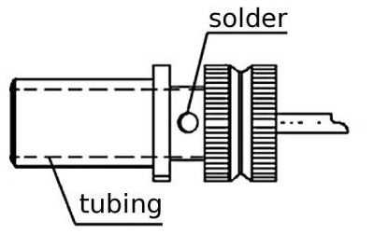
PL-259 to Heliax LDF2-50
Not shown - Coupling Ring (threads over plug assembly shown)
PL-259 Tubing Inside Diameter - 9.5 mm
LDF2-50 Outer Conductor Outside Diameter - 9.652 mm
PL-259 Centre Pin Inside Diameter - 2.2 mm
LDF2-50 Inner Conductor Outside Diameter - 3.048 mm

Slide 7
PL-259 to Heliax LDF2-50
The First Problem
Enlarge the PL-259 Tubing Inner Diameter from 9.5 mm to accommodate the LDF2-50 outer conductor diameter of 9.652 mm
Next standard drill size above 3/8” is 25/64” (9.92 mm)
Solution
Carefully drill out the PL-259 tubing taking care not to remove too much metal from the area around the solder holes. Drill a bit past the solder holes to accommodate the LDF2-50 outer conductor when inserted.

Slide 8
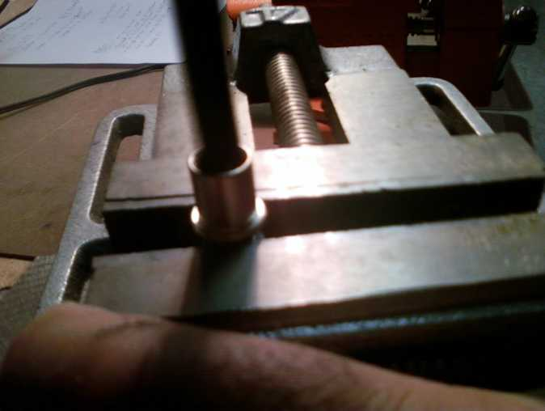
PL-259 to Heliax LDF2-50

Slide 9
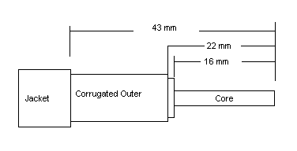
PL-259 to Heliax LDF2-50
Heliax Stripping Instructions
Use tubing cutter or Dremel saw tool to cut through the jacket, corrugated copper outer conductor, and foam dielectric insulation using the above dimension drawing
Core Grinding
Using Dremel sanding drum, grind core down from 3.048 mm diameter to less than 2.2 mm. Use a PL-259 to check the fit along the length of the exposed core.

Slide 10
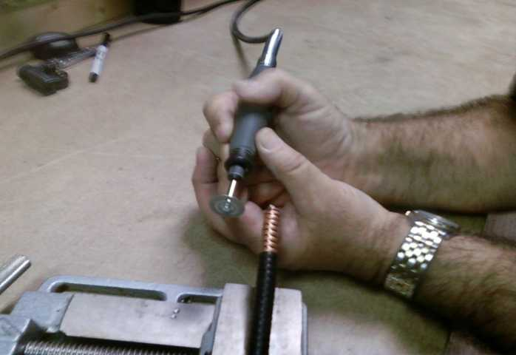
PL-259 to Heliax LDF2-50
“Stripping” the heliax using a Dremel tool saw

Slide 11
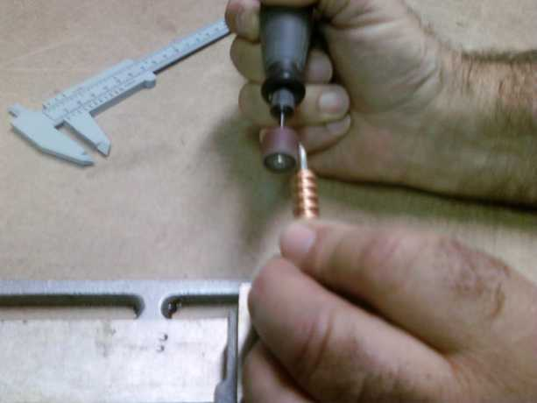
PL-259 to Heliax LDF2-50
Grinding down heliax core using Dremel sanding drum tool

Slide 12
PL-259 to Heliax LDF2-50
Preparation for Soldering
Position the modified PL-259 over the modified LDF2-50
The corrugated outer conductor should show through the solder holes and the modified LDF2-50 core should project out to the tip of the PL-259 centre pin
Make final adjustments to the stripping and drilling dimensions if necessary using the Dremel tool. It should not be necessary to grind down the thin heliax outer shield.
Ensure the PL-259 threaded coupling ring is on the cable and properly oriented before starting to solder.

Slide 13
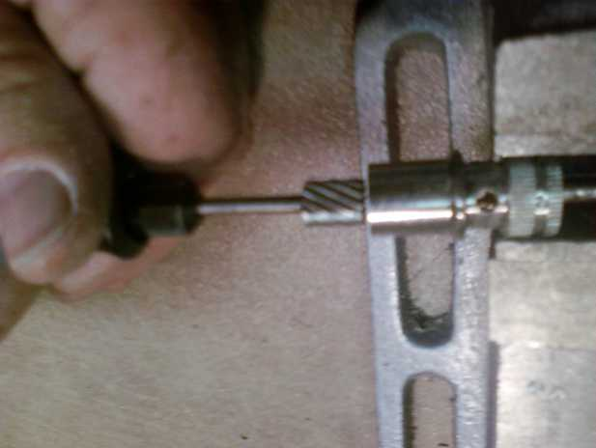
PL-259 to Heliax LDF2-50
Fine tuning of PL-259 inner diameter using reamer tool

Slide 14
PL-259 to Heliax LDF2-50
Soldering
Conventional solder works, but “Solder-It” silver bearing solder paste provides lower melting point (430F), 5X strength and extremely high electrical conductivity.
Use a fine point butane torch for best results and to avoid dielectric damage due to excess heat.
Apply solder paste to centre pin and through solder holes.
Apply the butane flame to the work not the solder. When the surrounding area gets up to 450F the solder paste will quickly flow. Remove heat immediately.
Note: Silver solder is not shiny when cool after melting.

Slide 15
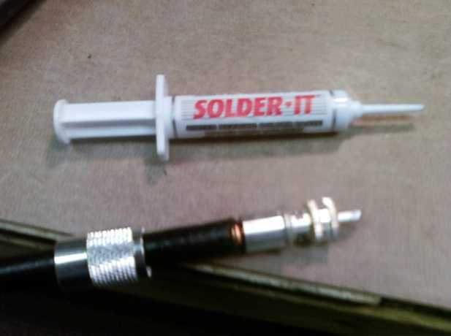
PL-259 to Heliax LDF2-50
SOLDER-IT silver solder paste melts at only 450F

Slide 16
PL-259 to Heliax LDF2-50
The Finishing Touches
After soldering is complete, slide down and screw on the threaded coupling ring
Securely seal the cable to the connector body using X-TREME TAPE self-bonding silicone rubber tape.
Add cable colour-coding tape if needed for your application.
Sources
X-TREME TAPE: $9 - Benson’s Auto Parts - Bell’s Cors
SOLDER-IT: www.solderit.com

Slide 17
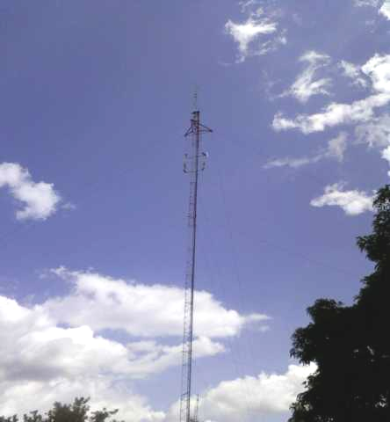
Moving to FN15vf
The Christie-Walther pager tower north of Almonte

Slide 18
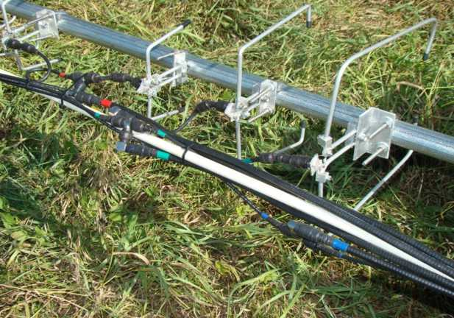
Moving to FN15vf
On site, we had to connect the new heliax feedlines …

Slide 19
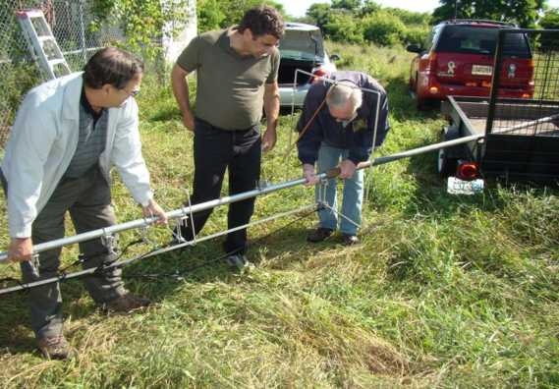
Moving to FN15vf
… and slip the beacon mast into our heavy duty 2” mast, before lifting the assembly over the fence and standing it up

Slide 20
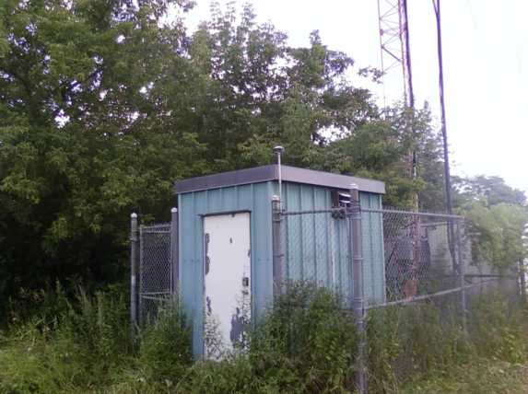
Moving to FN15vf
Lower portion of tower showing our mast attached to fence

Slide 21
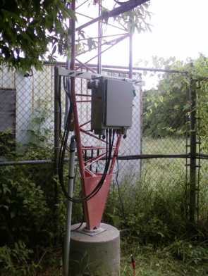
Moving to FN15vf
VE3WCC Beacon enclosure hung on the tower with LDF2-50 dressed around mid-line of fence to mast on the south side

Slide 22
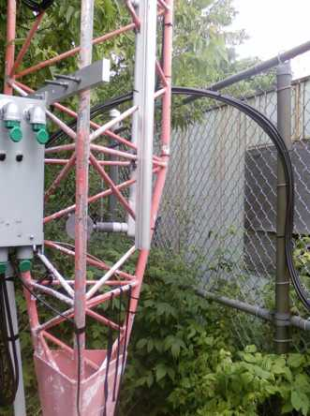
Moving to FN15vf
Heliax formed into loop for ease of site maintenance access

Slide 23
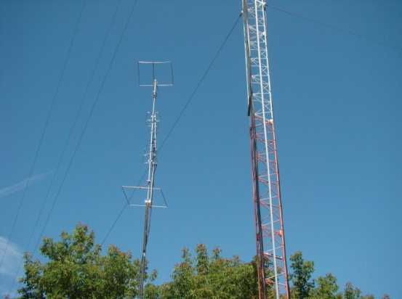
Moving to FN15vf
VE3WCC/B in operation next to Christie - Walther Pager Tower. Feedpoint elevation 485 ft ASL - same as at VE3XK

Slide 24
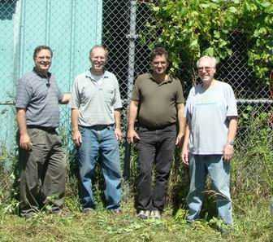
Moving to FN15vf
The re-location team: Barney - VA3BGB, Andy - VE3NVK, Phil - VE3CIQ and Doug - VE3XK (with Tom - VE3ELM on camera)

Slide 25
Moving to FN15vf
Additional Work Completed after the Move
Installation of station identification EPROM programmed with Grid FN15vf identifier.
Rebuild of Keyer Module to obtain 5 MS time constant on the P-Channel MOSFET keyer output.
Replacement of UHF feed-through adapters with UHF Female bulkhead connectors, thus eliminating three coaxial adapters per band.

Slide 26
Moving to FN15vf
The Results?
Within the first day, Ken - VA3KA monitored a DX-spot stating that VE3WCC/b 6M beacon had been heard in Newfoundland. From FN15wg it had been heard in Florida, and 2M beacon heard south of Brantford near Lake Erie!
Various WCARC members have reported hearing the other beacons - in some cases better than at the temporary initial location on the VE3XK tower. Better feedlines? Better location? Both?
Ken - VA3KA reports that key clicks are gone now.
Keep listening. Spread the word. We need more people listening to the beacons and more signal strength reports.

