Slide 1
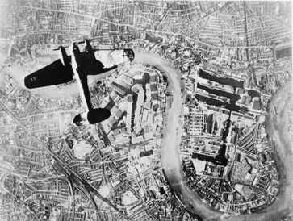
"....the Battle of France is over,
…the Battle of Britain is about to begin.”
WINSTON CHURCHILL June 18, 1940

Slide 2
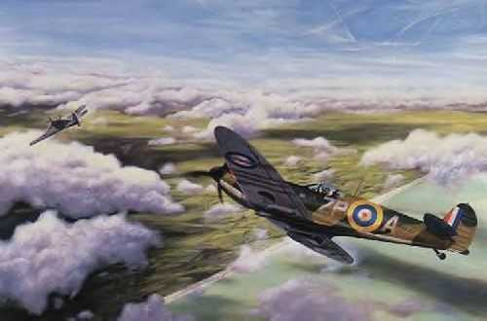
A Race on the Edge of Time
Development of the British
Air Defence System and
the Battle of Britain
Alphonse Penney
VO1NO
Notes:
The painting depicts the Supermarine Spitfire piloted by ‘Sailor’ Malan, in action against and Me109 piloted by Major ‘Vati” Mölders. This dogfight took place on Sunday 28 July 1940, over southern Kent. Malan damaged Mölders’ aircraft and the Luftwaffe ace was wounded, but succeeded in returning to his French base-

Slide 3
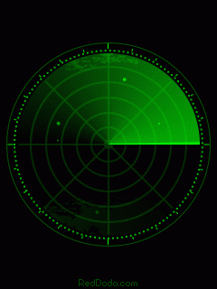
So who actually invented radar?

Slide 4
So who actually invented radar?
Sir Robert Watson-Watt?

Slide 5
So who actually invented radar?
Sir Robert Watson Watt?
The Americans?

Slide 6
So who actually invented radar?
Sir Robert Watson Watt?
The Americans?
The Russians?

Slide 7
So who actually invented radar?
Sir Robert Watson Watt?
The Americans?
The Russians?
The Japanese?

Slide 8
So who actually invented radar?
Sir Robert Watson Watt?
The Americans?
The Russians?
The Japanese?
Actually, it was invented by a number of people over long period of time.

Slide 9
In 1895 Alexander Popov noted interference caused by the passage of a ship.
In 1904 Christian Hülsmeyer patented his Telemobiloscope for detecting the presence of a ship in fog.
Notes:
In 1895, Alexander Popov, a physics instructor at the Imperial Russian Navy school in Kronstadt, developed an apparatus using a coherer tube for detecting distant lightning strikes. The next year, he added a spark-gap transmitter. During 1897, while testing this in communicating between two ships in the Baltic Sea, he took note of an interference beat caused by the passage of a third vessel. In his report, Popov wrote that this phenomenon might be used for detecting objects, but he did nothing more with this observation^{[citation needed]}.
The first to use radio waves to detect "the presence of distant metallic objects" was Christian Hülsmeyer, who in 1904 demonstrated the feasibility of detecting the presence of a ship in dense fog, but not its distance.^{[7][8]} He received Reichspatent Nr. 165546^{[9]} for his pre-radar device in April 1904, and later patent 169154^{[10]} for a related amendment for ranging. He also received a patent^{[11]} in Britain for his telemobiloscope on September 23, 1904.^{[7][12]}

Slide 10
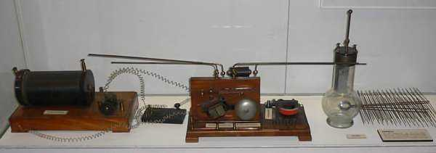
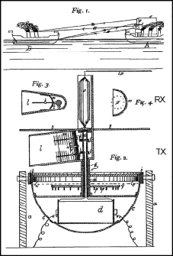
Hülsmeyer’s Telemobiloscope

Slide 11
In the 1920s and 30s, many scientists and engineers developed systems that eventually evolved into what we now call radar.
In the UK, Sir Robert Watson-Watt and “Skip” Wilkins were the brainchildren behind British Radar.

Slide 12
“The Bomber will always get through.”
Stanley Baldwin
Lord President of Great Britain
1932
In the 1930s, most people believed that it was not possible to stop a determined bombing offensive.
Early warning used acoustic detectors – not very effective as the speed of airplanes increased in the 1920s and 1930s.
Notes:
On 10 November 1932 Baldwin said:
I think it is well also for the man in the street to realise that there is no power on earth that can protect him from being bombed. Whatever people may tell him, the bomber will always get through, The only defence is in offence, which means that you have to kill more women and children more quickly than the enemy if you want to save yourselves. (Note : was PM of the UK 1923-24, 24-29, and 35-37)
Difficult to stop a bombing offensive – bombers and interceptors traveled at about the same speed. Without early warning, it was not possible for fighter aircraft to get to same altitude and location of bombers in time to intercept them before bomb release. Located near the coast, London was particularly vulnerable compared to inland capitals such as Paris and Berlin.

Slide 13
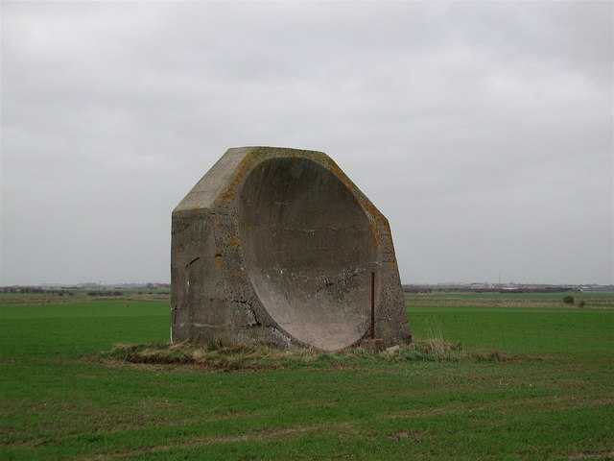
Notes:
Rare 4.5 metre high concrete structure near Kilnsea Grange, northwest of Godwin Battery, a relic of the First World War. On the pipe in front of the acoustic mirror was a trumpet-shaped ‘collector head’, a microphone which could pick up the reflected engine sound of Zeppelins approaching from the sea. Wires passed down the pipe to a listener seated in a trench nearby with a stethoscope headset, who would try to determine the distance and bearing of any enemy airships.

Slide 14
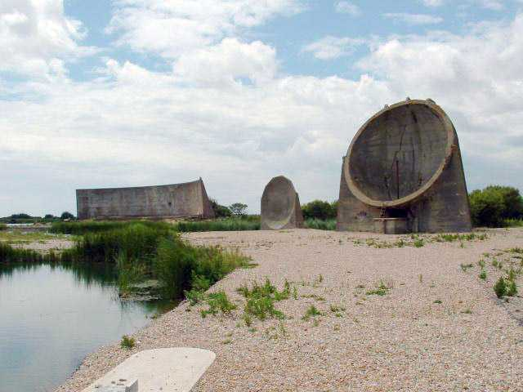
Notes:
Listening Ears near to Greatstone-on-Sea, Kent, Great Britain. These are concrete listening ears built before the Second World War. Aeroplanes flying across the channel could be heard by observers positioned near these "ears".
The large reflector in the background is 200 feet long and 25 feet high. It was designed to detect aircraft approaching from Paris – in the early 1930s France was seen as the possible aggressor!
In a major exercise in 1934, a milkman driving his horse and cart disrupted the test of the system. As one person put it “God forbid that the Germans attack when anyone was up and moving in England”!
The Dungeness mirrors, known colloquially as the "listening ears", consist of three large concrete reflectors built in the 1920s–1930s. Their experimental nature can be discerned by the different shapes of each of the three reflectors: one is a long, curved wall about 5 m high by 70 m long, while the other two are dish-shaped constructions approximately 4–5 m in diameter. Microphones placed at the foci of the reflectors enabled a listener to detect the sound of aircraft far out over the English Channel. The reflectors are not parabolic as sometimes imagined, but are in fact hemispherical mirrors.^{[1]} This design element is their genius, because in addition to being able to detect range (over 30 km, or 20 statute miles, on a good day), they could also detect direction.
Acoustic mirrors had a limited effectiveness, and the increasing speed of aircraft in the 1930s meant that they would already be too close to deal with by the time they had been detected. The development of radar put an end to further experimentation with the technique. Nevertheless, there were long-lasting benefits. The acoustic mirror programme, led by Dr William Sansome Tucker, had given Britain the methodology to use interconnected stations to pin point the position of an enemy in the sky. The system they developed for linking the ranging stations and plotting aircraft movements was given to the early radar team and contributed to their success in WW2; although the British radar was less sophisticated than the German system, the British system was used more successfully.

Slide 15
The first (British) steps…
Having witnessed the disruption caused by the milkman in 1934, A. P. Rowe sent his boss, H. E. Wimperis, a memo warning that unless a solution was found, England faced destruction from enemy bombers.
That memo initiated a chain of events that ultimately saved Great Britain, and probably most of the world, from Nazi domination!
Notes:
AP Rowe was the only assistant to the Air Ministry’s Director of Scientific Research, H.E. Wimperis.
In 1934 a large-scale Air Defence exercise was held to test the defences of Great Britain and mock raids were carried out on London. Even though the routes and targets were known in advance, well over half the bombers reached their targets without opposition. Prime Minister Baldwin's statement "The bomber will always get through" seemed true.

Slide 16
Wimperis wrote to the Secretary of State for Air, and the head of RAF’s Research and Development department, Air Marshall Sir Hugh Dowding, recommending the formation of a committee to
  “consider how far recent advances in scientific and technical knowledge can be used to strengthen the present methods of defence against hostile aircraft.”
Notes:
Wimperis took the warning very seriously, and despite the general mistrust of scientists by professional military officers of the time, he wrote to the Secretary of State for Air, and to the head of Research and Development, Air Marshall Sir Hugh Dowding. He recommended the formation of a committee to “consider how far recent advances in scientific and technical knowledge can be used to strengthen the present methods of defence against hostile aircraft.”
He demonstrated great courage however. He further recommended that the committee not be composed of members of the Air Ministry however, but outsiders instead. This implied that members of the Air Ministry would not demonstrate the freedom of thought and imagination necessary to examine the possibilities of all the different solutions that should be examined. This suggestion could have been enough for Wimperis to have lost his job. Fortunately for him, Dowding was not the conventional RAF senior officer!

Slide 17
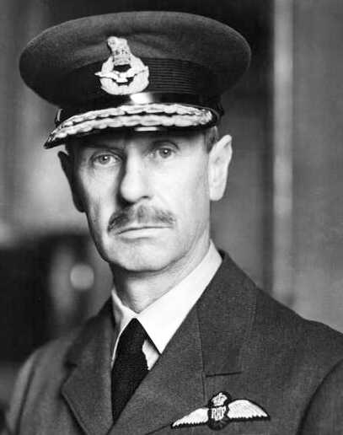
Air Chief Marshal Sir Hugh Dowding
Notes:
Air Chief Marshal Hugh Caswall Tremenheere Dowding, 1st Baron Dowding GCB, GCVO, CMG (24 April 1882 – 15 February 1970) was a British officer in the Royal Air Force. He was the commander of RAF Fighter Command during the Battle of Britain.
Hugh Dowding was born in the southern Scottish town of Moffat in 1882 and received his early education at St. Ninian's Boys' Preparatory School in Moffat which his father, Arthur Dowding, had been instrumental in founding.^{[1]} After moving to England, Dowding was educated at Winchester College and the Royal Military Academy, Woolwich. He later served abroad in the Royal Garrison Artillery.^{[2]}
Initially he served in Gibraltar, Ceylon, Hong Kong and India. After returning to Great Britain, Dowding attended the Army Staff College in January 1912 before being posted to the Garrison Artillery on the Isle of Wight in 1913. After becoming interested in aviation, Dowding gained his Aviator's Certificate on 19 December 1913 in a Vickers biplane at the Vickers School, Brooklands.^{[3]} He then attended the Central Flying School where he was awarded his wings. Although added to the RFC's Reserve List, Dowding returned to the Isle of Wight to resume his Garrison Artillery duties. However, this arrangement was short-lived and in August 1914, he joined the Royal Flying Corps (RFC) as a pilot on No. 7 Squadron.
Dowding was sent to France and in 1915 was promoted to commander of 16 Squadron. After the Battle of the Somme, Dowding clashed with General Hugh Trenchard, the commander of the RFC, over the need to rest pilots exhausted by non-stop duty. As a result Dowding was sent back to Britain and, although promoted to the rank of Brigadier General, saw no more active service during the First World War.
Dowding then joined the recently created Royal Air Force and gained experience in departments of training, supply, development and research. On 19 August 1924, Air Commodore Dowding was made Chief Staff Officer for RAF Iraq Command. In 1929, he was promoted to Air Vice Marshal and the following year joined the Air Council. Tragedy struck in the inter-war period when Clarice, his wife of two years, died after a short illness. Left alone to bring up his son, Derek, Hugh Dowding withdrew from socialising and threw himself into his work.
In 1933 Dowding was promoted to Air Marshal and was knighted the following year.
In the years prior to the Second World War, Dowding was the commanding officer of RAF Fighter Command. He conceived and oversaw the development of the "Dowding System"^{[4]}. This comprised an integrated air defence system which included (i) radar (whose potential Dowding was among the first to appreciate), (ii) human observers (including the Royal Observer Corps) who filled crucial gaps in what radar was capable of detecting at the time (the early radar systems, for example, did not provide good information on the altitude of incoming German aircraft), (iii) raid plotting, and (iv) radio control of aircraft. The whole network was tied together, in many cases, by dedicated phone links buried sufficiently deep to provide protection against bombing. The network had its apex (and Dowding his own headquarters) at RAF Bentley Priory, a converted country house on the outskirts of London.
Dowding also introduced modern aircraft into service during the pre-war period, including the eight-gun Spitfire and the Hurricane.
He was promoted to Air Chief Marshal in 1937.

Slide 18
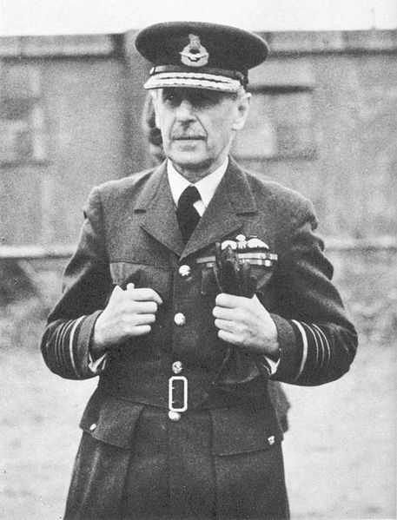
Notes:
Due to retire in June 1939, Dowding was asked to stay on until March 1940 because of the tense international situation. He was again grudgingly permitted to continue, first until July and finally until October 1940. Thus he fought the Battle of Britain under the shadow of retirement.
In 1940, Dowding, nicknamed "Stuffy" by his men, proved unwilling to sacrifice aircraft and pilots in the attempt to aid Allied troops during the Battle of France. He, along with his immediate superior Sir Cyril Newall, then Chief of the Air Staff, resisted repeated requests from Winston Churchill to weaken the home defence by sending precious squadrons to France. When the Allied resistance in France collapsed, he worked closely with Air Vice-Marshal Keith Park, the commander of 11 Fighter Group, in organising cover for the evacuation of the British Expeditionary Force at Dunkirk.
Through the summer of 1940 in the Battle of Britain, Dowding's Fighter Command resisted the attacks of the Luftwaffe. Beyond the critical importance of the overall system of integrated air defence which he had developed for Fighter Command, his major contribution was to marshal resources behind the scenes (including replacement aircraft and air crew) and to maintain a significant fighter reserve, while leaving his subordinate commanders' hands largely free to run the battle in detail. At no point did Dowding commit more than half his force to the battle zone in Southern England.
Fighter Command pilots came to characterise "Stuffy" Dowding as a distant figure, but one who cared for his men and had their best interests at heart. Dowding often referred to his "dear fighter boys" as his "chicks". Indeed his son Derek was one of them: a pilot in 74 Squadron. In spite of his reserve, many junior officers regarded "Stuffy" as a fatherly figure with a steady hand on the tiller.
Because of his brilliant detailed preparation of Britain's air defences for the German assault, and his prudent management of his resources during the battle, Dowding is today generally given the credit for Britain's victory in the Battle of Britain.
Dowding's subsequent downfall has been attributed to his prickly temperament and lack of diplomacy and political savoir faire in dealing with intra-RAF challenges and intrigues, most obviously the Big Wing controversy (in which a number of senior and active service officers argued at the time in favour of large set-piece air battles with the Luftwaffe as an alternative to Dowding's successful Fabian strategy).^{[5]} Another reason often cited for his dismissal is the inability of Fighter Command under his leadership to counter German nighttime bombing raids on British cities. The account of radar pioneer, E. G. Bowen in Radar Days (1987) rebuts the claim that Dowding's perception of the problems of British night fighters was inadequate. He suggests that if Dowding had been left to follow his own path; the ultimately effective British response to night bombing (which depended completely on developments in air-borne radar) would have come somewhat sooner.^{[6]}. Dowding himself showed that he had a good grasp of night fighter defence and was planning a defence system against night bombing in a letter he wrote some time after the Battle of Britain.
The new Chief of the Air Staff, Air Chief Marshal Charles Portal removed Dowding from his post in November 1940, and replaced him with his ambitious rival (and onetime Big Wing advocate), Sholto Douglas.
Dowding was made a Knight Grand Cross of the Order of the Bath. Publication of his book, Twelve Legions of Angels, was suppressed in 1942. The British Government considered that it contained information which might be of use to the Germans. The book was finally published in 1946, soon after the war ended.
Lord Dowding died at his home in Tunbridge Wells, Kent, on 15 February 1970 aged 87. He was cremated. At a memorial service at Westminster Abbey, his ashes were laid to rest below the Battle of Britain Memorial Window in the Abbey's Royal Air Force chapel. Dowding's son Derek (1919–1992) inherited the title of Baron Dowding.

Slide 19
The Committee for the Scientific Survey of Air Defence
Dr. H. T. Tizard (Chairman)
Professor A. V. Hill
Professor P. M. S. Blackett
Dr. H. E. Wimperis
A. P. Rowe (Secretary)
Notes:
The committee was formed as recommended by Wimperis. It initially consisted of:
Henry Tizard – despite poor eyesight became a pilot during WWI. Noted scientist, head of the Aeronautical Research Committee. Led what became known as the Tizard Mission to the United States, which introduced to the US, amongst others, the newly invented resonant-cavity magnetron and other British radar developments, the Whittle gas turbine, and the British Tube Alloys (nuclear weapons) project.
Archibald Vivian Hill CH CBE FRS (26 September 1886 – 3 June 1977) was an English physiologist, one of the founders of the diverse disciplines of biophysics and operations research. He shared the 1922 Nobel Prize in Physiology or Medicine for his elucidation of the production of heat and mechanical work in muscles.
Patrick Maynard Stuart Blackett, Baron Blackett OM CH FRS (18 November 1897 – 13 July 1974) was an English experimental physicist known for his work on cloud chambers, cosmic rays, and paleomagnetism. He also made a major contribution in World War II advising on military strategy and developing Operational Research. His left-wing views saw an outlet in third world development and in influencing policy in the Labour Government of the 1960s.

Slide 20
Death Rays!
Possibly sparked by discoveries made into radioactivity, Death Rays became a popular weapon in science fiction in the 1920s and 30s.
Investigating one possibility, Wimperis asked Dr. Robert Watson Watt if it would be possible to concentrate a beam of radio energy so that it might incapacitate a pilot or his airplane – in effect, a death ray!

Slide 21
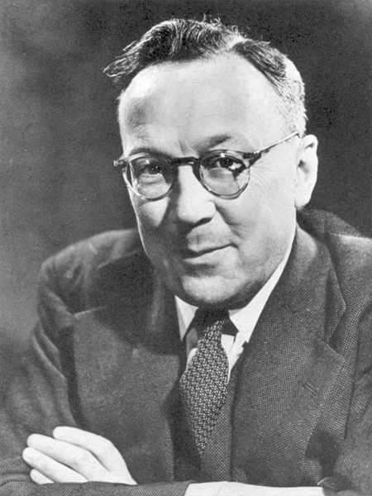
Sir Robert Watson-Watt
Notes:
Sir Robert Alexander Watson-Watt, KCB, FRS, FRAeS (13 April 1892 – 5 December 1973) is considered by many to be the "inventor of radar". (The hyphenated name is used herein for consistency, although this was not adopted until he was knighted in 1942.) Development of radar, initially nameless, was first started elsewhere but greatly expanded on 1 September 1936 when Watson-Watt became Superintendent of a new establishment under the British Air Ministry, Bawdsey Research Station located in Bawdsey Manor, near Felixstowe, Suffolk. Work there resulted in the design and installation of aircraft detection and tracking stations called Chain Home along the East and South coasts of England in time for the outbreak of WWII in 1939. This system provided the vital advance information that helped the Royal Air Force win the Battle of Britain.^{[1]}
Born in Brechin, Angus, Scotland, Watson-Watt was a descendant of James Watt, the famous engineer and inventor of the practical steam engine.
In 1915 Watson-Watt wanted a job with the War Office, but nothing obvious was available in communications. Instead he joined the Meteorological Office, who were interested in his ideas on the use of radio for the detection of thunderstorms. Lightning gives off a radio signal as it ionizes the air, and he planned on detecting this signal in order to warn pilots of approaching thunderstorms.[
His early experiments were successful in detecting the signal, and he quickly proved to be able to do so at long ranges. Two problems remained however. The first was locating the signal, and thus the direction to the storm. This was solved with the use of a directional antenna, which could be manually turned to maximize (or minimize) the signal, thus "pointing" to the storm. Once this was solved the equally difficult problem of actually seeing the fleeting signal became obvious, which he solved with the use of a cathode-ray oscilloscope with a long-lasting phosphor.^{[citation needed]} Such a system represented a significant part of a complete radar system, and was in use as early as 1923. It would, however, need the addition of a pulsed transmitter and a method of measuring the time delay of the received radio echos, and that would in time come from work on ionosondes.
At first he worked at the Wireless Station of Air Ministry Meteorological Office in Aldershot, England. In 1924 when the War Department gave notice that they wished to re-occupy their Aldershot site, he moved to Ditton Park near Slough in Berkshire. The National Physical Laboratory (NPL) already had a research station there. In 1927 they were amalgamated as the Radio Research Station, with Watson-Watt in charge. After a further re-organisation in 1933, Watson-Watt became Superintendent of the Radio Department of NPL in Teddington.

Slide 22
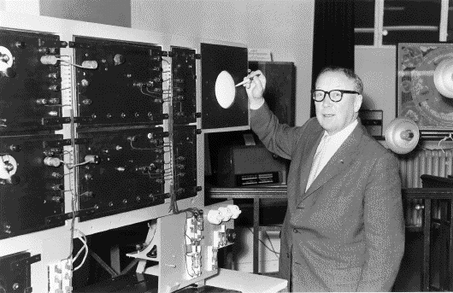
Notes:
Sir Robert Watson-Watt – mention story of moving to Canada and being given a ticket for speeding.
Wimperis asked Mr Watson-Watt, Superintendent of the Radio Research Station at Slough for his views on the possibility of developing a radio "Death Ray" to melt metal or incapacitate an aircraft pilot. Watson Watt immediately doubted that a radio signal would be able to kill a pilot or even cause an engine to shut down, but passed the letter to A.F. Wilkins and asked him to calculate how much RF energy would be required to raise the the temperature of 8 pints of water from 98F to 105F at a range of 5 km and an altitude of 1 km. Watt realized that a death ray would not need to boil a pilot’s blood – all that had to be done was to raise his body temperature enough that the fever would knock him out or at least drive him into a delirium.

Slide 23
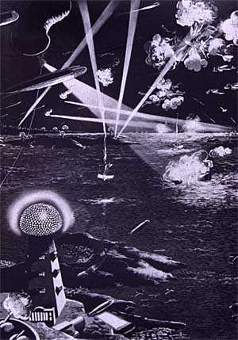
Notes:
Wilkins’ calculations showed that despite what science fiction writers published, a tremendously large amount of power was required, even if the pilots’ body wasn’t shielded by a metal fuselage. Clearly, a death ray was not possible.

Slide 24
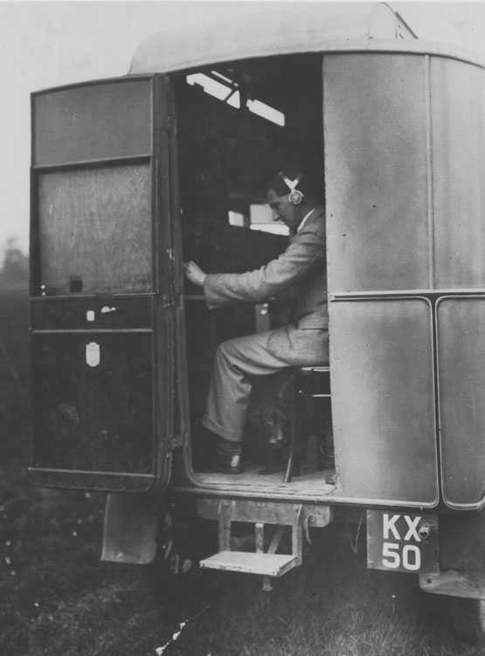
Notes:
A.F.Wilkins in van later used for Radar experiments. c.1933.
In an interview long after the war, Wilkins indicated that when he gave Watson-Watt the results of his calculations, Watt asked “Well, then, if the death ray is not possible how can we help them?” Wilkins replied to the effect that Post Office engineers had noticed disturbances to VHF reception when aircraft flew in the vicinity of their receivers and that this phenomenon might be useful for detecting enemy aircraft.
It has been suggested that genius is the ability to see relationships between apparently disparate processes, and to connect them in new ways. If ever in the history of the world the birth of a great sequence of events can be traced to just such an inspiration, this was indeed the case on that January day in 1935. (A Race on the Edge of Time, page 31).

Slide 25
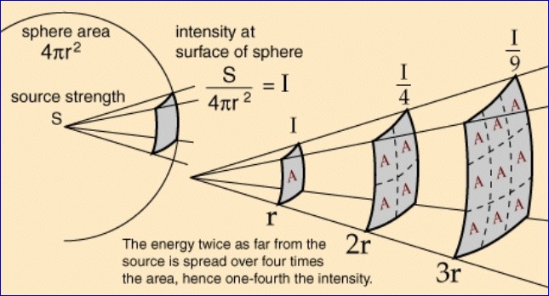
Notes:
Watson-Watt and Wilkins set to work calculating how much energy could be reflected from an aircraft. One of the biggest concerns was the Inverse Square Law – the intensity of an electromagnetic wave decreases by a factor of 4 every time the distance from the source is doubled. Of course, much of the energy that hits a target is dissipated as heat or reflected every which way but back towards the transmitter. The Inverse Square Law applies to the reflected wave as well, so the amount of energy actually reaching an antenna after traveling both to and from a target is quite small.
Wilkins selected a wavelength of 25 meters, anticipating that bombers would grow larger in the future and their wingspans would approach that length. With a half-wave dipole at 18 meters above ground, perpendicular to an aircraft 6km away and at 6km altitude, and using a reasonable power level, the incident wave would produce a field of 14 millivolts per meter, and a current of about 1.5 milliamperes per ampere of current of the transmitting antenna in the wing of the airplane. The reflected wave would be about 20 microvolts per meter for every ampere in the transmitting antenna.
Wilkins reported that reflected fields on the order of one millivolt per meter were readily available, and that such a reflected beam is “about 10,000 times that required for radio communication” In other words, the idea would work!

Slide 26
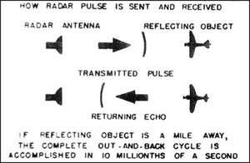
Notes:
Wilkins double-checked his calculations and couldn’t believe that the desired result was so obtainable. Watson-Watt checked it several times, and also found it incredible. At the end of January 1935 their results were forwarded to Wimperis. That the death ray would not work was no surprise. The idea of detecting aircraft using radio waves was a surprise however. He checked the calculations himself, and had an assistant check them – no errors were discovered.
Wimperis presented the findings at the very first meeting of the Committee for the Scientific Survey of Air Defence on Jan 28 1935. The members were intrigued and asked for a more detailed description. Watson-Watt delivered his paper “Detection and Location of Aircraft by Radio Means” two weeks later. Described by some as having the importance of the Magna Carta, it made England an island again.
Two days later Watson-Watt met with Tizard, Wimperis and Dowding in London to describe his proposal. The next day Wimperis asked Dowding, the keeper of the Research and Development funds, for 10,000 Pounds to begin work on an early warning system.
Dowding said no!

Slide 27

Notes:
Dowding, though very interested, said he must have a simple practical demonstration to show feasibility before committing scarce funds to the project. He was not a dinosaur unable and unwilling to use the latest technology. His use of radio in exercises in the 1920s and 30s proved that. He had a limited amount of funding however, and had to use it to best effect.
Wimperis and Watt had no idea how to conduct a demonstration. Once again Wilkins came to the rescue. He suggested using the existing BBC shortwave transmitter at Daventry, and showing how an aircraft would reflect the signal. They agreed, and on 25 Feb Wilkins found a suitable field in the beam of the transmitter, and began to set up his equipment.

Slide 28
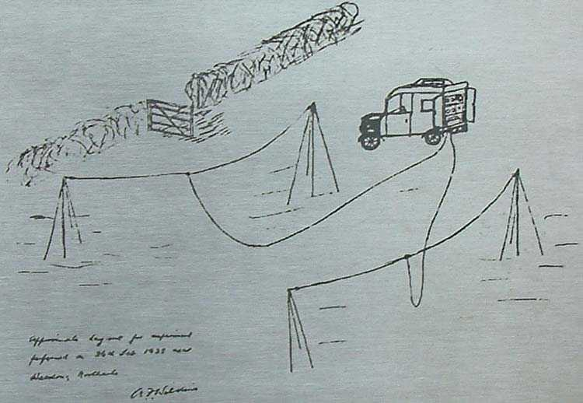
Notes:
See pages 61-63 of A Race on the Edge of Time.

Slide 29
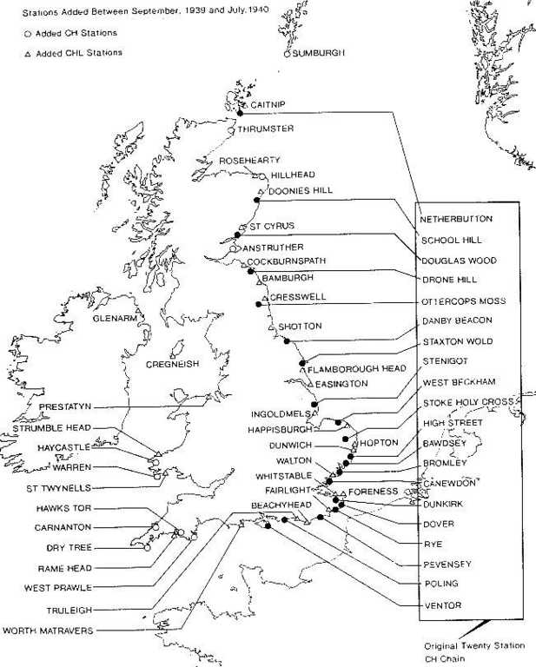
Notes:
I do not have time to cover the details of how the British radar system evolved over the next 5 years, but it was a busy period.
In mid-May 1935, Wilkins left the Radio Research Station with a small party, including Edward George Bowen, to start further research at Orford Ness, an isolated peninsula on the coast of the North Sea. By June they were detecting aircraft at 27 km, which was enough for scientists and engineers to stop all work on competing sound-based detection systems. By the end of the year the range was up to 100 km, at which point plans were made in December to set up five stations covering the approaches to London.
One of these stations was to be located on the coast near Orford Ness, and Bawdsey Manor was selected to become the main centre for all radar research. In an effort to put a radar defense in place as quickly as possible, Watson-Watt and his team created devices using existing available components, rather than creating new components for the project, and the team did not take additional time to refine and improve the devices. So long as the prototype radars were in workable condition they were put into production.^{[4]} They soon conducted "full scale" tests of a fixed radar radio tower system that would soon be known as Chain Home, an early detection system that attempted to detect an incoming bomber by radio signals.^{[4][7]} The tests were a complete failure, with the fighter only seeing the bomber after it had passed its target. The problem was not the radar, but the flow of information from trackers from the Observer Corps to the fighters, which took many steps and was very slow. Henry Tizard with Patrick Blackett and Hugh Dowding immediately set to work on this problem, designing a 'command and control air defence reporting system' with several layers of reporting that were eventually sent to a single large room for mapping. Observers watching the maps would then tell the fighter groups what to do via direct communications.^{[4]}
By 1937 the first three stations were ready and the associated system was put to the test. The results were encouraging and an immediate order by the government to commission an additional 17 stations was given, resulting in a chain of fixed radar towers along the east and south coast of England.^{[4][7]} By the start of World War II, 19 were ready to play a key part in the Battle of Britain, and by the end of the war over 50 had been built. The Germans were aware of the construction of Chain Home but were not sure of its purpose. They tested their theories with a flight of the Zeppelin LZ 130, but concluded the stations were a new long-range naval communications system.

Slide 30
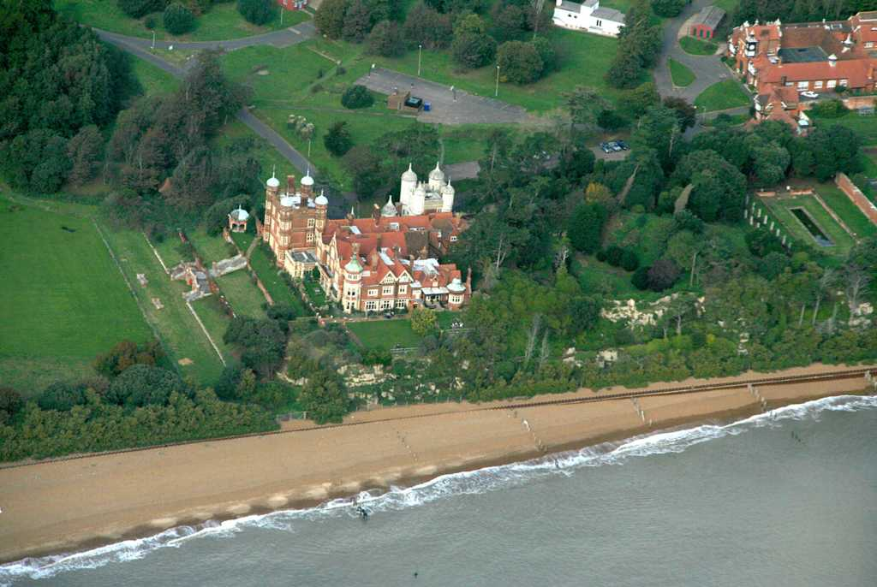
Bawdsey Manor
Notes:
Bawdsey Manor stands at a prominent position at the mouth of the River Deben close to the village of Bawdsey in Suffolk, England, about 118 km northeast of London.^{[1]} Built in 1886, it was enlarged in 1895 as the principal residence of Sir William Cuthbert Quilter. Requisitioned by the Devonshire Regiment during World War I and having been returned to the Quilter family after the war was purchased by the Air Ministry for £24,000^{[2]} in 1936 to establish a new research station for developing the Chain Home RDF (radar) system^{[3]}, Bawdsey was used as an RAF base through the Cold War until the 1990s. The Manor is now used for weddings and courses^{[4]} with a small museum in the Radar Transmitter Block^{[5]}.
In February 1936 research scientists, including Robert Watson-Watt moved into the Manor to begin research and development into radar for practical military use^{[8]} and it became known as RAF Bawdsey. Stables and outbuildings were converted into workshops and 240 ft wooden receiver towers and 360 ft steel transmitter towers were built. Bawdsey was the first Chain Home Radar Station. By the outbreak of World War 2 a chain of radar stations was in place around the coast of Britain^{[2]}. Bawdsey Manor continued as an RAF base through the Cold War and Bloodhound Missiles were sited on the cliffs until the Bloodhound force ceased operations in 1990, when all the missiles were withdrawn to RAF West Raynham. RAF Bawdsey was closed in 1991^{[2]}.

Slide 31
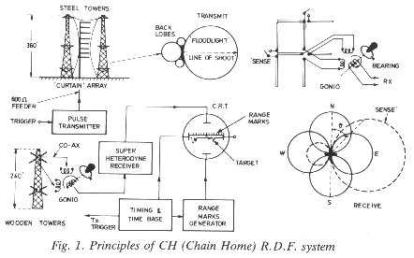
Notes:
The basic operating principle of CH is very simple: the volume of sky to be kept under surveillance is literally 'floodlit' with r.f. pulsed energy; the back-scattered pulses or echoes' from all aircraft within this volume are received back at the ground station by a set of crossed-dipoles connected to a low-noise, high-gain receiver and displayed as a Y-deflection along the time base of a CRT. The aircraft range is simply a precise measurement of the elapsed time between the transmitted pulse and the 'echo', and the bearing a measurement of the ratio of 'echo' strengths of the X- and Y-components of the crossed-dipoles. These principles are illustrated in figure1.
Choice of frequency, polarization and p.r.f.
The choice of radio frequency was principally influenced by three factors: the 'state of the art' technology in 1935, feasible antenna dimensions to provide the vertical polar diagram and antenna gain required for efficient floodlighting and heightfinding; and a wavelength that was considered at that time likely to give the best 'echo' from a typical bomber of the period. Very little, if anything, was known at that time about the effective back-scattering cross-section of an aircraft or how it varied with frequency.
It was earlier thought that an approaching aircraft could be regarded as a half-wave, horizontally polarized dipole; in fact, a typical enemy bomber of that period, a Heinkel 111 with a wingspan of 22.5 metres, closely matched the original 'Daventry Experiment' frequency of 6 MHz. This theory was later abandoned.
The original plan was for each station to have the choice of operating on any of four allocated spot frequencies in the band 20 to 55 MHz as a counter-measure to possible jamming and as alternative frequencies should interference or propagation effects cause operational problems.

Slide 32
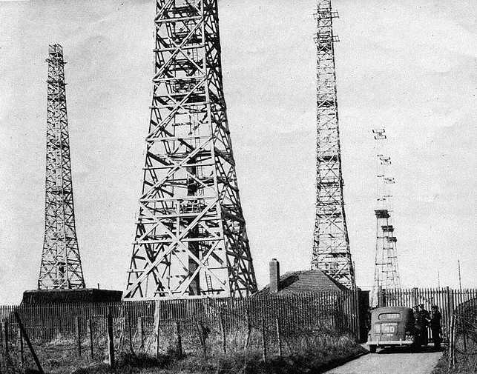
Notes:
For that purpose, four transmitter and four receiver towers were provided, each pair of towers being dedicated to one spot frequency. It was later decided to abandon the four frequency plan and to have simply a main and standby in the frequency band 20-30 MHz.
All CH Stations used horizontally polarized radiation. The decision to use horizontal rather than vertical was based mainly on three factors:-
1. An approaching aircraft has a predominantly horizontal aspect, favouring - for metric wavelengths -a horizontally polarized wavefront.
2. The signal phase change of Pi radians on reflection from the ground is constant for all relevant angles of elevation; this is particularly important for the formation of the vertical polar diagram required for height finding.
3. A horizontally polarized antenna is inherently symmetrical with respect to ground, permitting balanced, open-wire transmission lines capable of withstanding very high peak voltages to be used without undue complication. Also the symmetrical nature of the antenna simplifies both its design and installation.
OUTLINE DESCRIPTION OF TYPICAL 'EAST COAST' STATION
At the end of World War 2, there were approximately fifty early warning CH Stations (AMES Type 1), of which there were a number of variants, either in 24 hour operation or at standby around the coast of Britain. All used the same basic 'floodlighting/DF' principle but configured differently depending on their operational role; some were 'all-round-looking', there were a number of buried reserves to back up the Chain should the main station be disrupted by enemy action, the West-Coast Chain used different antennae masts and transmitters to the East-Coast; and there were variations in the siting arrangements.
The CH described here is a typical East-Coast version, figure 2, of the type familiar to most people because of the distinctive and massive appearance of the antennae masts, and the vital role it played in winning the Battle of Britain. Of the fifty CH Stations in Britain, twenty one were basically of this type and were installed along the East and South-East coast from Ventnor in the Isle of Wight to Netherbutton in the Orkneys. (See Appendix 1 for complete list).
Four 240 feet wooden receiver towers, usually placed in rhombic formation, carried the receiver arrays. These towers and the associated receiver building were some hundreds of yards from the transmitter buildings and in some cases, were in a separate com-pound; truly bistatic in fact!
Each station employed four (later stations were reduced to three) in-line, 360 feet steel transmitter towers spaced approx 180 feet apart, each tower being fitted with cantilevered platforms at 50, 200 and 350 feet. The transmitter 'curtains' were slung between towers and fed by strained 600 ohm transmission lines leading from the heavily protected transmitter building nearby. Two identical transmitters (Type T.3026) were used in a main and standby role, with rapid change-over arrangements in the event of failure of the operational transmitter.

Slide 33
Operating Parameters
Frequency: 20 to 30 MHz
Peak Power: 350 kW (later 750 kW)
Pulse Repetition Frequency: 25 and 12.5 pulses per second
Pulse Length: 20 microseconds
Notes:
The low p.r.f. of 25 p.p.s. was determined by the need for a long interpulse period to minimize the effect of long range 'scatter' (or clutter) being returned via the ionosphere as 'second, third or fourth time round' signals cluttering the display and masking the area under surveillance. A further requirement was the need to synchronize all CH Stations to the National Grid system to avoid mutual interference (known as 'running rabbits'). A sub-multiple of 50 Hz was therefore essential, plus the need for a long interpulse period to allow sufficient time space (40 ms) for adjacent stations to be allocated time slots which did not overlap. When ionospheric 'scatter' conditions were severe, the operator had a choice of an alternative p.r.f. of 12.5p.p.s., thereby increasing the interpulse period to 80 ms and extending the immunity range of the 'scatter' to over 6000 miles.

Slide 34
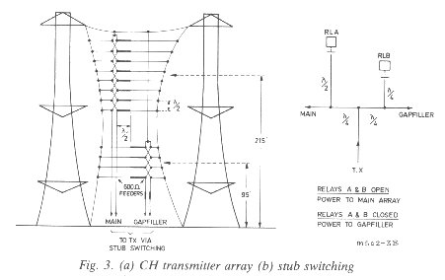
Notes:
To provide the necessary 'floodlighting' the transmitter main array consisted of a vertical stack of eight half-wave dipoles. The dipoles were spaced by a half-wavelength and end-fed by an open wire transmission line with alternate feed points transposed to preserve in-phase excitation of the stack, figure 3a. Associated with each dipole was a 'tuned' reflector spaced by 0.18 wavelength. The mean height of the array was 215 feet, which produced a main elevation lobe resulting from ground reflection at about 2.6º, and a first gap at 5.2º. The horizontal 'beamwidth' of the dipole stack, influenced by the 0.18 wavelength spaced reflectors, was in the order of 100º.
To fill the first gap, an auxiliary stack of four similar end-fed dipoles and reflectors was provided at a mean height of 95 feet producing a main elevation lobe at about 6º. This auxiliary array, known as the 'Gapfiller', was selected remotely by the operator, the change over from main array to gapfiller being made by relay-operated stub switching of the transmission line, figure 3b.
Both the eight-stack and the four-stack arrays were slung on the same centre line as a 'curtain' between the cantilevers of two of the four 360 feet steel towers. R.F. power from the transmitter was fed to the curtain by a 600 ohm, open-wire, balanced transmission line and stub matched to the array. The four-stack array was matched to the transmission line by a quarter-wave transformer of suitable impedance slung in the transmission line to the four-stack. As the system was not a true 'floodlight' because of the directional characteristics of the dipole stack and the suppression of the unnecessary back radiation by reflectors, each station was allocated a 'line-of-shoot' (LOS), which determined the alignment of the antenna with respect to the coastline.

Slide 35
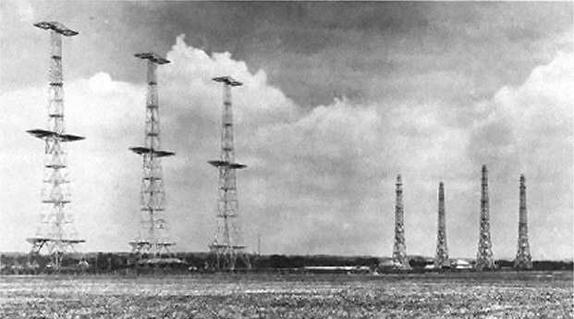
Notes:
For that purpose, four transmitter and four receiver towers were provided, each pair of towers being dedicated to one spot frequency. It was later decided to abandon the four frequency plan and to have simply a main and standby in the frequency band 20-30 MHz.
All CH Stations used horizontally polarized radiation. The decision to use horizontal rather than vertical was based mainly on three factors:-
1. An approaching aircraft has a predominantly horizontal aspect, favouring - for metric wavelengths -a horizontally polarized wavefront.
2. The signal phase change of Pi radians on reflection from the ground is constant for all relevant angles of elevation; this is particularly important for the formation of the vertical polar diagram required for height finding.
3. A horizontally polarized antenna is inherently symmetrical with respect to ground, permitting balanced, open-wire transmission lines capable of withstanding very high peak voltages to be used without undue complication. Also the symmetrical nature of the antenna simplifies both its design and installation.

Slide 36
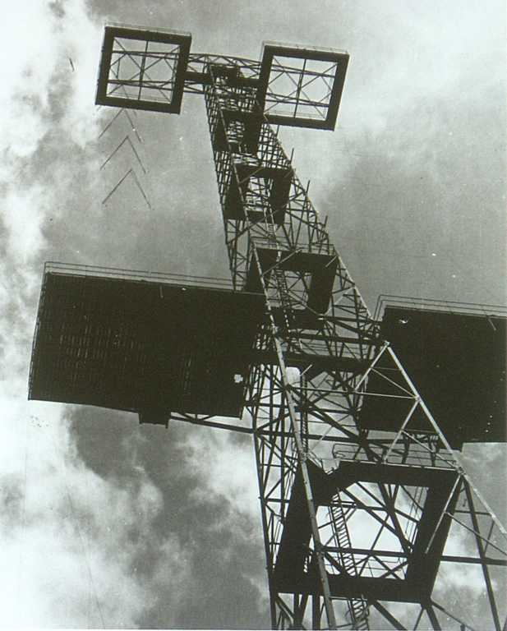
Notes:
One of the towers used to support the transmit antennas at RAF Bawdsey.

Slide 37
Determining Direction
Notes:
The simplified block diagram shown in figure 1 illustrates the operating principles: r.f. pulses 'back scattered' from all aircraft in the 'floodlit' zone are received by a set of crossed horizontal dipoles positioned at an effective height of 215 feet above the ground.
The output of the E-W dipole (Y) is fed to one of the stator coils of the goniometer and that of the N-S (X) dipole to the other. The signals are com-pared by 'swinging the gonio' for a minimum deflection of the 'echo' on the CRT display. A minimum rather than maximum was used as it gave a sharper and more precise indication of azimuth when the signal-to-noise ratio was adequate, the gonio bearing 'rose' being aligned accordingly. For weak signals, of poor signal-to-noise ratio, the gonio was swung for a maximum, and the indicated bearing corrected by 90º.
With this method of direction finding (D/F), an aircraft on a reciprocal bearing would give exactly the same indication on the gonio. This ambiguity was resolved by having remotely switchable reflectors 1/4 wavelength behind the dipoles and noting whether the signal strength increased or decreased when they were switched in. This 'sensing' was done by the operator at the console before passing a plot.
The effective height of the crossed dipole stack was 215 feet which, on a flat site, would give rise to a wide vertical gap in the polar diagram centred at an elevation angle of approximately 5.2º; the radar would, therefore be blind at this elevation. This was overcome by having a second crossed-dipole stack at a mean height of 95 feet with a main elevation lobe of approximately 5.9º which, in conjunction with the transmitter 'gapfilling' lobe, effectively closed the gap, the switching being done remotely by the operator at the console whilst searching for, and tracking, targets.

Slide 38
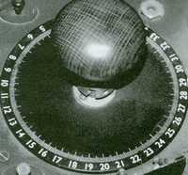
Notes:
However, there were two separated receiver aerials, one either side of the tower and the signals from each were fed to the famous 'goniometer'. This was a hand control containing two coils, each provided with one of the aerial signal inputs. A third output coil fed the signal on to the display by means of the electromagnetic coupling between all the coils. By rotating the knob one input coil moved mechanically in relation to the other.
The effect achieved by sweeping the goniometer back and forth was exactly the same as if the receiving aerials themselves had swept across the sector centred on the line-of shoot. At one particular point of the knob's rotation, the interaction of the two input signals caused a 'null' point where the displayed echo reduced significantly in amplitude. A scale in degrees arranged in a ring around the knob allowed the bearing of the null-point to be read off, and this system refined the accuracy in determining the target's direction to within plus or minus 5 degrees. As the target progressed, only tiny corrective movements of the goniometer were needed to maintain the null point, and this gradually incremented across the scale of degrees until it disappeared completely from the CRT display as the aircraft passed out of the fixed beam of radiation.

Slide 39
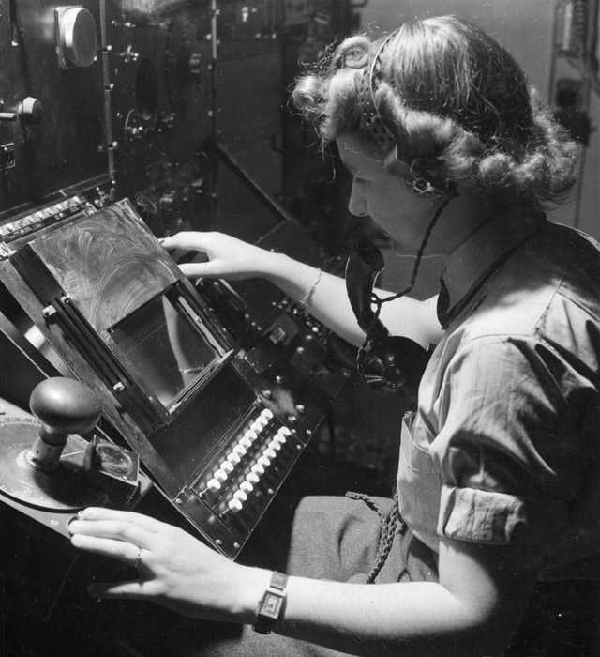
Notes:
Here we see WAAF radar operator Denise Miley plotting aircraft on the CRT (cathode ray tube) of an RF7 Receiver in the Receiver Room at RAF Bawdsey CH station.
The green cathode ray tube displays the signal received. At the left hand edge of the screen is the pulse sent out by the transmitter: the signal returned by an aircraft can be seen towards the centre of the screen. The scale across the tube is calibrated up to 322km (200 miles). A cursor is moved by the operator to the position of the trace, and this information is automatically passed to the calculating machine. Her right hand has selected the direction or height finding and her left hand is ready to register the goniometer (angle measurer) setting to the calculator.
To measure the bearing from the radar station to the aircraft the operator turns the goniometer until the 'blip' disappears. The scale is calibrated in degrees and this information also passes to the calculator. By means of a switch the goniometer can be connected to the height aerials and the process is repeated to enable the calculator to compute the aircraft's position and height.

Slide 40
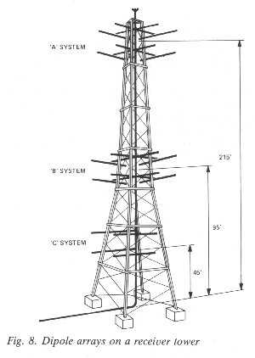
Notes:
Wooden towers, rather than steel, were used to avoid influencing the balance and symmetry of the receiver dipole stacks by the proximity of any metallic parts. The towers, 240 feet high with servicing plat-forms placed at regular intervals and accessed by a central ladder arrangement, are shown in figure 7
There were three discrete antenna stacks spaced one above the other, identified as the 'A' system at a mean height of 215 feet, the 'B' system at 95 feet and the 'C' system at 45 feet, see figure 8.
The 'A' and 'B' systems were identical, each consisting of two sets of centre-fed horizontal crossed-dipoles, vertically stacked by a half-wavelength, figure 8. The dipoles were aligned to look N-S, and E-W. The N-S dipoles were designated 'X' and the E-W dipoles designated 'Y'. On the N-side of the X dipoles and the W-side of the Y dipoles, at a spacing of quarter wavelength were placed centre-switched reflectors. With the centre of the reflectors open, the polar diagram of the dipole stack was simply a 'figure of eight', the reflectors having no effect. When closed, the reflectors were effective and the polar diagram was changed to a cardioid pattern increasing the signal strength in the E or S direction by some 3 db whilst reducing the W and N signals. These switches were relay operated and controlled by the operator at the console for 'sensing', as previously described.
The 'C' system at 45 feet was simply a stack of two single dipoles with non-switched reflectors. They were used only for heightfinding when the system was operating in the gapfiller mode and played no part in direction finding.

Slide 41
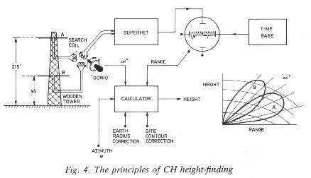
Notes:
Heightfinding was achieved by comparing the signal received by the 215 feet dipole stack (angle = 2.6º) with the signal received from the same aircraft by the 95 feet (angle = 5.9º) stack, the ratio of these two signal strengths being related to the angle of elevation of the aircraft, see figures 4 and 5. The ratio of the signal strengths is measured by feeding the signals received by the Y dipoles of the A system at 215 feet to the Y coil of the goniometer and the signals received by the Y dipoles of the B system at 95 feet to the X coil of the goniometer, see figure 4. The goniometer was then 'swung' for a minimum deflection of the echo on the CRT in exactly the same way that the azimuth angle (D/F) was determined in the direction finding mode. The number indicated by the goniometer pointer was then 'inputted' to a simple electro-mechanical computer known as the 'fruit machine' which also accepted the range of the target and performed the simple calculation: height (in feet) = 5280 (R sin angle+ R²/10000). The R²/10000 term corrects for earth curvature, assuming an effective earth's radius equal to four thirds of the true radius.
Since heightfinding relied on measurement of the ratio of signal strengths received by lobes created by the ground interference pattern, the ground in front of the antennae should, ideally have been flat out to a range of about one mile. A flat site, when account was taken of all other essential requirements, (see appendix 2) clearly was not achievable for all locations around the coast of UK, and compromises had to be made.
After installation, phasing and alignment of the instrumentation on the ground, a large number of calibration flights were carried out using an auto-gyro making circular and radial tracks at fixed heights. The deviations from the actual to the indicated heights were carefully noted and correction factors calculated for all azimuthal angles within the operational sector centred on the station's 'line-of-shoot.'

Slide 42
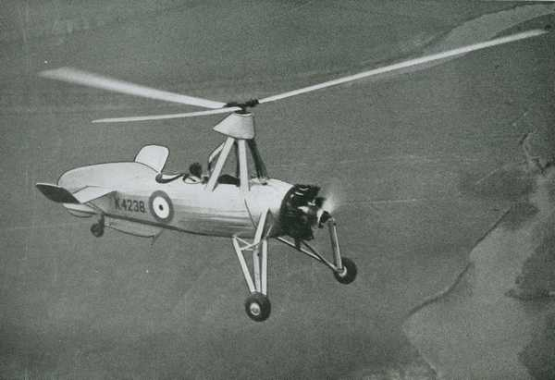
Cierva Autogiro
Notes:
This unusual two-seater aircraft was used in the calibration process of the CH radar system. It was chosen for its ability to fly in tight circles i.e. the nearest thing to hovering in those days and indeed if it was flown into a strong wind its forward progress was virtually zero.
Senor Juan de la Cierva had 'invented' this machine in Spain in the late nineteen twenties, but it was still in development when he was killed in a civil aviation accident at Croydon airport. At the time of the outbreak of the war it was an established Avro built machine for certain special applications, and indeed there were several private owners in this country. There were two versions. The C30 which required a 30 yard take-off and landing run had a loaded weight of 1400lbs. and flew at 100mph with a range of 280 miles. The C40 was a 'direct take-off' model which could make a ten foot hop into the air without any forward run, this being achieved by a temporary 'clutching in' of a drive to the the rotors from the main engine. It could also land without any run and had a speed of 120mph. The C40 had articulated rotor blades which were free to rise and fall as the rotor turned.
From 1934 these aircraft were manufactured in this country by Avro. Some were bought by the Air Ministry and they formed 1448 Flight at Duxford. The Air Ministry originally called the aircraft a 'Gyroplane' but by 1941 the official name had been changed to 'Rotaplane'. 1448 Flight became 529 Squadron in 1943 and operated from first Halton and then Henley on Thames. This squadron was exclusively used for radar calibration work.

Slide 43
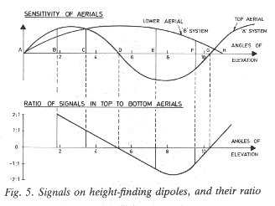
Notes:
These correction factors were 'hard-wired' into the calculator ('fruit machine') by linking the contacts of banks of Post Office type 'Uniselectors' in a manner which took account of the azimuth at which the height was being measured and making the appropriate correction. The calculator therefore received, in addition to the elevation angle from the gonio and range from the A scan of the CRT, the azimuth noted from the original D/F of the aircraft.
At higher elevation angles (angles above 8º), there was some ambiguity because of confusion with the multiple upper lobes of the 215 feet dipole stack, but these could be quickly resolved by a skilled operator noting the results of a series of readings. In fact, almost all aircraft of interest ('hostiles') were first observed at long ranges and therefore low angles of elevation, so this problem did not often arise.
For aircraft in the first elevation gap, heightfinding was achieved using the 95 feet (angle = 5.9º) dipole stack and a third stack at 45 feet (angle = 12.5º).
All the measurements were taken using the same goniometer, the feeders from the various antennae elements being selected by the operator, using buttons operating a remote, motorized set of change-over switches.

Slide 44
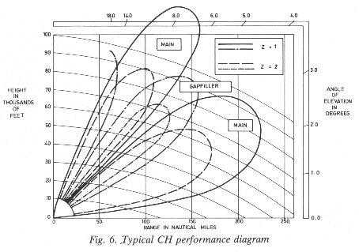
Notes:
Counting of aircraft in close formation (raid strength) relied on the skill of the operator who, when experienced, was able to make an assessment by observing the 'beat' rate of the composite echoes. To assist in this assessment, the transmitted pulse could be momentarily shortened to 6 microseconds (from 20 microseconds) by a push button on the console, the shorter pulse improving the range resolution by about 3:1.
It should be mentioned at this point that the great success of CH was due in no small measure to the incredible acquired skill of experienced operators, particularly the WAAFS (Women's Auxiliary Air Force). Signals at extreme ranges, well below 'noise' level, were detected and tracked.
The mechanism by which this was achieved is still not fully understood but believed to be due to an unconscious form of pattern recognition within the noise structure, somewhat analogous to the 'cocktail party' effect. Also, unlike scanning (searchlight) radars, CH, being a 'floodlit' system, provided up-date at p.r.f. rate with a corresponding integration gain when using a CRT with a long persistence phosphor. Figure 6 illustrates typical performance achieved by experienced operators on an average size bomber such as the Heinkel 111.
The cocktail party effect describes the ability to focus one's listening attention on a single talker among a mixture of conversations and background noises, ignoring other conversations.^{[1]} The effect enables people to talk in a noisy place. For example, when conversing in a noisy crowded party, people can still listen and understand the person they are talking with, and can simultaneously ignore background noise and conversations. Nevertheless, if someone calls out their name from across the room, people will immediately notice

Slide 45
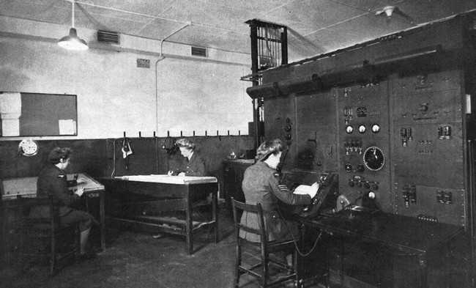
Notes:
WAAFs (Women's Auxiliary Air Force) operating a CH Radar

Slide 46
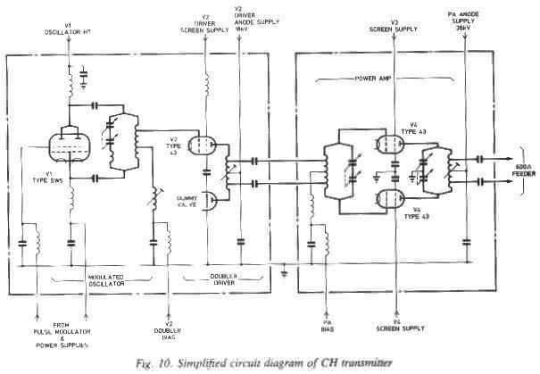
Notes:
As stated earlier, it was originally intended that each station should have the choice of any one of four allocated frequencies as an anti-jamming measure; it was intended, therefore, that each mast should carry a set of dipole stacks which had been carefully matched phased and calibrated for one specific frequency. This plan was later abandoned.
To preserve the electrical symmetry and low cross-talk between elements necessary for accurate direction and heightfinding, great care had to be taken in the bonding and alignment of the feeders connecting the dipoles to the remote goniometer and receiver system. Low loss, 72 ohm, solid copper cables pressurized with dry air to keep out moisture, were used as feeders. Phasing of the X and Y elements was achieved by inserting finely trimmed short lengths of flexible 72 ohm twin 'television' cable (BL7) between the co-axials and the goniometer, these links being folded up in a screened copper 'phasing' box and trimmed to length during the calibration process.
TRANSMITTER
The transmitter, designated T.3026, figures 9 and 10, was derived from a basic design by Metropolitan-Vickers for the short-wave station at Rugby. It was very unusual, probably unique at that time, in that it used continuously evacuated, demountable tetrodes as the output and driver stages, figure 11. Originally intended for c.w., the design was extensively modified to allow operation in a pulse mode at a very high peak power and low duty cycle (5 x 10⁻⁴). It was also required to have the capability of being switched to any one of four spot frequencies in the band 20-50 MHz within 15 seconds to meet the four frequency concept of the original anti-jamming plan. The specification for pulse shape and stability was very stringent for those days; an r.f. pulse of 300 kW was completely outside the transmitter designers' experience. An additional requirement was that during the quiescent or interpulse period, the power radiated from the transmitter was not to exceed a few microwatts to avoid masking the nearby, highly sensitive receiver during the 'listening' period following the pulse.

Slide 47
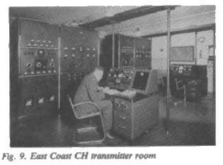
Notes:
Many ingenious ideas were tried in an endeavour to generate an r.f. pulse with fast leading and trailing edges and a minimum of c.w. breakthrough during the interpulse period together with very low intrapulse FM. The final solution used a biased-off tetrode coupled as a modified Hartley oscillator tuned to half the station frequency and gated by a fast, positive-going pulse applied simultaneously to both control and screen grids. The gating, or modulating, pulse, was generated by a pair of mercury vapour thyratrons associated with a somewhat complicated timing and trigger circuit.
The pulse oscillator was coupled to a balanced class 'C' frequency doubler-driver stage consisting of a single power tetrode and a 'dummy' valve of equivalent capacity to provide a symmetrical, balanced output.
The output stage consisted of a pair of push-pull, high power tetrodes operating in class 'C' driven by the balanced output from the frequency doubler stage. The final output was fed via Pyrex d.c. blocking capacitors and 600 ohm open wire feeder to the antenna system.
Frequency selection was achieved by remote control of a motorized, multi-pole rotary switch which selected the appropriate pre-set tuned circuits. The tetrodes used a tungsten filament operating at 18V/ 140 A. In its final form, the transmitter worked with around 35 kV on the anodes of the output stage and delivered a peak r.f. pulse power of approx 750 kW.

Slide 48
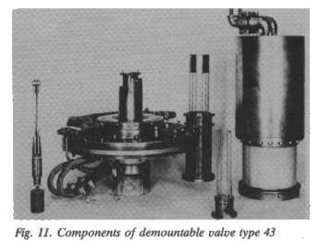
Notes:
The water-cooled power tetrodes Type 43, figure 11, were of particular interest, being demountable to permit replacement of the filament, control grid and screen grid. A vacuum plant using a two stage oil-diffusion pump backed up by a rotary pump continuously evacuated the system. The state of the vacuum was monitored by Pirani gauges which controlled the operation of the plant and provided the interlock should the gas pressure rise above the permitted safety level.
The tetrodes were cooled by distilled water pumped round a closed circuit heat exchanger, the water being delivered to the tetrode anodes by coiled rubber tubes wound as chokes to prevent r.f. leakage.
When a tetrode was let down to air to replace an electrode, usually the filament, the tube had to be pumped down to a hard vacuum. To reduce the time taken to reach correct operating pressure, the tetrode was 'conditioned' by applying raw a.c. to the electrodes, whilst the anode was held at a steady d.c. potential. This process caused the electrodes to be 'bombarded' and accelerated the emission of occluded gases, which were then drawn off by the vacuum pumps. The conditioning process was carried out with the tetrode in-situ, the additional components and control arrangements being incorporated in the basic transmitter design. The transmitter was triggered by incoming positive pulses derived from the timing circuit in the receiver, which also generated the command signal to reduce the pulse length from 20 us to 6 us.

Slide 49
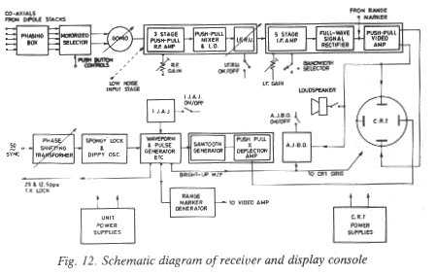
Notes:
The receivers were designed and manufactured by A. C. Cossor Ltd. to a TRE specification. As the war progressed, many modifications, improvements and additions were made to the original design, although the basic principles briefly described here remained virtually unchanged, figure 12. Figure 13 shows a general view of the receiver and display console, while figure 14 shows the team of operators at work.
The incoming co-axial cables from the receiver masts were fed via the 'phasing box' and motorized selector unit previously described, to the goniometer stator coils. In accordance with the original four frequency plan, there were actually four gonios each dedicated and calibrated to a spot frequency and all mechanically linked to a single search knob. A wave-change switch routed the operational goniometer search coil to the input stage of a three-stage r.f. amplifier. To preserve symmetry and hence stability, the r.f. stages were arranged in a push-pull arrangement, with each stage housed in its own screened box. The input stage used a pair of special low noise, 'aligned-grid' pentodes known as EF8s, very advanced valves for that period.
A push-pull mixer using a pair of triode-hexodes with separate triode local oscillator, down-converted the signal to 2 MHz was fed via a buffer and a two stage interference rejection unit (IFRU) to a 5 stage, single-ended i.f. amplifier. A choice of 3 bandwidths: 500 kHz, 200 kHz and 50 kHz was available to the operator selectable by a lever above the display. The matched bandwidth was theoretically 50 kHz, but many operators preferred a wider, non-optimum bandwidth as an aid to pattern recognition and raid strength assessment.
However, in the presence of jamming, the narrow bandwidth was used. After full-wave detection, the video signal was passed via a pair of push-pull deflection amplifiers to the Y plates of the CRT.
An important feature of the design of the r.f., i.f. and video stages was the necessity of restoring full sensitivity, immediately after the incidence of an overloading signal which could 'paralyze' the amplifiers. Care in the choice of decoupling capacitors, impedance of power supplies and time constants in general, was essential.

Slide 50
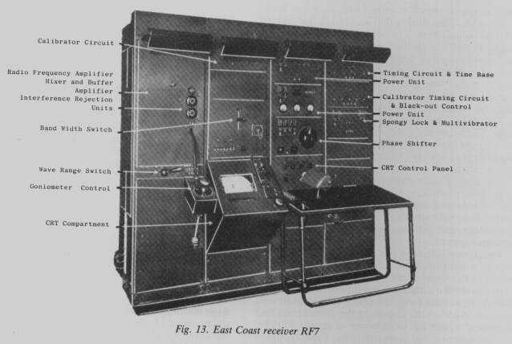
Notes:
The very special care taken in the design of the focussing, deflection amplifiers, astigmatism correction and shift controls plus the high quality and resolution of the CRT, was a significant feature of the display unit and contributed in no small measure to the ability of skilled operators to detect and track targets of very low signal-to-noise ratios which might otherwise have been missed.
As mentioned earlier, the normal operating p.r.f. of the radar was 25 p.p.s., locked to a preset point on the mains 50 Hz waveform, allowing stations in the chain to operate without interfering with each other. The phase of a 50 Hz sine wave derived from a phase-shifting transformer, energized from the mains supply, was used to lock a Dippy oscillator operating at 25 Hz. The locking was 'spongy' and worked in a manner similar to that of the flywheel time-base of a modern television set. The phase of the sine wave output of the phase-shifting transformer was continuously adjustable relative to the mains cycle, permitting a precise timing point to be chosen.
Each CH station was allocated a particular 'spot on the dial' from which it was not allowed to deviate without special permission from HQ! In conditions where severe 'scatter' from the ionosphere caused 'n^{th} time around' clutter on the display, the operator would often, unofficially, move the dial in an endeavour to 'phase' it off the screen, thus often causing chaos further along the chain!

Slide 51
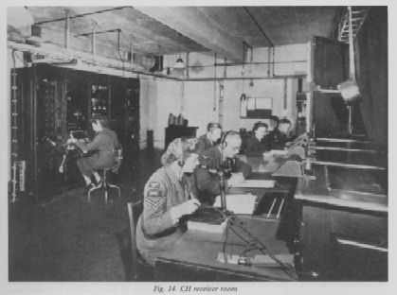
Notes:
The 25 Hz sinewave output from the Dippy oscillator was passed to a waveform generator and timing unit which produced the trigger for the transmitter, the time-base and bright-up waveform for the display and the trigger for the calibrator unit. The calibrator unit generated a sequence of 10 mile marker pips which could be mixed in with signal, allowing the time base to be accurately aligned to the range scale.
The waveform generator also produced a 12.5 Hz blanking pulse to suppress alternate trigger pulses to the transmitter and display unit when, under bad ionospheric conditions, the operator selected the alternative p.r.f. of 12.5 p.p.s.
In the early years of the war, aircraft were manually plotted by reading off range from the calibrated range scale of the display and the bearing from the goniometer, and then tracked locally on a grid-referenced plotting board. The grid references were then passed by the track-teller, via high quality landlines, to the Filter Room. Groups of stations were directly connected to the Filter Room each having their own dedicated plotter. The quality of the plots varied considerably, depending on the range and bearing of the target in relation to particular stations; it was the job of the plotters to sort out, or 'filter', the sometimes-conflicting information and endeavour to form a true track. New plots were assigned an 'X' number until positively identified and then allocated either an 'H' or 'F' prefix for hostile or friendly. The Filter Rooms were linked to the Fighter Control networks (GCI's, Sector Control, etc.) for appropriate action.

Slide 52
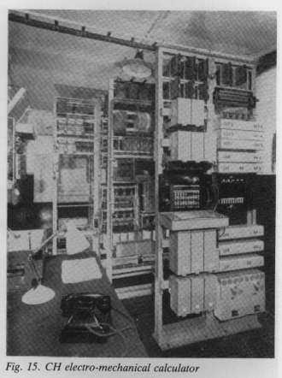
Notes:
Fruit Machine (British slang for a slot machine).
At a later stage, manual plotting was superseded by automatic plotting, using an electro-mechanical calculator, a 'fruit machine', figure 15, into which the various corrections resulting from calibration were programmed.
As the war progressed, many improvements were made to the equipment and to the reporting procedure to reduce the time taken to pass information to the various control centres at times when there were many raids in progress. For example, modifications to the receiver console were made to enable the operator after "D/F ing" the target and moving a cursor along the time-base to correspond to the target range, simply to press buttons for the data to be passed directly and automatically to the control centre.
Many ingenious devices, including optical converters, and calculators, too numerous to describe here, were introduced in the latter stages of the war which made the Chain Home system extremely efficient and reliable.

Slide 53
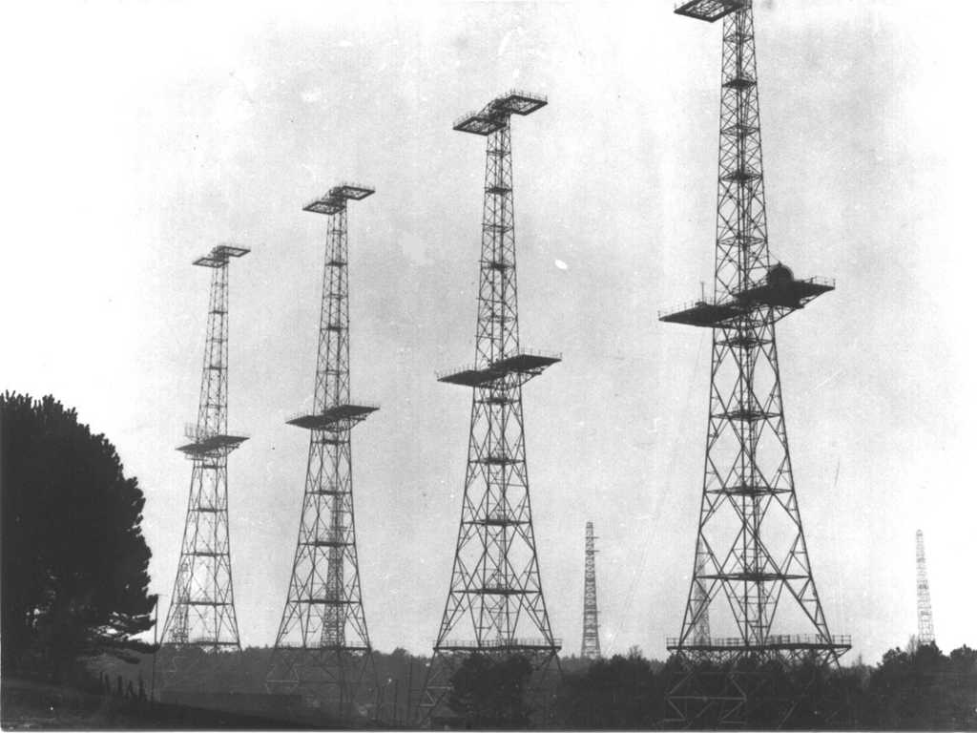
Notes:
There were a number of ingenious anti-interference/anti-jamming devices available to the operator. Perhaps the most significant was the use of a double phosphor CRT using a long 'afterglow' material (zinc cadmium sulphide) overlaid by an active blue phosphor (zinc sulphide). The 'flash' of the blue phosphor excited the long afterglow layer, leaving a yellowish image which could be viewed through a yellow filter whilst suppressing the blue flash, the theory being that enemy jamming, interference and the noisy background, being unsynchronized and of a transitory nature, would not build up a long afterglow image and would not be visible through the yellow filter. This system worked very well.
The IFRU, referred to earlier, was a pair of narrow-band notch filters, in series, which could be independently tuned within the i.f. pass-band to reject CW interference.
To counter the effect of 'spoofer' techniques, which enabled jammers to lock-on to the transmitted pulse and return a delayed pulse or sequence of pulses creating false targets, the station p.r.f. was intentionally 'jittered' in a random manner; false targets could then be easily identified as they would appear to jitter on the screen whilst true targets would appear stationary. This device was known as the Intentional Jitter Anti-Jamming Unit (IJAJ). Another device was the Anti-Jamming Black-Out unit (AJBO) which fed a portion of the video signal via a thresholding circuit with appropriate time constant to the grid of the CRT, 'blacking out' un-synchronized interference. A loudspeaker was also provided to assist the operator in identifying the nature of the interference or jamming by listening to the sound of the video signals.
It is worth mentioning at this point that the accuracy of the goniometer method of D/F was earlier thought likely to be inadequate especially in a heavy jamming environment. An alternative scheme, known as the 'Chapman' method (after the inventor, Corporal Chapman) using a system of range cuts to fix the target position, was proposed. One station would display echoes from its own transmitter plus echoes from the transmitter of an adjacent station on a second display. The operator had to swing his goniometer and note the two echoes, one on each CRT, which attained minima at the same goniometer setting to resolve ambiguity. The position of the target giving rise to the two echoes could then be found by range cuts, the goniometer playing no part in the position fixing. To prevent jitter between the two sources of signals, both locked to the grid system, the 'spongy-lock' method of synchronization mentioned earlier was adopted. In the event, the goniometer method of D/F, after careful calibration, was found to give sufficient accuracy for all practical purposes and the Chapman method was abandoned.

Slide 54
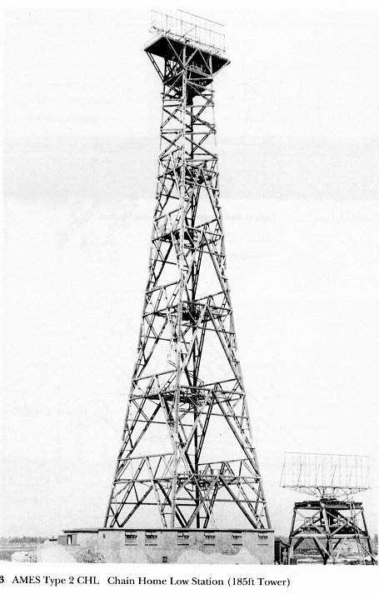
Chain Home Low
Freq: 200 MHz
Peak Power: 150 kW
Pulse Length: 3 microsec
PRF: 400 pulses per second
Notes:
Operational experience showed that the Chain Home (CH) system had significant gaps in its low level cover below about 2º and the 1938 R.A.F. exercises demonstrated that low-flying aircraft could escape detection completely.
In 1936 the War Office had established a small group at Bawdsey under Dr. E. T. Paris and Dr. A. B. Wood. This group had been working on gun-laying (GL) radar for antiaircraft guns and coastal defence (CD) radar for the direction of coastal artillery. The CD equipment worked on the higher frequency of 180-210 MHz and the aerial comprised of a broadside 32 dipole array that produced a narrow beam in both azimuth and elevation. By July of 1939 the CD set could detect an aircraft flying at 500 feet up to 25 miles away with very good accuracy and in August 1939, on Watson-Watt's recommendation, the Air Ministry ordered 24 CD sets from Pye Radio with the intention of placing one at each CH site. These stations became known as Chain Home Low (CHL) stations and the equipment as Radar Type 2.
The early CHL radars used the type A display, similar to that used in CH. The type A display comprised of a cathode ray tube (CRT) that displayed slant range, usually across the horizontal (X) axis, and a deflection proportional to the strength of the received signal on the vertical (Y) axis. The target bearing was read off of a vernier scale representing the direction the aerial was pointing (or goniometer in the case of CH). A major improvement in interception techniques came in June 1940 when the PPI display was introduced. A fuller description of the impact of the PPI on interception can be found in the GCI section.

Slide 55
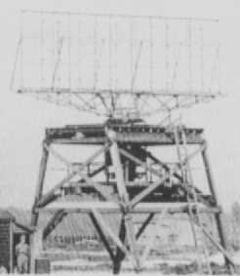
Notes:
The early equipments had separate transmit and receive aerials and cabins which were rotated synchronously. Several methods of rotation were tried out; some aerials were cranked around by hand whilst Gordon Kinsey describes another method in his book "Bawdsey - Birth Of The Beam":
"Wing Commander Kenneth Mummery remembers that the new system had its drawbacks as well as its advantages:
"Several mechanical problems were encountered during the early days of C.H.L. stations, as the narrower beam aerial array had to be rotated in order to sweep or scan, and many novel methods were devised to obtain this movement. One remembered by many was a framework not unlike that of a bicycle frame, with handlebars and seat, chainwheel and pedals which, when they were turned, rotated the aerial through a series of gears and links. A joke enjoyed by the 'informed' was that one could always identify one of the W.A.A.F. R.D.F. operators by her bulging calf muscles and unusually slim figure.""
Fortunately for the ladies power turning was introduced in April 1941!
The production models comprised of one common transmit and receive aerial that was made up of a 5-bay, 4 stacked dipole array mounted in front of a reflecting screen. The array could be rotated at 1, 1.5, 2 or 3.33 rpm. An impression of the size of the aerials can be gained from examining the detail from the main photograph; someone can be seen standing in the doorway at the bottom left hand corner of the detail!

Slide 56
The Germans become suspicious!
By 1939 it was pretty difficult to hide the towers dotting the British coast.
General Wolfgang Martini, Chief of Communications for the Luftwaffe, was determined to discover their purpose!
Notes:
Wolfgang Martini (Sept. 20, 1891- Jan. 6, 1963) was a Career Officer in the German Air Force, and largely responsible for promoting early radar development and utilization in that country.
While attending the Gymnasium in his hometown of Lissa in the Province of Posen, Wolfgang Martini had been a radio enthusiast. Upon graduating in 1910, he joined the Army as a Cadet, and his talents were such that he soon became a Lieutenant and made Company Officer of a Telegraph Battalion. During World War I, he had a number of leadership positions in radio operations, being promoted to First Lieutenant and then Captain. At the end of the war, he was a Radio Specialist in the Grand Headquarters and Commander of the Army Signals School at Namur in occupied Belgium.
After the Treaty of Versailles was signed in 1919, Martini was one of the few officers allowed to remain in the Army. For the next five years, he served as a signals instructor at several Army schools, and then from 1924 to 1928, he was the Signals Staff Officer with a District Command. Between 1928 and 1933, he was promoted to Major and served as an Equipment Advisor with the Reich Defense Ministry.
Upon the formation of the Luftwaffe in 1933, Martini transferred to this new service and shortly became the Chief for the Board of Radio Affairs. Promoted to Lieutenant Colonel in 1934 and then Colonel in 1937, he served as Leader of the Department of Communication Affairs. In 1938, he was promoted to Major General and named Chief of Communication Affairs of the Luftwaffe. Martini was elevated to General der Luftnachrichtentruppe (General of the Air Signal Corps) in 1941, and remained in this position until the end of the war in May 1945.^{[1]}
In the mid-1930s, the firm Gesellschaft für Electroakustische und Mechanische Apparate (GEMA) started the development of a Funkmessgerät für Untersuchung (radio measuring device for reconnaissance). This pulse-modulated system was based on earlier work by Dr. Rudolf Kühnhold, a scientist with the Kriegsmarine (German Navy), and was conducted in the greatest secrecy, not even informing the other military services of its existence.^{[2]}
GEMA’s product, an early-warning system code named Seetakt, was eventually demonstrated to the Luftwaffe General Staff in November 1938. Martini was there and immediately recognized the great value to the military of this new technology. He ordered the development of a similar system (ultimately called Freya) for the Luftwaffe, and from this time on was the primary promoter of Funkmessgerät (radar) to the German High Command.
Beginning in 1941, in addition to other duties he was officially the High Command’s Special-Agent for Radio-Ranging (Radar) Technology. Although not university educated, his grasp of this technology was instinctive and his involvement was perhaps the greatest impetus to the ultimate development of wartime radar in Germany.

Slide 57
Insert photo of General Martini Here!
Google Images let me down!!
Notes:
In most of his activities, Martini reported directly to Hermann Göring, Commander of the Luftwaffe, but Göring never fully trusted him and the two often clashed over technical decisions. For example, as British radar became known to the Germans through Martini’s Signals intelligence, they violantly disagreed as to its importance. Concerning this, Göring had told other commanders that Martini was a fool, “It was the same with all specialists; they exaggerate the importance of whatever they are working on.”^{[3]}
Following the war, General Martini, like other officers at his level, was held by the United States, and then Great Britain until 1947; however, no charges were ever placed against him for his service to the Luftwaffe. With the formation of the Bundeswehr (Federal Defense Force), Martini returned to high positions with the new Air Force in 1956, and later with NATO.
In these years, Martini established relationships with radar pioneers in several other countries. One of these, Sir Robert Watson-Watt, considered “the father of British radar,” included the following in his 1959 autobiography:
I have a very dear postwar friend in General Wolfgang Martini, a shy, modest, charming, and very perfect gentleman . . . His many claims on my affectionate respect include his failure to endear himself to Göring, from whom the qualities I have just tried to summarize may have concealed General Martini’s very high technical competence, wisdom, and resource.^{[4]}
Martini’s major awards included the Knight’s Cross Of The War Merit Cross With Swords (Feb. 1945), and the Grand Cross Of The Service-Order Of The Federal Republic Of Germany (Feb. 1959). Also in 1959, he was named an Honorary Member of the Board of the “Committee For Radiolocation.” In 1962, he was awarded an Honorary Doctorate in Engineering. Martini died of a heart attack on January 6, 1963, in Düsseldorf.^{[5]}

Slide 58
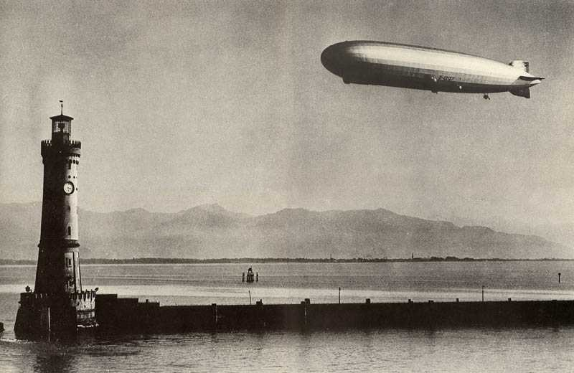
Notes:
Graf Zeppelin survole le lac de Constance - Crédit photo: © Digilander.libero
Martini had a succession of German “tourists” camp near the various radar stations in an attempt to discover their purpose. They brought back stories of locals reporting that vehicles would stall late at night and similar rumours. They could not carry the heavy radio equipment necessary to search the airwaves and analyze transmissions however. Lufthansa airliners could carry such equipment, but could not dwell near the towers for the time required. Martini decided that an Airship could do the surveillance job however. It took some doing, but eventually he obtained Goring’s permission to bring the Graf Zeppelin out of retirement.
It was quickly fitted with radios and antennas capable of monitoring broad swaths of the RF spectrum, and with Martini in charge it departed its shed on 7 May 1939 and set course for England.
It came across the North Sea from Frankfurt towards Bawdsey. Ten miles off the coast, in thick cloud, it began to cruise slowly along the coast. Inside, the operators listened for any signals that could come from the towers ashore, ready to record and analyze frequency, polarization, directional characteristics, modulation, etc.
But no signals were discovered!

Slide 59
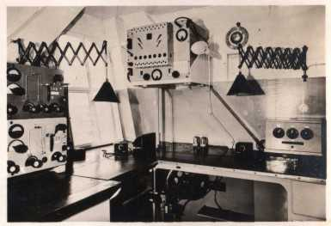
Notes:
Radio Room of the Graf Zeppelin.
The British radars were indeed operating, and had been tracking the Graf Zeppelin for some time. Its slow speed gave away its identity as an airship. The German equipment was not operating properly however, and they were unable to receive any of the British transmission.
At one point the Graf Zeppelin, in thick cloud, radioed it’s position back to Germany as a few miles off the Humber. This caused the British much amusement, as it was actually well inland, over the city of Hull. The Brits were tempted to radio a position correction to the Germans, but dared not to as it would have revealed the capabilities of the British radar.
Martini made one more attempt, on 2 August 1939. This time the German receivers were working perfectly! They did not count on another possibility however - the entire British radar system was down due to a technical problem! Again, no signals were heard, and the British had no idea the Graf Zeppelin was offshore. Frustrated, the Germans turned for home when daylight came and they were visually spotted by fighters sent up to investigate.
Just 2 nights later the RAF’s summer exercises began, and for the first time ever, the CH radar system worked flawlessly! Had the Graf Zeppelin’s flight taken place a few days later, or had a third flight been attempted, the Germans would have identified the radar transmissions, and realized the importance of those towers. Had that happened, the outcome of the second World War could have been quite different!

Slide 60
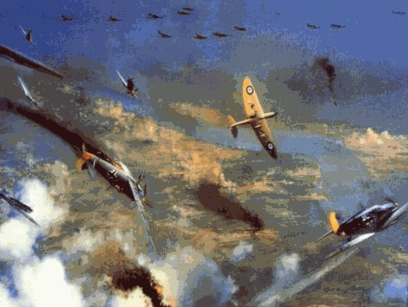
The Battle of Britain

Slide 61
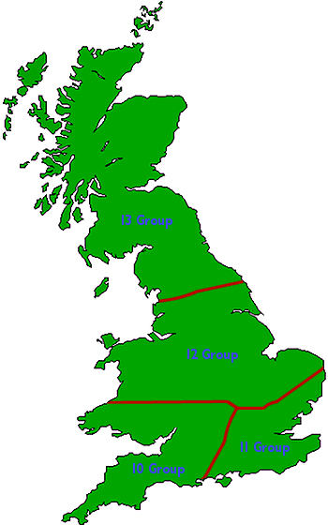
Fighter Command
Organization
Notes:
At the time of the Battle of Britain, Fighter Command was split into four groups. 13 Group covered the North of England and Scotland, 12 Group the Midlands and Wales, 10 Group South West England and, most importantly 11 Group covered the South East and London. 11 Group was also nearest to the Germans in an area where the German invasion of Britain, Operation Sea-Lion, was most likely to take place. By clicking on the groups on the map below, a full list of their stations and equipment during the period of the Battle can be viewed.
The Royal Air Force Chief of Staff was Air Chief Marshal Sir Cyril Newall, and the Fighter Command Air Officer Commanding-in-Chief was Air Chief Marshal Sir Hugh Dowding.
The Groups were commanded by:
Air Vice-Marshal Sir Quintin Brand, Air Officer Commanding 10 Group
Air Vice-Marshal Sir Keith Park, Air Officer Commanding 11 Group
Air Vice-Marshal Sir Trafford Leigh-Mallory, Air Officer Commanding 12 Group
Air Vice-Marshal Richard Saul, Air Officer Commanding 13 Group

Slide 62
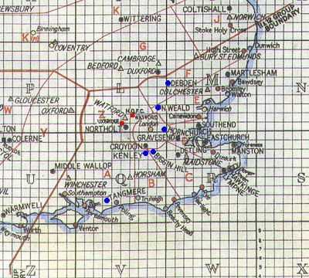
Notes:
The sectors of 11 Group from an original map. HQ Fighter Command (RAF Stanmore) and HQ 11 Group (RAF Uxbridge) are marked in red, the sector stations are marked in blue.

Slide 63
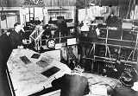
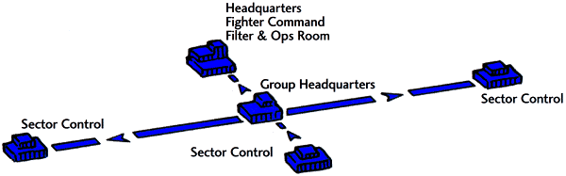
Notes:
First level control
Each Group was split into Sectors with RAF stations in each, one of which was the Sector Control Station. All the Sector Control Stations reported to the Group Headquarters, and they in turn reported to Fighter Command Headquarters at Stanmore in Middlesex, near London. The Headquarters acted as a filter and communications center.

Slide 64
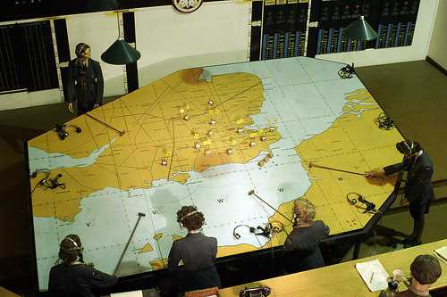

Slide 65
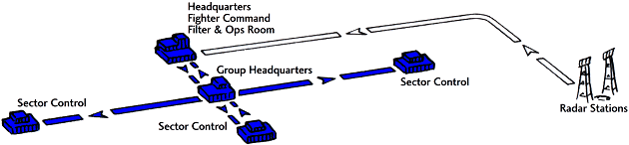
Notes:
RDF Reporting
All round the coast were radar (Radio Detection and Ranging) stations, which could 'see' an enemy raid, in some cases while it was still over France. The raid was reported to Fighter Command HQ (FCHQ) where it was plotted on a large map. This information was then passed to the Group Headquarters, who passed it on to the Sector Control Rooms affected by the plot.

Slide 66


Notes:
The RDF information was crude by modern standards, but was more than sufficient to give bearing and range information on an incoming raid. The system consisted of two dials and a cathode ray tube that gave a screen presentation of the raids range. The two dials supplied time and bearing information. The height of the raid could only be accurately provided once the raid came within visual sighting range of the Observer Corps posts. With experience, RDF Operators could judge the size of the raid by the size and shape of the blip on the screen.
The RDF screen. The readout at the top shows the ground return blip, from trees, buildings and any terrain near the station, at zero miles. The blip at 40 miles is the raid. The left hand dial shows a bearing to the raid of 89 degrees. The time on the right hand dial reads 11 hours, 10 minutes and 27 seconds from the inner dial outwards.

Slide 67


Notes:
Observer Corps Reporting
All over the country were Observer Corps Posts. Their job was to report the raids once they had crossed the coast and were behind the radar. They reported to Observer Corps Centres, who passed the information on to their Sector Control Rooms, thence to Group Headquarters, who in turn sent it to FCHQ and the plot of the raid was kept up to date.

Slide 68

Notes:
One of the problems of the Radar Stations, was that their beams were directed out to sea and away from the coast. This was fine, as radar could pick up and track hostile aircraft as soon as they were leaving the French coast and making their way across the Channel. But, as soon as they were over the English coast, the enemy was no longer in the hands of radar. Of course, radar could not detect how many aircraft there were, nor could they supply any information as to type and exact height. This task was left to a band of men, looking skywards and visually making a 'sighting' and reporting their findings to a central command post. This band of highly trained and skilled men were to be known as The Observer Corps. The Corps was by no means new. In fact their history would go back to the beginning of First World War, where at that time it was the Royal Naval Air Service that was responsible for Britain's home defence. It was the duty of the local police to act as observers and report to the Admiralty any sightings of enemy aircraft. Of course, they were by no means skilled operators at this and quite often many unidentified aircraft were reported, and on many an occasion, being as the policeman had to report by telephone which we must remember were not in every home as they are today, so by the time he had found a telephone and made his report the aircraft could have traveled many miles and even changed its course. By the middle of the war, the Admiralty had handed over to the Army, and the Royal Flying Corps was in operation, the police had been relinquished of their observer duties and it was handed over to civilians who were spaced at regular intervals around what was interpreted as 'important and vulnerable' targets. With the Army now in control, all sightings had to be reported to the War Office. It was not until 1921 that these civilians were given the title of Observer Corps, a title that was to stay with them when Hugh Dowding took over Fighter Command in 1936.
Dowding saw the importance of the Observer Corps and immediately took steps that they should work in conjunction with the Radio Direction Finding Stations as soon as tests at Bawdsey were complete. It would be the task of the RDF to detect hostile aircraft whilst still out to sea, then it would be the job of the Observer Corps to track them once the are over land.
But the men of the Observer Corps were much more highly trained under Fighter Command than those of the First World War. Strenuous lectures in aircraft recognition became mandatory, as did lessons in judging aircraft height. Although they were not equipped with any elaborate instruments, it was mainly their enthusiasm, an aircraft recognition booklet, a pair of binoculars and a simple yet effective sighting instrument were the only tools that this dedicated band of men tackled their all important duty.

Slide 69

Notes:
Once radar, as it had now become known as, had picked up an enemy sighting and the information passed on to the Filter Room at Fighter Command HQ, it was the Group Operations Room that contacted the Observer Corps Command Centre who in turn notified the small Observer Command Posts scattered at between six and ten miles apart along the coastline, where it would be apparent that the detected enemy formation would possibly be sighted. As soon as the call was received, the post, normally manned by three to five men would scan the skies with their binoculars and keep a keen ear out for the sound of aircraft engines. In inclement weather and on days with low cloud, visual sighting was almost an impossibility and detection could only be made by sound. How long they would have to wait to make contact with the enemy, no one knew, all they had been told was "hostile" aircraft had been detected '"X" miles south of Dover" or wherever the first detection had been made. How old was the message, how fast were the aircraft traveling and how far away were they and on what course. The observers may have to wait half an hour, three quarters, or maybe the aircraft had changed direction, in which case they would approach further up the coast. If possible, any change that had been detected, would come through as a message and the post commander would just say 'okay chaps, relax, looks like so and so's got this one," meaning that a post twenty miles along now had the task of visually sighting the enemy.

Slide 70

Notes:
An Observer Corps control room which receives reports from outlying observation posts. Information is then passed to the Sector Control Room.
Once a sighting had been made, the observers had to detect which types of aircraft were in the formation, how many, the heading that they were taking and height. All these factors were of vital importance because it would be the picture that they presented that gave the Sector Stations (Unlike radar stations that gave Fighter Command HQ their sighting and contact first, the Observer Corps gave details of their first sighting to the Sector Station in their area so that fighters could be "scrambled" as soon as possible once the enemy was crossing the coast) an overall view of the situation. Trouble was brewing if the observers gave the height of the enemy as 5,000 feet when in fact they were 8,000 feet, because it meant that when the British fighters were airborne and searching for the enemy, they could easily be "jumped" on by hostile fighter escorts because they had not been at the correct height to meet the formation. The observers would give the type of aircraft detected by its name, Heinkel III, Junkers 88's etc, they did not have to count every single aircraft, this would take up too much valuable time, they had been trained to observe a formation and be able to accurately estimate its strength and they would report this strength as "50 plus" or "100 plus". If any fighter escort could be visually seen, this may be reported, but generally, fighter escorts flew much higher than the bomber formation that they were protecting. But even if a fighter escort was not reported, the Sector Station on receiving the report knew full well that there was one there.....there always was.
As you can see, the importance of the Observer Corps was an extremely important one. Working on information already received, they were the last to provide details of height, location, heading and strength of the enemy before Fighter Command would despatch their fighters to engage combat. They had no sophisticated operation equipment, just experience and simple tools.
As Churchill said, it was like going from the middle of the twentieth century to the early stone age. To cater to this transition there were "Lost Property Offices" which recorded aircraft reported by the Observer Corps but not by radar. (The Observer Corps were only allowed to track aircraft that had been detected by the Radar Stations.)
Len Deighton Fighter 1977 Pluriform Publishing

Slide 71



Notes:
All this information was passed up or down to the Sector Control Rooms, which actually directly controlled the defences. The Sector Controller then knew exactly where the enemy were and alerted the balloon sites in possible target areas to put up a balloon barrage. The balloons forced the German pilots to fly their bombers higher, which made bomb-aiming more difficult.
The Sector Controller also warned the anti-aircraft gun sites along the route of the raid, so they were ready to fire when the enemy came within range. Most importantly, he could scramble fighters from his Sector airfields and vector (direct) them towards the incoming raid. Without this vital system, time and fuel would have been wasted in constant airborne patrolling of the coast; some raids would have got through to their targets with no warning at all.

Slide 72


Slide 73

Notes:
Barrage Balloon with the Tower Bridge in the background.

Slide 74

Notes:
QF 3.7 inch anti-aircraft guns in Hyde Park, London in 1939.

Slide 75


Notes:
The 3.7-Inch QF AA was Britain's primary heavy anti-aircraft gun during World War II, the equivalent of the German 88 mm FlaK with a slightly larger calibre of 94 mm. It remained in use after the war until AA guns were replaced by guided missiles in the late 1950s.

Slide 76

Notes:
Controlling the Fighters
In order to vector the defending fighters on to an incoming raid, the controller had to know exactly where they were. The last link in the defence system, keeping track of the RAF fighters, were Direction-Finding or D/F radio stations. These also reported to their local Sector Control Room, and so up the chain of command in the same way as the Observer Corps. Again, this information was transmitted to every sector to keep the "Big Picture" spread throughout the command system. By doing this, the loss of a single Sector Control Room did not destroy Fighter Command's ability to function as an effective defence.
This control system is the source of many of the terms still used in air traffic control today. To assist the RDF and D/F operators, British fighters were equipped with a simple form of transponder, which automatically replied to interrogation from the ground systems with an identification signal. Known as IFF, or Identification Freind or Foe, it identified friendly aircraft on the screens. A secret device, it was code-named 'Parrot'. The instruction to switch it on was therefore "Squawk your Parrot". That term is still in use today as modern transponder codes are known as 'Squawks'. Steer is also still in use, and these remnants are a testimony to the basic soundness of the system of 1940.

Slide 77
Notes:
The Radar Stations and the Observer Corps were fine for the purpose of detecting and tracking hostile aircraft coming in from across the English Channel, but to make the detection system work and function properly the it was essential for the Sector Controllers to have an accurate assessment as to the position of their own fighter aircraft. Without knowing where their aircraft were it would have been impossible to vector them to another combat area or where their aircraft were to in relation to any current attack. One of the early methods of friendly aircraft detection was being experimented as early as February 1939. A.F.Wilkins and a R.H.A.Carter, scientists at Bawdsey were busy testing apparatus that they had built in an effort to display a different sort of blip on the CRT screens so that the filter rooms could tell if a detected aircraft was one of theirs, or if it was an enemy aircraft. During one of the official tests in March 1939, the operators at Bawdsey, busy checking their screens suddenly picked up an unusual and strange blip on the screens. Instead of the small round blip that was usually displayed, this one was brighter and the shape was elongated. They had picked up the experimental aircraft that was fitted with a new device and they tracked it for many minutes.
The information was immeadiately sent to Bentley Priory Filter Room and it was classified as a confirmed detection of a friendly aircraft. One of those present at 'Bentley" was Lord Chatfield who was Minister for Co-ordination of Defence who exclaimed that this was a great step forward and that radio detection was about to be perfected. ACM Hugh Dowding was also aware of the contribution that IFF could make in aircraft detection, and by early 1940 with the Battle of Barking Creek in which two Hurricanes of 56 Squadron were accidently shot down by Spitfires of 74 Squadron was still fresh in his mind, he was pushing for such an apparatus where he could know the position of all friendly aircraft.
IFF worked reasonably well but it did have its failings. In dogfights it became impossible to distinguish one aircraft from another. Many times friendly aircraft were not able to be detected while at time they were easily seen.
In practice, the IFF system was later to be found to be not totally reliable, and accurate aircraft identification remained founded on the judgement made at Filter Rooms, where information about aircraft movements of home forces was available.
Peter Flint Dowding & Headquarters Fighter Command p173 Airlife.A later method that was introduced was the use of HF/DF, High Frequency Direction Finding to give it its correct name, but to most it was known as "Pip-squeak" the code name given to the apparatus. All British fighters were equipped with a TR9D transmitter receiver. This was the only contact that a pilot had with ground control, although its main drawback was that it was limited to a range of only 40 - 45 miles (64 - 72Km) at about 15,000 feet (4,545m) although under perfect weather conditions this range could be extended further. The unit had two channels. One channel was used for the purpose of voice communication with Sector Control to which the aircraft was attached. Each squadron had its own frequency and always operated with this setting. The other channel was set on a common frequency to all squadrons and was unsuitable for voice communication. It was this channel that was known as "Pip-squeak".
As soon as this channel was selected, the transmitter sounded a shrill fourteen second whistle at about 1,000 cycles, which was received by the Sector Controller.
Automatic periodic DF transmissions from aircraft were achieved by "pip-squeak" (named for the cartoon characters of the day). It automatically switched on the HF transmitter in the aircraft for 14 seconds every minute. A clock in the control room showed (from four coloured sections) which aircraft should be transmitting (by a hand rotating once a minute). Each of four aircraft had its position plotted once a minute and navigation was not necessary. If one forgot to switch on, the controller would say 'Is your cockerel crowing?' cockerel being the code word for Pip-squeak. The DF system and radar were the keys to all the interceptions made and meant that it was unnecessary to fly standing patrols (which were impossible anyway). The HF/DF bands were overcrowded and distorted so a VHF (Very High Frequency) Radio Telephony (RT) set with a range of 100 miles was needed. Alas, the TR (Transmitter Receiver)1143 was not forthcoming in time and the Battle of Britain was fought largely on HF with the old crystal controlled TR9 with which I was still battling as late as 1943! By September 1940 only 16 day fighter squadrons had VHF.
Doug Tidy HF/DF Operator 74 Squadron
A sector had three direction finding (D/F) stations that formed a triangle with each corner being approximately thirty miles apart and each being connected by a land line to the stations Fixer Room. Here, on a small map table, the D/F stations were marked and were surrounded by a compass rose. As each of the D/F stations received its bearing from "Pip-squeak" a plotter at the map table could then take a line, with a humble piece of string from each D/F station on the map, and when that station reported the direction from which it picked up the aircraft's signal, the operator of the string aligned it with that direction. Thus, when the three strings were aligned in unison, where they crossed was the position of the aircraft. [1] Calculating quickly the compass course on which to send the fighter squadrons for accurate interception proved a vexing problem. Not only were pages of trigonometry consulted but a number of small computers were built to assist the calculation. Until one day, watching an exercise, an exasperated Wing Commander said he could judge the interception course by eye alone. He was immediately challenged to do so by the irritated boffins. He picked up the microphone that connected the Operations Room with the fighter pilots and gave them courses, until two RAF formations taking part in the exercise met in a perfect interception. The Wing Commander's judgment was greeted by amazed disbelief. Asked to explain how he did it, he said it was a process of imagining an isosceles triangle, with the fighters and bombers at each base corner -- interception would take place at the summit. He gave the course accordingly. It was a rough calculation but quite good enough to become standard procedure. The most common discrepancy, due to the superior speed of the fighters, was no real problem. The fighters were ordered to orbit until the bombers arrived.
Len Deighton Fighter 1977 Pluriform Publishing
[1] Peter Flint Dowding and Headquarters Fighter Command 1966 Airlife p33
The Battle of Britain - 1940 website © Battle of Britain Historical Society 2007

Slide 78
The Battle of Britain
Phase 1 – 10 July to 7 August 1940
  Attacks on Channel convoys and targets in the planned invasion area.
Phase 2 – 8 August to 6 September 1940
  Attacks on the fighters and airfields of Fighter Command.
Phase 3 – 7 September to 5 October 1940
  Attacks on London and the cities, gradual shift to nighttime bombing, the Blitz.
Phase 4 – 6 October to 31 October 1940
  Continuing attacks on the cities, but worsening weather.

Slide 79

Notes:
In order to invade Britain, the Germans had to have control in the air over the English Channel, otherwise the RAF and the Royal Navy would have been able to destroy their invasion force before it reached the shore. It has been postulated by many naval experts that due to the type of flat-bottomed barge built by the Germans, simply running a Destroyer Squadron at full speed through their ranks would have caused many to capsize in the wake from the ships. The troops and their equipment would have suffered heavy casualties, and the invasion effectively stopped with little or no gunfire. The Luftwaffe's command of the air was therefore vital to any plan for an invasion fleet to successfully cross the Channel, to prevent British sea or air forces from interfering with the operation.
Interestingly, the German Navy, Army and Air Force each had their own plans and ideas as to how and where the invasion should be launched. There seems to have been little co-operation between the German armed forces, and despite the impressive build up of barges and other equipment in the Channel ports, the actual detailed planning for the operation, code-named "Sea Lion", was never really thrashed out. All depended on the success of the Luftwaffe it would appear, before the invasion was to be taken seriously.
Starting on 10 July 1940, the Luftwaffe attacked shipping convoys in the Channel and Channel Ports. They also suspected the importance of the British radar masts and attacked the stations on the South coast, damaging some of them very badly.
One of the aircraft types used in these raids was the Junkers Ju87 'Stuka' dive-bomber. These were very accurate, and had been particularly successful earlier in the war when there was no effective fighter opposition. But when dive-bombing, they were very vulnerable to attacks against them and the Hurricanes and Spitfires of Fighter Command found them easy prey. Because of their heavy losses, they were withdrawn from the battle in mid-August.
In this stage of the battle, the Luftwaffe was in effect probing the British defences - looking for weaknesses before a major assault could be launched to exploit them.

Slide 80

Notes:
At the beginning of August, with German invasion forces and troop barges being assembled on the French coast, the raids against the South coast of England were increased in size and number.
Believing that the British early warning system had been destroyed and the coastal towns sufficiently 'softened up' for an invasion, the Luftwaffe began the next stage of their plan.
On 13 August (called Adlertag or Eagle Day by the German High Command), massive raids began on the airfields of 11 Group. The aim was to destroy the RAF, either in the air or on the ground, in South East England. To put pressure on the British defences, the Germans sent high and low level raids to different targets at the same time.
Sometimes low level raids sneaked past the battered but still working radar stations, and the first warning the British fighter pilots had was bombs landing on their airfield. Particularly good in the low-level role was the Dornier Do 17 and its derivatives, several of their raids succeeded in achieving complete surprise and escaping any form of interception.
This pattern continued into September and the situation in 11 Group became desperate. Small civilian airfields were used in the emergency, as many RAF stations became badly damaged. The Spitfire and Hurricane could easily take off from grass fields, but the maintenance and spares supply situation became dangerously stretched. Ground crews working in the open suffered heavy casualties from the raids, and many manitenance facilities were destroyed in the bombing. Despite this, the crews kept the fighters as combat ready as possible, winning the Battle on the ground as the pilots were in the air.
Suggestions were made that the fighters should be pulled back north of the Thames, but Dowding and Park knew that this was exactly what the Germans wanted, effectively giving them air superiority over the intended invasion area. So the 11 Group squadrons stayed and fought for their lives.
To keep up the pressure, the Germans began night raids, to stop the defenders repairing damage overnight. On one night raid, some aircraft bombed civilian areas of London by mistake; a mistake which was to become a crucial turning point in the Battle. Attacks on civilian centers were something which had been specifically banned by Hitler, who was still hoping at this time that the hoplessness of the situation would cause the British to sue for a negotiated peace. The German High Command knew that widespread civilian casualties would only harden the resolve of the nation to fight on. In reply to this accidental attack, the British bombed Berlin. Fears grew that cities would be raided more often, so children were evacuated again in a second mass exodus to places of safety in the country, as they had been during the Phoney War of 1939.
However, just when it seemed that the country and 11 Group in particular couldn't continue for another day, the Germans changed their tactics.

Slide 81

Notes:
Hitler was enraged by the attack on Berlin and because it seemed that the attacks on airfields were not destroying enough RAF fighters, he ordered a change of targets. By attacking cities and industry, the Germans hoped to break British morale and to destroy the factories that built fighter aircraft. They also hoped that RAF fighters would gather in force round the cities to protect them, which would make it easier for the Luftwaffe to shoot them down in the numbers required to establish air superiority.
The change of plan was a mistake for a number of reasons. It gave 11 Group a chance to repair their airfields and radar sites, so the defences became fully operational again. The German Me 109 fighter could only carry enough fuel for 20 minutes flight over Britain, so London was on the edge of its limited range. Finally, the German raids now came within the range of 12 Group, and their large formation tactics known as "Big Wings".
Much has been written about the different tactics employed by Nos 11 and 12 Groups and their commanders, and the supposed disagreements these differences caused. Suffice to say that 11 Group's fast response tactics with whatever was available, meeting the enemy formations as far from their targets as possible, was best suited to their geographical proximity to the German bases. 11 Group Squadrons simply did not have the time to assemble, they had to get airborne and climb to height as quickly as possible or miss intercepting the raid altogether. 12 Group, being further north had somewhat more time for a large formation of fighters to assemble and climb to meet the oncoming attacks, tactics that suited their circumstances. Dowding, as befits a true leader, allowed his Group commanders to run their organisations as they saw fit, the detail work being done a Group level while he dealt with the overall picture. The life of an 11 Group pilot was made more difficult by these operating methods, but Park understood the true situation of his command, and employed his Squadrons with brilliant effectiveness. In the light of the outcome of the Battle, and the fact that for many days he had the fate of a nation resting on his shoulders alone, Park must be considered as the architect of the RAF's victory.
Knowing the target to be London and the industrial centers, the British controllers now had time to assemble a large number of fighters to attack the German formations and break them up before they could bomb. The appearance of large numbers of Hurricanes and Spitfires came as something as a shock to the Luftwaffe pilots, who had been told by their intelligence officers that Fighter Command had practically been wiped out by the earlier raids against the airfields. By changing tactics and targets, the Germans had actually helped Fighter Command to deal with raids.
For the people living in the cities, the Blitz had begun, as night raids followed daytime raids and gave the civilians little rest. Everybody was in the front line, and there was little the RAF could do to stop the night raids. Airborne radar was in its infancy, but there were some successes for the Blenheim, Defiant and early Beaufighter night-fighter Squadrons. Some of the Hurricane and Spitfire day-fighter Squadrons also took part in the night defences, but relied largely on luck to make an interception.

Slide 82

Notes:
As the long, hot summer ran into October, the German daylight bomber losses became too heavy. Their bomber force started to operate only at night, and the damage they caused to Britain's cities was enormous. Many civilian organisations were set up to help deal with the wounded people and damaged buildings.
The German raids continued, but the RAF had started to develop night fighters equipped with radar which could tackle the problem. The first AI (Airborne Intercept) radar sets were being fitted to Blenheim, Defiant and Beaufighter aircraft, and proved increasingly effective as the equipment developed and operational experience increased.
During the day, German fighters, mostly Me 109s but occasionally Me 110s, were sent over carrying bombs in small and large scale Jagd-bomber or "Jabo" raids. Largely these nuisance raiders were aimed at engaging the RAF fighters and disrupting defensive operations over the South-East. Defenders, tired from the night attacks, were stretched still further by these raids. They flew fast and high and were difficult to intercept. The radar warning was not long enough to allow a Spitfire to climb to this height from the ground, so the RAF had regular patrols between 15,000 and 20,000 feet. This was a costly and inefficient use of the aircraft and pilots, exactly the situation the control system had helped to avoid during the earlier phases of the Battle, but German losses began to increase. The weather also began to worsen and the raids stopped in late October.
The Germans then realised that the RAF could not be defeated in 1940. Germany was also preparing to attack Russia, so Operation Sea-Lion was cancelled indeffinitely and eventually abandoned altogether. The Battle of Britain was over. Strangely, for such a ground breaking Battle, the first to be decided purely in the air and the first real test of air power as a defensive and offensive weapon, it did not really end, so much as petered out

Slide 83


Slide 84

Notes:
Hurricanes!

Slide 85


Slide 86


Slide 87

Notes:
Vapour trails signal the start of an air battle

Slide 88

Notes:
Dorniers passing Beachy Head

Slide 89


Slide 90


Slide 91


Slide 92


Slide 93


Slide 94


Slide 95


Slide 96


Slide 97

The Few

Slide 98


Slide 99
Conclusion
Primitive, slow, poor low-level coverage, etc. - Chain Home Radar had a lot of faults.
BUT, it was the right system, ready just in the nick of time!
The tactical advantages provided not just by CH Radar, but by the entire Command and Control system as a whole, proved decisive in the Battle of Britain.
Notes:
CH was the first radar to be organised into a complete air defence system and the first such system to be used in wartime operations. The essential point to remember is that CH did not rely on any new radio techniques. Watson-Watt and his team adapted the available technology into a highly effective air defence system and herein lies their genius. If Britain had waited until new technologies were forthcoming then the air defence system that Watson-Watt's team developed would not have been available or operational at the outbreak of World War II and the Control and Reporting System would not have been in place; and the final outcome might have been very different - for Britain at least.
Primitive it was, by today’s standards, however it was the combination of available technologies and the pioneering work on effective Control and Reporting Systems that made CH so successful. It is interesting to speculate on what the outcome at Pearl Harbor might have been if the US had protected Hawaii with a CH radar system along with its associated Control and Reporting System! For all its faults (HF technology, poor low level cover below 2º, slow data transmission and so on) the CH flood-light radar system represented the best general early warning system that could then have been devised given the technological capability and the level of scientific knowledge available in Great Britain at that time. CH held the fort until new technologies such as the cavity magnetron developed by Messers Randall and Boot could be brought into service use.
CH was a remarkable achievement when set against the desperation of the times; it seems nothing short of miraculous that following a simple proving experiment at Daventry, the Home Chain was planned, developed, engineered, manufactured and installed just in time to meet the onslaught of the Luftwaffe. There can be no shadow of doubt that without CH, Britain would not have survived. We should be eternally thankful for men of the calibre of “Stuffy” Dowding, Henry Tizard, Watson-Watt, Arnold Wilkins, E.G. Bowen and many others who had the vision, courage, ability and above all the faith, to forge a system of the magnitude and complexity of the Home Chain in the little time available.
It was, indeed, a close run thing!

Slide 100

Questions?

Slide 101


Slide 103

Notes:
Supermarine Spitfire F Mk XIIs of 41 Sqn.

