Slide 1
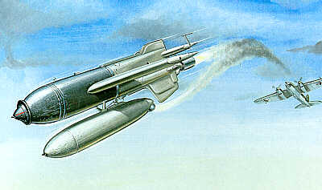
Defeating Hitler’s
“Chase Me Charlies”
Al Penney
VO1NO / VE3

Slide 2
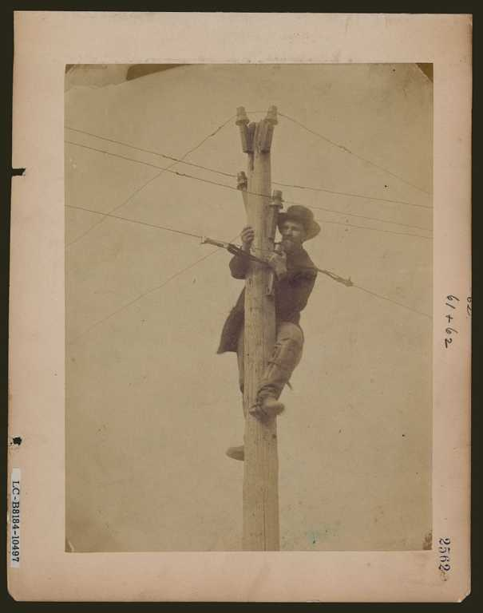

Slide 3

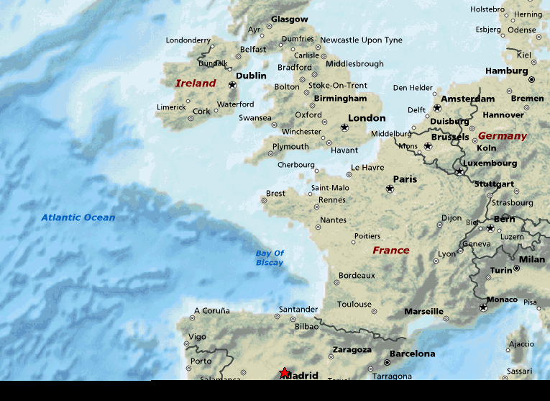
First Escort Group’s
Area of Operations,
Late August, 1943
Notes:
In late August 1943, the First Escort Group, composed of the sloop HMS EGRET, and the frigates HMS JED and HMS ROTHER, was operating in the south of the Bay of Biscay, off Cape Finisterre. Allied Intelligence indicated that German U-Boats trying to get into the Atlantic from French ports had suffered heavy losses crossing the Bay of Biscay, and were now trying to creep along the shore and escape into the Atlantic off the north west coast of Spain. The First Escort Group, under Captain Brewer in the EGRET, was tasked with cutting off this route.

Slide 4

Cape Finisterre
Notes:
Cape Finisterre. First Escort Group would have been operating in the vicinity of this photo.
Great location for antennas!

Slide 5
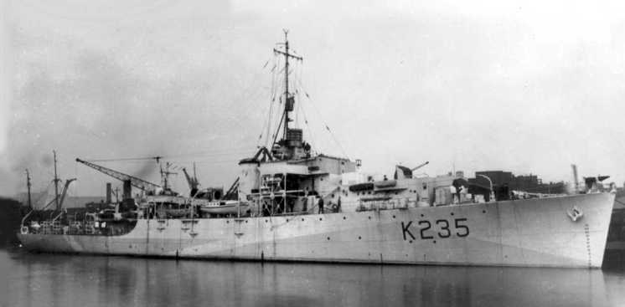
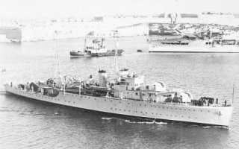
HMS JED
and
HMS ROTHER
HMS EGRET
Notes:
River Class Frigate
Displacement 1370 BRT
Length 301 feet
Complement 140 men
Armament Original design;
2 x 4inch guns (2x1)
10 x 20m guns (2x2,6x1)
1 x Hedgehog 24 spigot A/S projector
up to 150 depth charges
Max speed 20 knots
Engines 2 shaft Reciprocating (4 cyl. V.T.E.)
Commonwealth frigates were specifically designed as anti-submarine escorts for trans-Atlantic convoys. River class frigates offered the size, speed, and endurance of escort sloops using inexpensive reciprocating machinery of corvettes. River class were designed for North Atlantic weather conditions and included the most effective anti-submarine sensors and weapons. HMS Rother and HMS Spey were launched in late 1941, and Canadian and Australian construction continued through 1944. Early River class units were available for the turning point convoy battles of the winter of 1942-43.
EGRET Sloop
Displacement 1200 BRT
Length 276 feet
Complement 188 men
Armament 8 4" AA guns (4x2).
4 .5" AA (1x4).
Max speed 19.25 knots
Engines Geared turbines, 2 shafts
Power 3600 SHP
Like Corvettes, the sloop was a slow escort vessel, small and somewhat lightly armed. The main design element of this type of ship was long voyages so they could outperform the corvette in this regard.
They were intended for the Mediterranean and South Pacific service which made them cold and miserable ships in the more hostile North Atlantic. One class, Black Swan, that was designed just before the war, was faster (19 knots) and carried more anti-aircraft armament. Sloops generally carried a large number of depth charges and were very well equipped with sensors making then effective U-boat hunters.

Slide 6
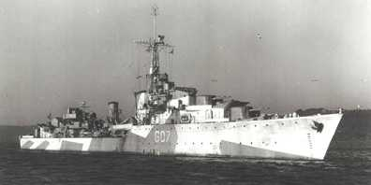
HMCS ATHABASKAN
Notes:
The destroyers HMCS ATHABASKAN and HMS GRENVILLE were assigned to cover the First Escort Group from surface or air attack.
Captain G.R. Miles
Displacement 1,883 tons (2,559 full complement) BRT
Length 377 feet (oa)
Complement 190 men
Armament 6 x 4.7" guns (3x2), 2 x 4” AA guns (1 x 2)
4 x 2pdr AA (1x4)
10 x 20mm cannon AA
4 21" torpedo tubes (1x4)
Max speed 36 knots
Engines Geared turbines, 2 shafts
Power 44000 HP

Slide 7
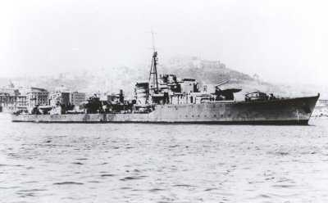
HMS Grenville
Notes:
GRENVILLE was a “U” Class destroyer, under the command of LCdr Roger Hill, RN.
Displacement 1710 BRT
Length 363 feet
Complement 180 men
Armament As designed;
4 4.5" guns (4x1)
2 40mm AA (1x2)
6 20mm AA (2x2, 2x1)
8 21" torpedo tubes
Max speed 37 knots
Engines Geared turbines, 2 shafts
Power 40000 HP

Slide 8
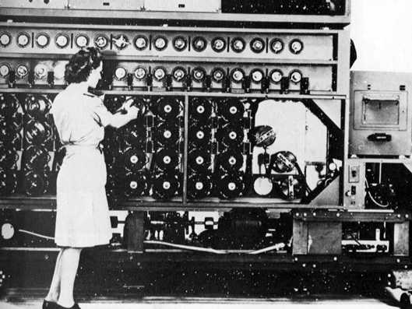
Notes:
The head of the Escort group had also been advised by Allied Intelligence that the Germans were believed to be developing a rocket-propelled, radio-controlled bomb. Not much was known about it at the time, but a team of “boffins” – defence scientists – had embarked in the EGRET with specialized radios to try to record any German transmissions should an attack be mounted. Here, an operator adjusts the equipment used to decode NAZI encyphered messages. Such interceptions would have provided information on the German weapons.
On 25 August 1943, 21 Luftwaffe bombers had attacked another Escort Group operating in the same area. Because of poor weather, and probably the inexperience of the operators, none of the 14 radio controlled bombs hit their targets. Noticing how the bombs seemed to follow the twisting tracks of the ships as they tried to evade being hit, one Royal Navy Yeoman of Signals nicknamed them “Chase-me-Charlies”!

Slide 9
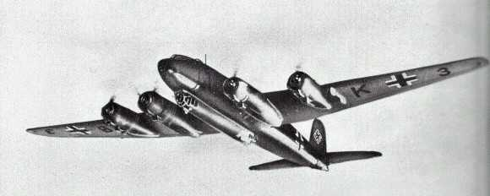
Focke-Wulf 200 Condor
Notes:
At 0750 on 27 Aug, two Focke-Wulf 200 Condor reconnaissance airplanes were spotted circling around the Escort Group at an altitude of 8,000 feet. This was unusual – the Focke-Wulf’s usually operated at a lower altitude, keeping outside gun range. Later that morning the C in C Plymouth sent a message to the group – “You were reported by enemy aircraft at 0800”.
The Condors were not the only ones informing the German command about the location of the Allied ships however. At 1045 GRENVILLE signaled Captain Brewer in EGRET “Spanish trawler Perez Campos broadcast in Spanish for 20 minutes on 5455 kc/s. What about sinking him?” Brewer replied “Well done. We will board him on the way back.”

Slide 10
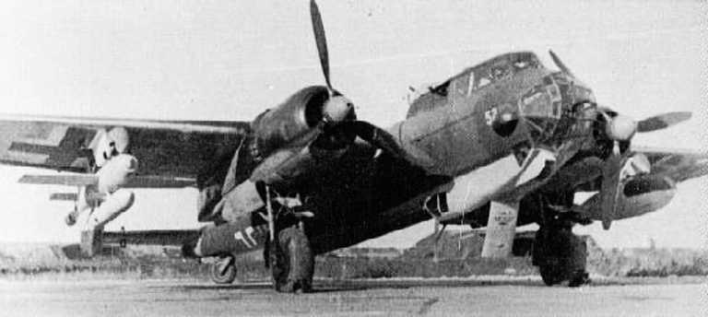
Dornier Do 217
Notes:
At 1254 a large group of aircraft inbound from the north-east was detected at 25 miles by radar. The Escort Group made ready for action! Shortly, 20 Dornier Do 217 medium bombers came into sight.
ATHABASKAN opened fire first as 5 bombers ran alongside her track and launched their missiles. In the words of Commander Roger Hill, CO of the GRENVILLE, the bombers “steered parallel to us at about 5 miles range. There was a bright flash underneath the plane, and a bomb with short square wings came hurtling towards us. Whilst this bomb was in flight the next plane peeled off and attacked.”

Slide 11
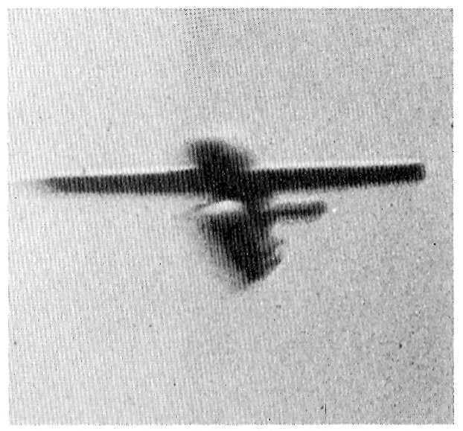
“It seemed the controller could control the direction
of the bomb but not the loss of height”.
Notes:
The new German guided bomb coming at GRENVILLE.
Despite heavy anti-aircraft fire, the bombs approached the ships at 400 knots. Although the ships twisted and turned to evade the attacks, Cdr Hill reported that “It seemed the controller (in the German aircraft) could control the direction of the bomb but not the loss of height”.

Slide 12
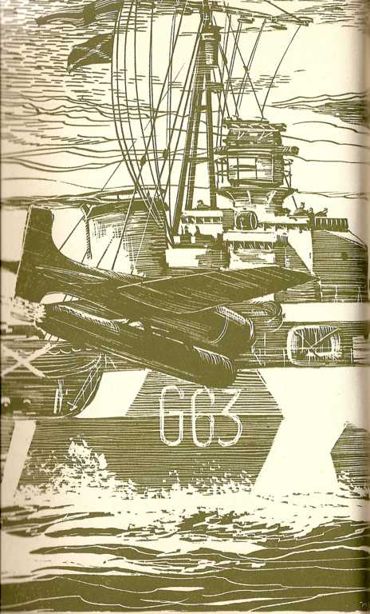
Notes:
ATHABASKAN put up a withering barrage, but it was no match for the new German weapon. A bomb “struck the destroyer with shattering impact, passed clean through the hull below the bridge, and exploded when it was 6 feet clear of the side”. With severe damage to her boiler room ATHABASKAN coasted to a stop. Two more bombs came flying in, but fortunately missed, possibly due to the smoke and steam that now shrouded the ship. The forepart of the ship was wrecked, with large splinter holes in the ship’s side. Five men had been killed, and another 12 injured. Her radar and gunfire control system were out of action, and a large fire raged. Nevertheless, her after guns never ceased firing!

Slide 13
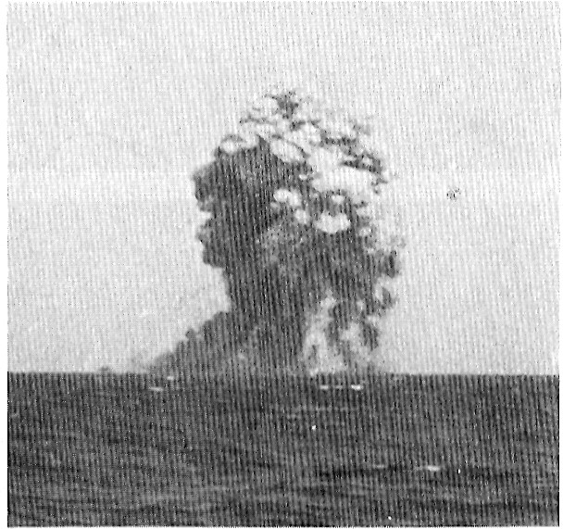
Notes:
EGRET was not so fortunate however. Two minutes after ATHABASKAN was struck, EGRET erupted into a tremendous explosion!

Slide 14
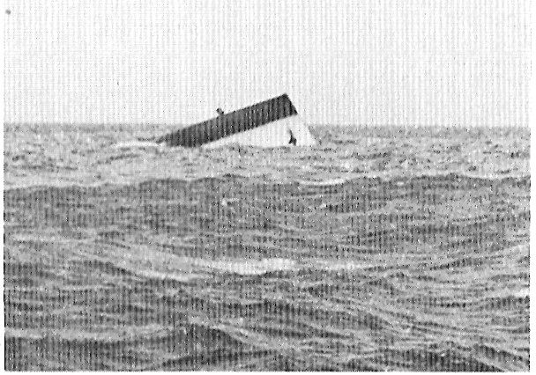
Notes:
EGRET capsized and briefly floated upside down, her Asdic dome visible. Of her crew of 231, only 37 survived.
The doctor from EGRET had an amazing experience. After the ship exploded, he regained consciousness to discover himself outside his sickbay in an air pocket in the overturned hull. Realizing the only way to escape was to dive down and out, he plunged into the cold water. He was fortunate – he found his way outside the hull and was picked up by GRENVILLE’s boat. As soon as he arrived onboard the GRENVILLE he went to work treating the wounded.

Slide 15
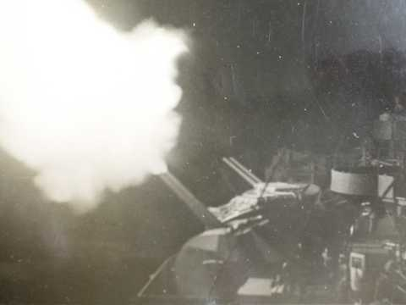
Notes:
After the action GRENVILLE sent ATHABASKAN a message: “Your gun flashes showing through the smoke and fire which was all we could see of you was a proud sight.”
Survivors from EGRET reported that the defence scientists had detected the voice transmissions of the German bombers as they launched from Occupied France. No missile control transmissions had been detected however.
ATHABASKAN limped back to Plymouth, arriving several days later. The remaining ships of the Escort Group defiantly stayed on station. That defiance was rewarded the next evening with a U-boat kill!

Slide 16
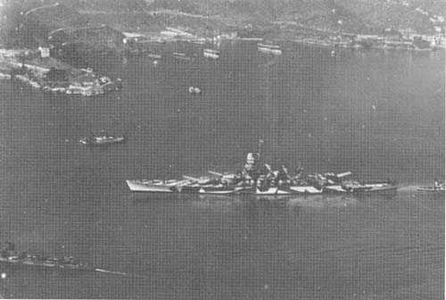
La Spezia
Notes:
On Sep 8, 1943, Italy signed an armistice with the Allies, and in accordance with the conditions laid down, main units of the the Italian fleet departed La Spezia for Malta to be interned and disarmed. The German High Command was aware of negotiations between Italy and the Allies, and were expecting some movement of the Italian Navy. Squadron 3 of the Luftwaffe KampfGeschwader 100 (KG 100)
was standing by to deal with the Italian fleet - “If it sails north, protect it, if it sails south, sink it”.

Slide 17
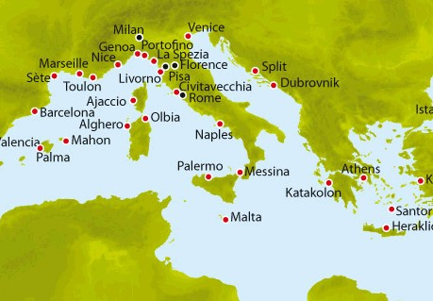
Planned Escape Route for the Italian Fleet, Sep 1943
Notes:
German suspicions were confirmed – the fleet sailed south. On the next day, as the fleet passed through the Straits of Bonafacio, which separate Corsica from Sardinia, it was attacked by 11 Do-217s. Unlike the aircraft which had attacked the First Escort Group however, these Dorniers came in at 16,000 feet.

Slide 18
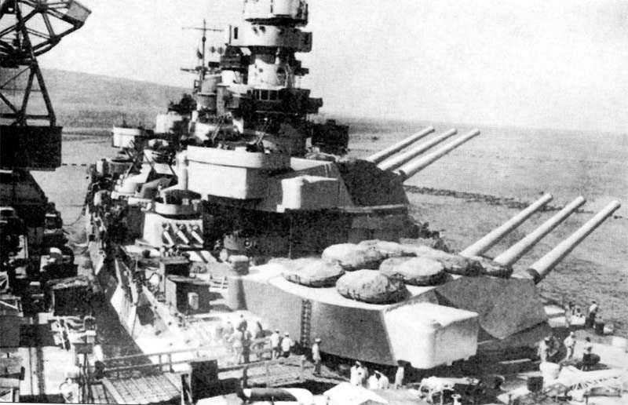
Battleship ROMA
Notes:
Included in the Italian Fleet was the modern battleship ROMA, its sister ship the ITALIA (formerly the LITTORIO – renamed on July 25, 1943), and the Vittorio Veneto, as well as three cruisers and eight destroyers. The force was commanded by Admiral Bergamini in the ROMA.

Slide 19
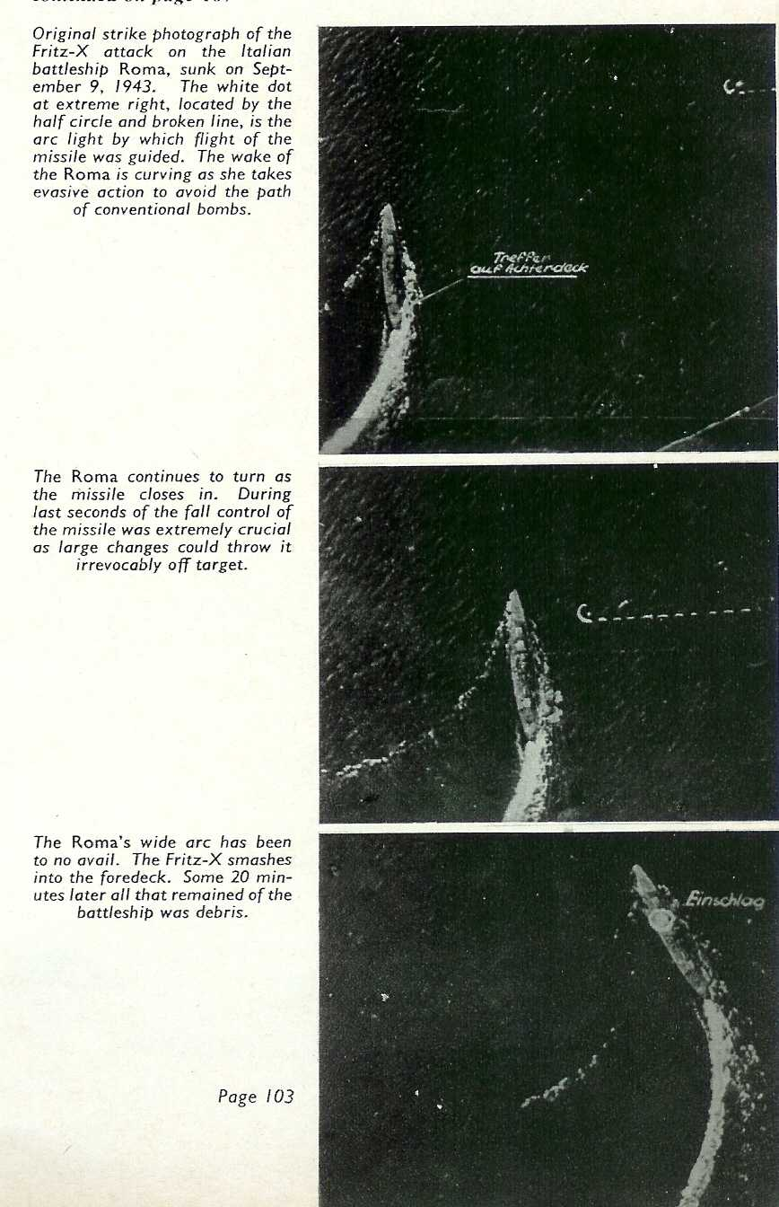
Notes:
At 3:37 on September 9, while the force was off the island of Asinara, near La Maddalena on Sardinia, lookouts reported aircraft. The aircraft kept formation and followed at a distance, so the Italian commander thought that they were Allied aircraft, which had been promised to provide cover. In fact they were German bombers, which had sortied from southern France when German intelligence reported that the Italian fleet had sailed to surrender itself.
The German bombers concentrated their attacks on the ROMA and ITALIA. Unlike the bombs that resembled small airplanes used in the attack on the First Escort Group however, these German bombs were much heavier, with very stubby “X-shaped” wings. Dropped from a greater altitude, they also had a much higher terminal velocity. Their accuracy was uncanny – of 11 bombs dropped, 2 hit the ROMA, while another struck the ITALIA.
These are German photos taken during the attack. The track of the bomb has been highlighted in white.

Slide 21
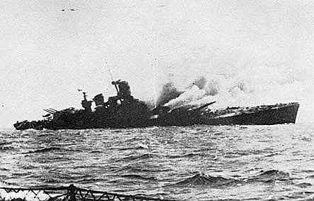
Notes:
ROMA after the second hit. Note that B Turret is missing, and the list to starboard.
Oddly, the dropped their bombs very early and turned way, so the Italians thought that they would again avoid damage. But the bombs followed a shallow glide path, and homed in on the Italian vessels. The battleship Italia was hit first, well aft, where it caused 800 tons of flooding and jammed the rudder. Roma was struck next, with a weapon diving into her starboard side amidships. The weapon punched through the ship's hull, destroying an engine room and two boiler rooms. Roma staggered out of formation, fires erupting all over the ship from seawater arcing electrical components as she took on a severe list. A few minutes later a second weapon struck the ship forward, abreast 'B" turret barbette. The weapon buried itself deep in the ship before exploding and destroying the forward engine room, starting tremendous fires.
From an Italian Navy website:
“At 15.45 the Roma was hit on the right side. The bomb burst into sea after having crossed the whole hull and the ship’s speed was reduced to 10 knots.
At 15.50 the Roma was struck again by a second bomb. This one exploded in the forward deposits of the big caliber complexes. The ship was fatally wounded. A column of flames and smoke rose for a thousand meters. The turret n. 2 (1.500 tons) along with all of its occupants and the command tower were projected aloft and tilted to the right side. It was the end for Bergamini and his staff. The ship began to tilt to the right side. It was a horrendous show of death and destruction. The majority of the men were burnted alive.”

Slide 22
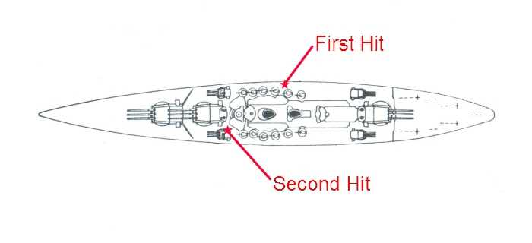

Slide 23
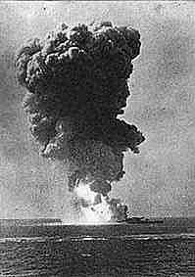
Notes:
Magazine explosion in the ROMA.
A few seconds later a main powder magazine exploded, tossing the 1500-ton turret clear of the ship. Fire erupted like a volcano, and the ship was rent apart. As the fireball and smoke cleared, Roma was still afloat, but clearly her death was near. Smoke and flame belched from the gaping hole where 'B" turret used to be, and the tower superstructure began to slowly collapse into the damaged part of the hull. As water poured into the vessel the crew struggled to abandon ship, and the strength of the design bought them precious time. 622 men escape in the next 9 minutes, and then Roma finally lost her struggle.

Slide 24
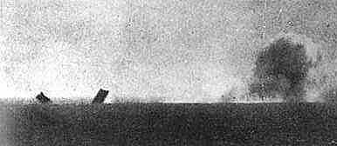
Notes:
At 16.12 the Roma capsized, broke in two, and sank. With her 2 Admirals, 86 Officers and 1264 sailors were lost.

Slide 25
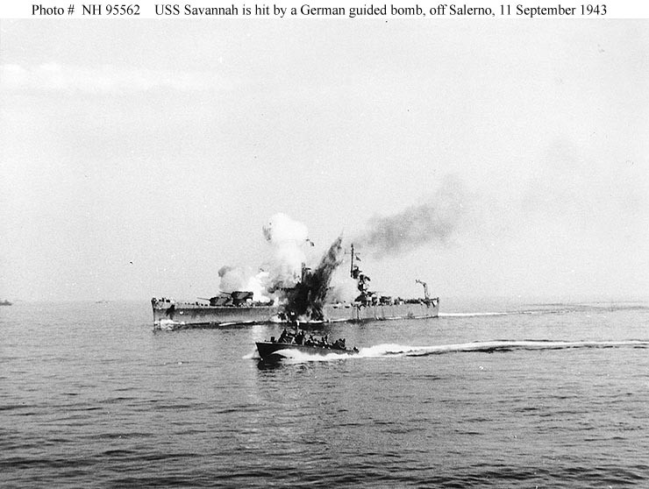
Notes:
More was to come however. Within a week, several major Allied warships fell victim to the new German weapon. On 11 Sep 1943 the American cruiser USS SAVANNAH was hit by a German radio-controlled bomb, while supporting Allied forces ashore during the Salerno operation. The bomb hit the top of the ship's number three 6"/47 gun turret and penetrated deep into her hull before exploding. The photograph shows the explosion venting through the top of the turret and also through Savannah's hull below the waterline. A motor torpedo boat (PT) is passing by in the foreground.

Slide 26
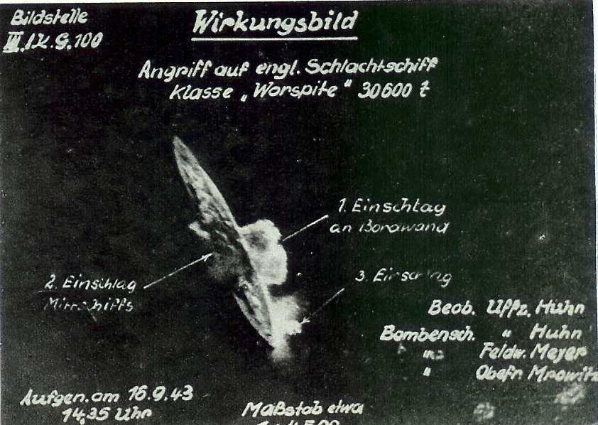
Notes:
On 16 Sep the British Battleship WARSPITE was struck by 3 guided bombs. One penetrated through six decks, before exploding against her double hull, blowing a hole in the bottom of the ship. The other two hit the side compartments, destroying one boiler room and flooding five of the other six. No fire broke out, but Warspite had no steam, and her guns and radar stopped working. She took on 5000 tons of water and sank by five feet. She had to be towed back to Malta for repairs, and was out of action until the summer of 1944. Casualties were only 9 dead and 14 wounded, blessedly light for so devastating an attack.

Slide 27
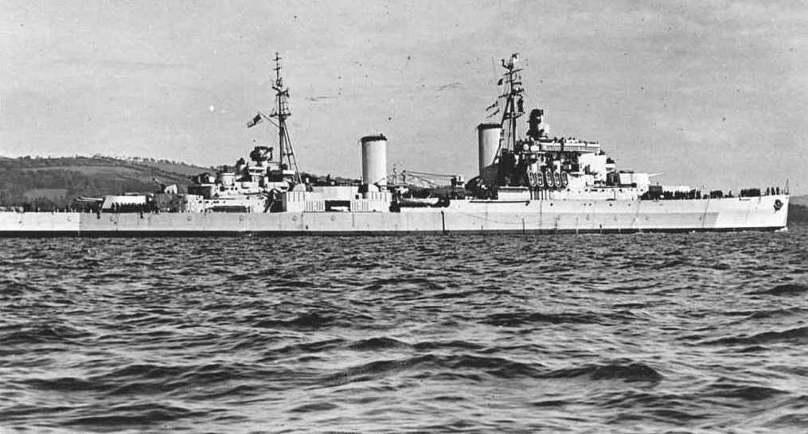
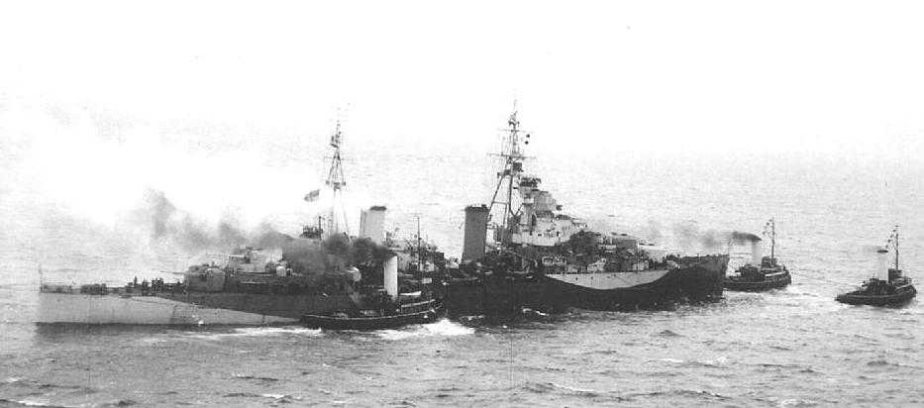
Notes:
HMS UGANDA (top) (later HMCS QUEBEC) was damaged by a German guided bomb on the same day as the WARSPITE. HMS SPARTAN (bottom) was sunk some time later.

Slide 28
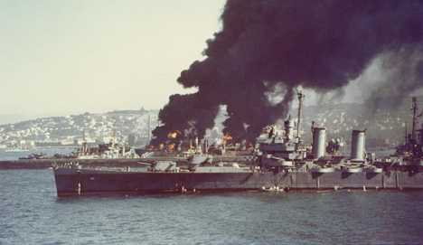
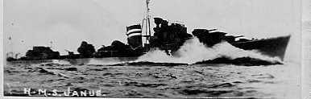
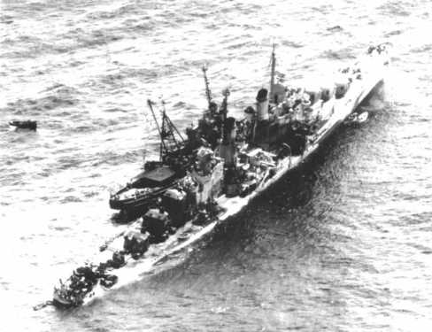
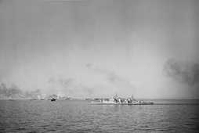
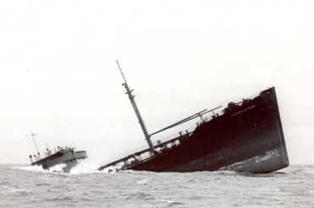
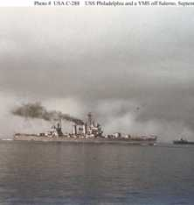
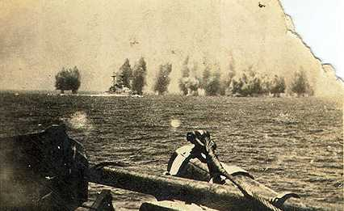
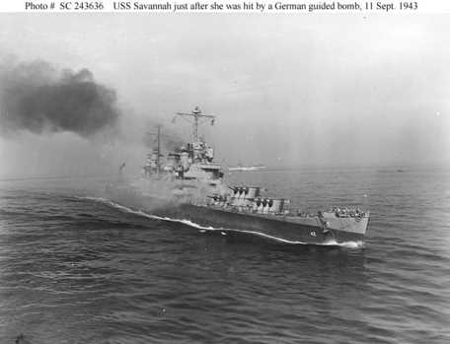
Notes:
In addition to these ships, a large number smaller vessels were sunk or damaged, including destroyers and merchant ships. The success of Allied amphibious operations, such at the landings at Anzio, and the upcoming Normandy invasion, depended on control of the seas. The phenomenal success of these new German weapons posed a serious threat. Countermeasures had to be found!

Slide 29
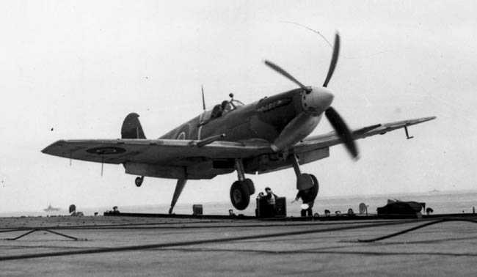
Notes:
Until airbases could be established ashore following an invasion, carrier aircraft such as this Seafire, could assist in protecting Allied shipping from the German bombers.

Slide 30
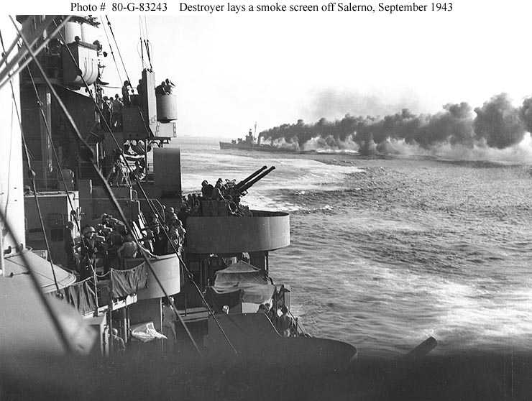
Notes:
Escorting ships could also lay smokescreens to hide the fleet from the German bombers, but the fact remained that an electronic method of disrupting the guided bombs was still necessary.

Slide 31
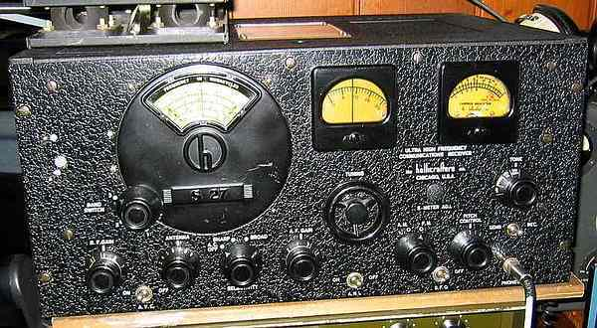
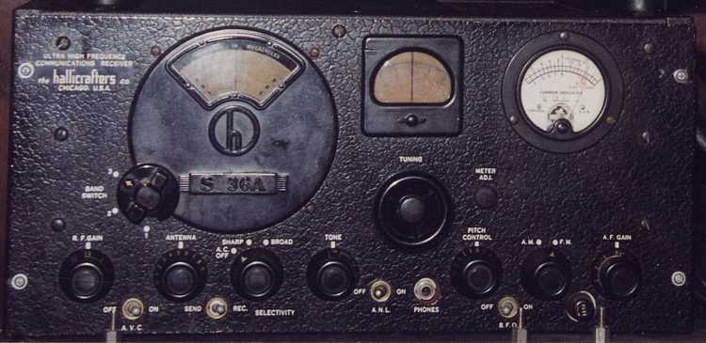
S-27
S-36
Notes:
British and American Electronic Intelligence (Elint) gathering teams were dispatched to the Mediterranean to try to copy the control signals from these guided bombs. The task was not easy – the Allies had very little information on the design of the bombs, and did not know in what part of the EM spectrum to start searching. Moreover, the flight time of the bombs was very short, giving precious little opportunity to try to tune in the signals. The Radio Division of the US Naval Research Laboratory modified Navy versions of the Hallicrafters S-27 and S-36 receivers. Together they covered the spectrum from 27 to 220 MHz. Modifications included motor-driven tuning, a CRT onto which the received signals could be displayed, and reduced selectivity in the IF stages to give a broader band-bass so that operators could search the spectrum more quickly. In 6 weeks the scientists, engineers and technicians modified about 20 such systems and sent them to sea. The efforts met with success - in early 1944 a guided bomb attack was made upon an American convoy off the coast of North Africa. An Elint team detected signals in the 48 – 50 MHz part of the spectrum.
S-27 "UHF Receiver," Single Conversion, AM/FM/CW. 3 bands 27-145MHz. 15 tubes. Production Year 1940-43.

Slide 32
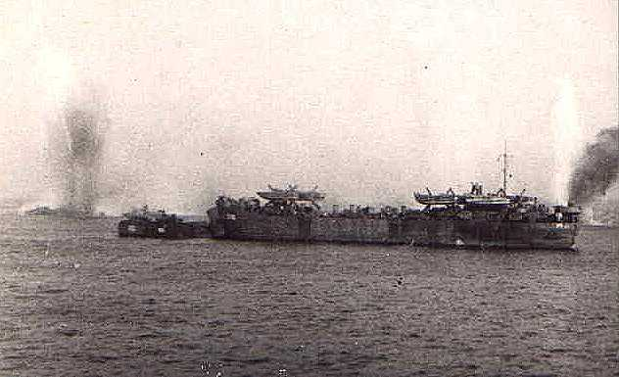
Notes:
British ELINT efforts also met with success. Lt Field of the G2 Section of the Telecommunications Research Establishment had been sent to the Allied beachhead at Anzio to monitor the airwaves. On 22 January 1944 he received guidance signals in the 6 meter spectrum. He was able to deduce that the guidance system was based on a variable mark-space ratio, two-tone modulation system. Armed with this, he set up a workshop in Naples to produce simple 150-watt spot jammers. To build these sets he scrounged spare parts used in Royal Air Force VHF transmitters (must have been a Ham!). These jammers were installed in 12 warships of the Mediterranean Fleet. They were not as successful as had been hoped however – trying to detect the signals, accurately determine their frequency, and then tune the jammers to the correct frequency was an extremely difficult task in the short time available. Given the pressure of imminent destruction, and the wild manoeuvering of a ship trying to evade the guided bombs, the chances of an operator being successful were slim.

Slide 33

Notes:
The continued success of the guided bombs caused considerable alarm among the men and officers of the Mediterranean Fleet. As a stopgap measure, the G2 section of the Telecommunications Research Establishment recommended that when a guided bomb attack was imminent, all officers who possessed electric razors should proceed to the upper deck, activate their razors, and hold them aloft. The objective was a crude attempt at jamming the missile control system with the electrical noise radiated from the razors. The effect, if it worked at all, would only have been effective at a very uncomfortably close range! At least it was of some psychological benefit to the crews!

Slide 34
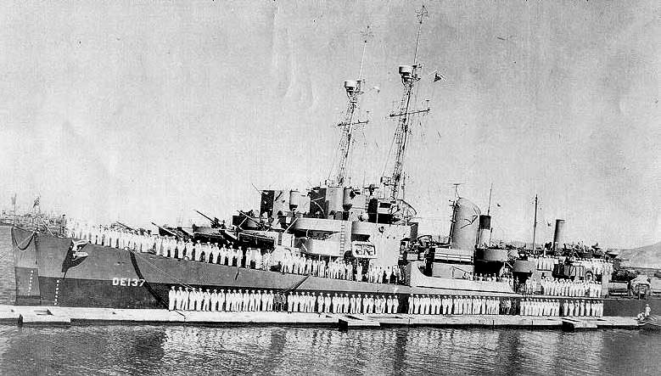
Notes:
The US Navy also produced spot jammers for the frequency range used by the guided bombs. Once again, technicians at the Naval Research Laboratory hand built the systems, which were installed in the destroyer escorts USS FREDERICK C. DAVIES and USS HERBERT C. JONES. On November 26 1943 they were escorting a convoy off Algeria when they were attacked by 21 Heinkel 177 bombers, each carrying 2 guided bombs. The destroyers activated their jammers as soon as the bombs were observed. The countermeasure operators found it impossible to spot-jam all the missiles coming in simultaneously on different control frequencies however. The JONES reported 13 glider bombs, while the DAVIES saw 12.
Photo of the JONES and DAVIES at Oran in North Africa. Note the antenna on the funnel – this could be the antenna for the jamming equipment.

Slide 35
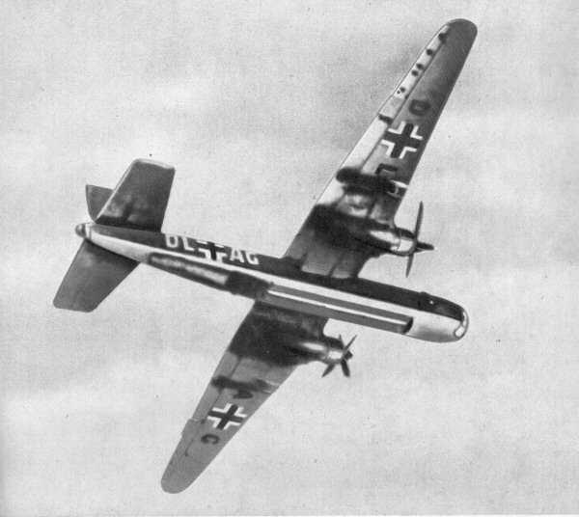
Heinkel He 177 Greif (Griffin)
Notes:
The Heinkel He 177 Greif (Griffin) was a long-range bomber of the Luftwaffe. The troubled aircraft was the only heavy bomber built in relatively large numbers by Germany during World War II. Aircrews nicknamed it the Luftwaffenfeuerzeug (Luftwaffe's lighter) due to the engines' tendency to catch fire on the early versions of the aircraft.^{[1]}
An unusual feature of the aircraft was the use of twin engines in each nacelle driving a single propeller. Siegfried Günther, chief designer of Heinkel, chose to use the Daimler-Benz DB 606, which consisted of two Daimler-Benz DB 601 engines coupled together to use a common propeller, in order to minimise drag. The two engines were coupled side by side in each nacelle and inclined so that the inner cylinder banks were disposed almost vertically, a single gear casing connecting the two crankcases, and the two crankshaft pinions driving a single airscrew shaft gear. The insistence of this engine configuration stemmed directly from the RLM's determination that the He 177 should be capable of dive bombing. The use of only two propellers on a heavy bomber also offered a substantial reduction in drag and a marked improvement in maneuverability.
Fortunately, Allied fighters arrived on the scene in short order and forced several of the bombers to break off their attacks. Six bombers were shot down and others sent limping home. The Luftwaffe bombers scored heavily however….

Slide 36
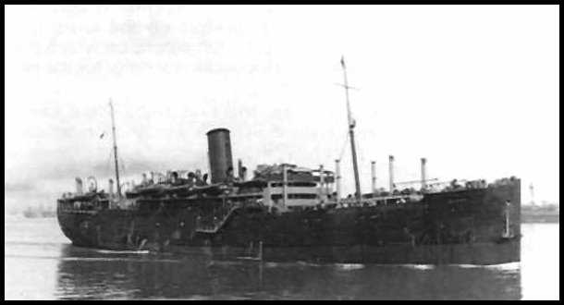
Troop Transport ROHNA
Notes:
A German HS293 glider bomb hit the troop transport Rohna. The device blew open a huge hole near the after end of the engine room and the No. 6 troop’s deck. Hundreds died upon impact. After the explosion that destroyed the Engine Room, the ship was engulfed in flames and started to sink. It was impossible to lower the lifeboats on the portside due to the side plates forced outwards by the explosion. Many of the lifeboats on the starboard side were lowered but were soon capsized because of the hundreds of troops that were already in the water and trying to climb into them. Others perished from cold and exhaustion while darkness and rough seas hampered rescue efforts. A total of 1,015 American troops, 3 Red Cross personnel, and 120 crewmen perished.
It was the first successful "hit" of a merchant vessel at-sea carrying US troops by a German remote-controlled bomb, and it resulted in the greatest loss of troops at sea in U.S. history.
It was so devastating that the U.S. Government placed a veil of secrecy upon it. Details were not released until 1967, following the introduction of the Freedom of Information Act

Slide 37
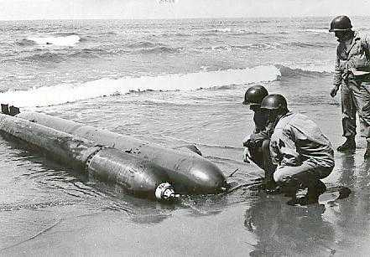
Notes:
Finally, the Allies got a break. After one raid on the beachhead at Anzio, an intact German guided bomb was found on the beach, presumably having gone out of control. Lt Field salvaged it, and had it sent to the Royal Aircraft Establishment in Farnborough for examination. From this examination, and from information provided from other intelligence sources, the truth about the German secret weapon began to emerge.
This photo is actually of a German one-man torpedo, but was the best photo I could find!

Slide 38
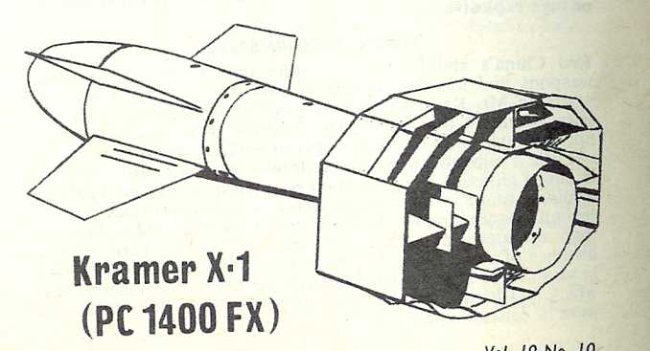
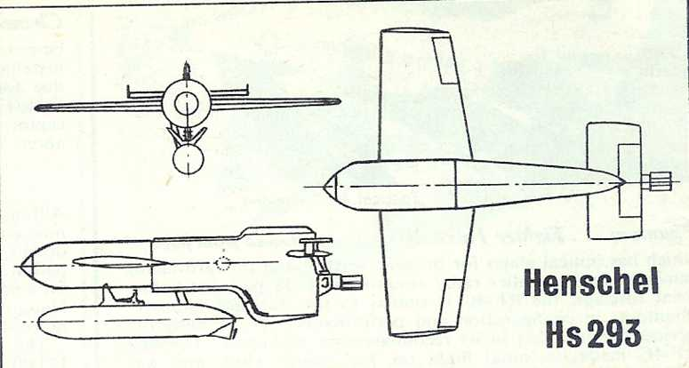
Notes:
The difference in attack altitudes finally became clear. There were actually two different guided bombs – a heavy, non-powered armour-piercing bomb dropped from high altitude, and a rocket-boosted glide bomb with stubby wings that was usually deployed at lower level.

Slide 39
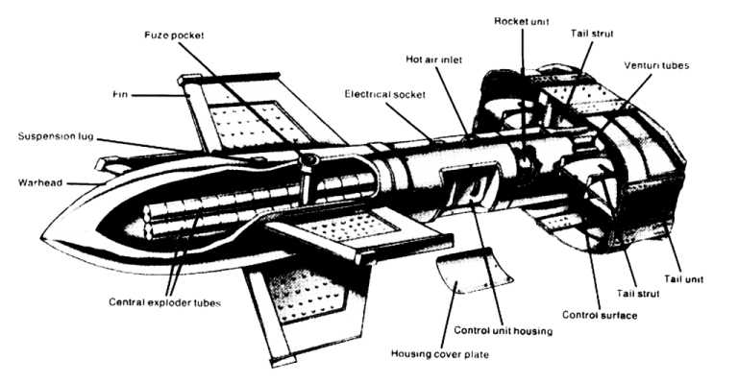
Fritz-X Guided Bomb
Notes:
The Fritz-X was based on an ordinary free-fall bomb except that it carried four stabilizing fins midway along the body and a 12-sided tail assembly that contained the guidance system. It weighed 3,100 pounds (1,400 kg). The weapon was designed to penetrate up to 130 mm (5.1 inches) of deck armour on warships when released at between 5,500 to 7,000 meters (18,050 to 22,970 feet).

Slide 40
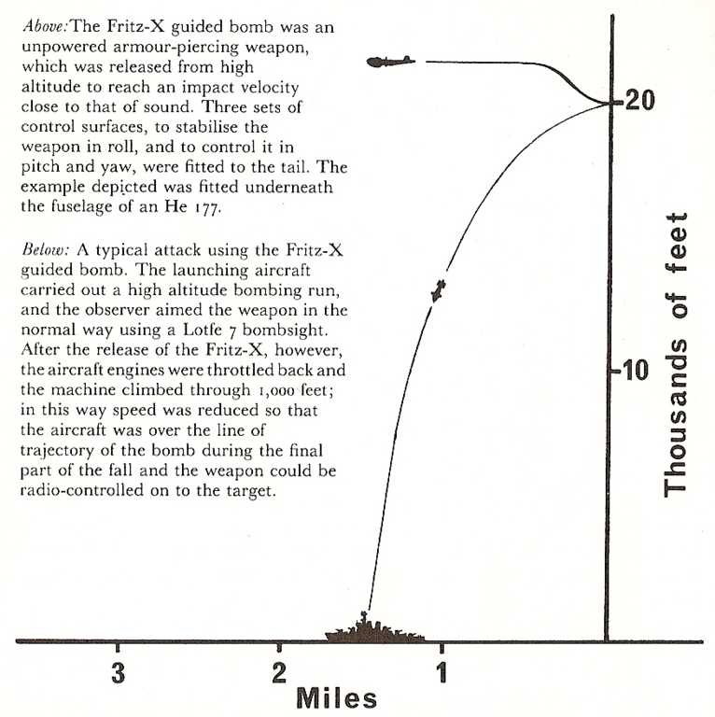
Notes:
The Fritz-X was carried on the Heinkel 177 and Dornier 217 bombers. After launch, the controlling aircraft throttled back and climbed 330 meters (1,000 feet) so as to be above the target when the bomb impacted. When dropped from 7,000 meters, it took 42 seconds to reach the surface. Dive brakes were used to limit the maximum speed. The weapon system did not work well when dropped below 5000 meters (other sources say 4000 meter) , and most operations was conducted above 6000 meters to help lessen the danger of AA fire. This was particular important as the controlling plane had to keep flying level and reduce speed to keep the aim, so if it was within range of allied fighters or AA fire it was extremely exposed.
The 4 fins were fitted with spoilers that allowed the operator to alter the trajectory up to 500 meters (1640 feet) in range, and 350 meters (1150 feet) in azimuth. The box-shaped 12-sided tail framed vertical and horizontal fins. The fins had spoilers mounted on them to provide aerodynamic control, with the fins actuated by solenoids to pop them in and out of the airstream at a rate of ten times per second.
It was the Fritz-X that sank the Italian battleship ROMA, and severely damaged the WARSPITE, SAVANNAH and UGANDA.

Slide 41
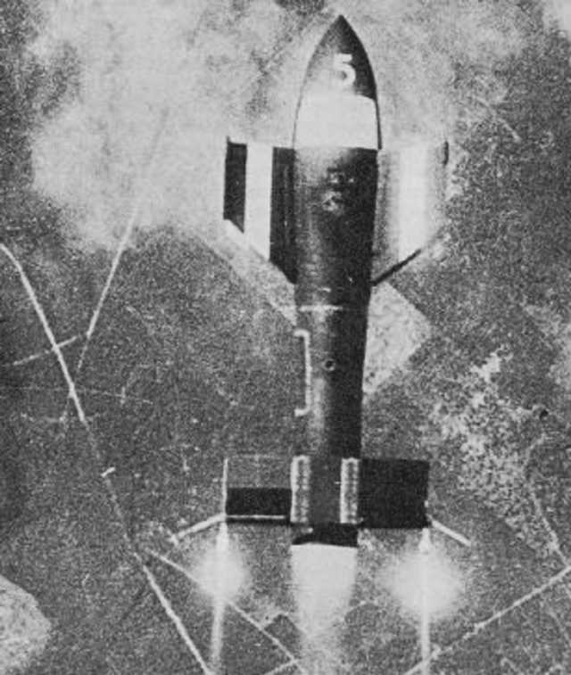
Notes:
Flares were fitted to the tail to assist the operator in keeping the bomb in sight.
Compared to the free fall weapons of WW2, the Fritz X was accurate! A skilled operator could get 50% of the bombs with in a 15 m radius of the aiming point, and about 90% hit within 30 m radius. (Other sources say 60% hits within 4,6 meters radius)

Slide 42
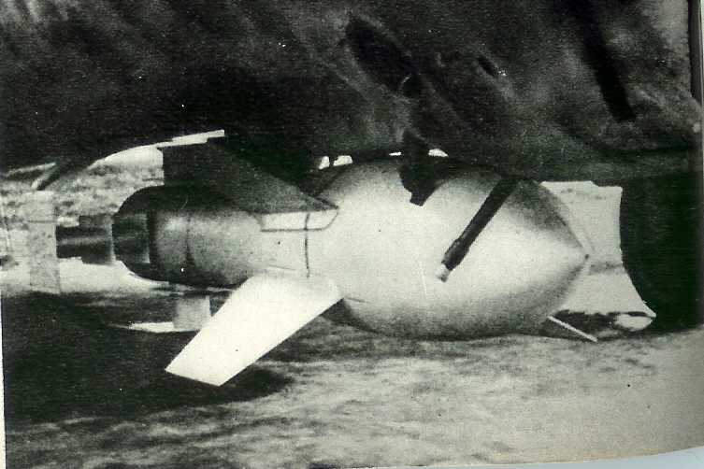
Notes:
It was carried under the wings or fuselage, depending on the aircraft.

Slide 43

Henschel Hs 293
Notes:
The Henschel Hs 293 consisted of two main sections, an upper body made of stressed-skin aluminum that housed the actual bomb and guidance equipment, and the lower rocket propulsion unit. The upper section had two short wings and a tail assembly with a short vertical stabilizer and elevator. In flight the missile was controlled like an airplane – ailerons in the wings controlled roll, while the tail elevator controlled pitch.
The warhead was thin walled and mainly good for light or non armoured targets as it lacked armour penetration capacity (unlike the Fritx X weapon) and in the rear of the fuselage were the controls: Ailerons operated by electromagnets and an elevator operated by a electric motor. The Weapon was stabilized by a gyroscope that took control of the ailerons when no guidance signal came from the launch plane. Beneath the body was a Walter 109 507 B liquid rocket , that could provide 600 kg (1300 lbs) of trust for 10 seconds. This could boost the launch speed by about 200 km/h. This made the weapon clear the launch plane fast and made the visual controls possible.
It had an overall length of 3.18 meters (10 ft 5 in), and a wingspan of 3.12 meters (10 ft 3 in). Weight was 785 kg (1730 pounds). The warhead contained 270 kg (600 pounds) of Trialen.
The rocket section in this example is missing a cover.

Slide 44

Notes:
Typical attack using the HS 293 guided bomb. The launch aircraft flew parallel to the target’s track at between 4,000 to 20,000 yards (2 to 10 nautical miles). Usual launch altitude was 1000 meters (3300 feet), with the target 30 to 60 degrees off the starboard nose of the aircraft. The weapon fell approximately 300 feet after launch before the rocket booster developed full thrust. The rocket produced 600 kg of thrust for 10 seconds, boosting the speed of the missile to 600 km/h (373 mph). The aircraft had to throttle back and stay steady for about 10 seconds after launch, but was then free to manoeuvre slowly. Abrupt changes in course or speed would throw off the aimer. Depending on launch altitude, flight time of the missile was between 30 and 110 seconds.

Slide 45

Notes:
The bomb aimer used a small joystick to guide the bomb onto the target, and with some practice, crews could deliver the ordnance with some degree of accuracy. The bomb aimer had two control panels to direct. The first panel contained two switches. One switch started the gyroscope and activated the radio receiver in the bomb while the other switch activated the radio transmitter in the aircraft. The second panel contained four gauges. A voltmeter and ammeter gave battery readings on the bomb. Another gauge indicated the temperature of the rocket fuel.

Slide 46

Notes:
Launch of an Hs 293. Engine exhaust was piped into the bombs to keep the propellants warm. On release, the flare in the tail of the bomb and the booster rocket were ignited.

Slide 47

Notes:
Heinkel He 177 Greif (Griffin) carrying an Hs 293. The troubled aircraft was the only heavy bomber built in relatively large numbers by Germany during World War II. Aircrews nicknamed it the Luftwaffenfeuerzeug (Luftwaffe's lighter) due to the engines' tendency to catch fire on the early versions of the aircraft.^{[1]}
An unusual feature of the aircraft was the use of twin engines in each nacelle driving a single propeller. Siegfried Günther, chief designer of Heinkel, chose to use the Daimler-Benz DB 606, which consisted of two Daimler-Benz DB 601 engines coupled together to use a common propeller, in order to minimise drag. The two engines were coupled side by side in each nacelle and inclined so that the inner cylinder banks were disposed almost vertically, a single gear casing connecting the two crankcases, and the two crankshaft pinions driving a single airscrew shaft gear. The insistence of this engine configuration stemmed directly from the RLM's determination that the He 177 should be capable of dive bombing. The use of only two propellers on a heavy bomber also offered a substantial reduction in drag and a marked improvement in maneuverability.

Slide 48

Notes:
Crew members learn to control the Henschel Hs 293 guided bomb in a simulator.

Slide 49

Notes:
Both the Fritz-X and the Hs 293 used the same guidance system.
The production Hs-293A was controlled by the "Kehl-Strassburg" superheterodyne command and control system, with the Kehl transmitter unit in the launch aircraft and the Strassburg receiver system in the glide bomb. The bomb could be preset to one of 18 different frequencies spaced 100 KHz in the 48:50 MHz band to allow up to 18 bombers to each drop and control a glide bomb simultaneously. The operator guided the bomb with a joystick wired to the Kehl transmitter. Tone modulations of 1, 1.5, 8 and 12 KHz were used to convey the appropriate up/down, left/right commands.
The guidance package was built around a Horn gyroscope, OPTA Radio control signal decoder, a Strassburg FuG-230b/E230 radio command link receiver, all powered by DEAG one shot batteries, and used to drive Hornasser solenoid control actuators for the ailerons and elevators.
In operation, the launch aircraft would send commands using a FuG-203 Kehl III radio transmitter, which received by the FuG-230b would be demodulated to generate steering commands for the control actuators. This was the first air launched Command to Line Of Sight (CLOS) guidance system ever used. A red coloured flare on the tail of the weapon was used to cue the operator when steering the weapon.
The bomb aimer had two control panels to direct. The first panel contained two switches. One switch started the gyroscope and activated the radio receiver in the bomb while the other switch activated the radio transmitter in the aircraft. The second panel contained four gauges. A voltmeter and ammeter gave battery readings on the bomb. The "H" ("Hitze" = heat) gauge gave the temperature in the bomb's rear fuselage "nerve center."

Slide 50

Notes:
Dornier Do 217 antennas:
1 – Suppressed navigation direction finding antenna
2 – Wire ant for VHF radio
3 – Post ant used for blind landing equipment
4 – Fixed DF loop for navigation system
5 – Wire ant for HF radio
6 – Wire ant for Fritz-X and Hs 293 guidance transmitter
7- “Towel Rail” ant for blind landing equipment
8 – Tube to deploy trailing wire for HF radio
9 – IFF ant
10 – Ant in the tail of the Fritz-X (in bomb bay)
11 – ant for tail warning radar
12 – ant for ship search radar
13 – Dipole for radio altimeter

Slide 51

ARQ-8 Spot Jammer
Notes:
With a better idea of the frequencies to be jammed, the US Navy tried a more powerful spot jammer. The ARQ-8 jammer is a good example of rapid response to a threat. In production for the US Army to jam German Army communications, it covered 25 – 100 MHz, making it ideal to jam the guide bombs. Once the Navy explained the urgency of the situation to the Army, twenty were turned over to the USN.
Hastily modified to deal with German glide bomb successes in the Mediterranean, the R-58/ARQ-8 and T-51/ARQ-8 showed immediate promise in dealing with the problem. It followed the trend at the time of using a DSBRC approach to widen the jamming bandwidth, and employed the master oscillator of the transmitter as the LO for the receiver on the left to ensure locked-in jamming. It was tuned +/- 2.5MHz about a predetermined center frequency using the C-93/ARQ-8 control box on the bottom. The "tuning meter" above the amplifier on the right is a TS-60/U used to measure plate current of the two 4E27 push-pull amplifier tubes. It was used on virtually all of the jammers as a tuneup tool.
Power output was 30 watts.
Although useful, it still required that the operator physically tune in the signal to be jammed, and so could be overwhelmed in a mass attack using many different control frequencies.
In mid-April the Naval Research Laboratory issued a top-priority order for a high-power jammer to counter the Kehl-Strassburg control system in the guided bombs. Called MAS, it was developed by the Airborne Instrument Laboratory (AIL) in just over 2 weeks. Forty were installed in ships in time for the invasion of Normandy. The system also included the RDG monitoring receiver and RDH Kehl search receiver. This was by far the most capable of the American jamming systems. To increase its effectiveness, the signal was modulated with one of the tones used to control the missile which in effect took over control of the weapon. From the calculations made recently, it should have been quite effective in the absence of counter-countermeasures.

Slide 52

Notes:
The British began work on their own spot jammer. To tackle the problem of having to search 2 MHz of spectrum to find the control frequency in use, the Telecommunications Research Establishment developed a panoramic display for the warning receiver. This enabled the entire 2 MHz spectrum in question to be monitored on a Cathode Ray Tube. (This is ARQ/5, covering 20 to 80 MHz in 2 bands, not the British panoramic display).
A British Army communications transmitter was modified to serve as a jammer, and paired up with the panoramic receiver. The intent was to quickly determine the missile control frequency using the panoramic display, and then tune the jammer, to that frequency. The system was designated the Type 650.
Although the jammer itself was effective enough, the British discovered, like the Americans had, that it was simply too difficult to tune the jammer to the correct frequency given the very short time available during an attack. If the British fleet was to be protected during the upcoming Normandy invasion, something better was required!

Slide 53

Let’s assume that the IF of
the missile receiver is 1.2 MHz…
48.5 MHz
Mix 48.5 MHz + 49.7 MHz
in the receiver, and get 1.2 MHz…
Which equals the IF…
Which results in
Cross-modulation
in the receiver!
49.7 MHz
Type 651 Jammer
Notes:
D.D Silverstone of the G2 Section at the Telecommunications Research Establishment developed an extremely elegant solution to the problem. He used two identical 1 kW transmitters that were spaced apart in operating frequency by the Intermediate Frequency of the receiver in the guided bombs. As the bombs approached the vessel carrying the jammer, both signals were able to leak past the front end of the receiver in the bomb, despite what frequency the radio had been tuned to. As the two signals mixed in the receiver, one of the products was equal to the IF of the receiver. This cross modulation jammed the guided bombs, making them uncontrollable. Unlike the spot jammers employed by the USN, the Type 651 jammer did not need to be tuned to each missile operating frequency during an attack – once turned on, it jammed all bombs within range!

Slide 54

Type 651 transmit antennas
Battleship HMS ANSON
Notes:
Type 651 transmit antennas in the battleship HMS ANSON.
From time of conception to full production took 3 months. Eventually, all major ships in the Royal Navy were equipped with the Type 651 jammer. The Luftwaffe was never able to successfully attack Allied vessels once the electronic countermeasures joined the lineup of possible measures to defeat the bombs.

Slide 55

Notes:
The missiles continued to see some use during the closing months of the war, the last attacks being carried out by a special unit of KG 200 that attacked bridges across the Oder with Do 217’s in April 45.
An interesting development of the missile system was the Hs 293 D . It was a standard HS 293 A1 missile with an extended nose and fuselage center, build to carry Television equipment, thereby removing the need for the carrier plane to keep line of sight to the target. In the rear section of the missile was an antenna sending signals to the carrier plane. The television equipment, K11, was crude compared to todays guided weapons, 224 line pictures been screened at a frequency of 50 pictures a second. Test flight were carried out in 1944, but the development program never really took off. The TV guidance by Joystick required quite some skill from the operator, and for the program to work there needed to be a large amount of simulator training. Range for the TV signal was about 4 km.
There was also the 293 F model with a delta wing and no tail unit, and 2 schmidding SG 33 rocket units for power that gave 1855 kg of trust for 3,5 sec , the extent of progress on this type is unknown.
The 293 G model was designed for vertical attack, to gain some of the advantage the Fritz X weapon had for anti shipping warfare. Only 10 were produced.
The 293 H model were designed to be an anti air weapon against bomber formation, to be detonated inside or close to the bomber formations, both infrared proximity fuses and TV guidance was planned. There was even a 293 HV 5 version planned for the high speed Arado 234 twin engine Jet.
The Hs 295 was a redesign to carry a larger armour piercing warhead with 580 kg of explosives. No quantity production was started.
Another version used a thin wire trailed out the tail to carry the guidance commands. This demonstrated promise, but was developed too late for service.
By the last year of the war, the Allies dominated the air so thoroughly that successful attacks by any German aircraft were very infrequent.

Slide 56

Conclusion
A total of 319 guided bombs used in 65 operations
215 functioned correctly, achieving a hit rate of 49.3 %
40 Allied warships and 39 merchant vessels sunk or put out of action for the loss of 48 aircraft
Compared to regular bombing, this was a phenomenal success rate!
Had these weapons been available earlier in the war… one shudders at what could have happened
Notes:
A translation of a Luftwaffe report on the operational use of guided missiles by KG 100 listed a total of 65 operations with 487 aircraft (both Fritz X and Hs.293). A total of 500 rounds were carried, but a number were lost with their aircraft, or returned to base. At the target, 319 bombs were dropped, of which 215 correctly functioned, with a 49.3% hit rate. Taken against the concurrent Allied night bombing success rate, this was phenomenally high.
In all, 79 enemy naval units, including 40 warships and 39 merchant ships of a gross registered tonnage of 291,000 tons were either partially or totally put out of action, for the loss of 48 aircraft. This was a better success rate than that of the Kamikaze.
One can’t help but to speculate. Had these weapon systems been available earlier in the war, both from The Condors roaming the Atlantic and the Luftwaffe planes attacking the Malta Convoys it might have made a much larger impact. But, like many other special German weapon systems, it was a case of too little and too late.

Slide 57


