Slide 1
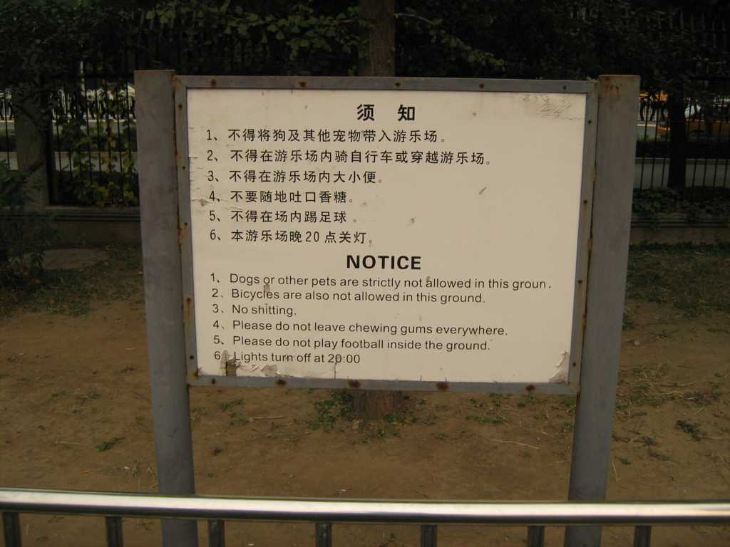
PHOTO ALBUM
by Dave

Slide 2
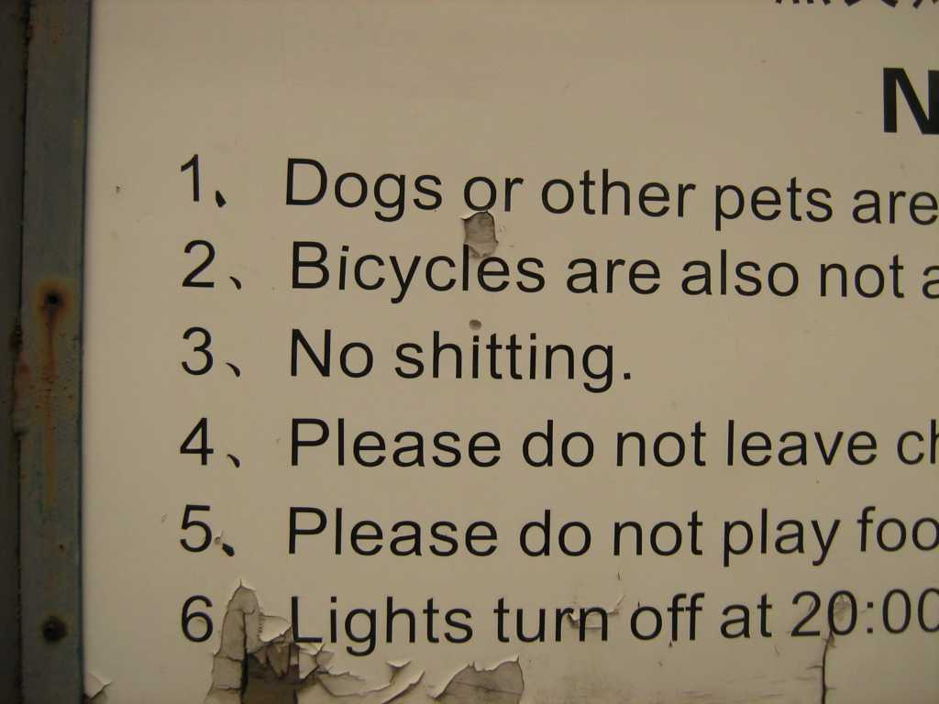
HAM RADIO CULTURE SHOCK
A Canadian Ham’s Two-Year Adventure in Asia

Slide 3
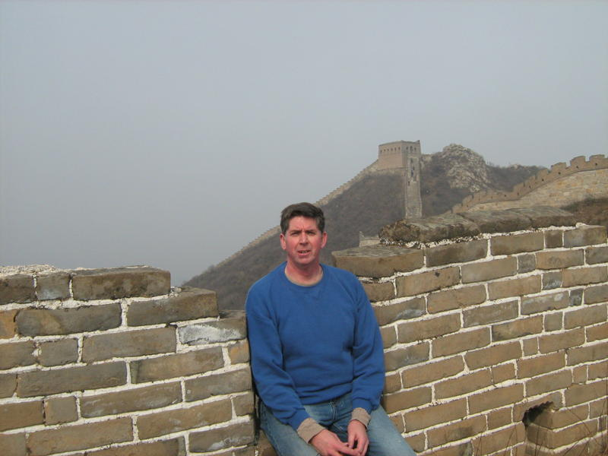
HAM RADIO CULTURE SHOCK
The two-year Asian adventure
of a Canadian Ham

Slide 4
The Years of the Long Call Signs
VO1AU/BY1TTY
VO1AU/BY1RX
VO1AU/BY1DX
JG1RSL
VR2/VO1AU
9M6/VO1AU
And one really short call: B1Z
EI/VO1AU
HL1/VO1AU
T32AU
ZL7/VO1AU
ZL/VO1AU

Slide 5
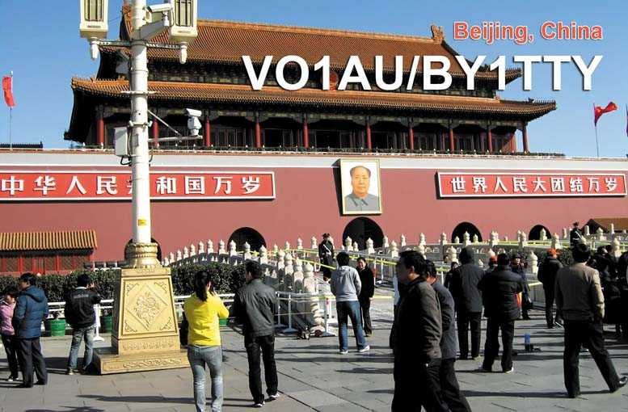

Slide 6
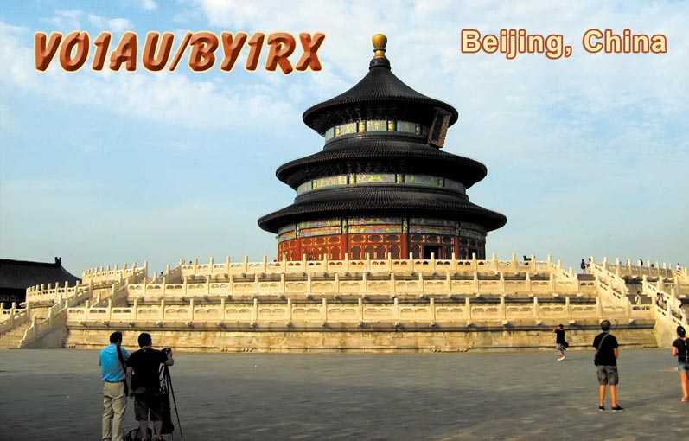

Slide 7
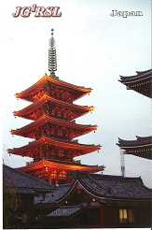

Slide 8
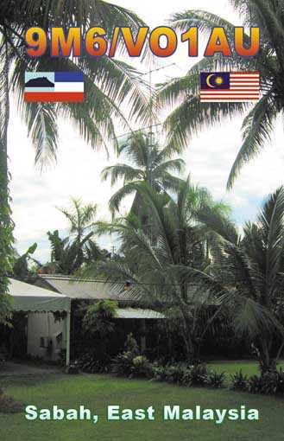

Slide 9
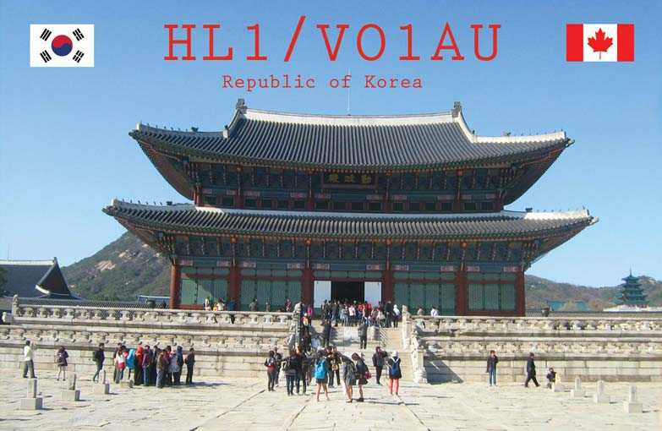

Slide 10
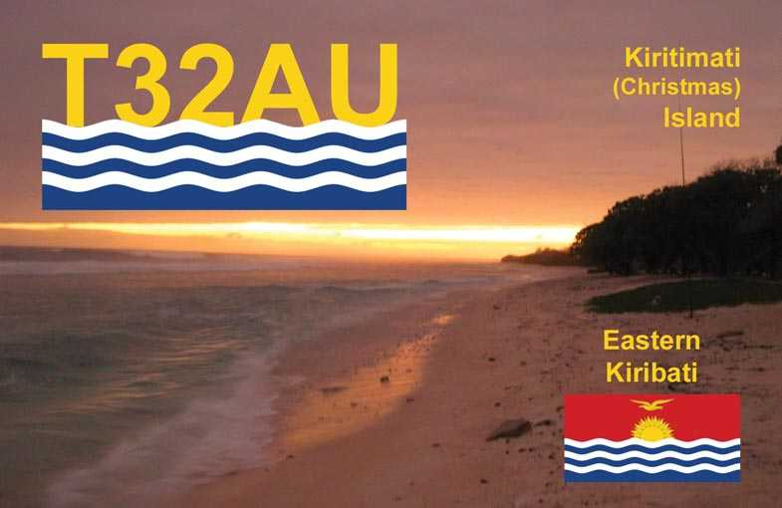

Slide 11
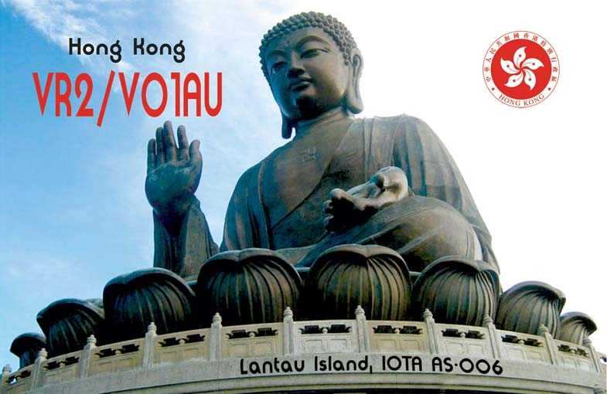

Slide 12
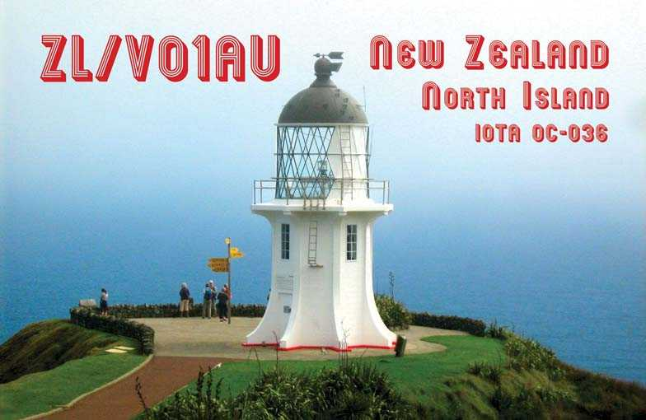

Slide 13
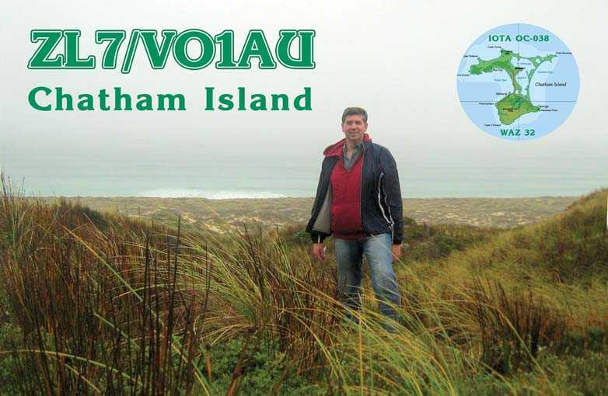

Slide 14
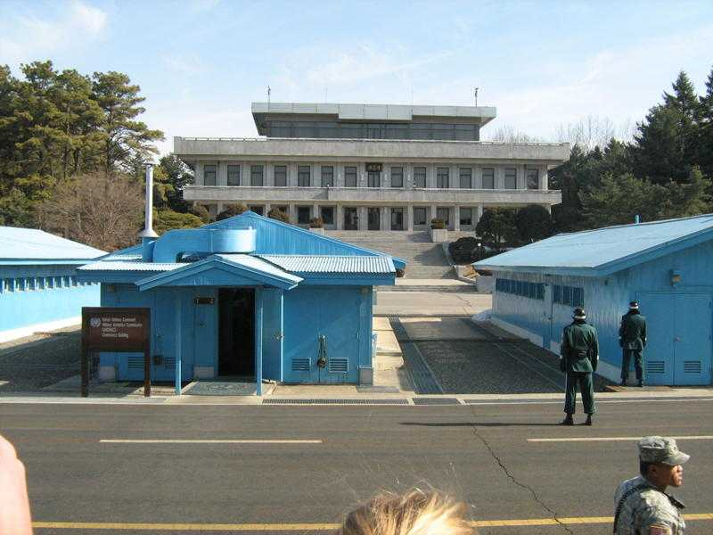
P5/VO1AU
Panmunjom, North Korea

Slide 15
Culture Shock - Licensing
Forbidden: North Korea
Restricted: China
Difficult: Macau
Easy, but with odd rules: Japan, South Korea
Easy: Hong Kong, Kiribati
Semi-Automatic: Ireland
Automatic: New Zealand, Chatham Island
Easy, but incompetent: Malaysia
  9M6/JØ1AU?
  JA8CCL was issued 9M9/CCL

Slide 16
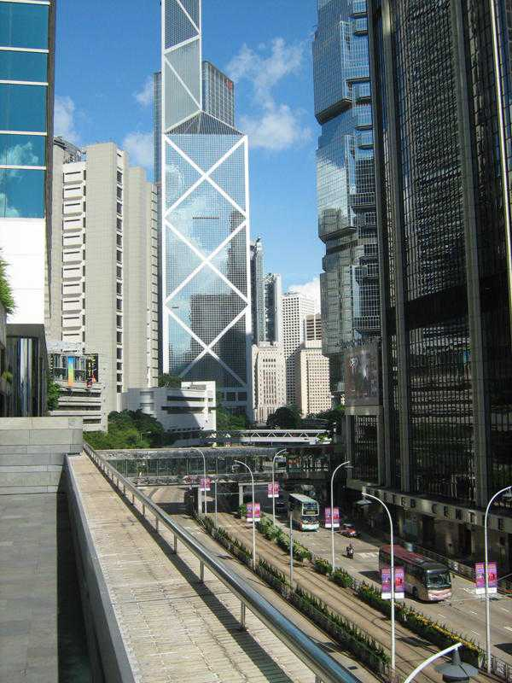
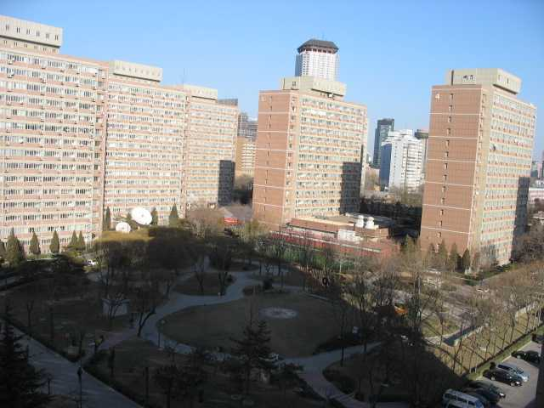
Culture Shock – Space!
Hong Kong
Beijing

Slide 17

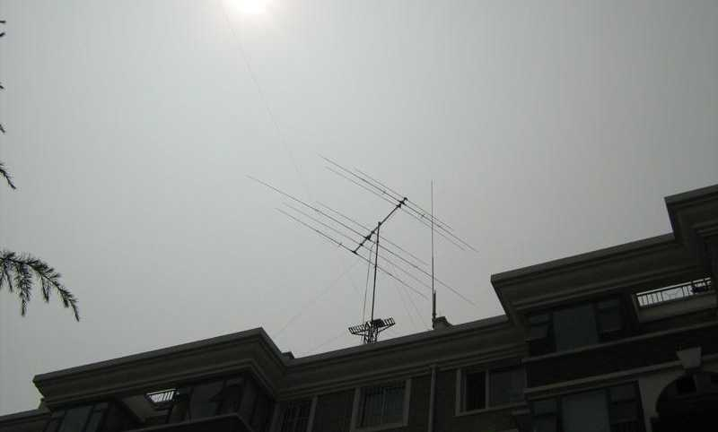
Ma Zhenxin BA1KW and home of BY1TTY
Six storey apartment building with tribander, vertical, 80m end-fed wire

Slide 18
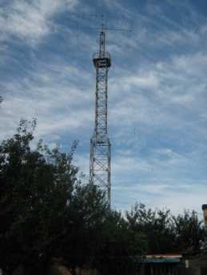
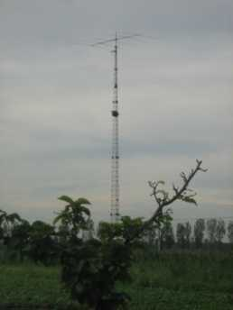
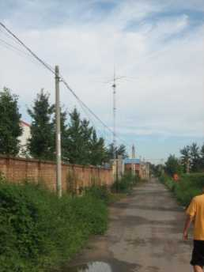
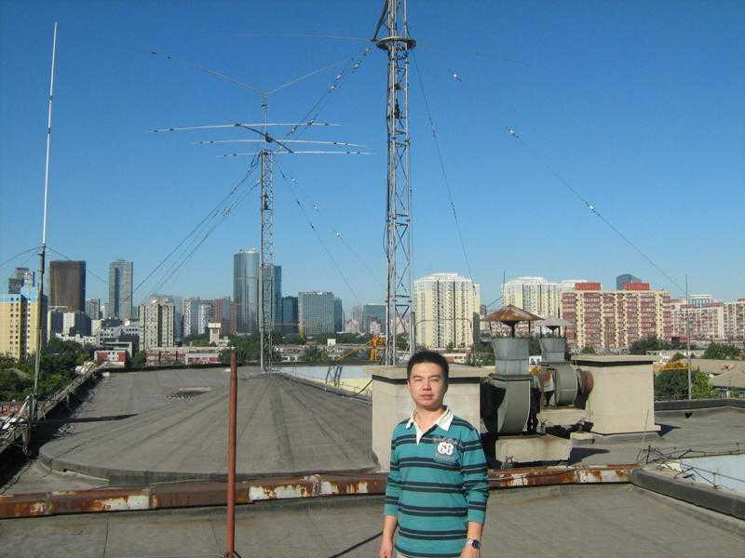
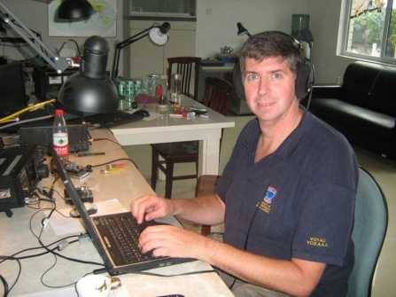
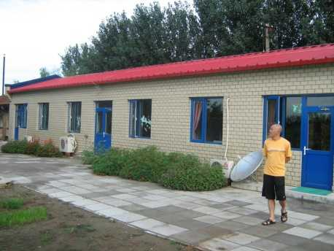
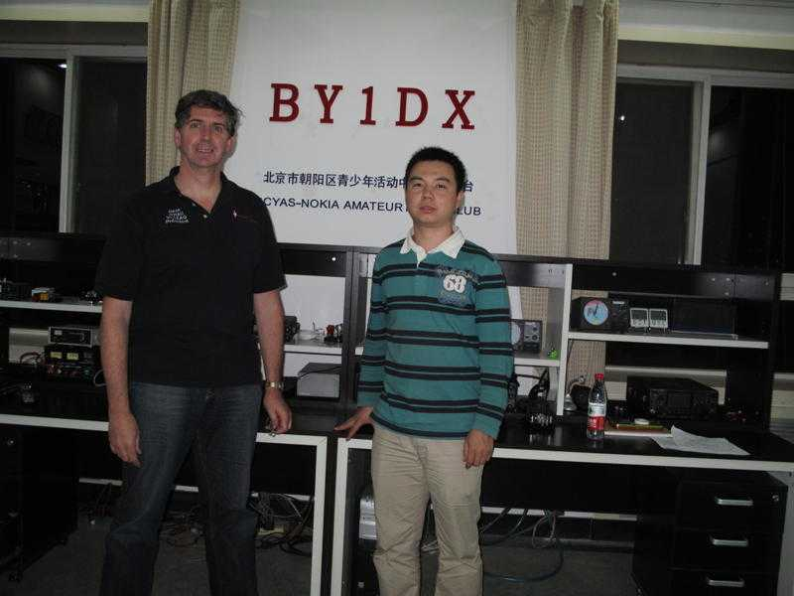
Club Stations in Beijing
BY1RX and B1Z
BY1DX

Slide 19
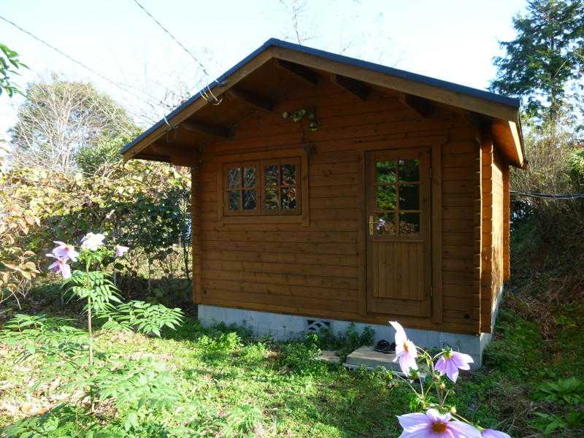
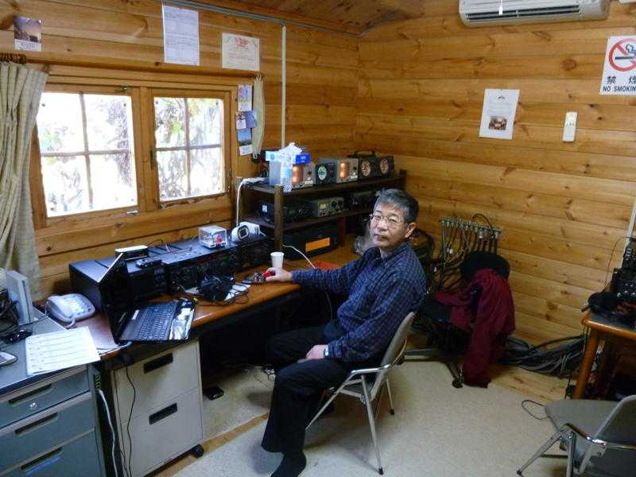
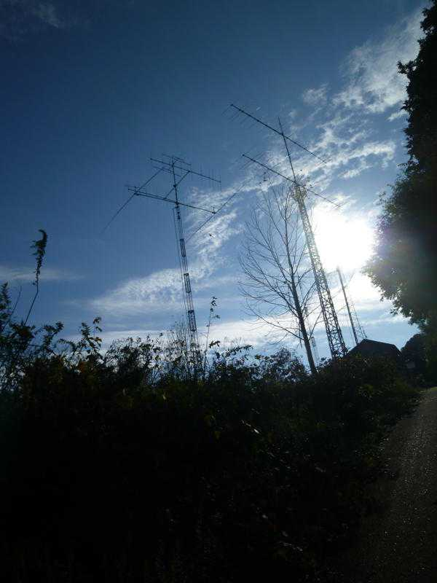
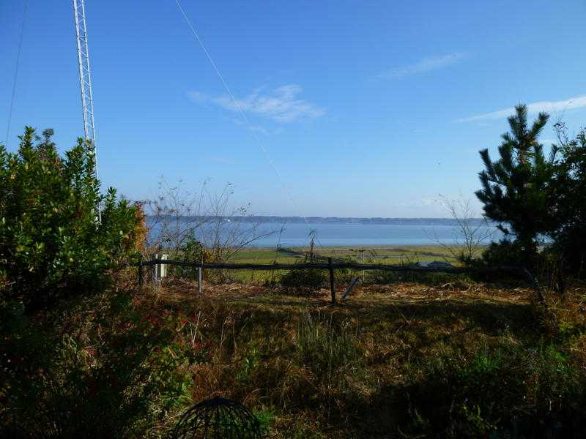
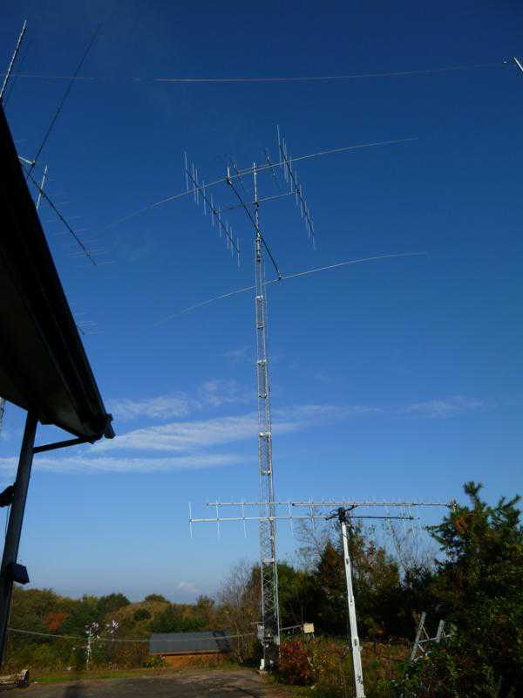
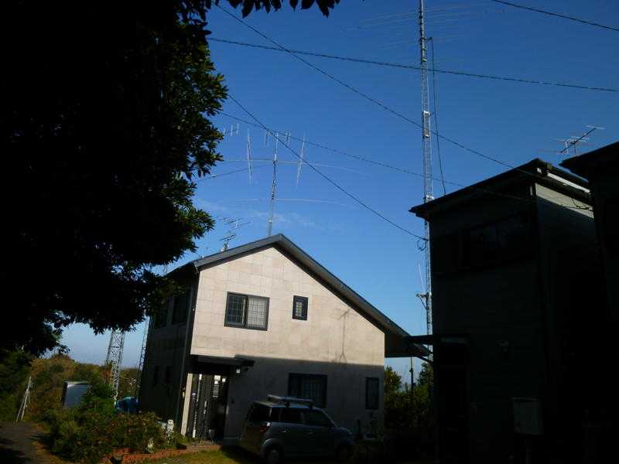
JG1RSL at JA1AHS

Slide 20
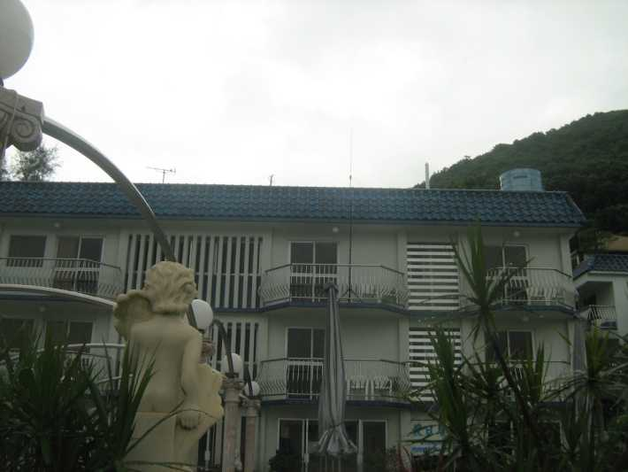
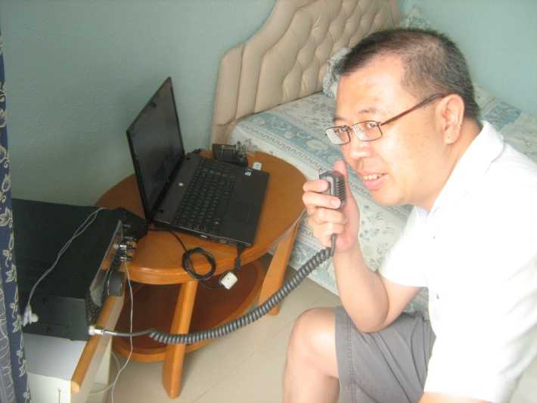
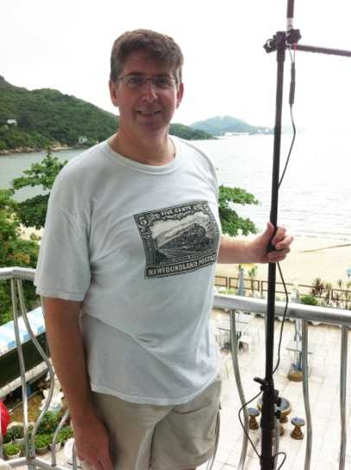
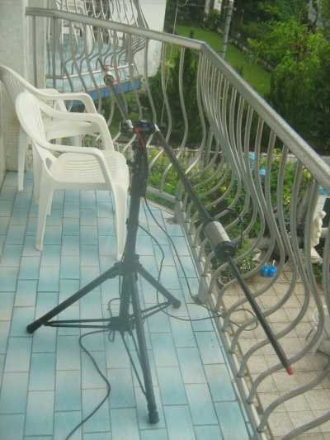
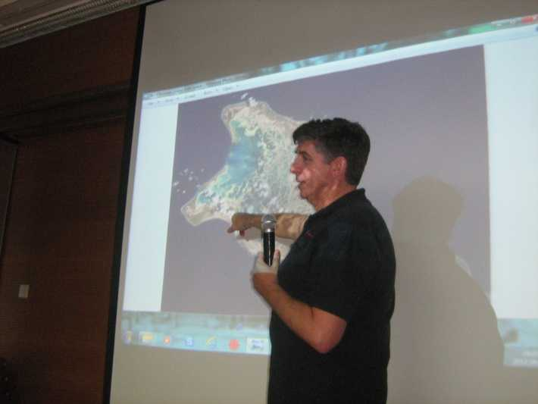
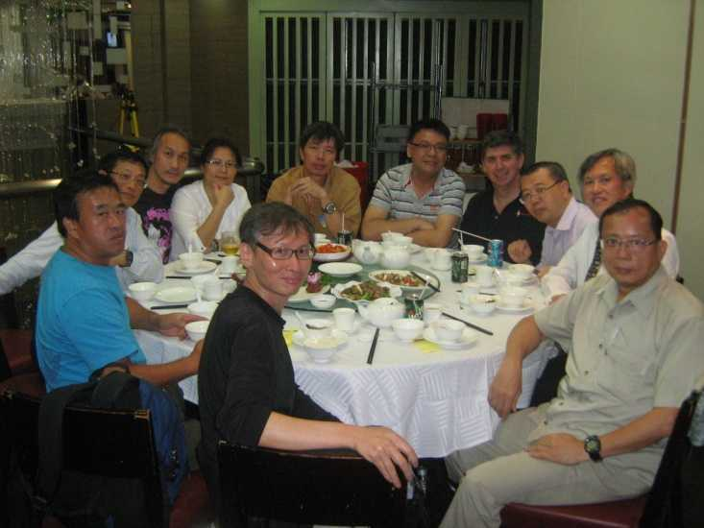
VR2/VO1AU and VR2XMC

Slide 21
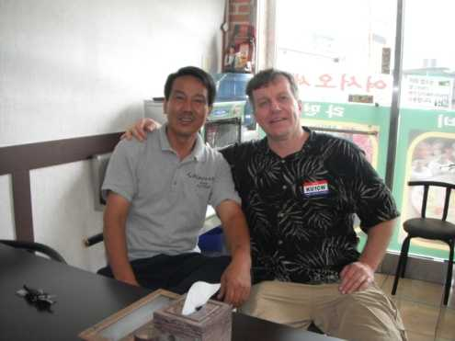
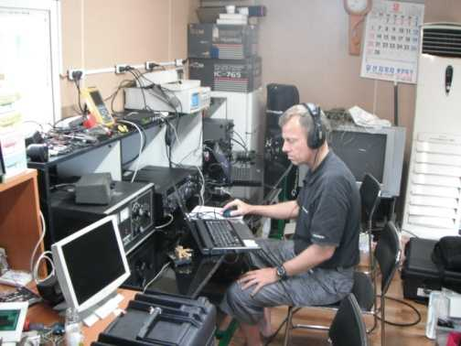
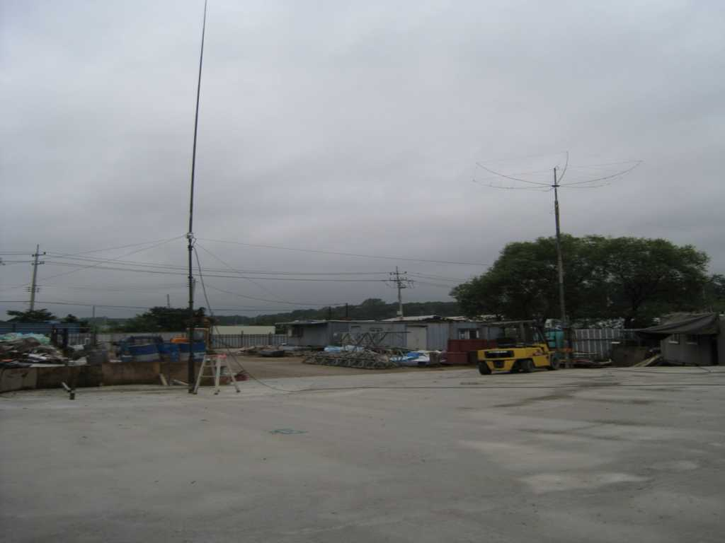
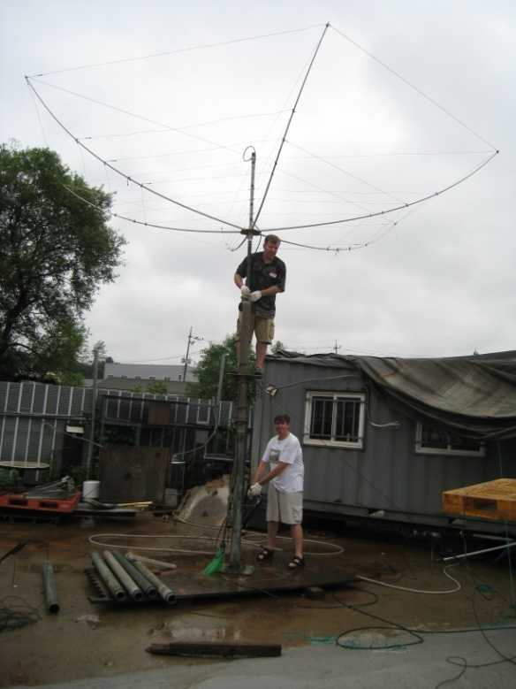
HL1/VO1AU and 6M0DX

Slide 22
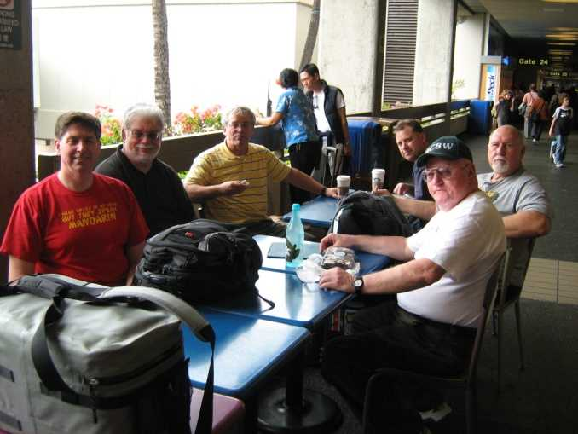
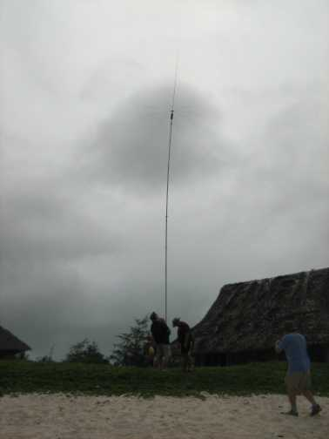
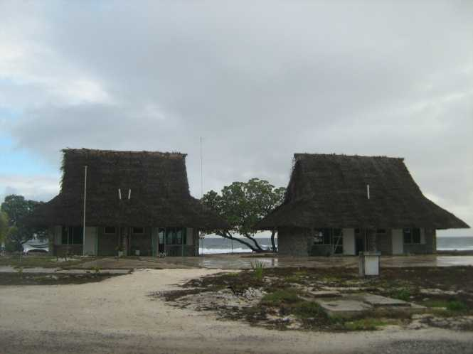
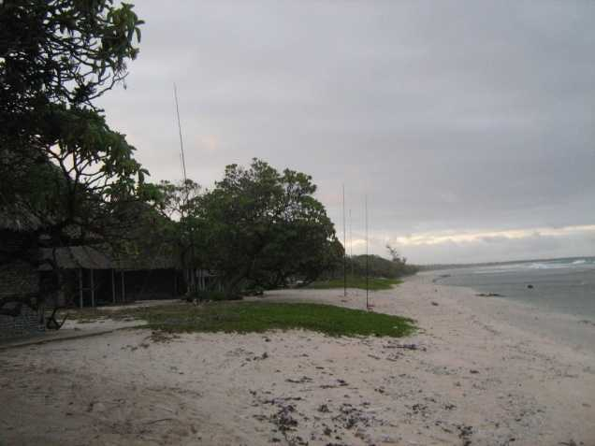
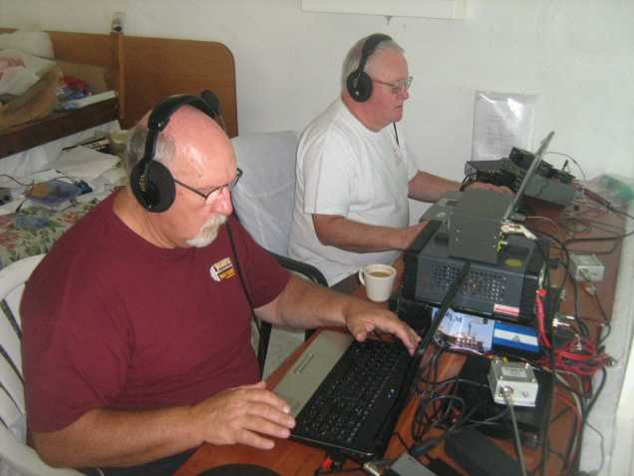
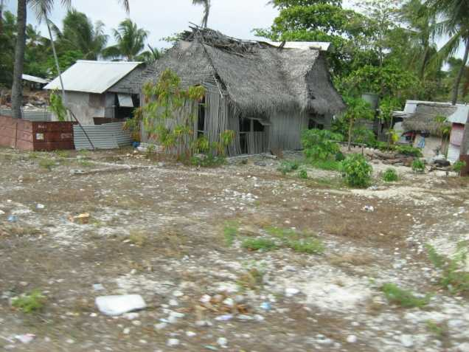
T32AU – Christmas Island

Slide 23
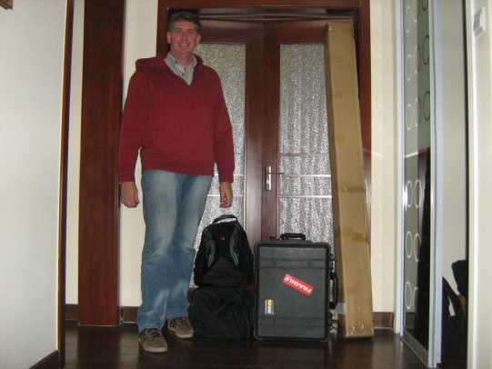
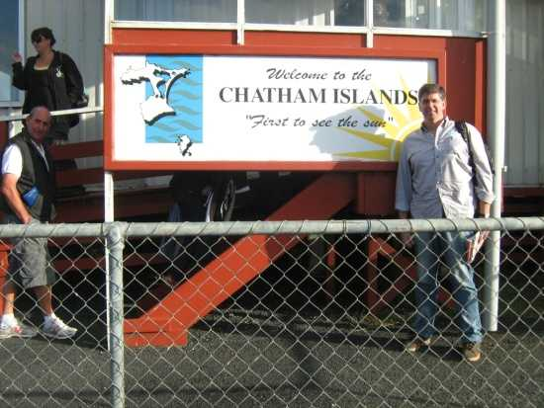
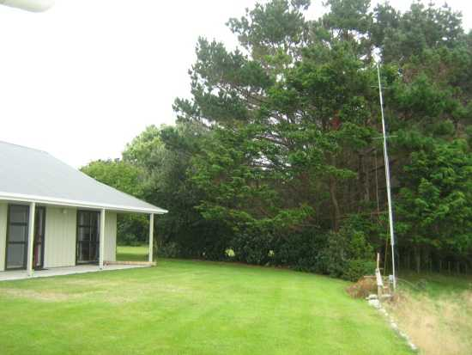
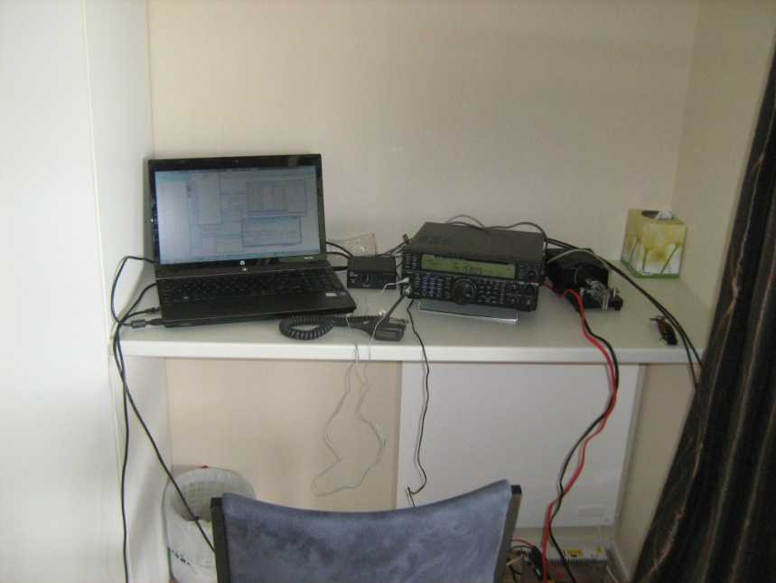
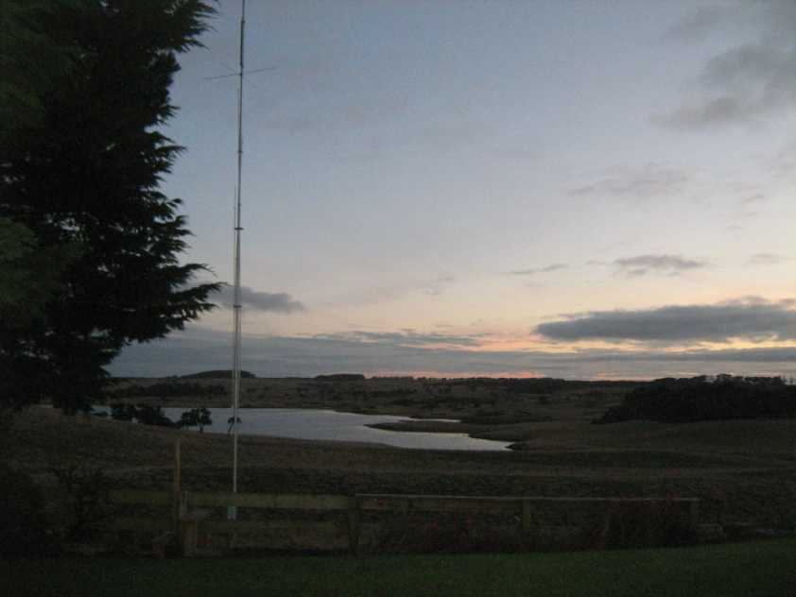
ZL7/VO1AU – Chatham Island

Slide 24






ZL/VO1AU at ZL1AIH, ZL1ANH

Slide 25








Ham Stores in Asia
Beijing: Chinese HTs
Japan: Akihabara – Rocket Radio
Hong Kong – CQ Shop

Slide 26


Culture Shock:
Propagation to the Antipodes
Ottawa Calgary

Slide 27




Antipodes from BY, 9M6, T32, ZL7
Beijing Sabah
BY1 9M6
Christmas I. Chatham I.
T32 ZL7

Slide 28
Culture Shock:
Propagation patterns
Importance of mutual daylight or darkness
Distance matters!
Toughest DX?
  From Ottawa: South-east Asia (Zones 26, 27)
  From East Asia, 9M6: Caribbean (Zones 7 and 8)
  From New Zealand: Africa (Zones 37, 38, 39)
  From Kiribati: southern Europe and North Africa (Zones 15, 33, 34)
  =“Black holes”12,000-14,000km via Auroral Zone
  9M6: Trans-equatorial propagation on 6m

Slide 29
Amateur Radio Highlights
Active from nine DXCC, visited four others
Almost 30,000 QSOs, most from China
Worked many Canadian hams from DX side
  Met many great hams: BA1KW, BA1RB, BD1BYV, JA1AHS, JR7HAN, 9M6DXX, VR2XMC, ZL3JT, ZL4PW, ZL4NR, ZL1ANH, ZL1AIH --- even Ying VA3YH!
Several contest operations:
  BY: 2010 CQ WW, 2011 WPX both SSB and CW, 2010 &2011 RAC Winter, 2010 ARRL 10m
  VR2: 2011 CQ WW SSB, 2011 AA CW, 2012 JIDXC
  HL: 2011 WAE CW
  ZL: 2012 CQ WPX SSB
  9M6: 2011 BERU and ARRL DX SSB
  JA: 2011 ARRL 10m
  T32: 2012 CQ 160m CW from T32
  ZL7: 2012 BERU
Bought new rigs at great prices
  FTdx-5000, TS-590 and FT-817ND: 30% less than Canada, 40% less than Japan!

Slide 30

Sounds from home
T32AU as heard by VE9DX
ZL/VO1AU as heard by VO1MX
ZL7/VO1AU as heard by VE9DX
HL1/VO1AU as heard by VE6LB

Slide 31




Do I miss life in Beijing?
On a clear day
On a bad day

Slide 32

Questions？
有问题吗？

