Slide 1
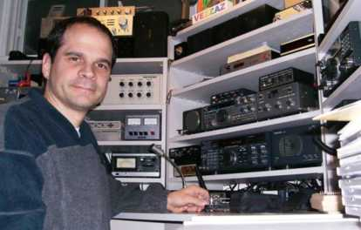
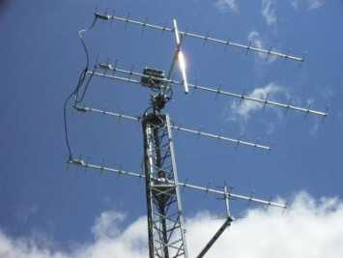
A Beginner's View of
Easy Moonbouncing...
By Bertrand Zauhar, VE2ZAZ
ve2zaz@amsat.org
http://ve2zaz.net

Slide 2
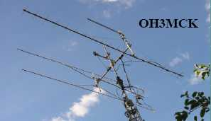
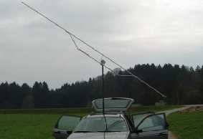
My Objective
GET YOU INTERESTED IN WORKING EARTH-MOON-EARTH QSOs.
  Most hams believe exotic equipment, huge antennas, and very high power are needed to work EME.
  You can enjoy the thrill of moonbounce with a modest setup.
    Basically the equipment you may already have.

Slide 3
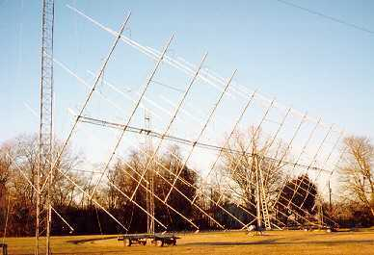
This Presentation
Why Moonbounce?
The History
A real challenge
The Bands
How Small a Station
Visit VE2ZAZ EME
Some Hints
Optimize Noise Figure
JT65
The Software
Moon Tracking
Web References
W5UN – Mighty Big Antenna. 32 x 17 el. Yagis on 2m

Slide 4
Why Moonbounce?
IT IS EXCITING!
  Most fun in ham radio is making rare, unusual, or difficult contacts. EME is the pinnacle of ham radio achievement.
ALLOWS TO WORK WORLDWIDE DX ON ANY BAND - 6M UP.
  No other unassisted mode provides this capability.
MOTIVATES YOU TO LEARN MORE ABOUT COMMS THEORY
  Propagation, noise, antenna phasing, polarization, space object tracking, etc.
PROVIDES AN INCENTIVE TO BUILD BETTER ANTENNAS.
  Complete EME arrays are not available commercially.

Slide 5
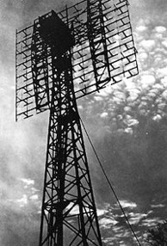
A Bit of EME History
1946: First experiments by US Mil. in Project Diana. 3,000 watts at 111.5 MHz into dipole array
Following years, Moon used for Teletype between mainland and Pearl Harbor
1953: First Amateur detection between W4AO and W3GK on 2m
1960: First EME QSO on 1296 MHz by W1BU club in MA.
1965: Arecibo Observatory Mounbounce contacts on 430 MHz with tens of kW !

Slide 6
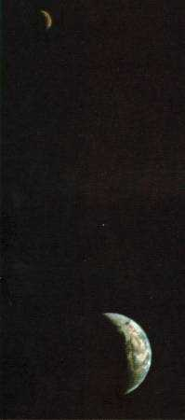
The Anatomy of an EME QSO
AVERAGE MOON DISTANCE: 384,000km
  Average Round Trip: 770,000km!
  Propagation Path Loss: 250+ dB!
  Echo delay: ~ 2.4 Seconds
93% OF WAVE ABSORPTION BY MOON
  Only 7% wave reflection
ANGLES AND BEAMWIDTH
  Moon is ~ 1 degree wide when seen from earth
  Antenna is 0.00....1 degree wide when seen from the moon!

Slide 7
Impairments in an EME QSO
POLARIZATON OFFSET
  90-degree polarization offset between stations, forget it!
    FARADAY ROTATION: Polarization rotation due to Ionosphere and earth's magnetic field. At 432MHz, up to 1.5 complete rotation, at 1296MHz 0.25 rotation. Negligible at higher F.
    SPATIAL OFFSET: Geometry of the path between two stations.
LIBRATION FADING
  Signal fading caused by the movement of the moon and surface imperfections.
  The higher the frequency, the faster the fading
COSMIC NOISE, SUN NOISE
  When Moon has noisy sky in background, forget it!
  When Sun and Moon line up, forget it!
QRM, QRN...

Slide 8
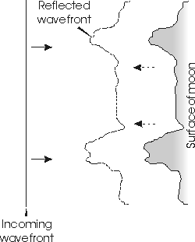
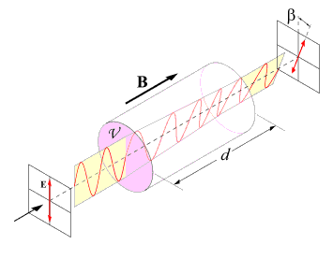
Libration And Faraday Rotation

Slide 9
What Band to use?
50MHz: Not very popular: Big antennas, lots of QRN, no preamp required, KW+ a must. Difficult.
144MHz: Most popular band, tons of stations work random JT-65 QSOs. A pair of long boom yagis and 500-1000W will keep you active.
432MHz: Fewer stations, more difficult to work random. Activity Periods. A pair of long boom Yagis or 4 yagis a good entry point. 400W+ an asset. Preamp is a must. QRN nil!
1296MHz: More and more stations, probably more than on 432MHz. A 10+ foot dish is the way to go. 100W+ a must.
2304MHz: Fewer stations, must plan skeds. More exotic gear to generate the high output RF power. Skeds only.
>2304MHz: Experiments, lots of experiments. TWTs, fancy stuff, waveguides. Some activity. Skeds only.

Slide 10
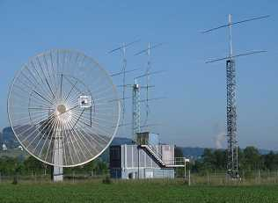
Big Guns are an Asset!
THEY DO ALMOST ALL OF THE WORK!
THERE ARE A LOT OF THEM, ESPECIALLY IN EUROPE.
HB9Q Club – 15m Dish (70cm, 23cm, 13cm), 8 x 19 el. Yagis (2m), 11 el. Yagi (6M)

Slide 11
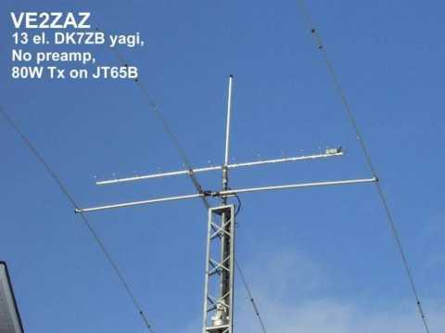
How Small Can an EME Station Be?
Single long-boom Yagi
80W
No Preamp
No Elevation Rotor
  Success in JT-65!
4 x long-boom Yagis
45W
Low NF Preamp
  Success in CW!
SIMPLE BASIC QSOs,
NOT RAG CHEWING!

Slide 12
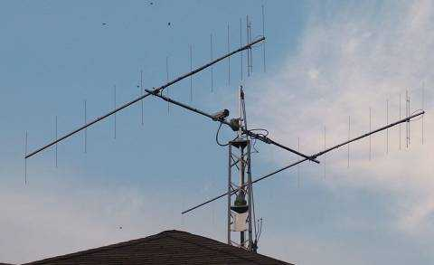
VA3TO – 2M EME, 112 Countries

Slide 13
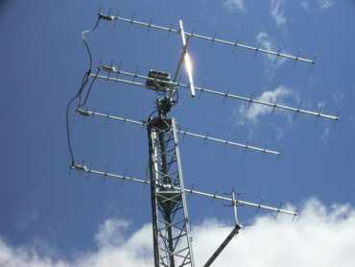
EME at VE2ZAZ... Outside
ANT: 4 x 13 element DK7ZB Yagi array (~20 dBd Gain), home-made
PREAMP: 20dB Gain, <0.3dB NF (ATF-54143), home-made
FEEDLINE: Andrew LDF4-50 Heliax (Tx), RG-214 (Rx)
SPLITTER: 4:1 Air dielectric round/square coaxial transformer, home-made
ROTORS: Hy-Gain Tailtwister (azimuth), Yaesu G-550 (elevation)
High Isol.
Relay
4:1 Combiner/Splitter
NC
NC
50 Ohm
Termination
High Power
Relay
Preamp
NF < 0.3dB
Rx Line
Tx Line

Slide 14
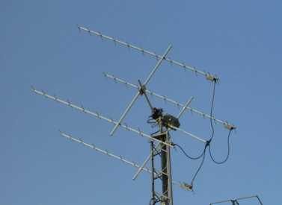
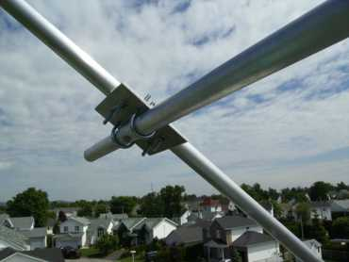
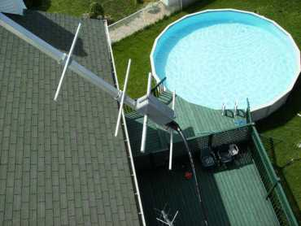
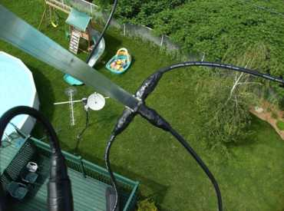
EME at VE2ZAZ... Outside

Slide 15
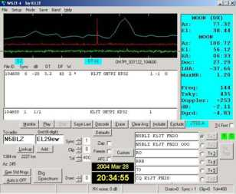
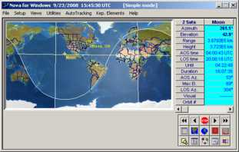
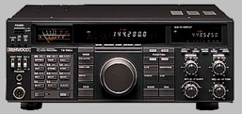

EME at VE2ZAZ... Inside
Rig: TS-790A (separated Tx and Rx ports)
Amp: Mirage D1010 brick (~100 W).
  Future: AM-6155 FAA amp (~400W)
Sequencer: "At Last" Sequencer (VE2ZAZ)
Audio Filter: JPS NIR-10 DSP
PC and Sound Card:
  WSJT Software
  Spectran Sound analysis/filter Software
  Nova For Windows tracking Software
  N0UK JT-65 EME Logger Website
  MultiKeyer CW Keyer Software

Slide 16
Some Hints for a Small EME Station
Minimize Losses Between Antenna and Preamp.
  Any attenuation is a direct deterioration of the Noise Figure.
    Best possible coax. RG-214 not good enough. LMR series better.
    Use N-Type connections everywhere, even at 144MHz.
Rule out old Yagi designs
  Constant element spacing not a good indication of modern design.
  Modern modeled antenna designs are best. K1FO long boom design is a baseline.
Every Watt Counts. Use the best possible TX feedline.
  At >432MHz, Heliax or equiv. Is a MUST!

Slide 17
More Hints for a Small EME Station
At 432MHz and Above, use a preamp with very low NF.
  NF < 0.5B recommended.
Transverters Work Great
  Are Cheaper.
  Can be located remotely to minimize feedline losses.
Operate When Moon Conditions are Best
  The 2dB difference in path loss can “make or break” a QSO.
  Avoid high sky noise.
Exploit Ground Gain, up to 6 dB due to ground reflections.
  Especially applicable to 50MHz and 144 MHz

Slide 18
More EME Hints...
Be careful about Amplifier Over-Stress from JT65.
  JT65 runs 50 secs at full power, 70 secs off.
  Use a fan on linear bricks. 24V fan on 13.8V is quiet and effective.
  Derate output power (from p.e.p. specs) on tube-type amplifiers.
Avoid Hot-Switching Coaxial Relays
  Wears out contacts at much accelerated rate.
Be on Frequency
  Measure your TX frequency offset and compensate for it.
  Use a Frequency Counter with a GPS Reference.
    Especially applicable to 1296MHz and above.
  Remember RX Doppler compensation...
    The higher the F, the larger the Doppler (proportional)
    At 432MHz Doppler varies +/- 1KHz.

Slide 19
Even More EME Hints...
Synchronize your PC to UTC Time
  To the nearest second.
  Win2K, WinXP, Vista have this built in.
Polarization Control is an Asset
  Feedpoint rotation on dishes.
  Cross-Yagi array
Watch for Coaxial Cable Power Handling Capability.
  At 432MHz, surprisingly low.
    RG-214 = ~ 300W
    9913 = ~ 400W
  Another reason to use Heliax coaxial cable.

Slide 20
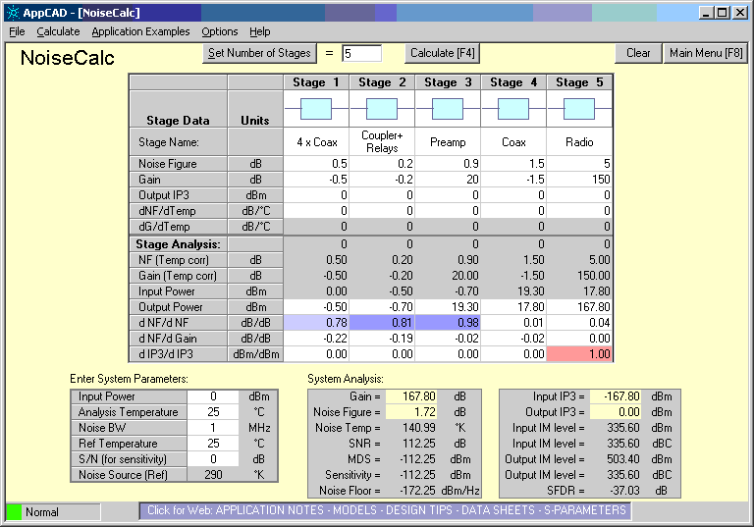
Optimize your Noise Figure
A “typical” Setup

Slide 21
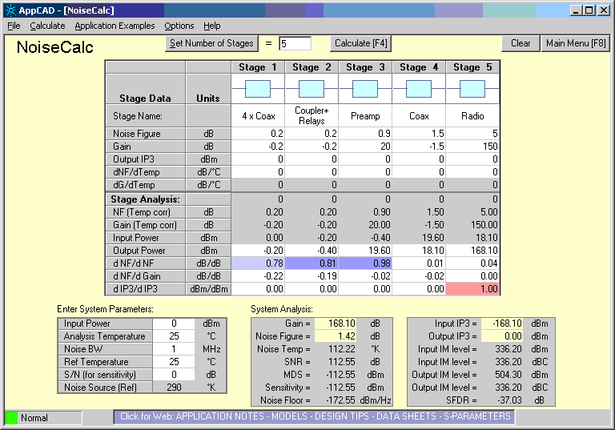
Optimize your Noise Figure
A better setup

Slide 22


Optimize your Noise Figure
A Much Better Setup

Slide 23
JT65 – The Small Station's Best Friend
Modulation mode created by Joe Taylor – K1JT in 2003
Software actually called WSJT.
Uses a PC and its sound card, Windows-based.
DSP techniques optimized for extremely weak but slowly-varying signals (e.g. meteor scatter and moonbounce)
Uses 63-frequency shift keying with constant phase
  Single tone and continuous phase: Usable on a non-linear transmitter and power amplifier!
Decode signals many decibels below the noise floor, even without signals being audible to the human ear.
  Forward Error Correction (FEC) used. 5.25:1 Redundancy Ratio
  Fixed and Expected Message, Grid and Callsign Formats
    CQ VE2ZAZ FN25
    K2UYH VE2ZAZ FN25
    O, RO, RRR, 73
  Does averaging of several Rx messages
  Uses Deep Search table (list of stations known to do EME)

Slide 24
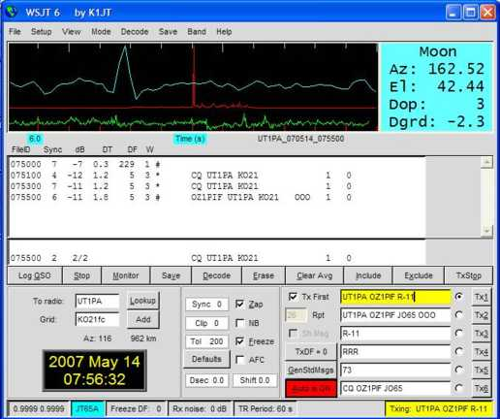
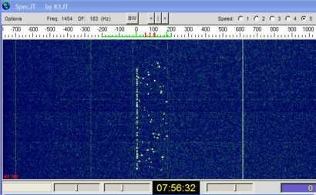
WSJT - JT65

Slide 25
The JT65 Controversy...
“Deep Search” Lookup Controversy
  Is it considered a complete copy of info for valid QSO?
Not a true EME QSO? Too easy!
  Endless Debate...
  Solution will be to produce specific award classes for the EME digital modes

Slide 26
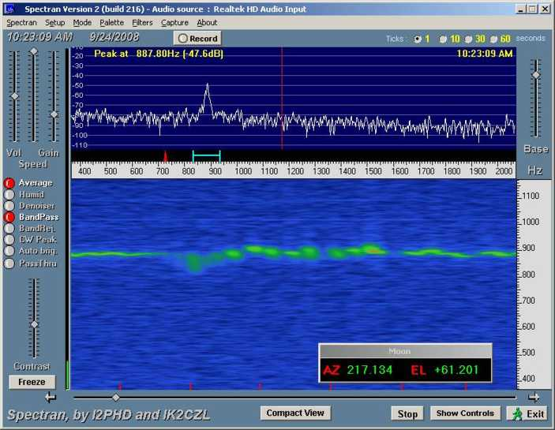
Spectran – Audio SA and Filter SW

Slide 27
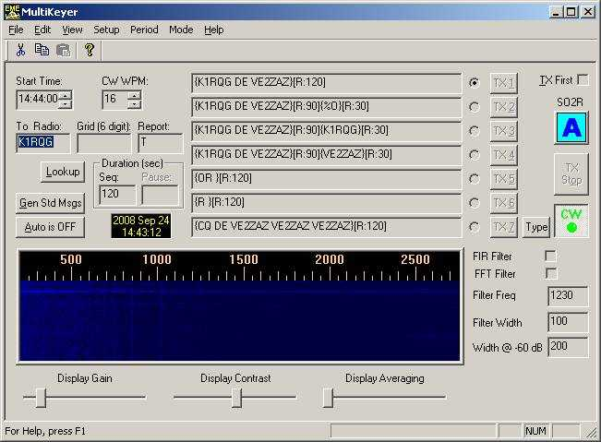
MultiKeyer – Auto CW Keyer SW

Slide 28
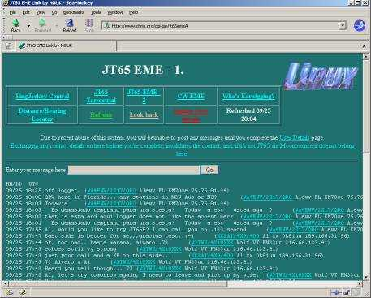
N0UK JT-65 EME Logger
A Must for both Skeds and Random QSOs
Mostly 144MHz activity, but all bands are seen
Other Logger Sites available
  HB9Q EME Logger
  ON4KST EME Chat

Slide 29
Moon Prediction
Software (Current Position, Prediction, Sked planning, Mutual Visibility)
  MoonSked $
  Nova $
  EME Systems
  SatTrack (Linux)
  Winorbit
  ...
Internet Applets (Current Position)
  Sun, Earth and Moon Applet
    http://www.jgiesen.de/SME/
  Sun & Moon Position Calculator
    http://www.satellite-calculations.com/Satellite/suncalc.htm
  ...

Slide 30
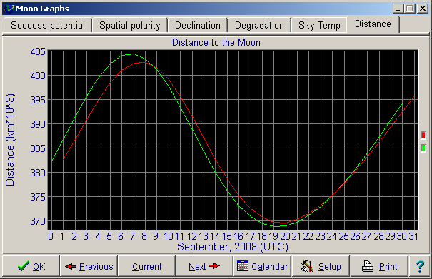
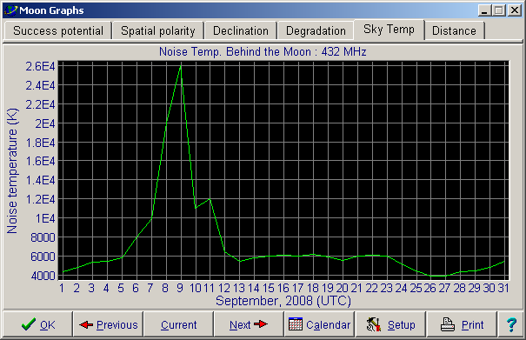
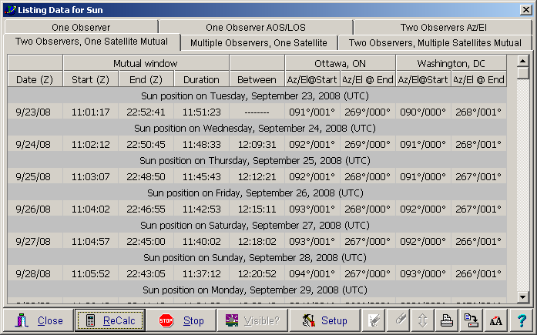
Moon Prediction – Nova

Slide 31
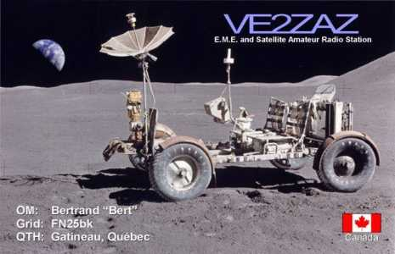
QSLs are a Must for EME
Get your QSL design refreshed!
Paper QSLs are still very popular within EME community.
Nice trophies for a Small Station!
QSL is normally sent Direct, not Via Buro.

Slide 32
Some References
Moon-Net Email Reflector
  http://list-serv.davidv.net/mailman/listinfo/moon-net_list-serv.davidv.net
144MHz EME Newsletter
  http://www.df2zc.de/newsletter/index.html
432 and Above EME Newsletters by K2UYH.
  http://www.nitehawk.com/rasmit/em70cm.html
DUBUS EME Moon Calendar
  http://www.marsport.org.uk/dubus/eme.htm
JT-65 Protocol Description
  http://www.physics.princeton.edu/pulsar/K1JT/JT65.pdf
The WWW IS FULL OF EME STUFF!

