Slide 1
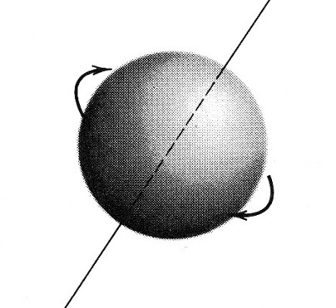
Ferrites
VE3KL
A spinning electron works like a gyroscope
Gyro frequency tells all
J
Bo
m
Notes:
A method that you can use easily to evaluate your own noise environment
A method that you can use to evaluate the quality of the ionosphere at any give time.
Some methods to control received noise
The Shannon Hartley limits

Slide 2
Presentation Outline
Review of magnetic terms: H, B , M and Gyro frequency
Ferrite materials, samples and measurements
Ferrite Applications
Ferrites with no applied magnetic bias
Ferrites with an applied magnetic bias
Description of an experimental test bed
Further reading
Notes:
A method that you can use easily to evaluate your own noise environment
A method that you can use to evaluate the quality of the ionosphere at any give time.
Some methods to control received noise
The Shannon Hartley limits

Slide 3
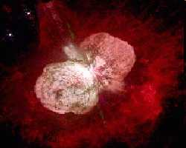
Gyro Frequency
Fo = 28000*Bo [MHz]
If Bo = 0.1 [T]
Fo = 2.8 GHz
Earth’s Magnetic Intensity Bo = 50 uTesla
Small Bar Magnet Bo = 0.01 Tesla
Sunspot B0 = .15 Tesla
Strong Lab magnet Bo = 10 Tesla
Magnetar Bo = 100,000,000,000 Tesla
http://en.wikipedia.org/wiki/Magnetar
Notes:
A method that you can use easily to evaluate your own noise environment
A method that you can use to evaluate the quality of the ionosphere at any give time.
Some methods to control received noise
The Shannon Hartley limits

Slide 4
Magnetics
F = I dl X B
A force is applied to a current that is in a field B. This equation defines B. This is how motors work.
Units of flux density B: Tesla in MKS units
F (Into the page)
I [Amps]
wire
B [tesla]
Notes:
A method that you can use easily to evaluate your own noise environment
A method that you can use to evaluate the quality of the ionosphere at any give time.
Some methods to control received noise
The Shannon Hartley limits

Slide 5
Magnetics
Magnetic Intensity H [A/m] defined by:
Curl H = J [A/m²] ..static case
Magnetic intensity depends only the current….NOT ON THE MATERIAL
H
J
Notes:
A method that you can use easily to evaluate your own noise environment
A method that you can use to evaluate the quality of the ionosphere at any give time.
Some methods to control received noise
The Shannon Hartley limits

Slide 6
Magnetics
Magnetization M [A/m]
Similar to H but currents are internal to the material due to spinning electrons
Notes:
A method that you can use easily to evaluate your own noise environment
A method that you can use to evaluate the quality of the ionosphere at any give time.
Some methods to control received noise
The Shannon Hartley limits

Slide 7
Magnetics
Relationship Between B, H, M
Here is where the material plays a role.
B = μ(H + M)
μ can be a constant… μo = 4π x 10⁻⁷ H/m
μ can be a complex number…mix #43 ferrite
μ can be isotropic… unbiased ferrites
μ can vary with direction…(Faraday Rotation)
μ can be nonlinear…(saturation)
Notes:
A method that you can use easily to evaluate your own noise environment
A method that you can use to evaluate the quality of the ionosphere at any give time.
Some methods to control received noise
The Shannon Hartley limits

Slide 8
Magnetics
Magnetic Units
Physical Quantity SI UNIT (MKS) Factor Gaussian (cgs)
B (Magnetic Flux) tesla (T) 10⁴ gauss
H (Magnetic Field) A/m 4πx10⁻³ oersted
M (Magnetization) A/m 10⁻³ magnetic
Inductance henry (H) 10⁹ abhenry
The Factor is the number of Gaussian units required to equal one SI unit.
To convert tesla to gauss multiply by the Factor 10⁴
Notes:
A method that you can use easily to evaluate your own noise environment
A method that you can use to evaluate the quality of the ionosphere at any give time.
Some methods to control received noise
The Shannon Hartley limits

Slide 9
What is a soft Ferrite
An engineered ferrimagnetic ceramic material
Soft ferrites do not retain a permanent magnetization
Contains bounded spinning electrons
High dielectric constant
High permeability
High resistivity
Can be biased to orient spinning electrons
Many forms and chemical composition
Notes:
A method that you can use easily to evaluate your own noise environment
A method that you can use to evaluate the quality of the ionosphere at any give time.
Some methods to control received noise
The Shannon Hartley limits

Slide 10
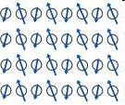
Ferrimagnetic Material
Soft Ferrite
Spinning electrons not aligned when Ho = 0
Spinning electrons have a large magnetic moment
B = μH where μ can be very high.
Notes:
A method that you can use easily to evaluate your own noise environment
A method that you can use to evaluate the quality of the ionosphere at any give time.
Some methods to control received noise
The Shannon Hartley limits

Slide 11
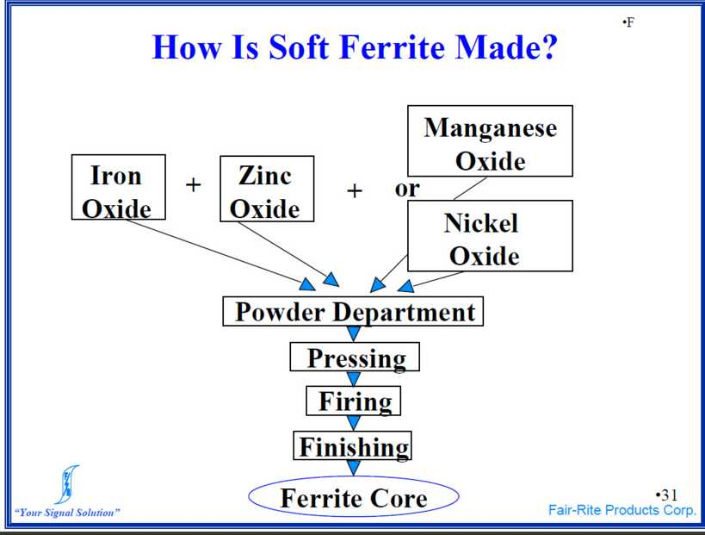
Notes:
A method that you can use easily to evaluate your own noise environment
A method that you can use to evaluate the quality of the ionosphere at any give time.
Some methods to control received noise
The Shannon Hartley limits

Slide 12
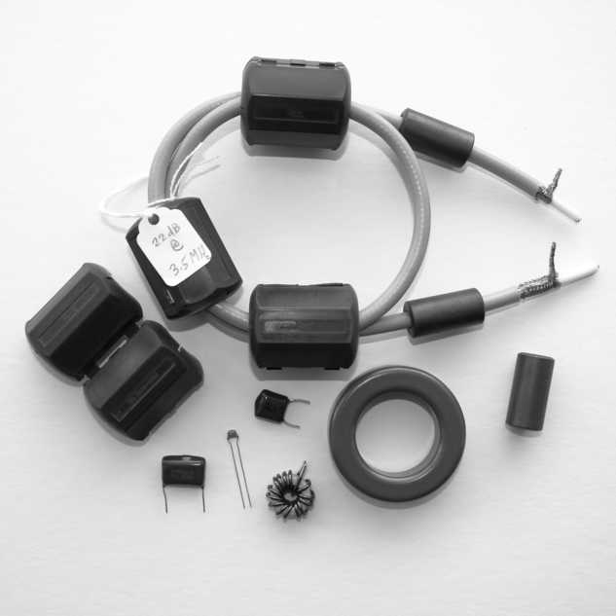
Ferrite Samples
Notes:
A method that you can use easily to evaluate your own noise environment
A method that you can use to evaluate the quality of the ionosphere at any give time.
Some methods to control received noise
The Shannon Hartley limits

Slide 13
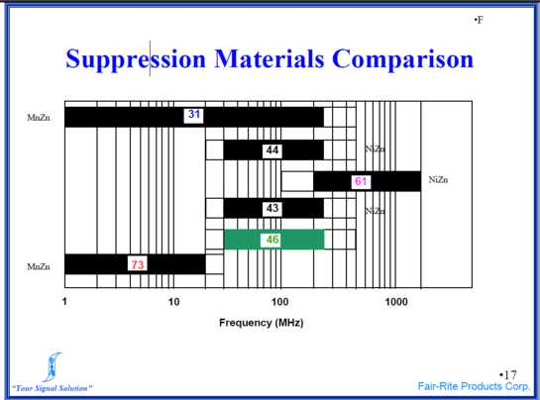
EMI Suppression Materials
Ho = 0
Note: For Balun’s there are different charts..
#61 material can be used at HF for high power Guenalla Balun
Notes:
A method that you can use easily to evaluate your own noise environment
A method that you can use to evaluate the quality of the ionosphere at any give time.
Some methods to control received noise
The Shannon Hartley limits

Slide 14
Ferrite Applications
Waveguide Phase Shifters and Isolators
Microwave Circulators
Antenna Baluns
RFI Common Mode Chokes
Antenna Common Mode Chokes
Transmission Line Transformers
Notes:
A method that you can use easily to evaluate your own noise environment
A method that you can use to evaluate the quality of the ionosphere at any give time.
Some methods to control received noise
The Shannon Hartley limits

Slide 15
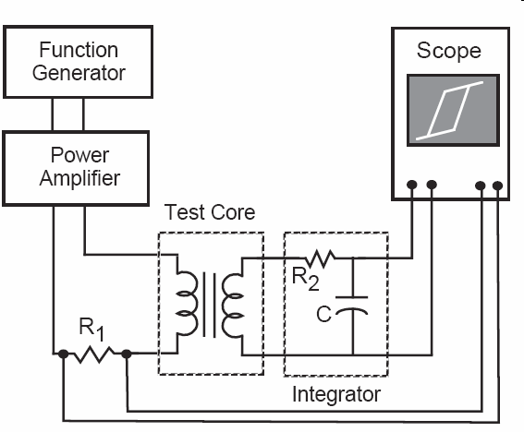
Magnetics
B-H Test Set
Measuring B-H curves.
See http://www.cliftonlaboratories.com/type_43_ferrite_b-h_curve.htm
Notes:
A method that you can use easily to evaluate your own noise environment
A method that you can use to evaluate the quality of the ionosphere at any give time.
Some methods to control received noise
The Shannon Hartley limits

Slide 16
Special Cases
Case 1…Small Signals
No applied DC Magnetic Field
Mix #43
μ = 800 (relative) at low frequency
μ is complex
μ = μ^{ı} + jμ^{ıı}
Spinning electrons not aligned
Spinning electrons have a large magnetic moment
B = μH where μ can be very high.
μ does not depend on direction (isotropic material)
Transmission Line used for high frequency
Ferrite used for low frequency
Notes:
A method that you can use easily to evaluate your own noise environment
A method that you can use to evaluate the quality of the ionosphere at any give time.
Some methods to control received noise
The Shannon Hartley limits

Slide 17
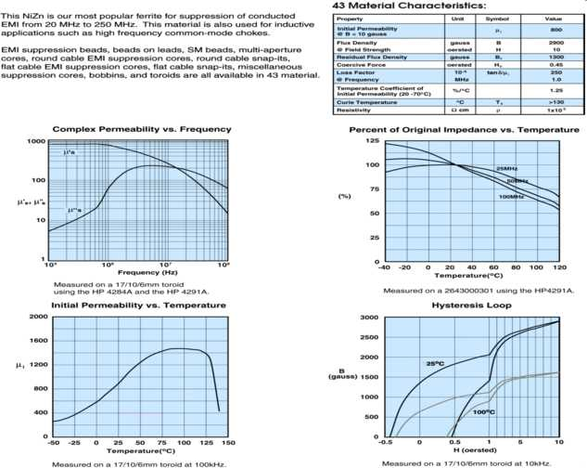
Mix #43 from Fair-Rite Products
Transmission Line used for high frequency
Ferrite used for low frequency
Notes:
A method that you can use easily to evaluate your own noise environment
A method that you can use to evaluate the quality of the ionosphere at any give time.
Some methods to control received noise
The Shannon Hartley limits

Slide 18
Case 1 Ho = 0 No Bias
Ordinary modes exist….
Supports TEM and other waves
μ does not depend on direction (isotropic material)
Applications include EMI chokes and RF inductors
Used extensively in all of our radios
Notes:
A method that you can use easily to evaluate your own noise environment
A method that you can use to evaluate the quality of the ionosphere at any give time.
Some methods to control received noise
The Shannon Hartley limits

Slide 19
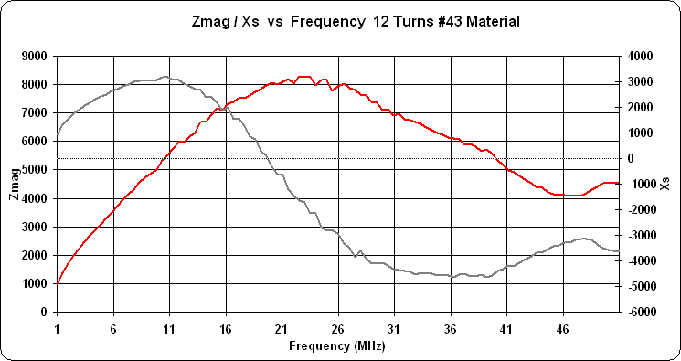
Amidon FT-114A-43 Toroid 12 Turns
Transmission Line used for high frequency
Ferrite used for low frequency
Notes:
A method that you can use easily to evaluate your own noise environment
A method that you can use to evaluate the quality of the ionosphere at any give time.
Some methods to control received noise
The Shannon Hartley limits

Slide 20
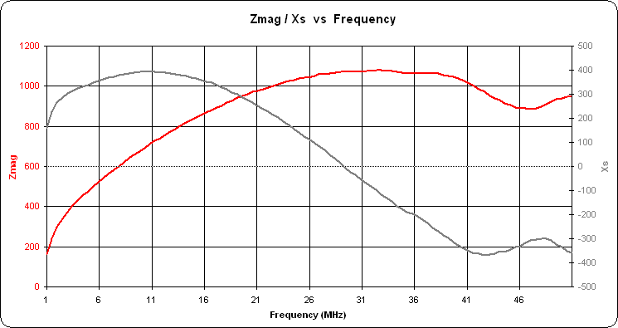
#43 EMI Fair-Rite Round Chokes
5 Chokes in Tandem #2643540002
Transmission Line used for high frequency
Ferrite used for low frequency
Notes:
A method that you can use easily to evaluate your own noise environment
A method that you can use to evaluate the quality of the ionosphere at any give time.
Some methods to control received noise
The Shannon Hartley limits

Slide 21
Special Cases
Case 2…Large Ho Bias (Saturation)
Direction of propagation
Lined up with spinning electrons
Ho
Spinning electrons aligned
No longer Isotropic
u depends on direction. (not a constant)
Wave propagation depends on direction
High precession frequency….microwave region
We expect big interaction with circularly polarized waves
(RHP different from LHP)
Transmission Line used for high frequency
Ferrite used for low frequency
Notes:
A method that you can use easily to evaluate your own noise environment
A method that you can use to evaluate the quality of the ionosphere at any give time.
Some methods to control received noise
The Shannon Hartley limits

Slide 22
Permeability, μ, under Bias (Ho)
(Assume Saturation)
z
μ
Bx k1 k2 0 Hx
By = k3 k4 0 Hy
Bz 0 0 μo Hz
Ho
K1, K2, K3, K4 depend on Ho
Notes:
A method that you can use easily to evaluate your own noise environment
A method that you can use to evaluate the quality of the ionosphere at any give time.
Some methods to control received noise
The Shannon Hartley limits

Slide 23
Case 2
Propagation in Direction of Ho
Solve Maxwell’s equations assuming M is saturated in the z direction
No solution for a TEM wave
Circularly polarized waves can exist……RHP + LHP
RHP and LHP travel at different velocities
This leads directly to Faraday Rotation.
A frequency near the ferrite precession frequency reacts strongly
Many interesting things occur such as stop bands
Transmission Line used for high frequency
Ferrite used for low frequency
Notes:
A method that you can use easily to evaluate your own noise environment
A method that you can use to evaluate the quality of the ionosphere at any give time.
Some methods to control received noise
The Shannon Hartley limits

Slide 24
Faraday Rotation
A linearly polarized wave can be decomposed into RHC + LHC wave
RHC and LHC waves propagate with different velocities
This produces a rotation of the wave as it propagates through the ferrite
Ho
Biased Ferrite Rod
E
Notes:
A method that you can use easily to evaluate your own noise environment
A method that you can use to evaluate the quality of the ionosphere at any give time.
Some methods to control received noise
The Shannon Hartley limits

Slide 25
Faraday Rotation Phase Shifter
Create a RHC wave with a quarter wave plate
Phase shift it by applying a bias Ho to a ferrite rod
Convert back to a linearly polarized wave
See Pozar page 569 for drawing
Quarter Wave
Plate
Ferrite Rod
Ho Bias
Quarter Wave
Plate
Linear
Polarization
Circular
Circular
Phase Shifted
Linear
Notes:
A method that you can use easily to evaluate your own noise environment
A method that you can use to evaluate the quality of the ionosphere at any give time.
Some methods to control received noise
The Shannon Hartley limits

Slide 26
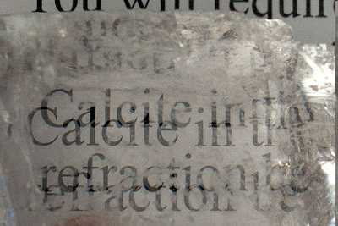
Case 3
Propagation Perpendicular to Ho
Ho
Direction of Propagation
Two plane waves: ordinary and extraordinary
Waves have different velocities and even stop bands
This is called birefringence
Applies mainly to optics and the ionosphere
Birefringence in Calcite
Transmission Line used for high frequency
Ferrite used for low frequency
Notes:
A method that you can use easily to evaluate your own noise environment
A method that you can use to evaluate the quality of the ionosphere at any give time.
Some methods to control received noise
The Shannon Hartley limits

Slide 27
EMI Demonstration Block Diagram
Coaxial Transmission Line
RG8-X Zo = 50 Ohms
R1=R2=25 Ohms
R1
R2
Signal Generator
Rc
Local Ground 2
Local Ground 1
Rc = 0 at low frequencies in this test
Notes:
A method that you can use easily to evaluate your own noise environment
A method that you can use to evaluate the quality of the ionosphere at any give time.
Some methods to control received noise
The Shannon Hartley limits

Slide 28
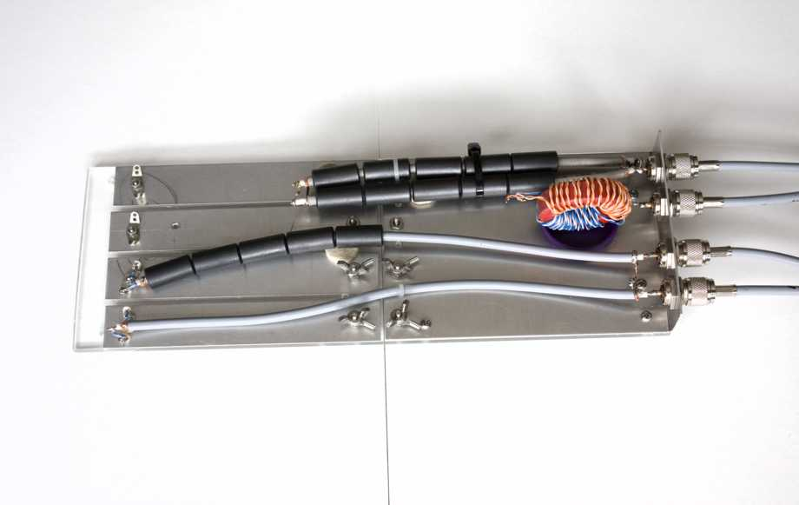
The Test Bed
Choke Balun
Guanella 4:1 Balun (100:25 Ohms)
Guanella 4:1 Balun (200:50 Ohms)
50 Ohm Coax Reference Line
50 Ohm Balanced Load
Common Mode Shorting Bar
Extreme Common Mode Tested
Notes:
A method that you can use easily to evaluate your own noise environment
A method that you can use to evaluate the quality of the ionosphere at any give time.
Some methods to control received noise
The Shannon Hartley limits

Slide 29
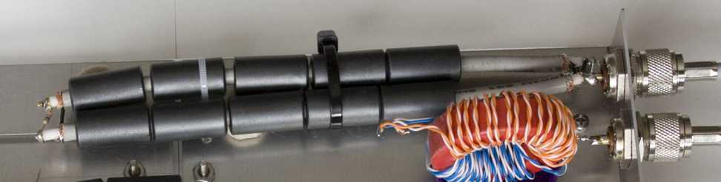
Guanella Balun 4:1 100: 25 Ohms
Uses 50 Ohm Coaxial Line…..not a transformer
100 Ohm Load
DC short at near end
Ferrite sleeves prevent common mode currents
Easy to simulate using new version of LTSPICE
Notes:
A method that you can use easily to evaluate your own noise environment
A method that you can use to evaluate the quality of the ionosphere at any give time.
Some methods to control received noise
The Shannon Hartley limits

Slide 30
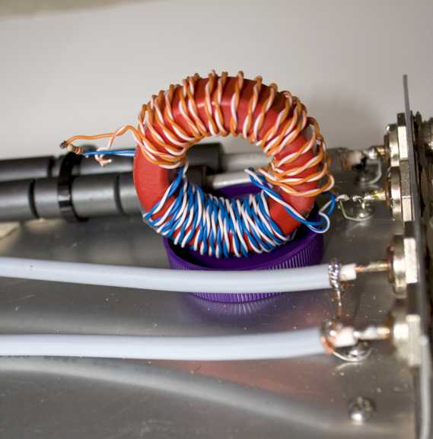
Guanella 4:1 Balun Using CAT5 Cable
100 Ohm CAT 5 Transmission Line
200:50
Ohms
Ferrite Core
Transmission Line used for high frequency
Ferrite used for low frequency
Notes:
A method that you can use easily to evaluate your own noise environment
A method that you can use to evaluate the quality of the ionosphere at any give time.
Some methods to control received noise
The Shannon Hartley limits

Slide 31
Further Reading
Hyper Physics Web Site
Fair-Rite Catalog
ARRL handbook
Transmission Line Transformers, Sevick, ARRL
Microwave Engineering, Pozar, Adison-Wesley
Fields and Waves in Communication Electronics: Ramo Whinnery Van Duzer: John Wiley
Clifton Labs: http://www.cliftonlaboratories.com/type_43_ferrite_b-h_curve.htm
Notes:
A method that you can use easily to evaluate your own noise environment
A method that you can use to evaluate the quality of the ionosphere at any give time.
Some methods to control received noise
The Shannon Hartley limits

Slide 32
Conclusions
Soft Ferrites can be biased or unbiased
EMI filters and inductors
Guenalla current Baluns
Microwave Phase shifters and other components
Same theory used to describe wave propagation in the Magnetosphere
Test bed used to study performance of EMI components
        73 Dave VE3KL
Notes:
A method that you can use easily to evaluate your own noise environment
A method that you can use to evaluate the quality of the ionosphere at any give time.
Some methods to control received noise
The Shannon Hartley limits

