Slide 1
FN04xa 6 CM Band Project
Month One - Progress Report
Doug Leach - VE3XK

Slide 2
FN04xa 6 CM Band Project
Our 6 CM Band project is based on using cordless phones as 6 CM transceivers for the next June VHF QSO Party contest and FN04xa DXpedition and in later contests we may enter.
The idea came from VE3OIL/Rover and VE3NPB/Rover, who both brought inexpensive cordless phones to FN04xa in June to work VE3WCC on a band we didn’t otherwise have.
We already have 903 MHz and plan a 2300 MHz transverter, leaving only the 5.8 GHz (6 CM) phones for this application.
The cordless phone industry has migrated to the so-called 1.9 GHz DECT band (not a ham band) and production has ceased on 5.8 GHz models, so we can buy only “manufacturer surplus” or “refurbished” phones that are offered “subject to prior sale”.

Slide 3
FN04xa 6 CM Band Project
Our proposed use conforms with the relevant ARRL contest rules:
1. Operation must be entirely within an amateur radio band. Our cordless phones use FHSS within the telephone band 5725 to 5850 MHz - entirely within our 5650 to 5925 MHz 6 CM band
2. Multi-operator stations may not includes QSOs with their own operators, except, on frequencies above 2.3 GHz, multi-op stations may work their own members. Even then, a complete different station must exist for each QSO. We will use a different handset (station) per QSO, and we operate at 5.8 GHz
3. While no minimum distance is specified for contacts, equipment should be capable of communications at a range of at least 1 KM. Our unmodified phones have a range over 2 KM!!

Slide 4
FN04xa 6 CM Band Project
At the last meeting, an expenditure of up to $200 was approved to purchase a Uniden TRU-9488-3 FHSS cordless phone with three TCX905 handsets (effectively four 5.8 GHz smart transceivers) plus a 27 dBi Para-Grid antenna.
Unfortunately, XS Cargo, here in town, who had a new “surplus” unit in stock at C$69.95 the week before, was sold out by the time I had WCARC funding approval to buy.
The alternative was RefurbDepot.com at US$59.95. They would not accept a Canadian VISA card, so I had to ask a friend in Florida to buy and reship to here . Including the double shipping charges and a money order fee (no duty), the total cost of the TRU-9488-3 was C$109.24 ($33.69 above XS)

Slide 5
FN04xa 6 CM Band Project
The TRU-9488-3 arrived last week, was inspected, batteries were installed in the three handsets and charged overnight.
VA3BGB and I were amazed when we tested the line-of-sight range of the base to all 3 handsets to be greater than 2 KM.
With >1 KM range our standard units are Contest Legal.
The excellent range of the standard units suggests that we need not buy the highest gain Para-Grid (27 dBi) with its hard to aim 4° beamwidth*, though we could use a few dB more gain to reach FN13 and to work FN03 through foliage.
*Tellurometers with 9° Beam Width are easy to aim.

Slide 6
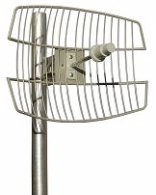
FN04xa 6 CM Band Project
Pacific Wireless Inc Grid 58-22 Para-Grid Antenna. 21/22 dBi. 10° Beam Width. Weight 8 lbs. Welded steel rods, galvanized and powder coat painted. Low wind loading. Bulkhead N Female connector. US$55 (US$3 less than the 27dBi model approved for purchase.

Slide 7
FN04xa 6 CM Band Project
To connect any external antenna, we need to establish the feasibility of installing an External Antenna connector on the rear of the Base Unit plastic enclosure.
We also need to locate the Base Unit’s internal antenna feedpoint and to verify the feasibility of disconnecting the internal antenna and soldering on a coaxial cable for that new External Antenna connector.
This involves carefully opening the base unit enclosure and inspecting the internal electronics.

Slide 8
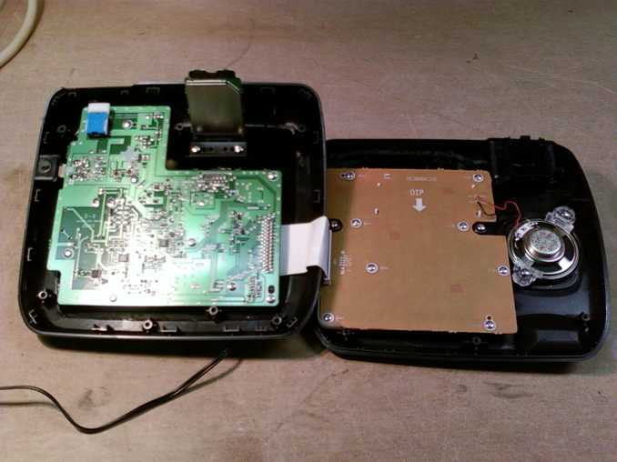
FN04xa 6 CM Band Project
Uniden TRU-9488 Base Unit - lid folded back. RF Module is standing up vertical in the main circuit board cutout. There is space for a Type N External Antenna connector to the right of the RF Module.

Slide 9
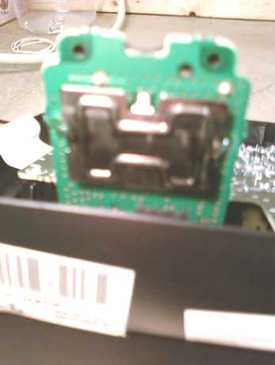
FN04xa 6 CM Band Project
Front view of the RF Module shows the edge-fed 30 X 22mm 6.8 dBi (2λ perimeter) “plate monopole” antenna, suspended above the RF circuit board. The pattern is ribbing to stiffen the plate so it doesn’t sag.The plate antenna feedpoint tab is in the slot at the top. It is here that we would disconnect the antenna and solder the coax cable for the nearby Ext Ant connector.

Slide 10
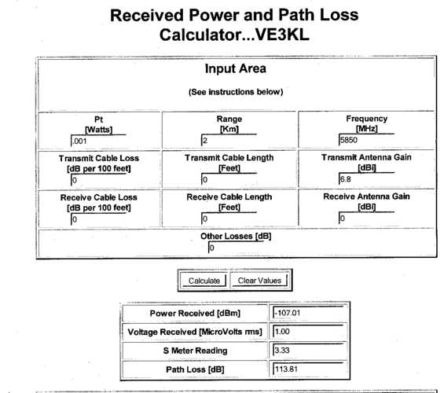
FN04xa 6 CM Band Project
Cordless phone frequencies are up to 5850 MHz. Typical power for cordless phones is 1 Milliwatt (.001W). Transmit Gain is set to 6.8 dBi and others assumed to be 0 dB. Path Loss works out to be 113.81 dB for 2KM at 5850 MHz with 1µV Voltage Received.

Slide 11
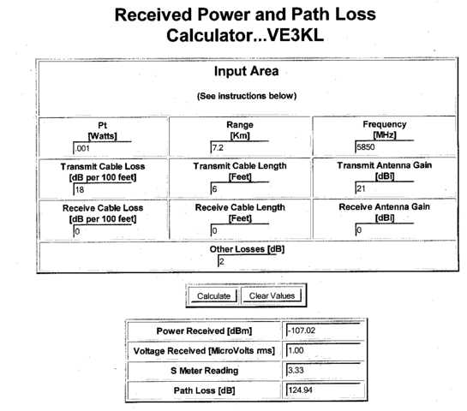
FN04xa 6 CM Band Project
Replacing the internal 6.8dBi plate monopole with the 21 dBi Para-Grid, fed with 6 ft of 18 dB/100 ft cable plus 2 dB loss in three connectors out to the Para-Grid, allows a range of 7.2 KM (124.94 Path Loss) with the same 1µV Voltage Received. This “range margin” may be needed to work FN03 through foliage.

Slide 12
FN04xa 6 CM Band Project
Our fall-back position (with no further purchases) has always been to use the unmodified TRU-9488-3 as a cordless intercom between trailer and tents. We can “borrow” those 3 intercom handsets to work FN04 and likely FN14 for 3 contacts in 2 grids. FN13 possible (?). FN03 unlikely. (Cost to date $109.24).
As the TCX905 refurb handsets are selling out fast, we should decide now whether to buy 7 more handsets ($375 budget), or they will be gone by the time we decide. Yesterday the lowest price source was US $46.95 each, SPS. (Total cost ~$C475).
We would have to settle for less units if the $375 won’t buy seven at the going price on day of purchase. Or we have to try to buy them one at a time on e-Bay, at whatever price. (?)

Slide 13
FN04xa 6 CM Band Project
There is an alternative to the Para-Grid - using a spare sat-tv dish as a passive reflector. We could experiment with positioning the unmodified Base unit antenna at or near the focal point of the dish. It would be very awkward to hold in place (might need a jig) , but might get us a few more KM for FN13 or through some foliage for FN03. Volunteer?
Worst case, we could still order the Para-Grid and modify the Base unit but that makes sense only if we have 10 handsets.
Thanks
Vy 73
VE3XK

