Slide 1
FN04xa 5 GHz Band Proposal
A proposal for more contest points above 2 GHz if we want to invest in more microwave gear
Doug Leach - VE3XK

Slide 2
FN04xa 5 GHz Band Proposal
We plan to add high power amps for 23 CM (1.3 GHz) down.
We also plan to deploy 13CM (2.3-2.45 GHz). Higher bands?
6CM Amateur Radio Band: 5.650-5.925 GHz.
6CM Cordless Telephone Band: 5.725-5.850 GHz.
Latest technology DECT phones in new 1.9 GHZ non-ham band. Phones in the 900 MHz, 2.4 and 5 GHz bands are being sold off
Not a phone band, 9CM (3.3-3.5 GHz) needs a transverter on each end. Without amp, probable contacts mostly with Rovers.
Contest use of cordless phones is like Tellurometer use - if we lend one to make contact with our base station, it cannot be re-used in that contest. We would need to provide one for each club participant (legal above 2 GHz) plus one per visiting Rover.

Slide 3
FN04xa 5 GHz Band Proposal
A cordless base unit normally connects to a phone line from which the audio originates and sends it to a cordless handset
Full Duplex communication of proposed phone, between the base and handset is digital spread spectrum, frequency-hopping within the 5725-5850 MHz cordless phone band limits (well within our 6CM ham band - 5650-5925 MHz)
To be acceptable for a contest, the base must be modified to accept an external high gain antenna so that operation between base and any handset is possible over a distance of over 1 mile. We should then be able to work adjacent grids.
To activate the base, in absence of a phone line, a Plain Old Telephone Set would normally be connected to the base.

Slide 4
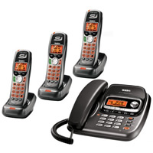
FN04xa 5 GHz Band Proposal
This Uniden model uses frequency-hopping digital spread spectrum mode. Most cheaper models are analog FM and operate base-handset at 5.9GHz but handset-base at 900 MHz. The corded handset in this base replaces the P.O.T.S. for speech to/from handsets.
Uniden Model TRU9488-3 with three cordless handsets
$69 at XS Cargo (subject to prior sale)
Base handles DSS addressing for ten cordless handsets
Requires 9V power from wall wart (13V operation?)

Slide 5
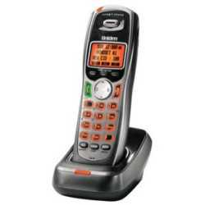
FN04xa 5 GHz Band Proposal
No modifications are required for contest use of these sensitive cordless handsets. A high gain antenna on the base unit should allow full duplex contacts beyond a mile (adjacent grids?).
Uniden TCX905 Expansion Cordless Handset for TRU9488-3 with charging cradle - available (new) by mail order from Tech Crazy in LA for US$13.95 each (SPS), if not available from XS Cargo at a comparable price.

Slide 6
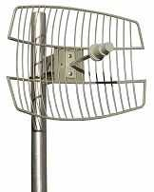
FN04xa 5 GHz Band Proposal
Galvanized steel and stainless steel hardware for customer mast or tripod
FAB Corp Grid 58-26 26dBi Parabolic Grid Antenna US$58
Only 13 lb, rugged UV powder coated, low wind loading
Bulkhead Type N female connector for feedline
Base must be modified to add an external antenna connector for that end of the feedline - preferably also Type N female.

Slide 7
FN04xa 5 GHz Band Proposal
Impact on Contest Score of 6CM Band Operation
QSO points: 50/144 - 1, 222/432 - 2, 902/1.3 - 3, 2.3 GHz+ - 4
Contact with one station located in each of the three adjacent grids on 5 GHz (FN04, FN14, and FN13) scores 12 points.
The above assumes that we cannot find a location in FN03 where microwave contacts are possible. Using a strobe we intend to find that FN03 location. Adding that additional grid would bring the total to 16 points per station contacted.
Assuming ten handsets, the score could be 120 for three grids or 160 for four grids. With 15 handsets the scores could be 180 for three grids or 240 for four grids per contact.
Scoring this many points on the lower bands is more difficult.

Slide 8
FN04xa 5 GHz Band Proposal
With our other WCARC priorities, is it worth $200 to buy the TRU9488-3 and FAB Grid 58-26 antenna to start this project?
Is it worth another $130 to buy seven more handsets to max out the addressing capacity of the base unit (10)?
Should we go for even more handsets ($20 ea)? This is best done with a second base but the first base can be field- reprogrammed to accept a second set of up to 10.
There would be no need to duplicate the Grid 58-26 antenna
We should also consider buying a few more Tellurometers to lend out for 3CM (10 GHz)? VE3BFM has two. Others are available in SW Ontario, as most 3CM op’n now narrow band
Should we also look at laser - scored as 300 GHz+ band?

Slide 9
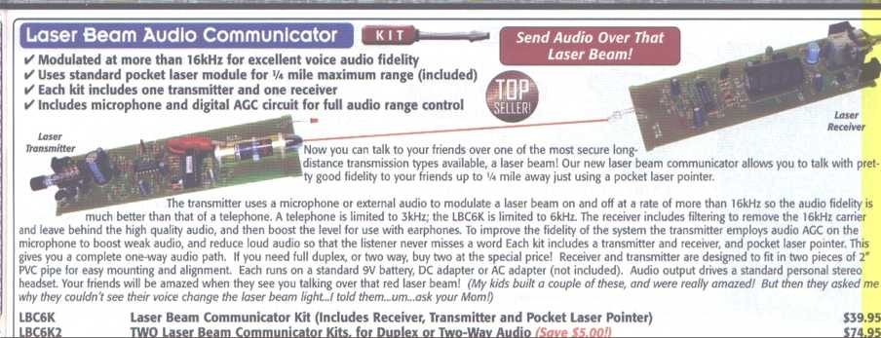
FN04xa 5 GHz Band Proposal
Ramsey LBC6K2 - At US$75 per unit (full duplex) plus optics (if needed for communication beyond 1 mile), battery, microphone earphones and cases, this would be an expensive add-on band.
Some claim 5 kM range. Tom VA3NFA has a pair for evaluation.

