Slide 1
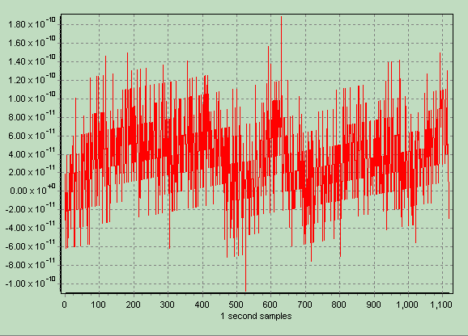
Oscillator Frequency Performance Measurements
By Bertrand Zauhar, VE2ZAZ
ve2zaz@amsat.org
http://ve2zaz.net

Slide 2
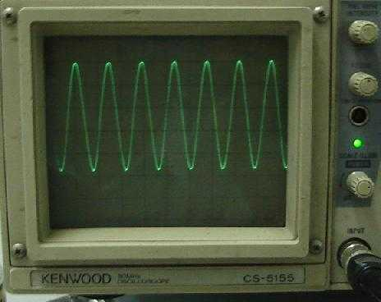
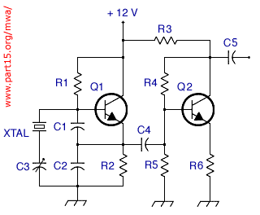
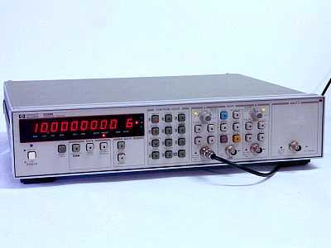
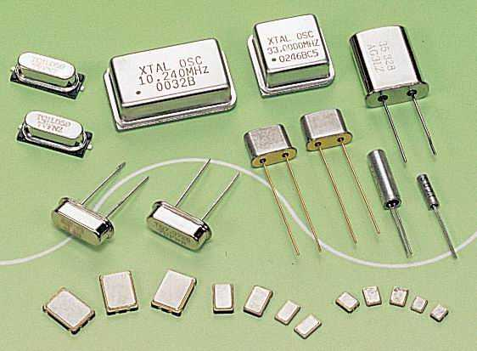
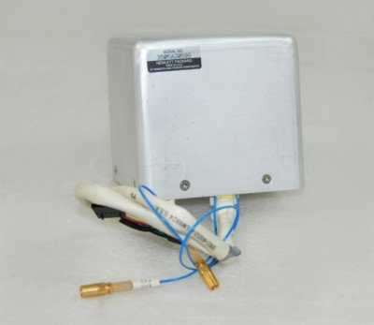
THIS PRESENTATION
Oscillator Performance Definitions
Frequency Offset Measurement Methods
Anatomy of:
  Frequency Counter
  Time Interval Analyzer
Types of Crystal Oscillators
Concept of Stability
Stability Measurement (Short, Long term)
  Practical Setups
  Results
Web References

Slide 3
Oscillator Performance Definitions
Very Short Term Variations
  Occur within a second or less. They usually manifests themselves as frequency (or phase) modulation (or amplitude modulation), and they are usually measured in the frequency domain using spectrum analyzers or phase noise meters.
Short Term Variations
  Occur between one second and several minutes to an hour. Usually we consider short term variations to include the effects of temperature variation, but to exclude the effects of aging for instance.
Long Term Variations
  Go from minutes to hours or days, sometimes months or more. Aging is the prime cause.

Slide 4
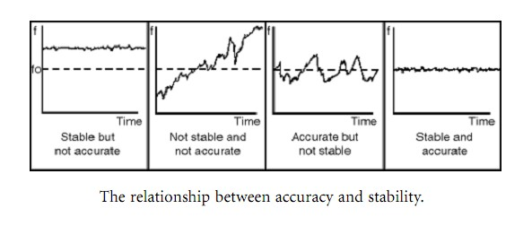
Oscillator Performance Definitions
Stability
  indicates how well an oscillator can produce the same time or frequency offset over a given time interval.
Accuracy
  is the degree of conformity of a measured or calculated value to its deﬁnition. Accuracy is related to the offset from an ideal value.
Notes:
A stable clock has a more constant frequency offset (constant phase shift rate), and this can be compensated for.
An unstable clock has a varying frequency offset, and this is is difficult to compensate for.
A short-term stable oscillator is more expensive.

Slide 5
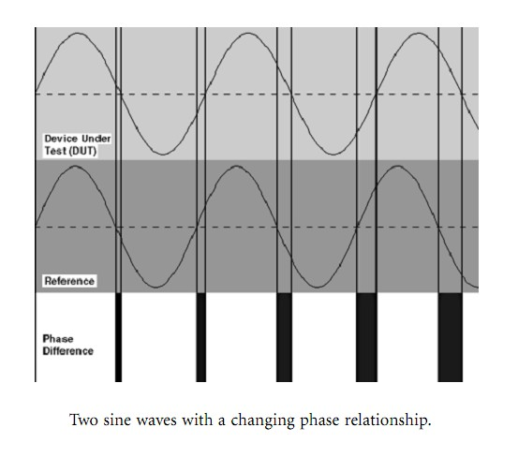
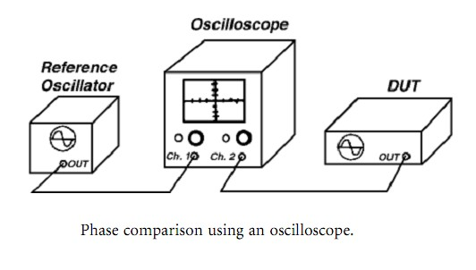

Frequency Offset:
Oscilloscope Method
Notes:
Time shift as read on scope, divided by the measurement period T.

Slide 6
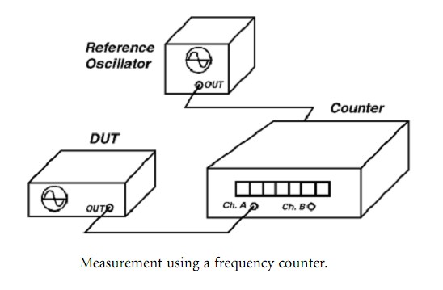

Frequency Offset:
Frequency Counter Method
,

Slide 7
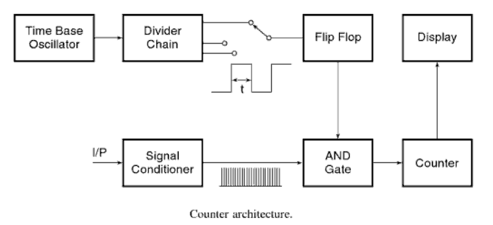
Anatomy of Basic Frequency Counter
Notes:
Computes number of input pulses within two timebase pulses. Measuring 60 Hz will display 60Hz with 1s gate time.

Slide 8
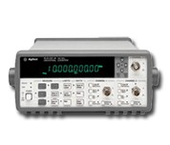
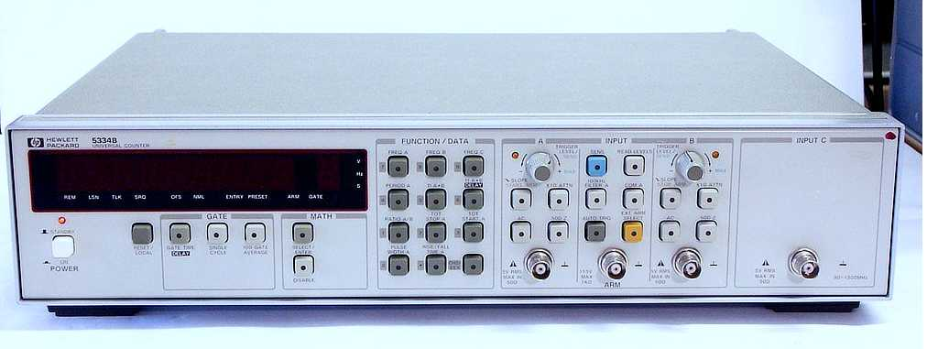
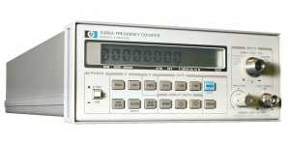
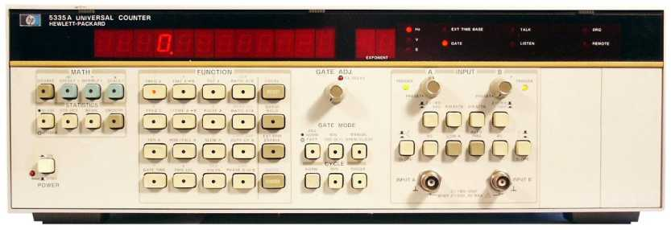
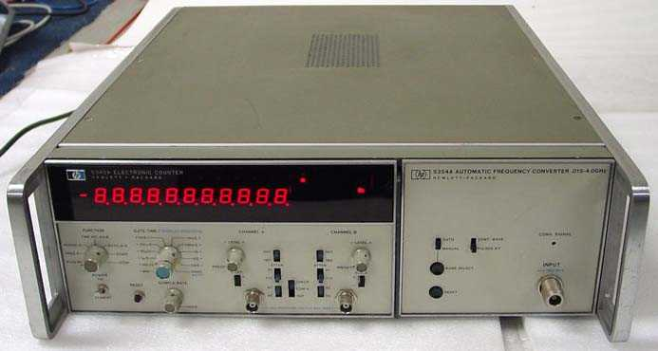
Some Suitable Frequency Counters
HP 5334A / B
HP 53131A / 53132A
HP 5386A
HP 5335A / B
HP 5345A
Notes:
Computes number of input pulses within two timebase pulses. Measuring 60 Hz will display 60Hz with 1s gate time.

Slide 9
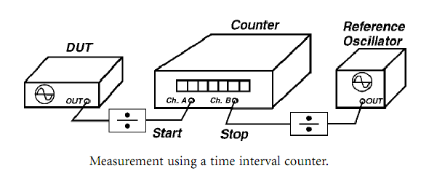
Frequency Offset:
Time Interval Counter Method
Notes:
Phase slip between the two signals divided by the measurement period T.

Slide 10
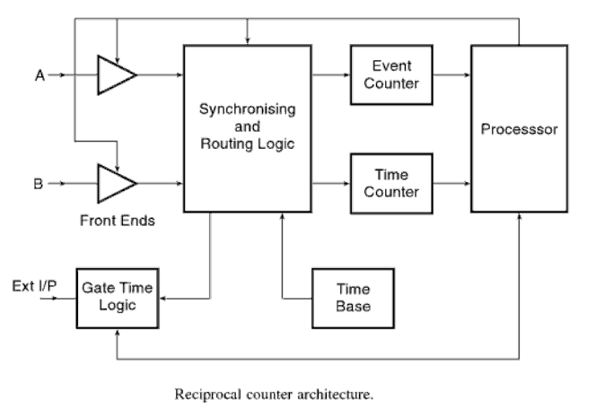
Anatomy of Time Interval Analyzer
Notes:
Computes both the number of pulses and the time between A & B inputs. Does # pulses / Time. Provides much more resolution. Needs a processor to compute results. Measuring 60 Hz could display 60.38753 Hz. Averaging improves even further.

Slide 11
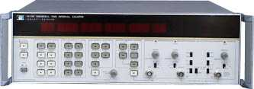
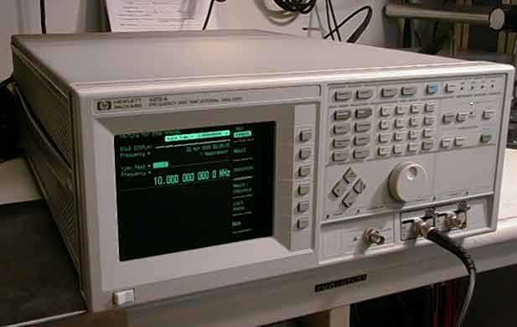
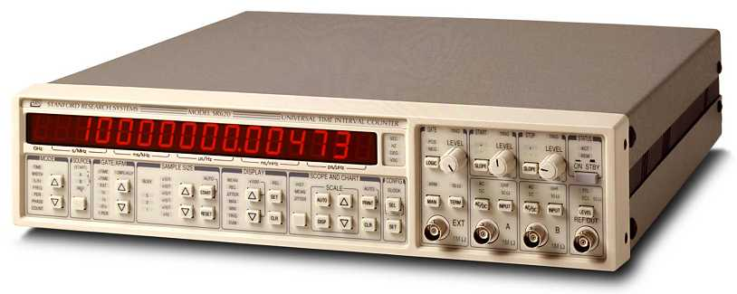
Some Suitable T.I. Counters / Analyzers
HP 5370A / B
HP 5371A / 5372A
Stanford Research SR620
Notes:
Computes number of input pulses within two timebase pulses. Measuring 60 Hz will display 60Hz with 1s gate time.

Slide 12
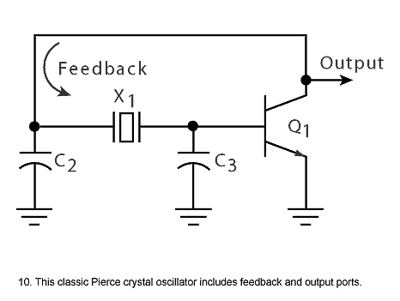
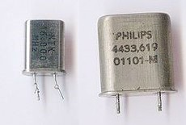
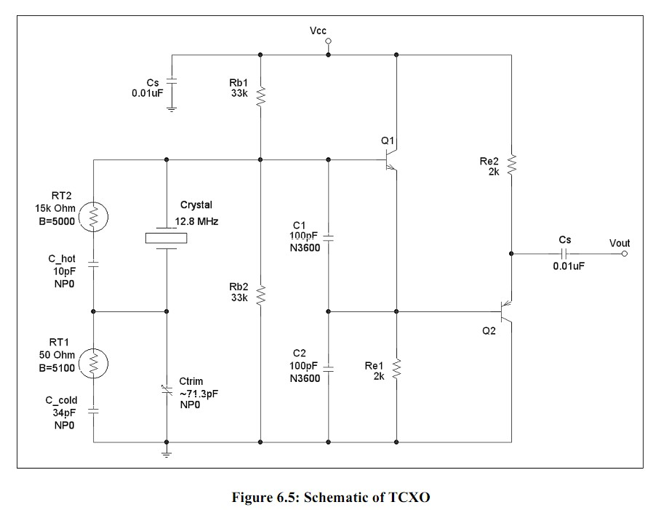
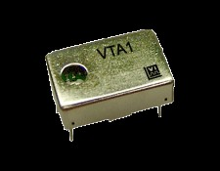
Types of Crystal Oscillators
Crystal Oscillator (XO)
Temperature Compensated XO
Temperature Shifting Values

Slide 13
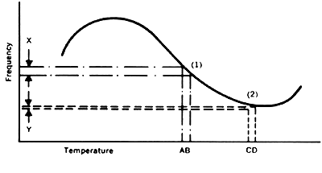
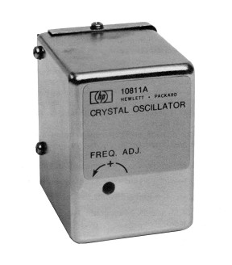
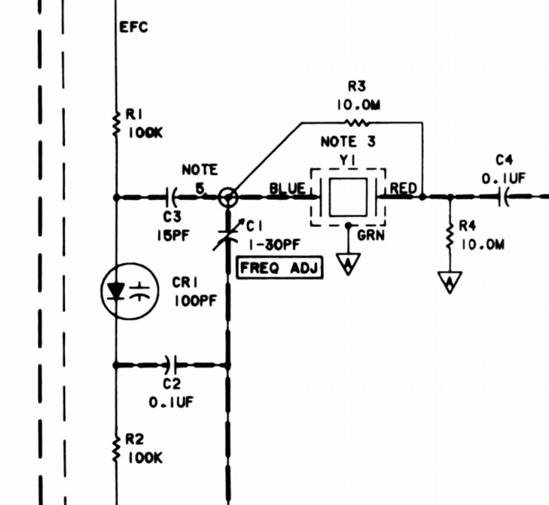
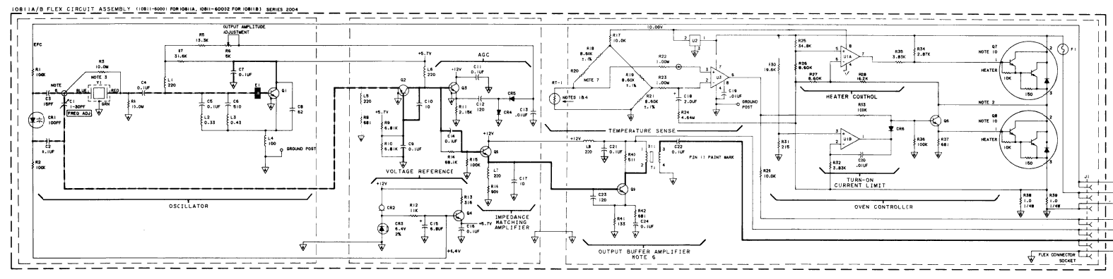
Types of Crystal Oscillators (Cont.)
Oven-Controlled XO
SWEET SPOT
~75ºC

Slide 14
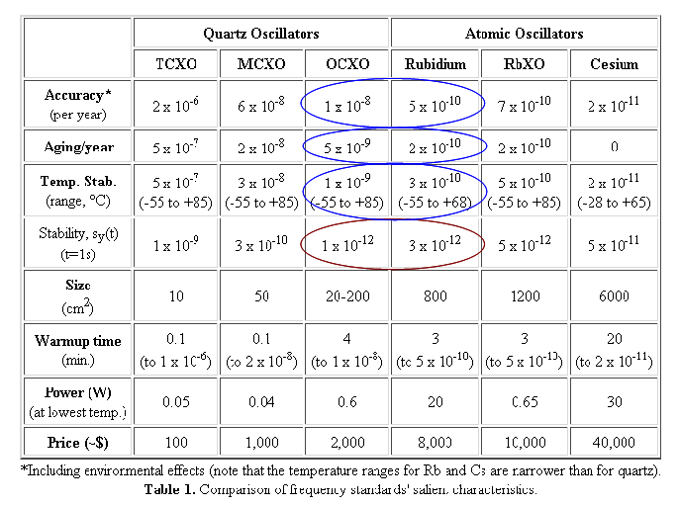
Oscillator Comparison
Best of Both Worlds: GPS-Disciplined OCXO !

Slide 15
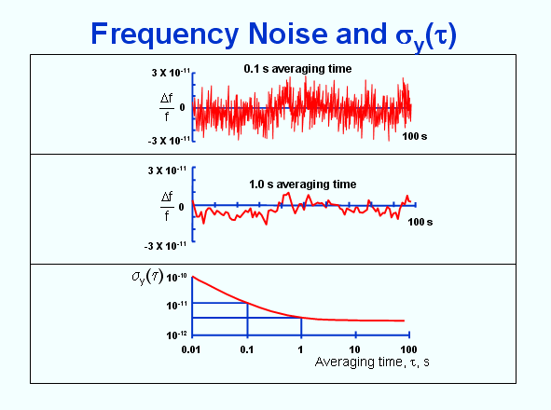
Illustration of Short Term Stability
Depends on Integration (Averaging) Time

Slide 16
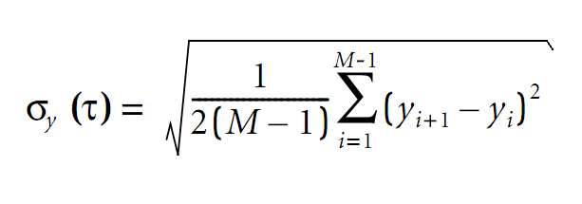
The Allan Deviation
Allan Deviation
  A statistical tool that calculates how accurately you can predict the occurrence of the next pulse, transition or event, based on measurements made on previous pulses, transitions or events.
  For instance, you may have an oscillator that drifts in a predictable way, and it's Allan Deviation would be good (low), or you may have an oscillator that has little drift on average, but wanders a lot around its nominal frequency (phase noise), and its Allan Deviation would be bad (high).

Slide 17
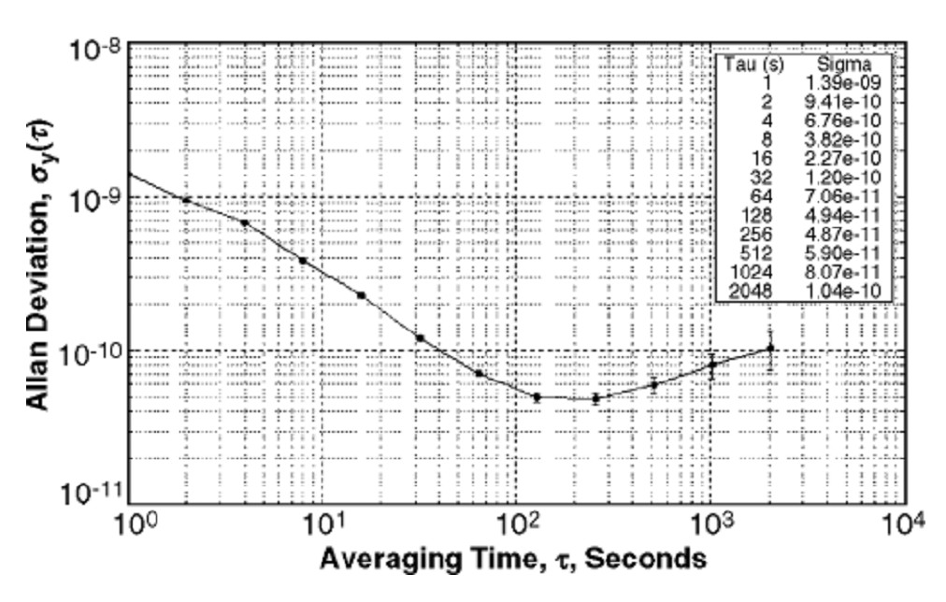
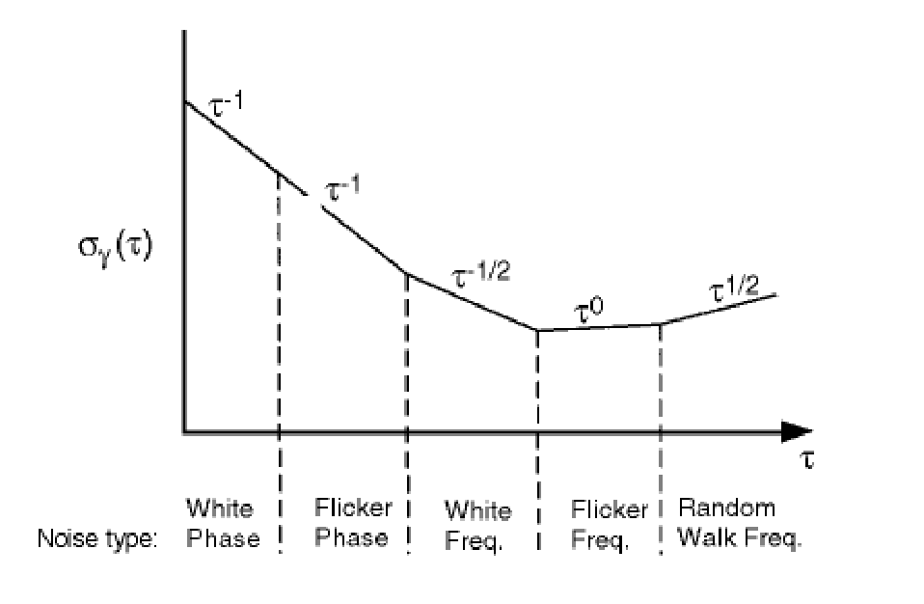
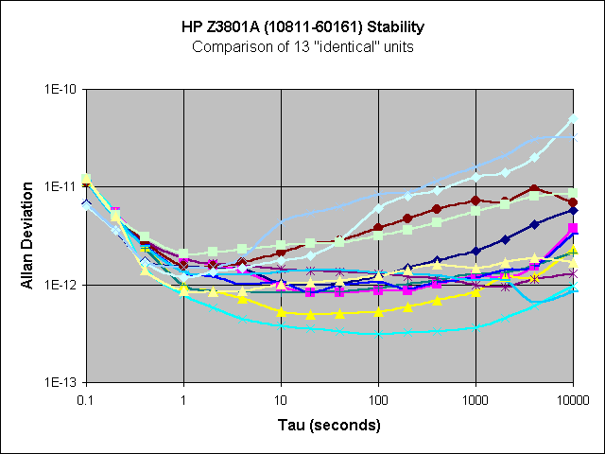
The Allan Deviation
Typical Allan Deviation Curves

Slide 18
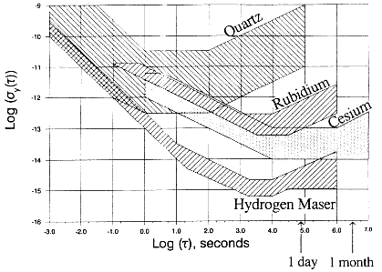
Oscillator Comparison (cont.)
Relative Allan Deviation of Various Oscillator Technologies

Slide 19
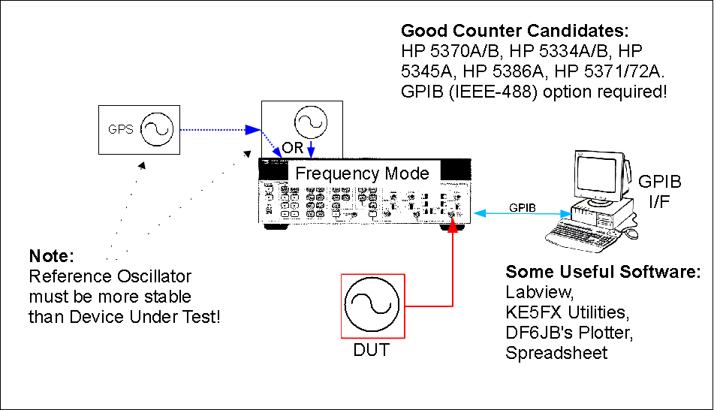
Method 1: Frequency Measurements using a Time Interval Counter

Slide 20
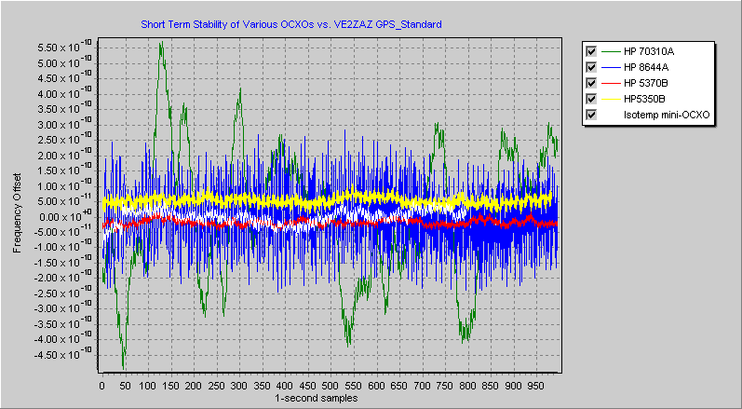
Method 1: Short Term Results

Slide 21
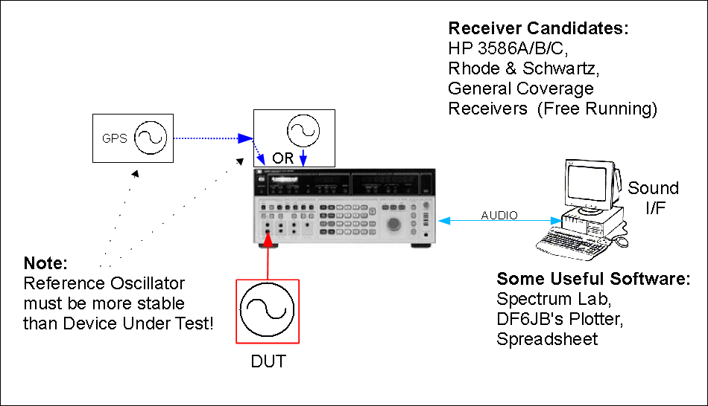
Method 2: Frequency Measurements using a Receiver / Sound I/F / PC

Slide 22
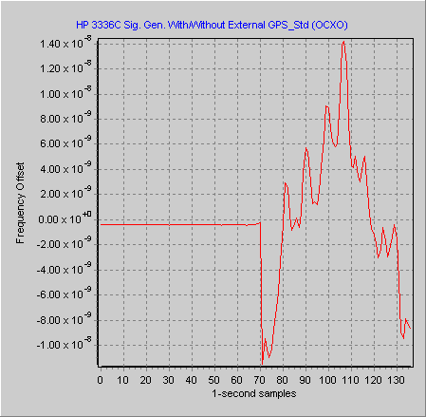
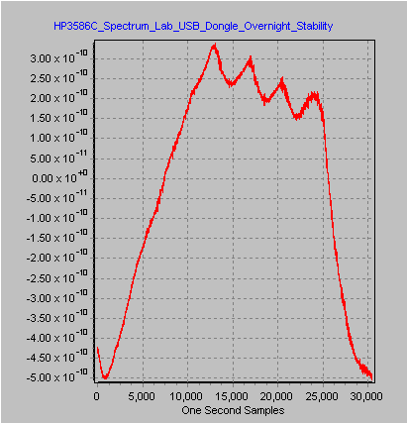
Method 2: Short / Long Term Drift

Slide 23
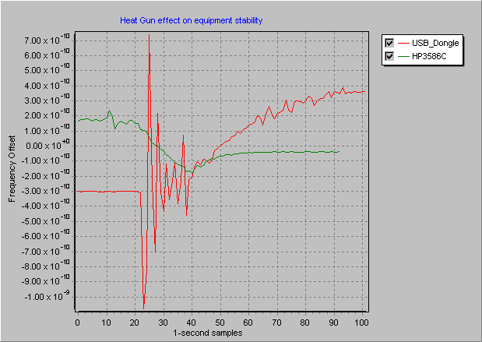
Method 2: Effects of Temperature
Heat
Gun!

Slide 24
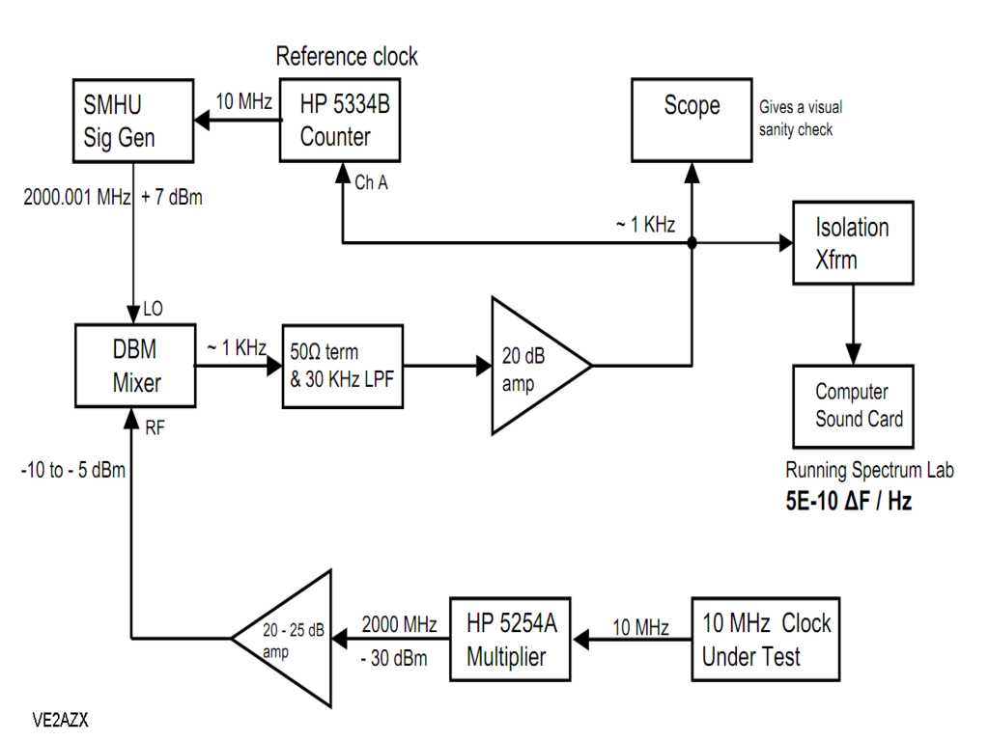
Method 3: Frequency Measurements Freq Mult. / Mixing / Sound I/F / PC (VE2AZX)
Noise x200
x200
DUT

Slide 25
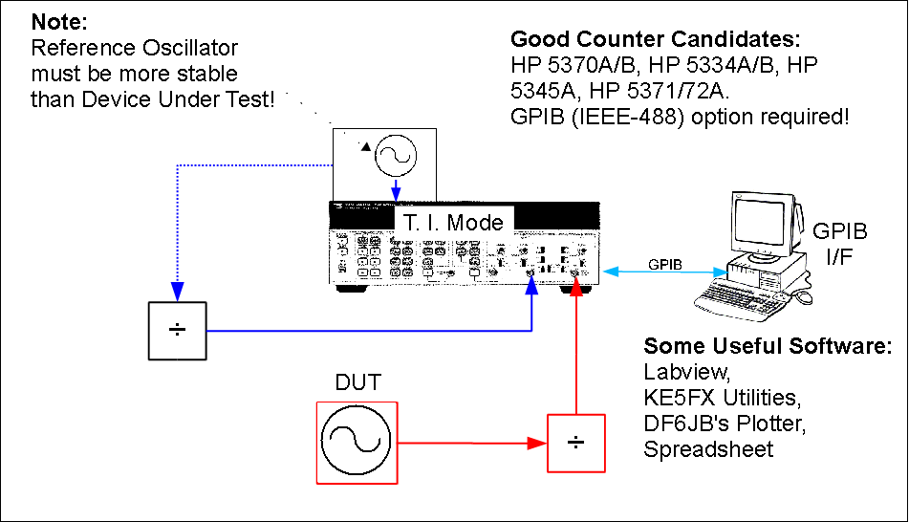
Method 4: Time Interval Measurements using a Time Interval Counter

Slide 26
Some Facts of Stability Measurement
Short Term Measurements
  Need a clean and stable reference, not an accurate reference.
  Mix-and-Match measurement of various OCXOs will reveal the best units.
Long Term / Very Long Term Measurements
  Need a stable reference, not an accurate reference.
    Free running OCXO References will drift if not disciplined.
  Averaging math will remove short term stability components.
  GPS disciplining or Atomic clock best.
All Cases
  Need to let Instruments and PC (Sound Card) warm up a few hours.
  Be prepared to purchase several OCXOs and/or Instruments equipped with OCXOs.
    Ebay: ~ 20$ to $80 each OCXO.

Slide 27
Some References
Spectrum Lab Software
  http://www.qsl.net/dl4yhf/spectra1.html
DF6JB's Plotter Software
  http://www.ulrich-bangert.de/html/downloads.html
HP: Fundamentals of Time Interval Meas. (AN 200-3)
  http://cp.literature.agilent.com/litweb/pdf/5965-7663E.pdf
NIST: Fundamentals of Time and Frequency
  tf.nist.gov/general/pdf/1498.pdf
KO4BB: FAQ#1: Measuring Oscillators Stability
  http://www.ko4bb.com/Timing/FAQ-1.php
VE2ZAZ's Website
  http://ve2zaz.net
VE2AZX's Website
  http://ve2azx.net

