Slide 1
HANDS FREE MOBILE HAM RADIO
AND
BLUETOOTH
Presented to the West Carleton ARC
November 3rd, 2009
By: Norm Rashleigh, VE3LC

Slide 2
Ontario Bill 118
Prohibition on use of
Hand-Held Devices while Driving
ONTARIO REGULATION 366/09
made under the
HIGHWAY TRAFFIC ACT
Made: September 28, 2009
Filed: September 29, 2009
Published on e-Laws: September 30, 2009
Printed in The Ontario Gazette: October 17, 2009
DISPLAY SCREENS AND HAND-HELD DEVICES

Slide 3
What it means to Amateur Radio
Time-limited exemption for amateur radio operators
13. (1) Until January 1, 2013, drivers who hold a valid radio operator certificate issued under the Radiocommunication Act (Canada) may drive a motor vehicle on a highway while holding or using a two-way radio.
Exemption for pressing buttons
14. (1) A person may drive a motor vehicle on a highway while pressing a button on a hand-held wireless communication device to make, answer or end a cell phone call or to transmit or receive voice communication on a two-way radio if the device is placed securely in or mounted to the motor vehicle so that it does not move while the vehicle is in motion and the driver can see it at a quick glance and easily reach it without adjusting his or her driving position.
(2) A person may drive a motor vehicle on a highway while pressing a button on a device that is worn on his or her head or hung over or placed inside his or her ear or is attached to his or her clothing and is linked to a hand-held wireless communication device to make, answer or end a cell phone call or to transmit or receive voice communication on a two-way radio or a hand microphone or portable radio.

Slide 4
So what seems to be required for Legal Operation while driving
Mobile or Portable Radio that :
Is securely mounted inside the vehicle;
Is in view at a glance;
Can be readily adjusted from the drivers position;
Uses a Microphone that is not handheld and
Uses a PTT button/switch that is not handheld but may be worn on the body.

Slide 5
Wired Options for the Amateur
# 1
Fix mount a microphone in the car, on the visor, windshield pillar or rear-view-mirror.
and
Use a separate PTT toggle switch perhaps secured to the gear shift lever or other easy access location. It is suggested the switch should be toggle on, toggle off, and not momentary action.

Slide 6
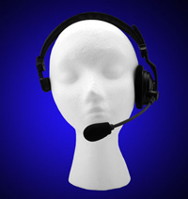
Wired Options for the Amateur
# 2
HEIL TRAVELER
SINGLE SIDE

Slide 7
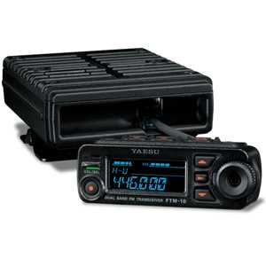
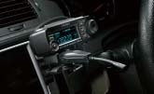

Wireless Bluetooth Options
Yaesu FTM 10R
With Bluetooth option

Slide 8
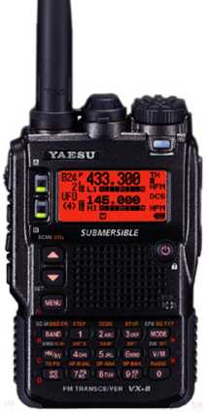
And
Yaesu VX-8R Portable
With optional Bluetooth
Board and accessories
the same as the
FTM – 10R mobile
Add $ 100 for BU-1
Bluetooth adapter.

Slide 9
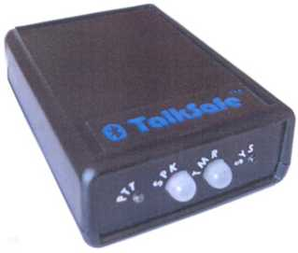
TalkSafe Bluetooth Interface
Made by:
RPF Communications Ltd
Essex, UK
Available at:
RadioWorld, Toronto
$220

Slide 10
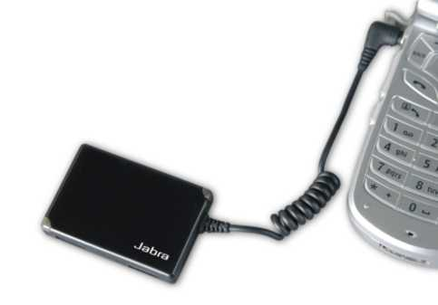
My Option
Based on Jabra A210
Purchased 5 from
Vendor on E-Bay
So called“Defective”
Units .. All had
Defective batteries,
but otherwise worked.

Slide 11
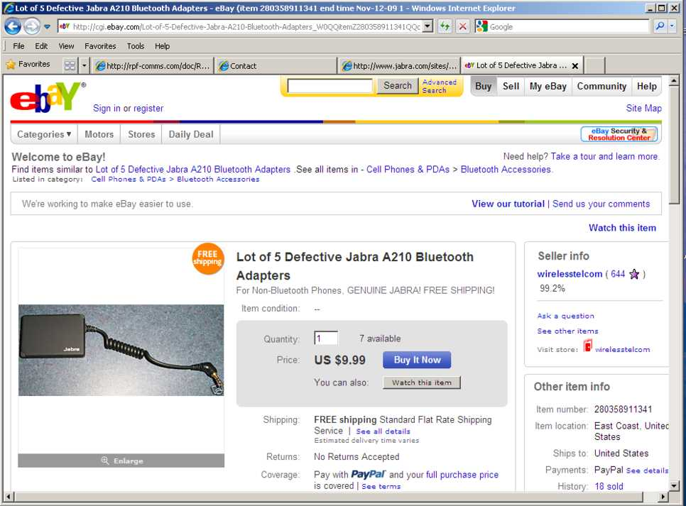

Slide 12
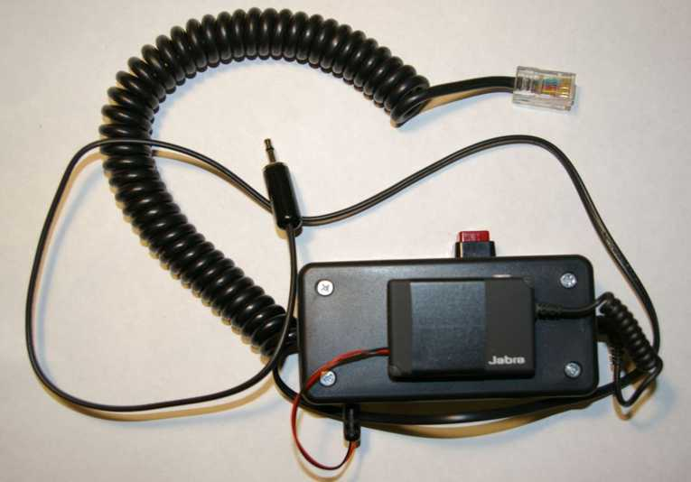
Here's the A 210 Mobile Interface for the ICOM IC 706

Slide 13
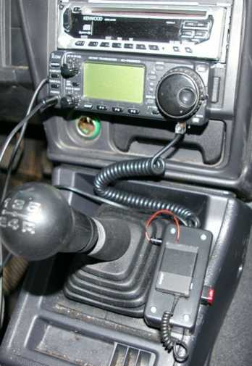
In Car View of Chevy Tracker
Interface to microphone
modular receptacle and
headphone jack.
PTT is Red Button
Push On / Push Off

Slide 14
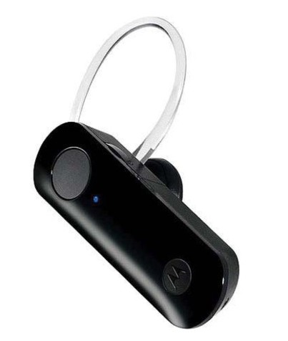
My Bluetooth Headset
(for starters)
Motorola H390
$29.95 at Walmart

Slide 15
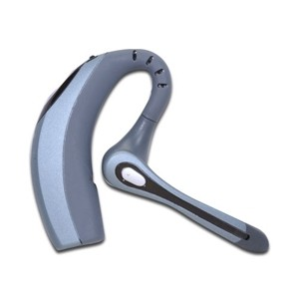
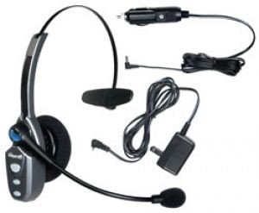
Other Attractive Bluetooth Headsets
Plantronics 510, $75
Blue Parrott B250-X $100

Slide 16
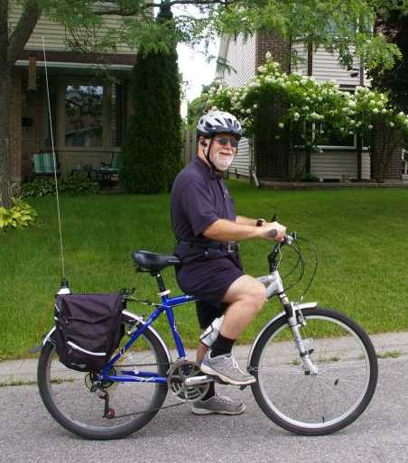
My Bicycle Setup

Slide 17
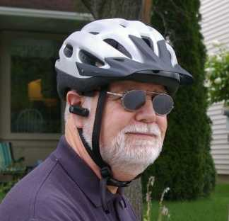
Wearing the Earpiece

Slide 18
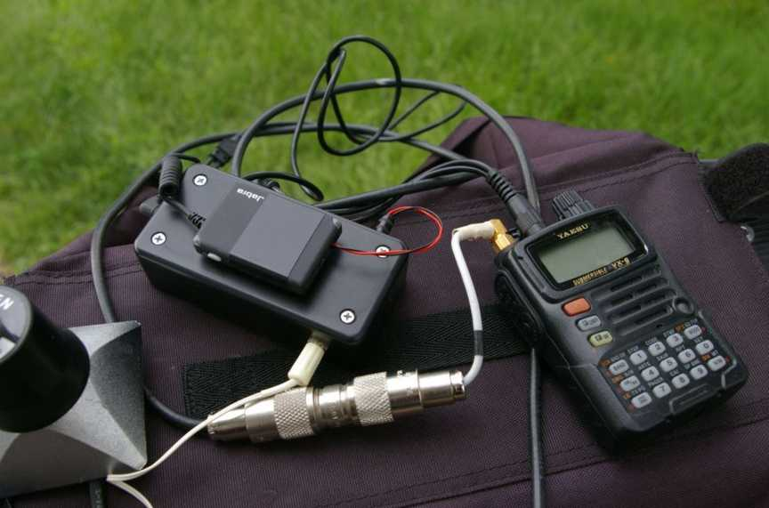
The A210 interfaced to VX 6 Portable

Slide 19
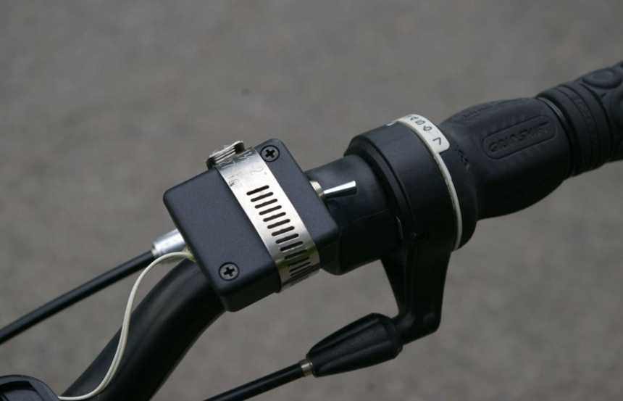
Handlebar PTT

Slide 20
Issues using the Jabra A 210
PIN Code is Static and set to 0000
As a consequence, can not be used with some Bluetooth equipped cars that generate a random PIN code for security.
Unmodified, the device “Times Out” after loss of Receive Audio for 60 seconds.

Slide 21
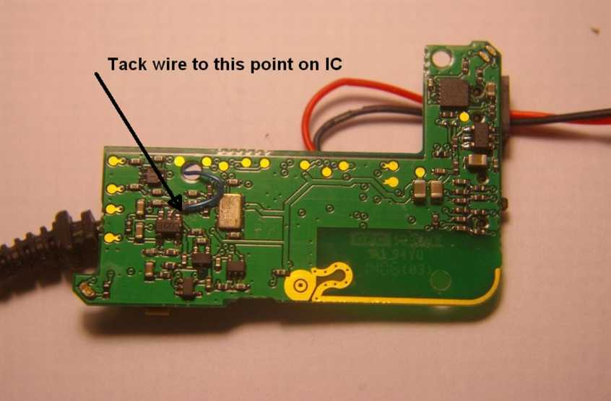
Modifications to A 210 to prevent time out

Slide 22
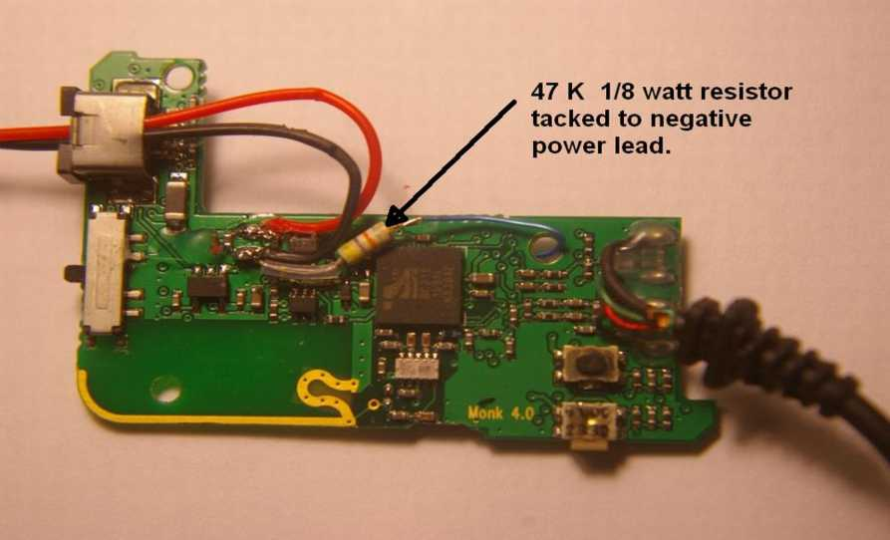
Modification to A 210 to prevent time out

Slide 23

Basics
Named after Danish Viking King Harald Blatand (translated “Bluetooth” in English). King Bluetooth evidently ate a lot of Blueberries which stained his teeth blue, hence the name.
King Bluetooth (10th century) kingdom united Denmark and Norway hence the inspiration of the name of the technology uniting devices
Bluetooth is essentially short range wireless cable replacement technology

Slide 24
Bluetooth Radio Basics
Operates in the 2.4 GHz ISM band between frequencies 2402 – 2480
Frequency Hopping Spread Sprectrum
79 frequencies in the Hop Set ( 1 Mhz between frequencies
Hop sequence is randomly generated
1600 Hops/Second / 625 usec per hop
All TX and RX transceivers share same hop sequence in “PICO-NET”
Up to 7 Slave devices to one Master Device in a single Pico-Net.

Slide 25
Other Bluetooth Basics
Class 1 device = 100 mW (100 dBm)
Class 2 device = 2.5 mW (4 dBM)
Class 3 device = 1.0 mW (0 dBm)
Most consumer devices are 2.5 mW for a range ~ 10 meters
Receiver sensitivity ~ -70 dBm for 0.1% bit error rate (BER)

Slide 26
Radio Modulation
Version 1.0 , GFSK good for 1 Mbits/sec
Version 2.0 , pi/4 DQPSK good for 2 Mbits/sec
Version 2 +EDR, 8 DPSK good for 3 Mbits/sec

Slide 27
Bluetooth Security
Unique 48 Bit address for every Bluetooth device.
PIN codes (generally 4 digits).
Authentication using PIN between units in initializations process
Devices paired to the Master in a Pico-Net assigned an “Active Member Address”, others can't break into the Net.
Encrypted “Link-Key” established and exchanged (128 bit )

Slide 28
Pairing Process
Device “A” searches for other devices in the “discovery” mode. (I'm available)
Device “A” detects Device “B” with Name ID.
Device “A” sends Device “B” “PIN” Code
Device “B” compares received “PIN” Code with its own.
Device “B” sends “PIN” Code back to Device “A”
Encryption “Link-Key” exchanged.
A “trusted Pair” is established for further communications and shouldn't require further authentication.

Slide 29
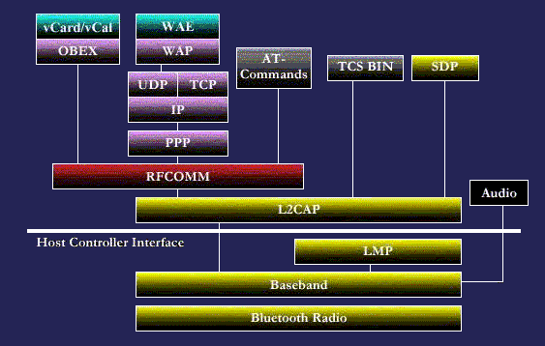
Bluetooth Protocol Stack

Slide 30
Bluetooth Digital Audio Codec
Based on 64 Kbit/sec log PCM (pulse code modulation)
or
64 Kbits/sec CVSD (Continuous Variable Slope Delta Modulation)

Slide 31
Bluetooth Services
Personal Area Networking Service
Dial-Up Networking Service
Serial Port Service
Lan Access Service
File Transfer
Object Push Service
Printer Service
Human Interface Device Service (ie Mouse)
FAX Service
Audio Headset Service

Slide 32
QUESTIONS ?
DISCUSSION ?

