Slide 1

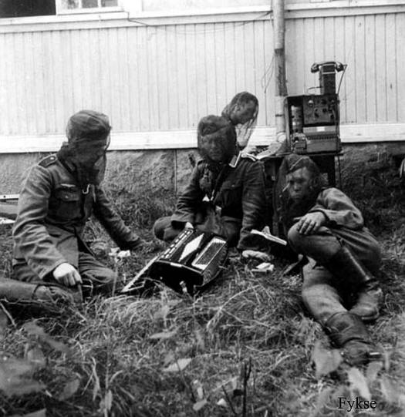
Hellschreiber
Feldfernschreiber (field teleprinter) Machine in use during WWII – photo courtesy of Helge Fykse, LA6NCA
Michael Babineau, VE3WMB January 2010

Slide 2
What is Hellschreiber ?
A German word that means “bright writing” - a pun on the name of its inventor, Rudolph Hell.
Quasi-synchronous “fax-like” direct printing text transmission mode(s) that use no coding (think CW married with a dot-matrix printer)
Family of Amateur Radio “sound-card” modes
Classified as “Fuzzy Modes” rather than pure Digital modes - a term coined by Murray Greenman, ZL1BPU
Often just referred to as “Hell”

Slide 3
Hellschreiber variants in use
Feld-Hell – “Field” Hell the traditional ON/OFF keying in time domain (most popular in Amateur Radio use)
C/MT-Hell – Concurrent Multi-Tone Frequency Domain Hell)
S/MT-Hell – Sequential Multi-Tone Frequency Domain Hell)
Slow-Feld – Intended for beacon usage (2 chars / min)
Duplo Hell – Dual tone mode (two columns sent at same time)
PSK Hell – Differential Phase Shift Keyed Mode (like PSK31)
FM Hell – similar to PSK Hell
FSK Hell – Usually 245hz shift (980hz black, 1225hz white)
This presentation will focus on Feld-Hell.

Slide 4
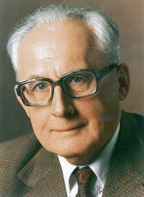
Hellschreiber History
Invented in 1920's by Dr. Rudolph Hell (1901-2002).
Patent granted in 1929 for “Apparatus for the Electrical Transmission of Text Characters”
In 1934 was put into service by press agencies and news media.
Used during WWII for press, diplomatic and military communications over land-line and radio, often in conjunction with Enigma encryption machines.
Commercial use of Hell continued into the 1980s.

Slide 5
Ham Radio Hellschreiber timeline
1958 - First known Amateur Radio HF QSO using Hell between DL1GP and DM3KG.
1977 - Article by Hans, PA0CX published in Electron Magazine.
1979 – PA0CX Article re-published in English in Ham Radio Magazine ( http://www.nonstopsystems.com/radio/hell-pa0cx-e.pdf )
1980 - Apple II Hell Program developed by Klaus PA0KLS
1997 – Hell Software for MS DOS using Hamcomm Interface developed by LA0BX
1998 – PSK31 mode and software created by G3PLX starting the “Windows soundcard mode” revolution in Ham Radio
1999 – Windows 95 Hellschreiber application released by Nino IZ8BLY in collaboration with Murray ZL1BPU ( for Pentium-class MS-Windows machines & soundcard)
2006 - Feld Hell Club formed (currently close to 3000 members worldwide)

Slide 6
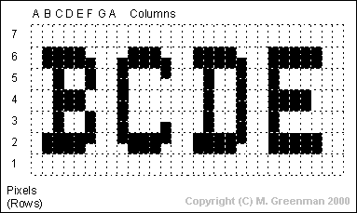
Feld Hell Transmission
On/Off keying at 122.5 baud yields a speed of 25 WPM
A text character is represented by 5 X 5 pixels in 7 X 7 dot matrix that is raster-scanned
Pixel Transmit order A1, A2 .. A7, B1, B2 etc.
Black pixels transmitted as tone-on, white as tone-off
Keyed sine-wave audio signal drives mic input of SSB Transmitter
Hell-specific fonts are used for maximum readability

Slide 7
Feld Hell Reception
Data, as received, is painted on the display for visual interpretation by the human eye (no FEC, no decoding of characters)
Quasi-synchronous reception – no auto synchronization of transmit and receive clocks. Both clock run at approximately the same speed. Synchronization is done by visual adjustment of clock speed at receiver, if required.
Small errors in timing are compensated for by displaying each received image twice (timing errors result in image slant).

Slide 8
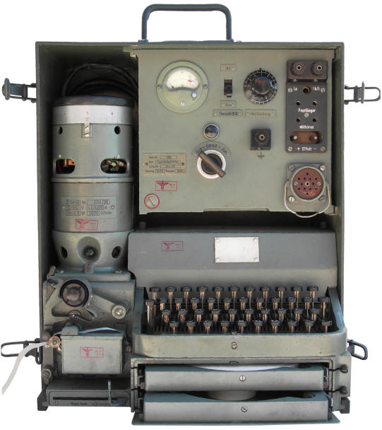
WW2 Siemens Hellschreiber (photo courtesy of Frank, N4SPP)

Slide 9
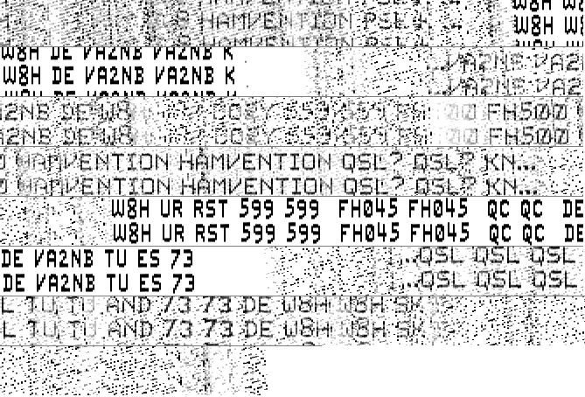
Sights and Sounds of Feld Hell
40m Contest QSO with W8H at Dayton Hamvention 2009 in severe QSB
(Note the very slight upward slant on his print)

Slide 10
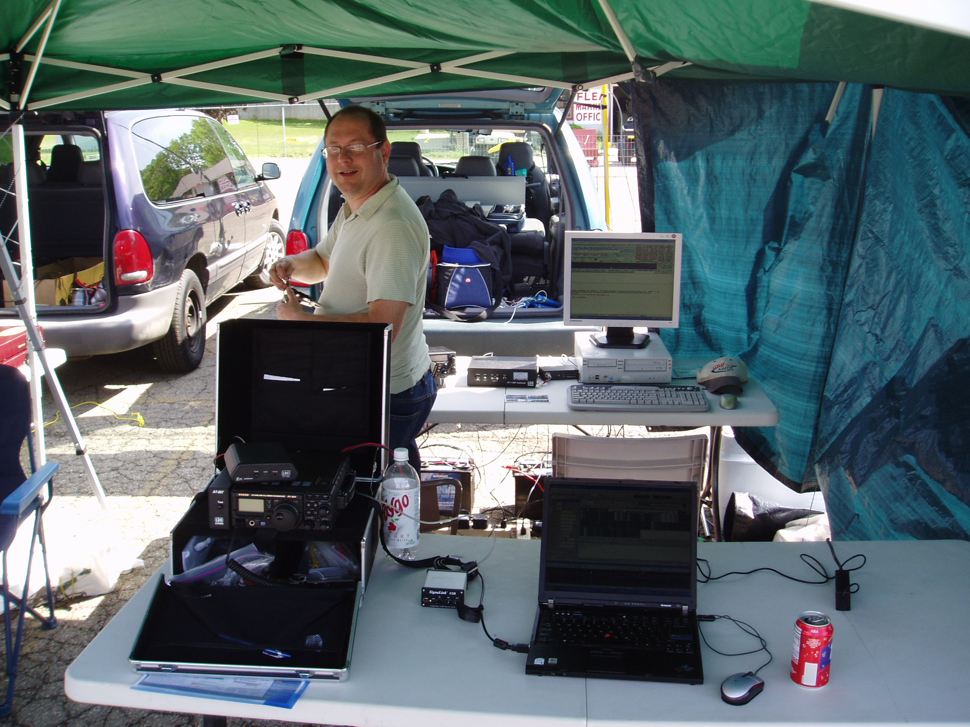

W8LEW at W8H Dayton Hamvention 2009 (photo courtesy of Tery, KD8GNC)

Slide 11
Why operate Feld Hell ?
Simplicity ! – It's Human readable. Think of it as “Visual CW”. The human brain excels at optical pattern recognition.
At 25 wpm is a good conversational mode for slow typists – promotes more real-time chats and fewer “canned QSOs”
Relatively narrow bandwidth (~300 Hz) adapts well to use of narrow CW IF filter on receiver.
Easy to use – tuning is not critical, is tolerant of frequency drift (works well with older HF rigs) unlike many modes.
Robust – similar to CW in ability to copy through noise; tolerant of Polar Flutter / Doppler effects, unlike PSK modes.
Hard to overdrive on Tx, not prone to IMD issues like PSK31
Works quite well at low power levels; low duty cycle like CW

Slide 12
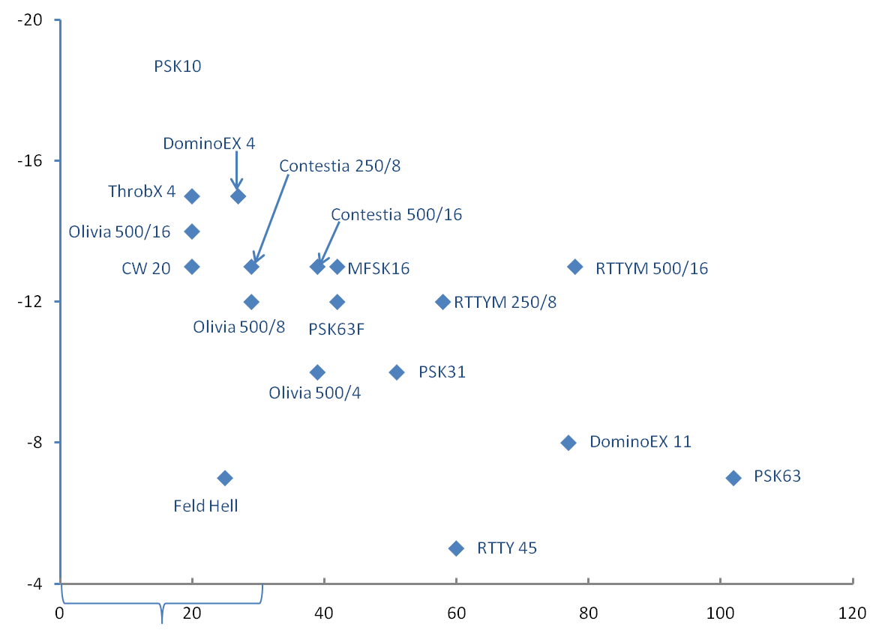
Comparison of Sensitivity vs. Speed for Soundcard Modes
Minimum SNR (db)
Slow
Speed (wpm)
Graph courtesy of Wes, WZ7I

Slide 13
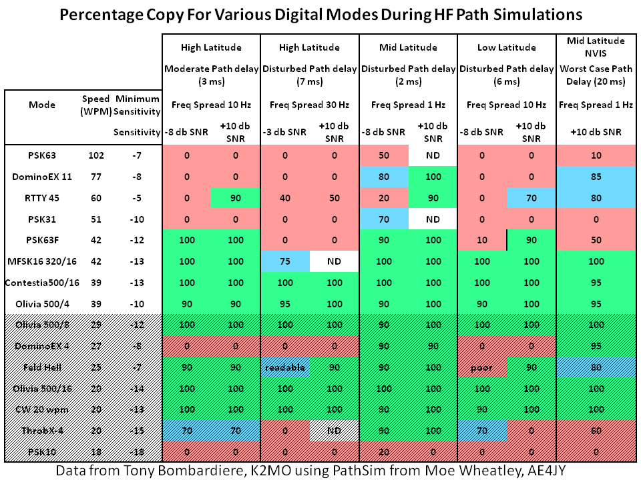
Multi-path Performance of Souncard Modes - (table courtesy of Wes, WZ7I)

Slide 14
Getting started with Feld Hell
Similar hardware requirements to other sound-card modes (i.e. if you are already using PSK31 you may have everything you need)
SSB transceiver
Computer with sound-card (MS Windows, Linux or Mac OS X)
Soundcard interface and cabling - providing interconnection, isolation and PTT capability
Software (mostly free)

Slide 15
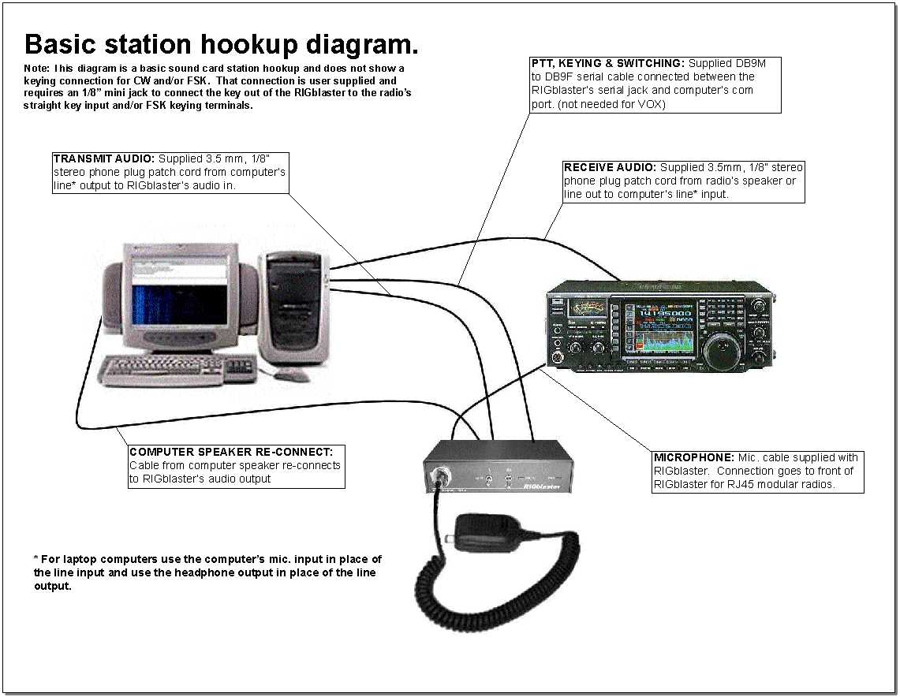
Typical Soundcard modes setup

Slide 16
Feld Hell software
IZ8BLY Hellschreiber - Hell modes only on MS Windows. Will run on anything from WIN95 and up. Good choice for older Celeron or Pentium class computers. (freeware)
Fldigi – Multimode, runs on Linux, Windows and Mac OS X (freeware)
Digital Master 780 (DM780) – Multimode, part of the Ham Radio Deluxe suite of programs (freeware). MS Windows Only.
MultiPsk – Multimode, MS Windows (freeware)
MixW – Multimode, MS Windows (requires payment to license)
others

Slide 17
Some operating tips
Most Hell applications support “panoramic” tuning (i.e point and click on a signal on the waterfall) so tuning is as simple as PSK31.
Unlike PSK31 and RTTY, Hell doesn't send a constant “diddle” during TX.
If you are using a soundcard interface that triggers the radio PTT via VOX you need to enable a VOX delay to avoid constant interface T/R switching (“chattering”) between transmitted characters.
Adjust TX audio level as you would for PSK31 (little to no ALC indication on the rig during TX).

Slide 18
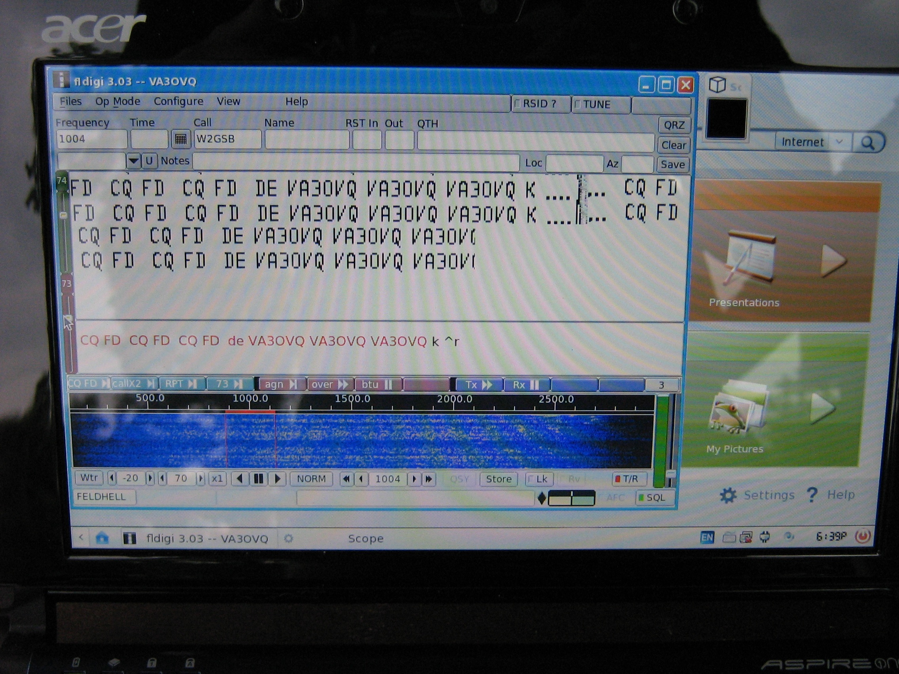
Fldigi running on a Linux Netbook

Slide 19
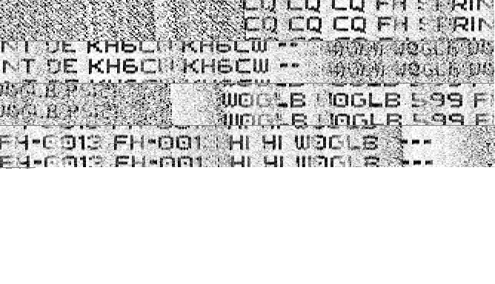
Hell Operating Frequencies
160M - 1.804 Mhz
80M - 3.574 to 3.584 Mhz
40M - 7.077 to 7.084 Mhz
30M - 10.137 Mhz
20M - 14.063 Mhz
17M - 18.104 Mhz
15M - 21.074 Mhz
12M - 24.924 Mhz
10M - 28.074 Mhz

Slide 20

Feld Hell Club
Started in 2007 to promote worldwide usage of Hellschreiber modes by Amateurs
3000+ members worldwide
Free Membership
Sponsors Awards, Nets and Monthly Contests & Sprints and Special Events.
Online presence via Web page, Twitter, Spotting page and Yahoo Discussion Group
http://sites.google.com/site/feldhellclub/

Slide 21
Acknowledgements - with thanks
Murray Greenman, ZL1BPU for allowing me to use information on the technical aspects and history of Hell from his excellent website. (http://www.qsl.net/zl1bpu/)
Helge Fykse, LA6NCA for the use of the cover photo http://www.laud.no/la6nca/radio/_x0001_
Frank, N4SPP for use of the Feldfernschreiber photo
Wes, WZ7I for the table showing Percentage copy for various path simulations (data supplied by Tony, K2MO) & SNR vs Speed Graph (http://mysite.verizon.net/wz7i/digitalmodes.html)
West Mountain Radio for permission to use their “Basic Station Hookup Diagram” - http://www.westmountainradio.com/
Lou, W8LEW & Tery, KD8GNC for the W8H Dayton Photo

Slide 22
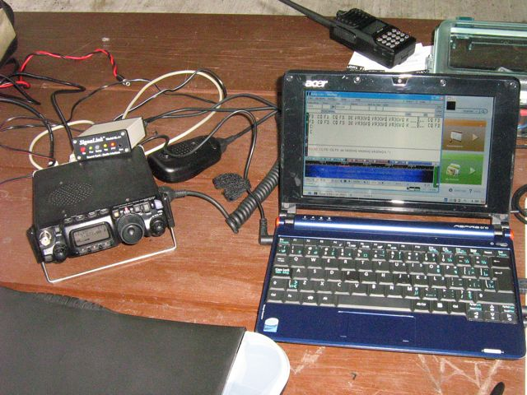
See you in Hell !

